Slide 1


CCNA 200-301 V2.0
28
Troubleshooting Client Connectivity
Part V — Wireless, Virtualisation and Operations
EXAM TOPICS
1.6
LECTURER
Dr. Mustafa Hameed
THE ISLAMIA UNIVERSITY OF BAHAWALPUR
Department of Information Technology
Notes:
Chapter 28: Troubleshooting Client Connectivity. Blueprint topics: 1.6.

Slide 2
THE COURSE
Where this chapter sits
Part I
Foundations
chapters 1–7
Part II
Switching and Network Access
chapters 8–14
Part III
IP Routing
chapters 15–19
Part IV
Network Services and Security
chapters 20–26
Part V
Wireless, Virtualisation and Operations
chapters 27–32
Part VI
Sitting the Exam
chapters 33–34
CCNA 200-301 v2.0 · Chapter 28. Troubleshooting Client Connectivity
CCNA 200-301 v2.0 · Chapter 28. Troubleshooting Client Connectivity
1.6
1.6
Notes:
Ten seconds. Students meeting a chapter in week ten cannot place it without being shown.

Slide 3
LEARNING OUTCOMES
What you will be able to do
• Read a host’s IP configuration on Windows, macOS and Linux, and recognise the four configurations that cannot work.
• Apply a reachability ladder that localises a fault in five commands.
• Check wireless security parameters on all three operating systems, including the modern default that breaks MAC-based authorisation.
• Decide, from the host alone, whether a fault is the client’s, the access layer’s, or the network’s — before escalating it.
CCNA 200-301 v2.0 · Chapter 28. Troubleshooting Client Connectivity
1.6
Notes:
Troubleshooting Client Connectivity 1.6

Slide 4
ASSUMED KNOWLEDGE
Before we start
Chapter 4 and Chapter 5 for addressing. Chapter 20 for what an address means when it arrives. Chapter 21 for name resolution. Chapter 27 for RSSI, SNR and the security protocols this chapter checks the settings of.
CCNA 200-301 v2.0 · Chapter 28. Troubleshooting Client Connectivity
1.6

Slide 5
KEY TERMS
Vocabulary for this chapter
APIPA
default gateway
subnet mask
reachability ladder
ipconfig
ip addr
ARP cache
MAC randomisation
supplicant
EAP method
Each is defined where it first matters — not here.
CCNA 200-301 v2.0 · Chapter 28. Troubleshooting Client Connectivity
1.6
Notes:
Do not define these now - they are defined as they arrive. This slide is for the students' notes.

Slide 6
ON THE EXAM
Three areas, three operating systems, named explicitly
This is what the blueprint actually asks for
Topic 1.6 is troubleshoot wired and wireless client connectivity (IP configuration, network reachability, and wireless security parameters on Windows, MacOS, and Linux).
The three operating systems are named in the topic statement. That is a strong signal: you are expected to know the equivalent command on each, not just the one you happen to use. The table in Section sec:oscmds is the single most examinable page in this chapter, and it is worth memorising in all three columns.
Note also what is not here: no server-side configuration, no controller. Everything in this topic is done standing at the affected machine.
CCNA 200-301 v2.0 · Chapter 28. Troubleshooting Client Connectivity
1.6

Slide 7
Start at the host
CCNA 200-301 v2.0 · Chapter 28. Troubleshooting Client Connectivity
1.6

Slide 8
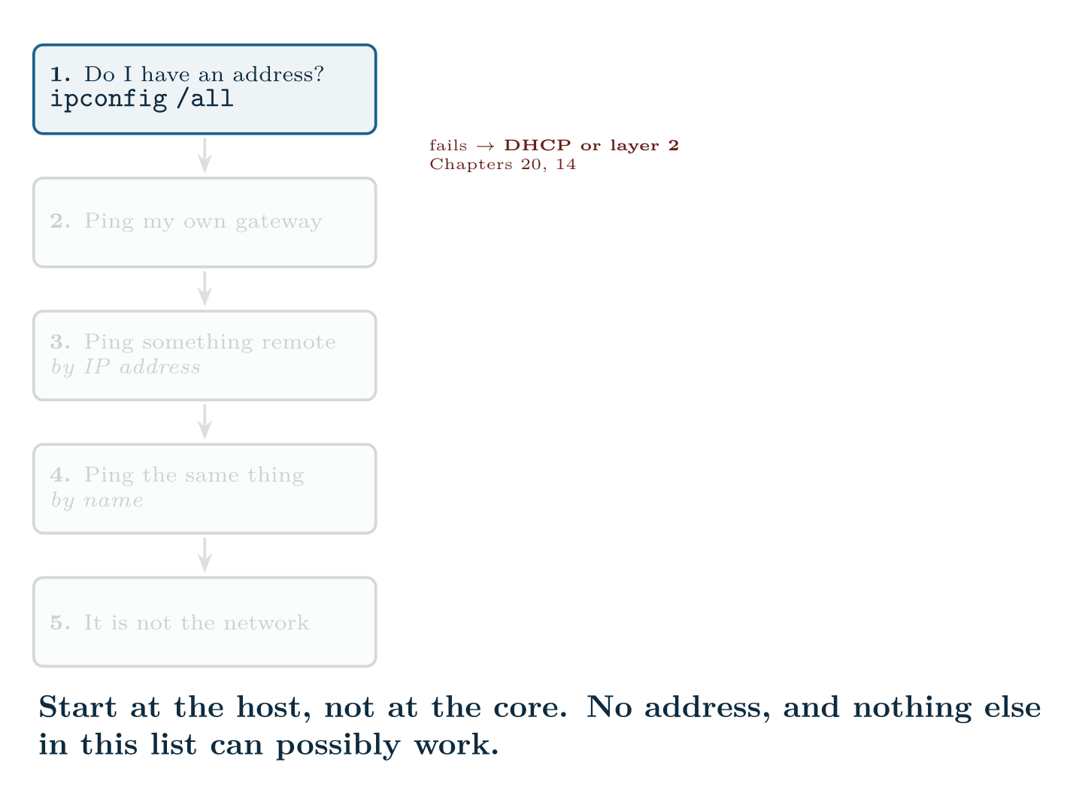
Start at the host
CCNA 200-301 v2.0 · Chapter 28. Troubleshooting Client Connectivity
1.6
Notes:
The instinct when a user cannot connect is to go and look at the switch. Resist it. Four commands at the host tell you whether there is any point.
The reachability ladder. Each rung that passes eliminates everything below it; the first rung that fails names the area to investigate.

Slide 9
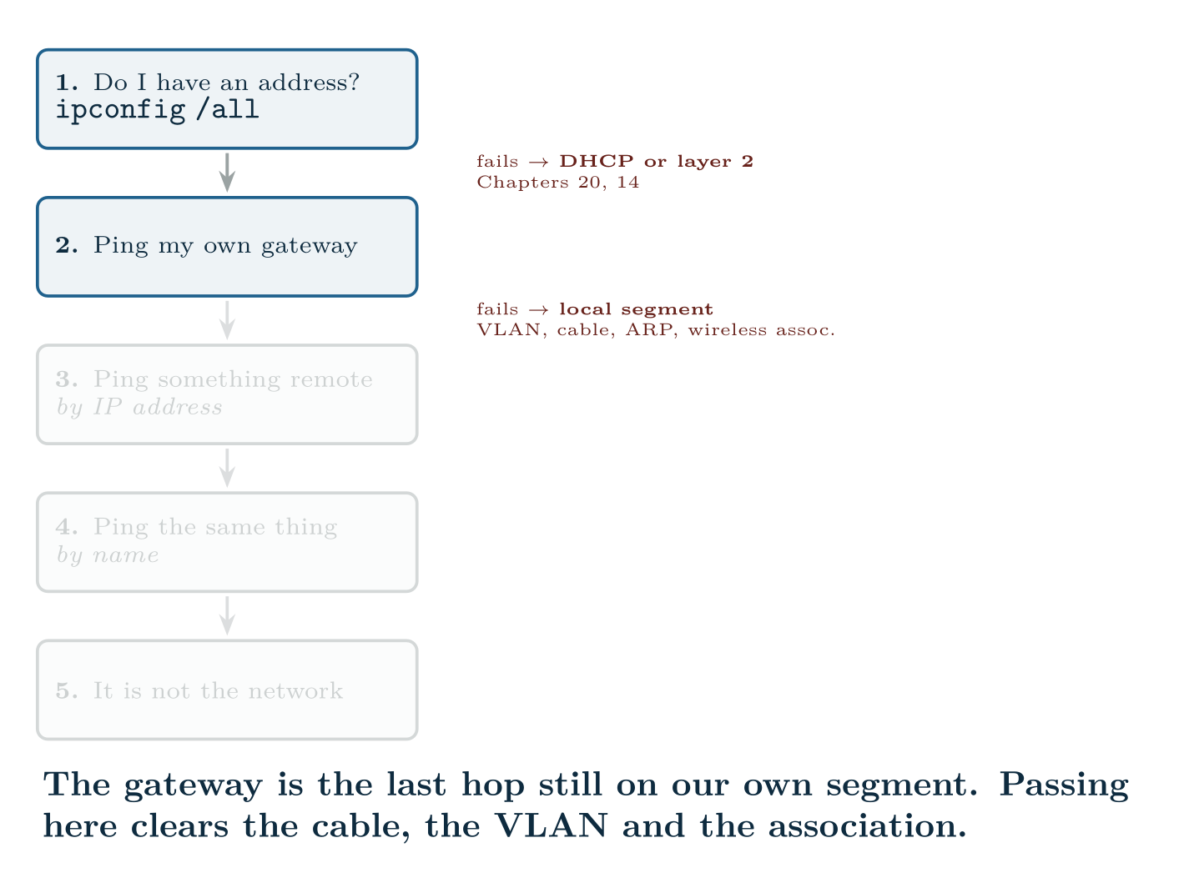
Start at the host
CCNA 200-301 v2.0 · Chapter 28. Troubleshooting Client Connectivity
1.6

Slide 10
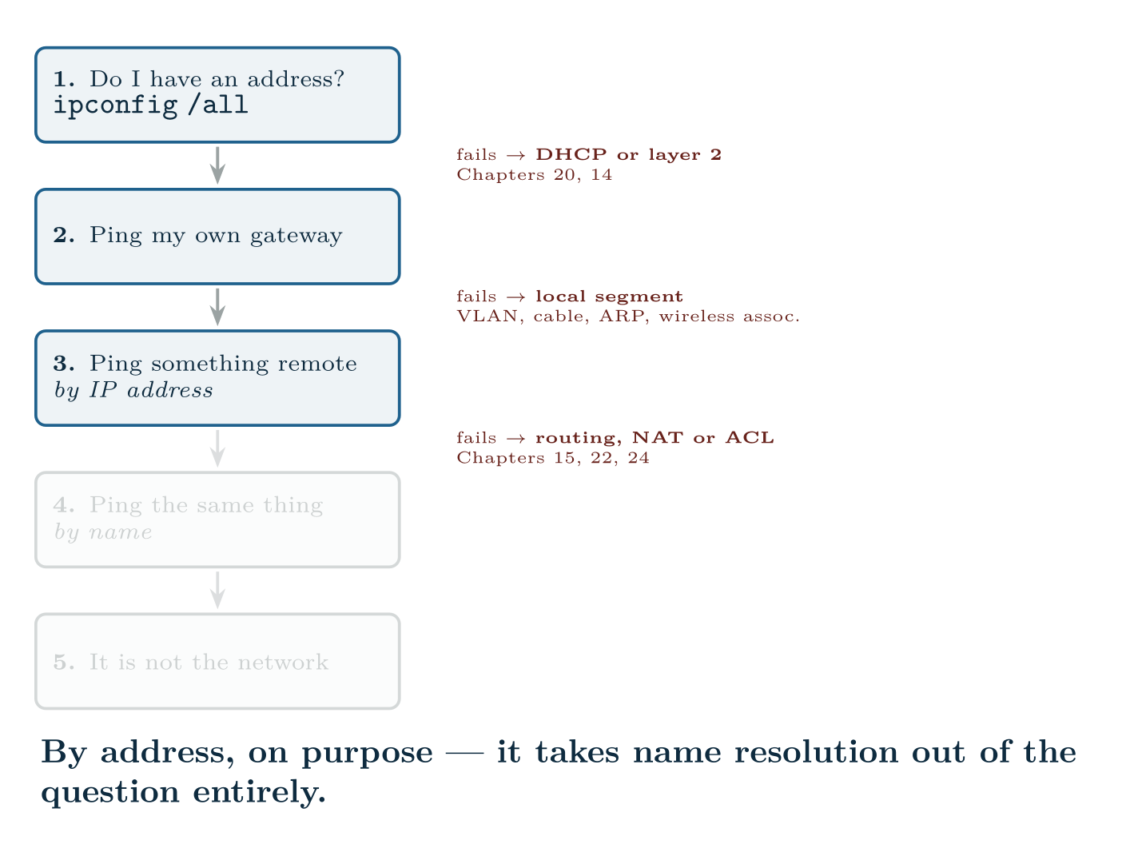
Start at the host
CCNA 200-301 v2.0 · Chapter 28. Troubleshooting Client Connectivity
1.6

Slide 11
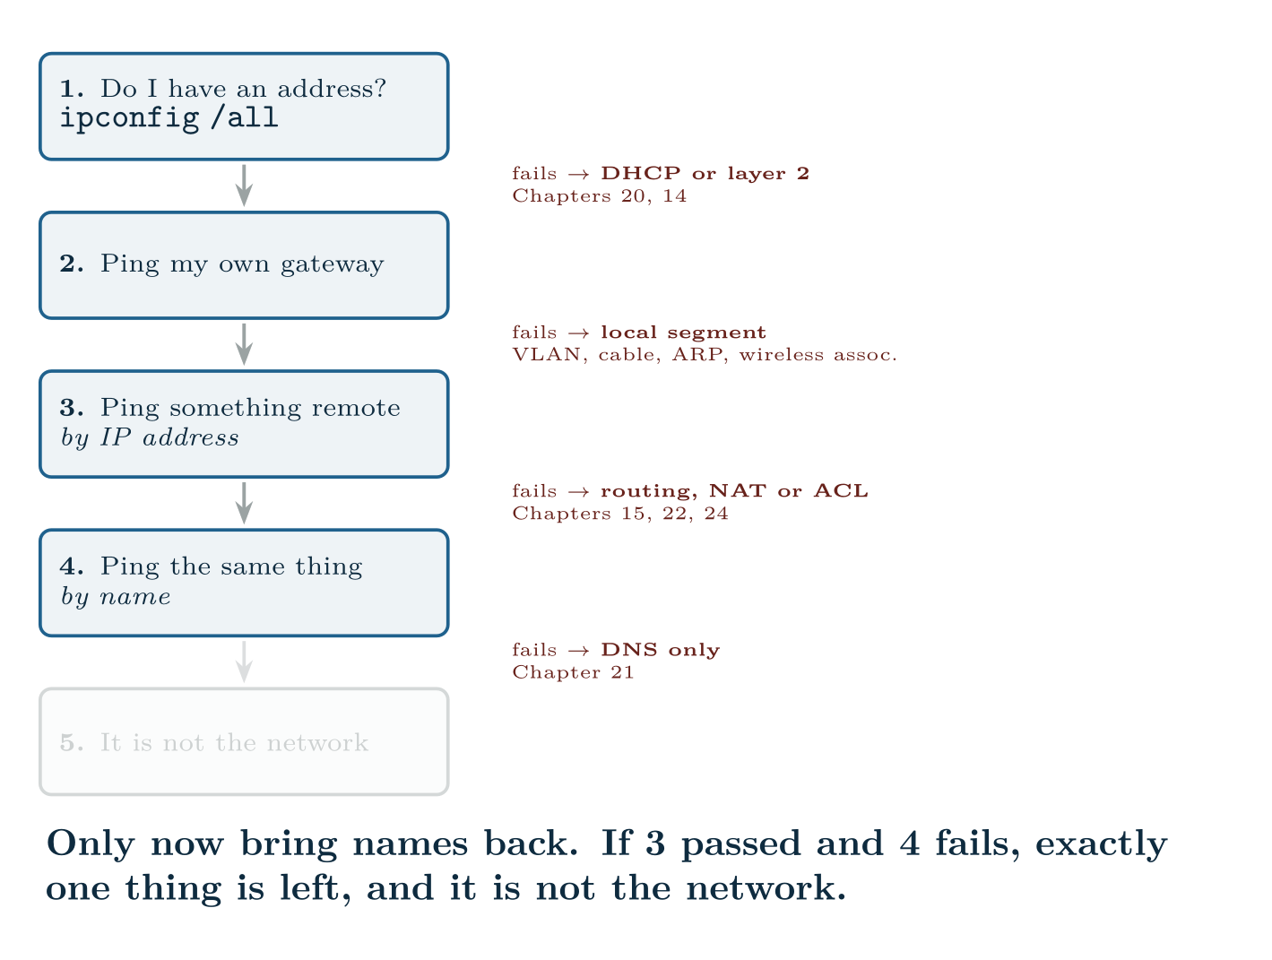
Start at the host
CCNA 200-301 v2.0 · Chapter 28. Troubleshooting Client Connectivity
1.6

Slide 12
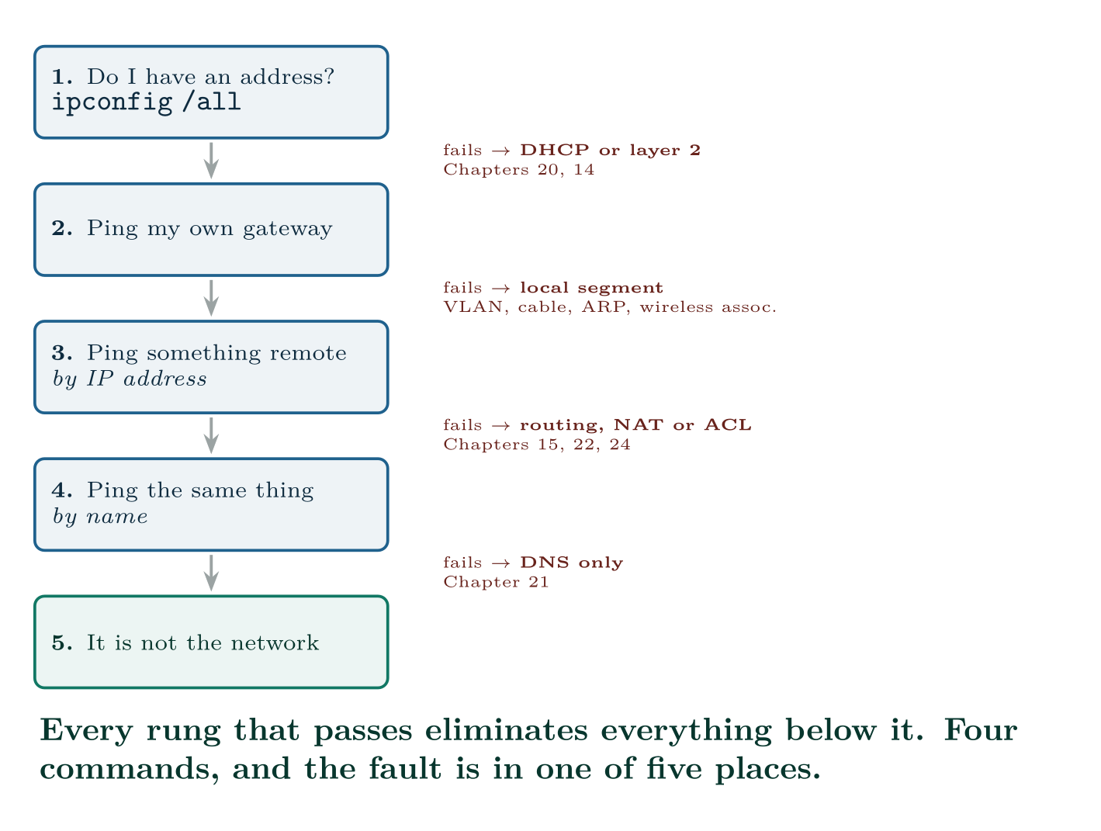
Start at the host
CCNA 200-301 v2.0 · Chapter 28. Troubleshooting Client Connectivity
1.6

Slide 13
CONCEPT
Why the order matters
Each step depends on every step above it. So the first failure is the fault, and everything below it is a symptom rather than a cause.
The commonest mistake in practice is starting at step 4 — “the website does not load” — and reasoning about DNS for twenty minutes on a machine that never had a valid address. Four commands, in order, cost ninety seconds and stop that happening.
CCNA 200-301 v2.0 · Chapter 28. Troubleshooting Client Connectivity
1.6

Slide 14
WATCH OUT
Two differences worth knowing rather than guessing
ifconfig is deprecated on Linux and absent from many modern distributions. ip replaced it. On macOS ifconfig is still the normal tool. Same command name, opposite advice, depending on the platform in front of you.
macOS does not release and renew the way Windows does. Setting the interface to NONE and back to DHCP is the equivalent; there is no single “renew” verb. In the GUI it is the Renew DHCP Lease button in the TCP/IP pane.
CCNA 200-301 v2.0 · Chapter 28. Troubleshooting Client Connectivity
1.6

Slide 15
Step 1: reading the IP configuration
CCNA 200-301 v2.0 · Chapter 28. Troubleshooting Client Connectivity
1.6

Slide 16
VERIFY
ipconfig /all
Windows
Wireless LAN adapter Wi-Fi:
Description . . . . . . . . . . . : Intel(R) Wi-Fi 6 AX201
Physical Address. . . . . . . . . : 8A-3C-D1-77-04-B2
DHCP Enabled. . . . . . . . . . . : Yes
IPv4 Address. . . . . . . . . . . : 192.168.10.34(Preferred)
Subnet Mask . . . . . . . . . . . : 255.255.255.0
Lease Obtained. . . . . . . . . . : 27 August 2026 08:14:02
Lease Expires . . . . . . . . . . : 27 August 2026 16:14:02
Default Gateway . . . . . . . . . : 192.168.10.1
DHCP Server . . . . . . . . . . . : 10.0.0.5
DNS Servers . . . . . . . . . . . : 192.168.20.10
192.168.20.11
CCNA 200-301 v2.0 · Chapter 28. Troubleshooting Client Connectivity
1.6

Slide 17
VERIFY
ip addr show wlan0
Linux
3: wlan0: <BROADCAST,MULTICAST,UP,LOWER_UP> mtu 1500 state UP
link/ether 8a:3c:d1:77:04:b2 brd ff:ff:ff:ff:ff:ff
inet 192.168.10.34/24 brd 192.168.10.255 scope global dynamic wlan0
valid_lft 21847sec preferred_lft 21847sec
inet6 2001:db8:acad:10:8a3c:d1ff:fe77:4b2/64 scope global dynamic
CCNA 200-301 v2.0 · Chapter 28. Troubleshooting Client Connectivity
1.6

Slide 18
CONCEPT
The wrong-mask fault, because it is worth recognising
A host configured 192.168.10.34/16 instead of /24 believes the whole of 192.168.0.0/16 is on its local segment. So for a destination in 192.168.20.0/24 it ARPs directly instead of sending to the gateway — gets no answer, and fails. For 8.8.8.8 it uses the gateway correctly, and works.
The symptom is therefore “the internet works but the file server does not”, which sounds like a server problem and is not. Check the mask whenever connectivity is selectively broken toward internal destinations.
CCNA 200-301 v2.0 · Chapter 28. Troubleshooting Client Connectivity
1.6

Slide 19
Steps 2 to 4: the reachability ladder
CCNA 200-301 v2.0 · Chapter 28. Troubleshooting Client Connectivity
1.6

Slide 20
VERIFY
ping 192.168.10.1
Windows
Pinging 192.168.10.1 with 32 bytes of data:
Reply from 192.168.10.1: bytes=32 time=1ms TTL=255
Reply from 192.168.10.1: bytes=32 time=1ms TTL=255
Ping statistics for 192.168.10.1:
Packets: Sent = 4, Received = 4, Lost = 0 (0% loss)
CCNA 200-301 v2.0 · Chapter 28. Troubleshooting Client Connectivity
1.6

Slide 21
VERIFY
ip neigh
Linux
192.168.10.1 dev wlan0 lladdr 00:1a:2b:3c:4d:5e REACHABLE
192.168.10.22 dev wlan0 lladdr 00:50:79:66:68:22 STALE
192.168.10.99 dev wlan0 FAILED
CCNA 200-301 v2.0 · Chapter 28. Troubleshooting Client Connectivity
1.6
Notes:
Gateway fails → the problem is on this segment. Wrong VLAN, a bad cable, a wireless client associated but not authorised, or an ACL on the SVI. Check the ARP cache: if the gateway has no MAC entry, the host cannot even find it. Gateway works, remote IP fails → the host is fine. The fault is routing, NAT or a filter. Run a trace to find where it stops. Remote IP works, remote name fails → DNS, and only DNS. Go to Chapter 21 and stop looking at anything else.

Slide 22
WATCH OUT
A ping that fails does not always mean unreachable
Plenty of hosts and firewalls drop ICMP by policy. Before concluding that a server is down, test the port the application actually uses:
• Windows: Test-NetConnection server.example.edu -Port 443
• macOS and Linux: nc -zv server.example.edu 443
A successful TCP connection to port 443 on a host that ignores ping is a working server. Reporting it as down because it did not answer ICMP is a common and avoidable error.
CCNA 200-301 v2.0 · Chapter 28. Troubleshooting Client Connectivity
1.6
Notes:
FAILED against an address means the host ARPed for it and nothing replied — so that address is either absent or not on this segment after all. It is a fast way to confirm a wrong-mask fault.

Slide 23
Wireless security parameters
CCNA 200-301 v2.0 · Chapter 28. Troubleshooting Client Connectivity
1.6

Slide 24
VERIFY
netsh wlan show interfaces
Windows
Name : Wi-Fi
State : connected
SSID : CAMPUS-STAFF
BSSID : 00:11:22:aa:bb:03
Network type : Infrastructure
Radio type : 802.11ax
Authentication : WPA2-Enterprise
Cipher : CCMP
Channel : 44
Signal : 78%
CCNA 200-301 v2.0 · Chapter 28. Troubleshooting Client Connectivity
1.6
Notes:
Wireless adds a step before the ladder even starts: the client must associate and authenticate. A client can be fully associated and still have no network access.

Slide 25
VERIFY
iw dev wlan0 link
Linux
Connected to 00:11:22:aa:bb:03 (on wlan0)
SSID: CAMPUS-STAFF
freq: 5220
signal: -58 dBm
rx bitrate: 780.0 MBit/s
tx bitrate: 585.0 MBit/s
CCNA 200-301 v2.0 · Chapter 28. Troubleshooting Client Connectivity
1.6

Slide 26
CONCEPT
Windows reports signal as a percentage, and it is not one
That Signal : 78% is a rescaling of RSSI, not a physical quantity, and different drivers scale it differently. It also tells you nothing about the noise floor, which Chapter 27 established is the number that decides whether a link works.
Prefer a tool that reports dBm. On Linux iw gives it directly; on macOS the option-click menu shows RSSI and noise together; on Windows a third-party analyser is usually needed.
CCNA 200-301 v2.0 · Chapter 28. Troubleshooting Client Connectivity
1.6

Slide 27
WATCH OUT
MAC randomisation, and why it breaks things that used to work
Windows, macOS, iOS, Android and most Linux distributions now generate a random MAC address per network by default, and some re-randomise periodically. It is a privacy feature and it is on unless somebody turned it off.
It breaks anything that identifies a device by MAC address:
The diagnostic tell: the MAC in ipconfig /all does not match the MAC on the device’s label or in the network’s records, and the second octet’s low-order bits mark it as locally administered.
Where to turn it off — and note the topic names all three:
• MAC-based authorisation or filtering — the device is unknown.
• DHCP reservations — the printer that always had .50 now does not.
• Per-device VLAN assignment.
• Any audit trail that assumed a MAC identified a machine.
• Windows — Settings, Network, Wi-Fi, the network’s properties: “Random hardware addresses”.
CCNA 200-301 v2.0 · Chapter 28. Troubleshooting Client Connectivity
1.6

Slide 28
WATCH OUT
MAC randomisation, and why it breaks things that used to work (continued)
• macOS and iOS — the network’s info panel: “Private Wi-Fi Address”.
• Linux (NetworkManager) — wifi.cloned-mac-address set to permanent on the connection profile.
The better long-term answer is to stop authenticating by MAC address at all and use 802.1X, which identifies the user. But the exam and the helpdesk both need the short answer.
CCNA 200-301 v2.0 · Chapter 28. Troubleshooting Client Connectivity
1.6

Slide 29
COMMON PITFALLS · What actually goes wrong
Common pitfalls
• Starting at DNS. Run the ladder in order.
• Concluding “down” from a failed ping. Test the actual port.
• Trusting a signal percentage. Get dBm, and get the noise floor.
• Ignoring the subnet mask when connectivity is selectively broken toward internal hosts.
• Forgetting that ifconfig is deprecated on Linux and normal on macOS.
• Assuming a MAC address identifies a device. It has not been safe to assume that since roughly 2020.
CCNA 200-301 v2.0 · Chapter 28. Troubleshooting Client Connectivity
1.6

Slide 30
COMMON PITFALLS · What actually goes wrong
Common pitfalls (continued)
• Not checking whether it is one host or many. One host is the host; a whole VLAN is the network. Ask before you start.
• Fixing it without recording what it was. A configuration you overwrote is evidence you destroyed.
CCNA 200-301 v2.0 · Chapter 28. Troubleshooting Client Connectivity
1.6

Slide 31
BREAK & FIX · SYMPTOM
Chapter 28
One laptop associates to the staff wireless, authenticates, and gets no address. Everyone else is fine.
A user’s laptop connects to CAMPUS-STAFF, shows as connected, and has 169.254.x.x. The same laptop works on the wired dock. Other laptops in the same room work on the same SSID. The wireless team confirms the client is associated and that 802.1X authentication succeeded.
CCNA 200-301 v2.0 · Chapter 28. Troubleshooting Client Connectivity
1.6

Slide 32
BREAK & FIX · YOUR MOVE
Chapter 28
One laptop associates to the staff wireless, authenticates, and gets no address. Everyone else is fine.
What would you check first — and what do you expect to see?
CCNA 200-301 v2.0 · Chapter 28. Troubleshooting Client Connectivity
1.6
Notes:
Pause here. Take two or three answers before advancing. The point is the prediction, not the command.

Slide 33
BREAK & FIX · EVIDENCE
Chapter 28
ipconfig /all
Windows#
Wireless LAN adapter Wi-Fi:
Physical Address. . . . . . . . . : 8A-3C-D1-77-04-B2
DHCP Enabled. . . . . . . . . . . : Yes
Autoconfiguration IPv4 Address. . : 169.254.88.14(Preferred)
Subnet Mask . . . . . . . . . . . : 255.255.0.0
Default Gateway . . . . . . . . . :
CCNA 200-301 v2.0 · Chapter 28. Troubleshooting Client Connectivity
1.6
Notes:
Read it aloud. Ask what single field decides the answer.

Slide 34
BREAK & FIX · EVIDENCE
Chapter 28
show ip dhcp snooping binding | include 8a3c
CCNA 200-301 v2.0 · Chapter 28. Troubleshooting Client Connectivity
1.6
Notes:
Read it aloud. Ask what single field decides the answer.

Slide 35
BREAK & FIX · YOUR MOVE
Chapter 28
What is the fault — and what does this output rule out?
CCNA 200-301 v2.0 · Chapter 28. Troubleshooting Client Connectivity
1.6
Notes:
The elimination matters as much as the answer.

Slide 36
BREAK & FIX · DIAGNOSIS
Chapter 28
Why it is doing that
Diagnosis. Work through what has already been ruled out, because it is most of the problem.
Association and 802.1X both succeeded, so the passphrase, the EAP method, the certificate and the RSSI are all fine — the radio link is working and the user is authorised. The wired dock working proves the laptop’s TCP/IP stack and the user’s credentials are fine. Other laptops working on the same SSID in the same room proves the AP, the WLAN and the DHCP scope are fine.
That leaves something specific to this device on wireless. The MAC address is the clue: 8A-3C-D1-77-04-B2. The first octet, 8A, is 10001010 in binary — and the second-lowest bit is set, which marks the address as locally administered rather than assigned by a manufacturer. This is a randomised MAC.
CCNA 200-301 v2.0 · Chapter 28. Troubleshooting Client Connectivity
1.6

Slide 37
BREAK & FIX · DIAGNOSIS
Chapter 28
Why it is doing that
The site assigns the staff VLAN by MAC address for devices in its asset register. The randomised address is not in the register, so the client is placed in a quarantine VLAN with no DHCP scope. Association succeeds, authentication succeeds, and no address is ever offered.
The confirming detail is the empty snooping binding query: the switch has no record of this MAC leasing anything, which is consistent with no offer having been made rather than with an offer being lost.
CCNA 200-301 v2.0 · Chapter 28. Troubleshooting Client Connectivity
1.6

Slide 38
BREAK & FIX · THE FIX
Chapter 28
And the lesson
Immediate fix. Turn off random hardware addresses for this network in Windows Settings, then disconnect and reconnect. The laptop presents its burned-in address, matches the register, lands in the staff VLAN and leases normally.
The real fix is at the other end. MAC-based VLAN assignment stopped being viable when every major operating system began randomising by default. The site already runs 802.1X — authentication succeeded — so it should assign the VLAN from the RADIUS response based on the authenticated user, not from a MAC table. That works regardless of what address the client presents, and it is the answer to give when this is reported for the fifth time.
CCNA 200-301 v2.0 · Chapter 28. Troubleshooting Client Connectivity
1.6

Slide 39
LAB · ANY THREE MACHINES, OR VIRTUAL MACHINES
The same fault on three operating systems
Platform note. This lab needs real operating systems rather than a network simulator, because the whole topic is about host-side tools. Virtual machines are fine. If you have only one machine, run Linux and Windows as VMs and use the host as the third.
1. On each of Windows, macOS and Linux, produce the full IP configuration, the routing table and the ARP cache. Build your own version of the command table in Section sec:oscmds from what actually worked — including any command that was missing on your distribution.
2. Run the reachability ladder on each machine while everything works, and record the normal output of each step. You cannot recognise abnormal output without this.
3. Break 1. Set a static address with the correct address and a wrong gateway. Predict which ladder step fails, then test.
4. Break 2. Set the mask to /16 on a /24 network. Find two destinations that behave differently and explain the difference using the ARP cache.
CCNA 200-301 v2.0 · Chapter 28. Troubleshooting Client Connectivity
1.6

Slide 40
LAB · ANY THREE MACHINES, OR VIRTUAL MACHINES
The same fault on three operating systems (continued)
5. Break 3. Remove the DNS servers. Confirm that steps 1 to 3 pass and step 4 fails, and that this is the only configuration that produces that pattern.
6. Break 4. Disconnect the network and observe APIPA. Note the address and mask each operating system chooses.
7. Release and renew the lease on all three, using the correct command for each. Note that macOS has no direct equivalent.
8. Wireless. Report SSID, BSSID, channel, authentication method and signal on each operating system. Compare what each tool tells you and what it omits.
CCNA 200-301 v2.0 · Chapter 28. Troubleshooting Client Connectivity
1.6

Slide 41
LAB · ANY THREE MACHINES, OR VIRTUAL MACHINES
The same fault on three operating systems (continued)
9. MAC randomisation. Find the setting on each operating system. Record the MAC with it on and off, and confirm the locally-administered bit in the randomised one.
10. Extension. Write the four-step diagnostic script you would give a first-line helpdesk, in the form of exact commands and what each result means. Keep it to one page.
CCNA 200-301 v2.0 · Chapter 28. Troubleshooting Client Connectivity
1.6

Slide 42
CHECKPOINT 1 of 6
Give the four rungs of the reachability ladder and the area each failure points to.
Discuss · then advance
Notes:
Ask the room. Do not advance until somebody commits to an answer.

Slide 43
ANSWER
Checkpoint 1 of 6
Give the four rungs of the reachability ladder and the area each failure points to.
(1) Do I have an address? Failure points to DHCP or layer 2. (2) Ping my gateway — failure points to the local segment. (3) Ping something remote by IP — failure points to routing, NAT or an ACL. (4) Ping the same thing by name — failure points to DNS and nothing else.
CCNA 200-301 v2.0 · Chapter 28. Troubleshooting Client Connectivity
1.6

Slide 44
CHECKPOINT 2 of 6
Name the command to show the full IP configuration on each of the three operating systems.
Discuss · then advance
Notes:
Ask the room. Do not advance until somebody commits to an answer.

Slide 45
ANSWER
Checkpoint 2 of 6
Name the command to show the full IP configuration on each of the three operating systems.
ipconfig /all on Windows, ifconfig on macOS, ip addr on Linux. Note that ifconfig is deprecated on Linux and normal on macOS.
CCNA 200-301 v2.0 · Chapter 28. Troubleshooting Client Connectivity
1.6

Slide 46
CHECKPOINT 3 of 6
A host has a correct address and a blank default gateway. What works and what does not?
Discuss · then advance
Notes:
Ask the room. Do not advance until somebody commits to an answer.

Slide 47
ANSWER
Checkpoint 3 of 6
A host has a correct address and a blank default gateway. What works and what does not?
It can reach hosts on its own subnet and nothing else. Everything local works, so the user may report it as “the internet is down” rather than as a network fault.
CCNA 200-301 v2.0 · Chapter 28. Troubleshooting Client Connectivity
1.6

Slide 48
CHECKPOINT 4 of 6
Why does a wrong subnet mask break some internal destinations and not others?
Discuss · then advance
Notes:
Ask the room. Do not advance until somebody commits to an answer.

Slide 49
ANSWER
Checkpoint 4 of 6
Why does a wrong subnet mask break some internal destinations and not others?
Because the mask decides which destinations the host believes are local. With a mask that is too short, the host ARPs directly for addresses that are actually on other subnets, gets no answer, and fails — while destinations genuinely outside the over-wide range still use the gateway correctly and work.
CCNA 200-301 v2.0 · Chapter 28. Troubleshooting Client Connectivity
1.6

Slide 50
CHECKPOINT 5 of 6
A device authenticates to wireless successfully and receives no address. Give two possible causes and how you would tell them apart.
Discuss · then advance
Notes:
Ask the room. Do not advance until somebody commits to an answer.

Slide 51
ANSWER
Checkpoint 5 of 6
A device authenticates to wireless successfully and receives no address. Give two possible causes and how you would tell them apart.
Either it is being placed in a VLAN with no DHCP scope — often because MAC randomisation means it is not recognised by a MAC-based authorisation list — or the relay or scope for its VLAN is broken. Tell them apart by checking whether other clients on the same SSID and VLAN are leasing normally; if they are, it is specific to this device.
CCNA 200-301 v2.0 · Chapter 28. Troubleshooting Client Connectivity
1.6

Slide 52
CHECKPOINT 6 of 6
How can you tell a randomised MAC address from a real one by inspection?
Discuss · then advance
Notes:
Ask the room. Do not advance until somebody commits to an answer.

Slide 53
ANSWER
Checkpoint 6 of 6
How can you tell a randomised MAC address from a real one by inspection?
The locally-administered bit is set — the second-lowest bit of the first octet. In practice the first octet’s second hex digit will be 2, 6, a or e (as in 8A), and the address will not match the device’s label or the manufacturer OUI.
CCNA 200-301 v2.0 · Chapter 28. Troubleshooting Client Connectivity
1.6

Slide 54
CHAPTER SUMMARY
What to take away
• Diagnose at the host first. Address, gateway, remote by IP, remote by name — in that order. The first failure is the fault.
• ipconfig /all on Windows, ifconfig on macOS, ip addr on Linux. ifconfig is deprecated on Linux and normal on macOS.
• Four broken configurations: no address (169.254), no gateway, wrong mask, no DNS. Each has a distinct signature in the ladder.
• A wrong mask breaks internal destinations selectively, which is why it looks like a server fault.
CCNA 200-301 v2.0 · Chapter 28. Troubleshooting Client Connectivity
1.6

Slide 55
CHAPTER SUMMARY
What to take away (continued)
• A failed ping is not proof of a dead host. Test the port with Test-NetConnection or nc -zv.
• Wireless clients can be associated and authenticated and still have no access. Check the security parameters separately from the radio.
• Windows reports signal as a meaningless percentage. Get dBm and the noise floor.
• MAC randomisation is on by default everywhere and breaks MAC-based authorisation, DHCP reservations and VLAN assignment. Identify it by the locally-administered bit.
CCNA 200-301 v2.0 · Chapter 28. Troubleshooting Client Connectivity
1.6

Slide 56
Where we got to
• Diagnose at the host first. Address, gateway, remote by IP, remote by name — in that order. The first failure is the fault.
• ipconfig /all on Windows, ifconfig on macOS, ip addr on Linux. ifconfig is deprecated on Linux and normal on macOS.
• Four broken configurations: no address (169.254), no gateway, wrong mask, no DNS. Each has a distinct signature in the ladder.
• A wrong mask breaks internal destinations selectively, which is why it looks like a server fault.
NEXT
Chapter 29 — Hypervisors, Virtual Machines and Containers

