Slide 1


CCNA 200-301 V2.0
30
Management Approaches, SNMP and Syslog
Part V — Wireless, Virtualisation and Operations
EXAM TOPICS
5.3
5.4
5.6
LECTURER
Dr. Mustafa Hameed
THE ISLAMIA UNIVERSITY OF BAHAWALPUR
Department of Information Technology
Notes:
Chapter 30: Management Approaches, SNMP and Syslog. Blueprint topics: 5.3, 5.4, 5.6.

Slide 2
THE COURSE
Where this chapter sits
Part I
Foundations
chapters 1–7
Part II
Switching and Network Access
chapters 8–14
Part III
IP Routing
chapters 15–19
Part IV
Network Services and Security
chapters 20–26
Part V
Wireless, Virtualisation and Operations
chapters 27–32
Part VI
Sitting the Exam
chapters 33–34
CCNA 200-301 v2.0 · Chapter 30. Management Approaches, SNMP and Syslog
CCNA 200-301 v2.0 · Chapter 30. Management Approaches, SNMP and Syslog
5.3 5.4 5.6
5.3 5.4 5.6
Notes:
Ten seconds. Students meeting a chapter in week ten cannot place it without being shown.

Slide 3
LEARNING OUTCOMES
What you will be able to do
• Describe the five network management approaches the blueprint names, and tell controller-based from automation-based.
• Describe how SNMP works, what its three versions differ on, and when to use a trap rather than an inform.
• Interpret any IOS syslog message: facility, severity, mnemonic and description.
• Recite the eight severity levels and explain what a logging threshold hides.
CCNA 200-301 v2.0 · Chapter 30. Management Approaches, SNMP and Syslog
5.3 5.4 5.6
Notes:
Management Approaches, SNMP and Syslog 5.35.45.6

Slide 4
ASSUMED KNOWLEDGE
Before we start
Chapter 23 for secure management access and for why credentials in clear are unacceptable. Chapter 6 for UDP. Chapter 14 — you have already read syslog output there; this chapter makes it systematic.
CCNA 200-301 v2.0 · Chapter 30. Management Approaches, SNMP and Syslog
5.3 5.4 5.6

Slide 5
KEY TERMS
Vocabulary for this chapter
device-based
controller-based
cloud-based
automation-based
infrastructure as code
SNMP manager
agent
MIB
OID
community string
trap
inform
facility
severity
mnemonic
Each is defined where it first matters — not here.
CCNA 200-301 v2.0 · Chapter 30. Management Approaches, SNMP and Syslog
5.3 5.4 5.6
Notes:
Do not define these now - they are defined as they arrive. This slide is for the students' notes.

Slide 6
ON THE EXAM
Three topics, three different verbs
This is what the blueprint actually asks for
5.3 describe network management approaches (device-based, cloud-based, controller-based, automation-based, and infrastructure as code) — five named approaches, so expect a matching or scenario question.
5.4 describe the function of SNMP in network operations — function, not configuration. What it does and how, not how to type it.
5.6 interpret syslog message content, severity levels, and facilities — interpret. You will be shown a log line and asked what it means. Section sec:syslog-read is built for exactly that and is the highest-value part of this chapter.
CCNA 200-301 v2.0 · Chapter 30. Management Approaches, SNMP and Syslog
5.3 5.4 5.6

Slide 7
WATCH OUT
Controller-based against automation-based: the distinction that gets tested
They sound similar and are structurally different.
Controller-based inserts a new system between you and the network. The controller holds the intended state, and it is in the path permanently. Take it away and you lose central management.
Automation-based adds tooling outside the network. Ansible logs in over SSH and types commands faster and more consistently than you can. Take it away and every device still works exactly as before, because nothing about them changed.
One-line test: does the network still have a management system when the tool is switched off? Controller, yes — and you have lost it. Automation, no — and you have lost nothing but convenience.
Infrastructure as code is a step beyond automation: not just running the change, but keeping the intended state in a repository that is reviewed, tested and versioned.
CCNA 200-301 v2.0 · Chapter 30. Management Approaches, SNMP and Syslog
5.3 5.4 5.6

Slide 8
SNMP
CCNA 200-301 v2.0 · Chapter 30. Management Approaches, SNMP and Syslog
5.3 5.4 5.6

Slide 9
DEFINITION
SNMP
The Simple Network Management Protocol. A manager polls agents running on network devices for values held in a MIB — a tree of variables, each identified by a numeric OID. Agents listen on UDP 161; the manager receives unsolicited notifications on UDP 162.
CCNA 200-301 v2.0 · Chapter 30. Management Approaches, SNMP and Syslog
5.3 5.4 5.6

Slide 10
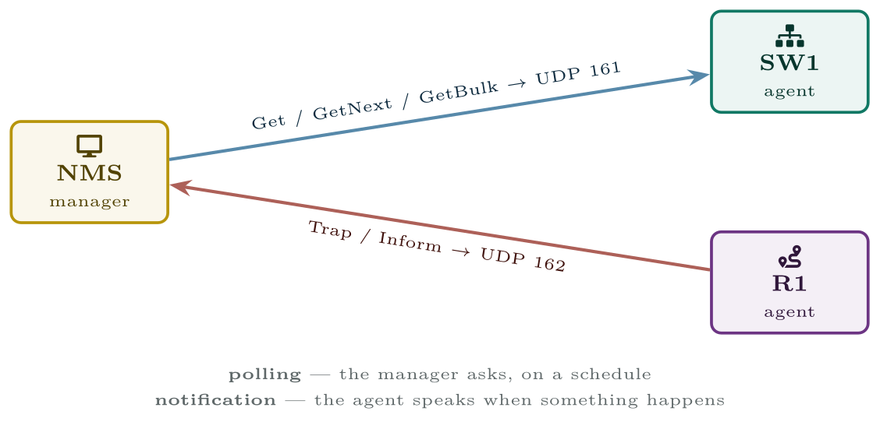
SNMP
SNMP works in both directions: the manager polls on port 161, and agents report events unprompted to port 162.
CCNA 200-301 v2.0 · Chapter 30. Management Approaches, SNMP and Syslog
5.3 5.4 5.6

Slide 11
CONCEPT
Trap or inform
A trap that is lost is lost silently, and the event it described never reaches anyone. An inform costs a round trip and some agent memory, and survives a dropped packet.
Use informs for anything you would be sorry to miss — a device losing power redundancy, a security event. Use traps for high-volume, low-consequence notifications where losing one does not matter. This is a fair exam question and a real design decision.
CCNA 200-301 v2.0 · Chapter 30. Management Approaches, SNMP and Syslog
5.3 5.4 5.6
Notes:
Get — fetch one value. GetNext — fetch the next one in the tree, which is how a manager walks a whole table. GetBulk — fetch many at once. Added in v2c, and the reason polling a large switch is not painfully slow. Set — write a value, changing the device’s configuration or state. Powerful, and the reason read-write access needs treating as an administrative credential. Trap — the agent notifies the manager of an event. Fire and forget: sent once, over UDP, never acknowledged. Inform — the same, but acknowledged and retransmitted until it is. Added in v2c.

Slide 12
WATCH OUT
“v2c is secure because the community string is not public”
It is not. The community string travels in clear text in every single polling packet, hundreds of times an hour, and anyone who can capture one packet has it. Renaming it from public to something obscure changes nothing.
And a read-write community string is equivalent to an enable password: an attacker holding one can reconfigure the device, and on many platforms can pull the entire running configuration. If SNMP must be v2c for a legacy tool, make it read-only, restrict it with an ACL to the management station’s address, and plan its removal.
CCNA 200-301 v2.0 · Chapter 30. Management Approaches, SNMP and Syslog
5.3 5.4 5.6

Slide 13
CONFIGURE
SNMPv3, read-only, for a monitoring station
IOS · configuration mode
snmp-server view OPSVIEW iso included
snmp-server group OPSGROUP v3 priv read OPSVIEW
!
! auth protects integrity and identity; priv adds encryption.
! "priv" implies "auth" -- you cannot encrypt without authenticating.
snmp-server user nms OPSGROUP v3 auth sha AuthPassPhrase priv aes 128 PrivPassPhrase
!
snmp-server host 10.0.0.45 version 3 priv nms
snmp-server enable traps
!
! These two are free and save an hour when somebody has to find the
! device in a building.
snmp-server location Campus Block C, Rack 4, RU 22
snmp-server contact netops@example.edu
CCNA 200-301 v2.0 · Chapter 30. Management Approaches, SNMP and Syslog
5.3 5.4 5.6

Slide 14
CONCEPT
What SNMP is actually used for
Three jobs, and the exam’s phrase “in network operations” points at them.
• Performance monitoring — polling interface counters every few minutes to produce the traffic graphs everybody recognises.
• Fault notification — traps and informs for events that cannot wait for the next poll.
• Inventory — serial numbers, models, software versions and uptime collected across the estate.
What it is not good at is configuration. Set exists, but nobody manages configuration by SNMP; that is what Chapters 31 and the automation approaches are for.
CCNA 200-301 v2.0 · Chapter 30. Management Approaches, SNMP and Syslog
5.3 5.4 5.6

Slide 15
Syslog, and how to read a message
CCNA 200-301 v2.0 · Chapter 30. Management Approaches, SNMP and Syslog
5.3 5.4 5.6

Slide 16
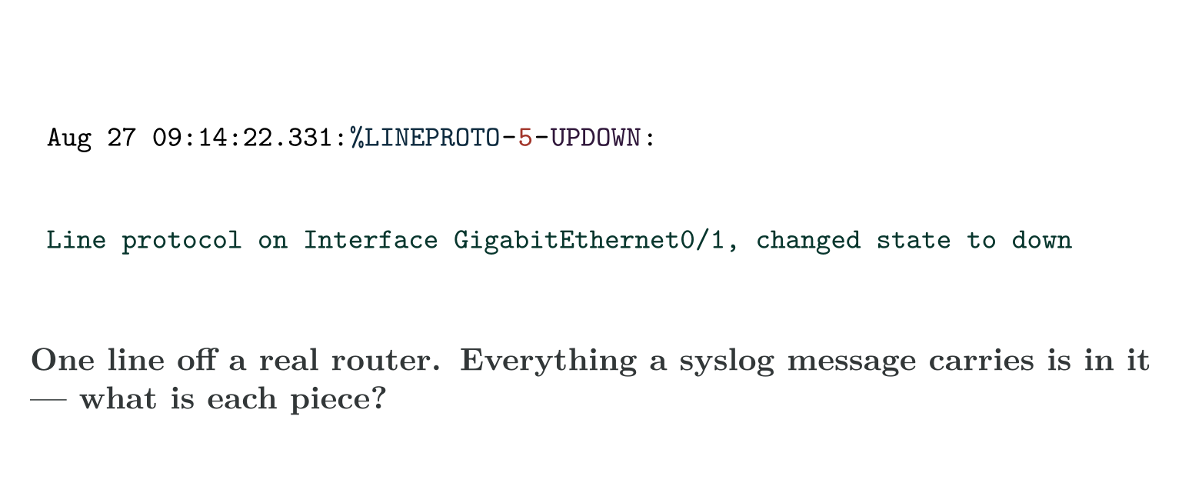
Anatomy of an IOS message
CCNA 200-301 v2.0 · Chapter 30. Management Approaches, SNMP and Syslog
5.3 5.4 5.6
Notes:
Syslog is where a device tells you what it did. Reading it fluently is the single most transferable skill in this chapter.
Every IOS syslog message has the same four parts after the timestamp. The severity is the single digit between the two hyphens.

Slide 17
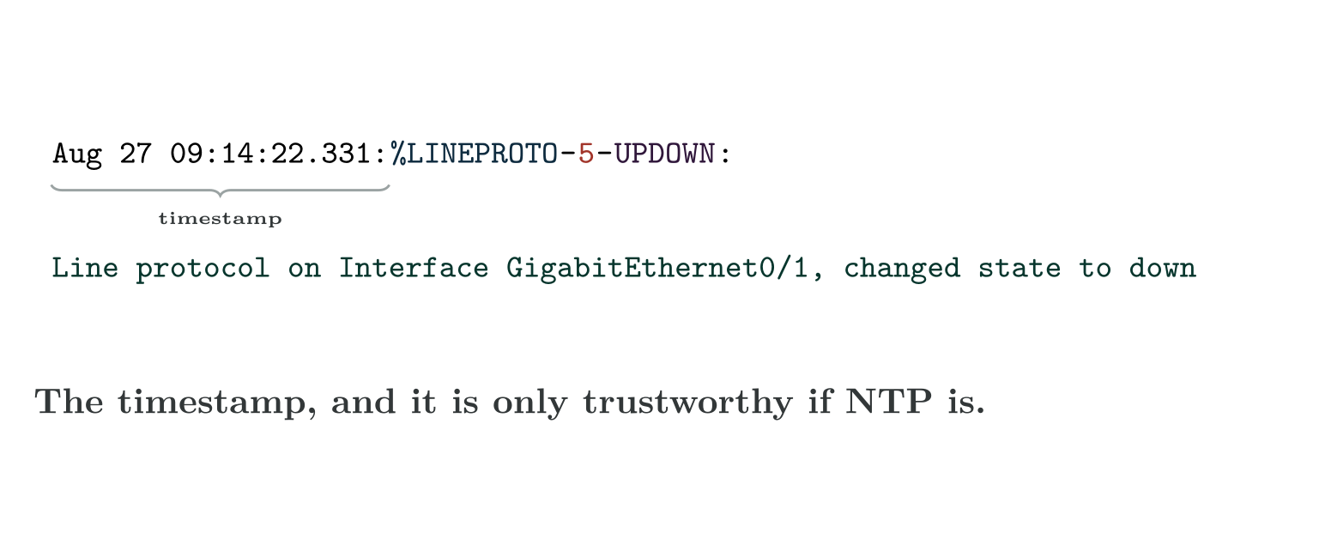
Anatomy of an IOS message
CCNA 200-301 v2.0 · Chapter 30. Management Approaches, SNMP and Syslog
5.3 5.4 5.6

Slide 18
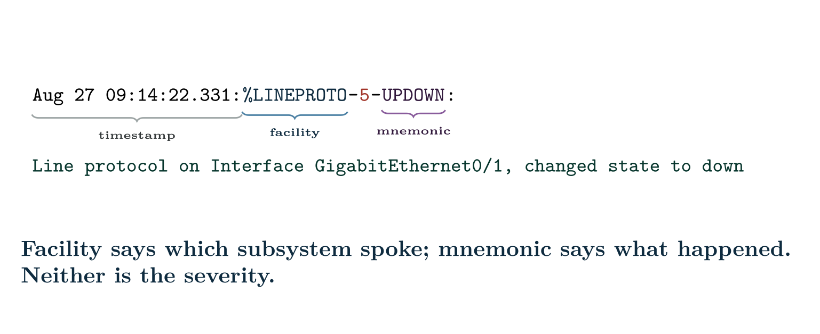
Anatomy of an IOS message
CCNA 200-301 v2.0 · Chapter 30. Management Approaches, SNMP and Syslog
5.3 5.4 5.6

Slide 19
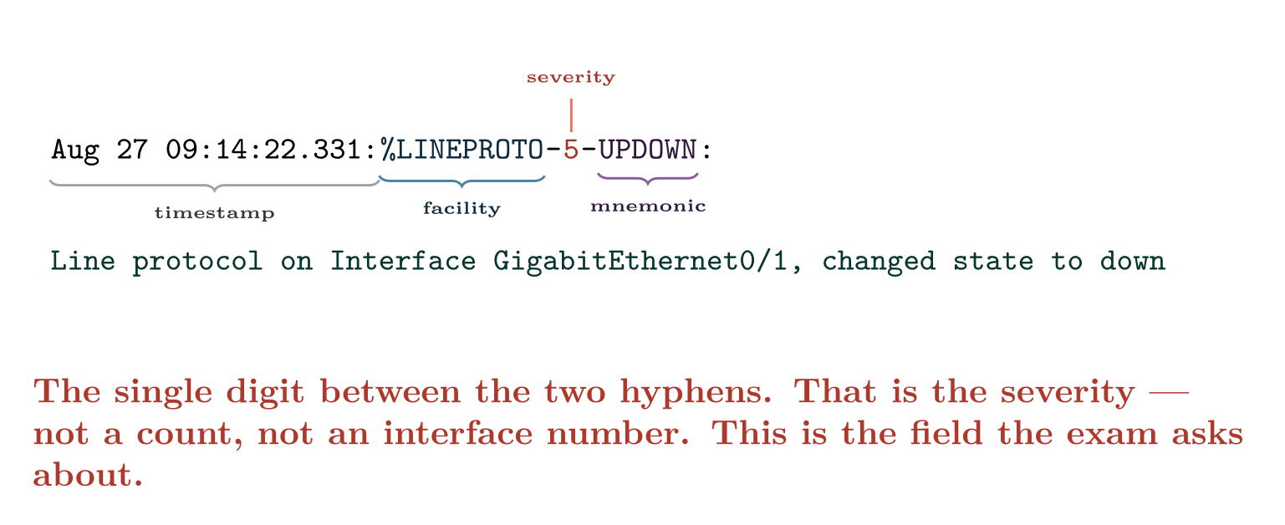
Anatomy of an IOS message
CCNA 200-301 v2.0 · Chapter 30. Management Approaches, SNMP and Syslog
5.3 5.4 5.6

Slide 20
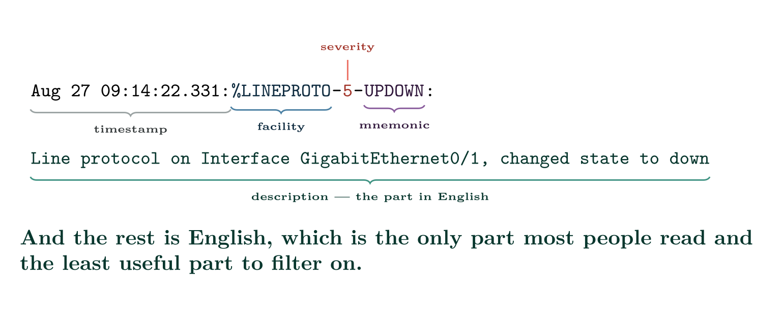
Anatomy of an IOS message
CCNA 200-301 v2.0 · Chapter 30. Management Approaches, SNMP and Syslog
5.3 5.4 5.6

Slide 21
WATCH OUT
The severity is the digit in the middle, and it is not the number of anything else
In %LINEPROTO-5-UPDOWN the 5 is the severity level. In %LINK-3-UPDOWN the 3 is the severity level.
Those two messages describe the same interface going down and carry different severities because they concern different layers. Seeing both together is normal and tells you the physical link dropped, which took the line protocol with it. A %LINEPROTO-5-UPDOWN without a matching %LINK-3-UPDOWN means layer 1 stayed up and something above it failed — keepalives, an encapsulation mismatch, or a shutdown of a subinterface.
CCNA 200-301 v2.0 · Chapter 30. Management Approaches, SNMP and Syslog
5.3 5.4 5.6

Slide 22
CONCEPT
Remembering the order
Every Awesome Cisco Engineer Will Need Ice-cream Daily — Emergency, Alert, Critical, Error, Warning, Notification, Informational, Debugging.
Two facts that follow and are examined: 0 is the most severe and 7 the least, which is the opposite of most people’s instinct. And configuring a logging destination at level n sends everything from 0 through n — so logging console warnings (level 4) also delivers levels 0 to 3, and silently discards 5, 6 and 7.
CCNA 200-301 v2.0 · Chapter 30. Management Approaches, SNMP and Syslog
5.3 5.4 5.6

Slide 23
CONFIGURE
A sensible logging setup
IOS · configuration mode
! Without this every message is stamped only with uptime, which is
! useless for correlating across devices. Do this first, everywhere.
service timestamps log datetime msec localtime show-timezone
service timestamps debug datetime msec localtime show-timezone
!
! Keep a generous local buffer at informational, so the evidence is
! on the device even if the syslog server was unreachable.
logging buffered 65536 informational
!
! Console logging on a busy device makes the CLI unusable. Turn it
! down; the buffer and the server still have everything.
logging console warnings
logging monitor informational
!
! The central server. "trap" here means the syslog severity
! threshold, NOT an SNMP trap -- an unfortunate collision of terms.
logging host 10.0.0.45
logging trap notifications
logging source-interface Loopback0
CCNA 200-301 v2.0 · Chapter 30. Management Approaches, SNMP and Syslog
5.3 5.4 5.6

Slide 24
CONFIGURE
A sensible logging setup (continued)
IOS · configuration mode
!
line con 0
logging synchronous
line vty 0 15
logging synchronous
CCNA 200-301 v2.0 · Chapter 30. Management Approaches, SNMP and Syslog
5.3 5.4 5.6

Slide 25
WATCH OUT
logging trap has nothing to do with SNMP traps
It sets the severity threshold for messages sent to a syslog server. logging trap notifications means “send levels 0 to 5 to the host”. The word is a historical accident and it confuses people every year.
logging synchronous is unrelated to both: it stops a log message printed mid-command from scrambling what you were typing. It changes nothing about what is logged and it will save your temper.
CCNA 200-301 v2.0 · Chapter 30. Management Approaches, SNMP and Syslog
5.3 5.4 5.6

Slide 26
VERIFY
show logging | include Console|Buffer|Trap
SW1#
Console logging: level warnings, 2201 messages logged
Monitor logging: level informational, 0 messages logged
Buffer logging: level informational, 88214 messages logged
Trap logging: level notifications, 41022 message lines logged
CCNA 200-301 v2.0 · Chapter 30. Management Approaches, SNMP and Syslog
5.3 5.4 5.6

Slide 27
COMMON PITFALLS · Configuring logging
Common pitfalls
• Reading severity backwards. 0 is worst, 7 is least important.
• Setting a threshold too high and concluding nothing is wrong. The message may exist and be filtered. Check the levels before trusting an empty log.
• No service timestamps. Messages stamped with uptime cannot be correlated across devices or with a user’s report.
• Confusing logging trap with SNMP traps.
• Leaving console logging at debugging on a production device. The CLI becomes unusable exactly when you need it.
CCNA 200-301 v2.0 · Chapter 30. Management Approaches, SNMP and Syslog
5.3 5.4 5.6

Slide 28
COMMON PITFALLS · Configuring logging
Common pitfalls (continued)
• SNMP v2c with a read-write community string. That is an enable password sent in clear thousands of times a day.
• No logging source-interface. Messages arrive from whichever interface routing chose, and the server cannot reliably attribute them.
• Relying on traps for events that matter. Use informs.
• Calling Ansible “controller-based”. It adds no control plane.
CCNA 200-301 v2.0 · Chapter 30. Management Approaches, SNMP and Syslog
5.3 5.4 5.6

Slide 29
BREAK & FIX · SYMPTOM
Chapter 30
Ports keep going down overnight. The log “shows nothing”.
An access switch drops several user ports most nights. By morning they are back. The site’s monitoring shows the interfaces bouncing, but the network team reports that the device’s own log contains no explanation.
CCNA 200-301 v2.0 · Chapter 30. Management Approaches, SNMP and Syslog
5.3 5.4 5.6

Slide 30
BREAK & FIX · YOUR MOVE
Chapter 30
Ports keep going down overnight. The log “shows nothing”.
What would you check first — and what do you expect to see?
CCNA 200-301 v2.0 · Chapter 30. Management Approaches, SNMP and Syslog
5.3 5.4 5.6
Notes:
Pause here. Take two or three answers before advancing. The point is the prediction, not the command.

Slide 31
BREAK & FIX · EVIDENCE
Chapter 30
show logging | include level
SW1#
Console logging: level errors, 14 messages logged
Monitor logging: level errors, 0 messages logged
Buffer logging: level errors, 14 messages logged
Trap logging: level errors, 14 message lines logged
CCNA 200-301 v2.0 · Chapter 30. Management Approaches, SNMP and Syslog
5.3 5.4 5.6
Notes:
Read it aloud. Ask what single field decides the answer.

Slide 32
BREAK & FIX · YOUR MOVE
Chapter 30
What is the fault — and what does this output rule out?
CCNA 200-301 v2.0 · Chapter 30. Management Approaches, SNMP and Syslog
5.3 5.4 5.6
Notes:
The elimination matters as much as the answer.

Slide 33
BREAK & FIX · DIAGNOSIS
Chapter 30
Why it is doing that
Diagnosis. Every destination is set to errors, which is severity 3. That delivers levels 0 to 3 and discards 4, 5, 6 and 7.
Look at what lives in the discarded range:
CCNA 200-301 v2.0 · Chapter 30. Management Approaches, SNMP and Syslog
5.3 5.4 5.6

Slide 34
BREAK & FIX · THE FIX
Chapter 30
Recording enough to diagnose
IOS · configuration mode
service timestamps log datetime msec localtime show-timezone
logging buffered 65536 informational
logging trap notifications
logging console warnings
CCNA 200-301 v2.0 · Chapter 30. Management Approaches, SNMP and Syslog
5.3 5.4 5.6

Slide 35
LAB · PACKET TRACER FOR SYSLOG; CML FOR SNMPV3
Making a device tell you what it is doing
Platform note. Packet Tracer has a syslog server and will carry tasks 1–6. SNMPv3 needs a real image and a real NMS, so tasks 7–9 want CML or GNS3 with an SNMP tool on a Linux host.
1. On a switch with default logging, run show logging and record every threshold before changing anything.
2. Enable service timestamps with date, time and milliseconds. Shut an interface and compare the message with one logged before the change.
3. Shut and unshut an interface and capture both messages. Identify the facility, severity and mnemonic in each, and explain why the two severities differ.
4. Set logging buffered errors. Repeat the shut and unshut. Record which of the two messages survives and explain why — this is the Break & Fix in miniature.
CCNA 200-301 v2.0 · Chapter 30. Management Approaches, SNMP and Syslog
5.3 5.4 5.6

Slide 36
LAB · PACKET TRACER FOR SYSLOG; CML FOR SNMPV3
Making a device tell you what it is doing (continued)
5. Restore logging buffered informational, save a configuration change, and find the %SYS-5-CONFIG_I message. Note that it records that a change was made, not what it was.
6. Point logging host at a syslog server, set logging trap notifications, and confirm messages arrive. Then set it to emergencies and confirm they stop.
7. SNMP. Configure SNMPv3 with authPriv and poll the device’s interface table from a Linux host. Record the OID you used.
8. Capture the polling traffic. Confirm you cannot read it. Then reconfigure for v2c, capture again, and find the community string in the packet. Write down what you saw.
CCNA 200-301 v2.0 · Chapter 30. Management Approaches, SNMP and Syslog
5.3 5.4 5.6

Slide 37
LAB · PACKET TRACER FOR SYSLOG; CML FOR SNMPV3
Making a device tell you what it is doing (continued)
9. Configure a trap receiver, generate an event, and confirm receipt. Change the trap to an inform and observe the acknowledgement.
10. Extension. Write the logging and SNMP standard your site should apply to every device, with a one-line justification per command, and the one thing you would check first when someone says the log is empty.
CCNA 200-301 v2.0 · Chapter 30. Management Approaches, SNMP and Syslog
5.3 5.4 5.6

Slide 38
CHECKPOINT 1 of 6
Name the five management approaches and give the one-line test that separates controller-based from automation-based.
Discuss · then advance
Notes:
Ask the room. Do not advance until somebody commits to an answer.

Slide 39
ANSWER
Checkpoint 1 of 6
Name the five management approaches and give the one-line test that separates controller-based from automation-based.
Device-based, controller-based, cloud-based, automation-based, and infrastructure as code. The test: does the network still have a management system when the tool is switched off? For controller-based, yes — and you have just lost it. For automation-based, no — nothing about the devices changed.
CCNA 200-301 v2.0 · Chapter 30. Management Approaches, SNMP and Syslog
5.3 5.4 5.6

Slide 40
CHECKPOINT 2 of 6
In %PM-4-ERR_DISABLE, identify the facility, the severity and the mnemonic, and say what the severity means.
Discuss · then advance
Notes:
Ask the room. Do not advance until somebody commits to an answer.

Slide 41
ANSWER
Checkpoint 2 of 6
In %PM-4-ERR_DISABLE, identify the facility, the severity and the mnemonic, and say what the severity means.
Facility %PM, severity 4, mnemonic ERR_DISABLE. Severity 4 is warning.
CCNA 200-301 v2.0 · Chapter 30. Management Approaches, SNMP and Syslog
5.3 5.4 5.6

Slide 42
CHECKPOINT 3 of 6
Which severity levels does logging buffered warnings record, and which does it discard?
Discuss · then advance
Notes:
Ask the room. Do not advance until somebody commits to an answer.

Slide 43
ANSWER
Checkpoint 3 of 6
Which severity levels does logging buffered warnings record, and which does it discard?
warnings is severity 4, so it records levels 0 to 4 and discards 5, 6 and 7 — notification, informational and debugging.
CCNA 200-301 v2.0 · Chapter 30. Management Approaches, SNMP and Syslog
5.3 5.4 5.6

Slide 44
CHECKPOINT 4 of 6
State the difference between an SNMP trap and an inform, and when you would choose each.
Discuss · then advance
Notes:
Ask the room. Do not advance until somebody commits to an answer.

Slide 45
ANSWER
Checkpoint 4 of 6
State the difference between an SNMP trap and an inform, and when you would choose each.
A trap is sent once over UDP and never acknowledged, so it can be lost silently. An inform is acknowledged and retransmitted until it is. Use informs for anything you would be sorry to miss, traps for high-volume low-consequence events.
CCNA 200-301 v2.0 · Chapter 30. Management Approaches, SNMP and Syslog
5.3 5.4 5.6

Slide 46
CHECKPOINT 5 of 6
Why is SNMP v2c unsuitable regardless of how obscure the community string is?
Discuss · then advance
Notes:
Ask the room. Do not advance until somebody commits to an answer.

Slide 47
ANSWER
Checkpoint 5 of 6
Why is SNMP v2c unsuitable regardless of how obscure the community string is?
Because the community string travels in clear text in every polling packet, hundreds of times an hour. Anyone who can capture one packet has it, so obscurity is irrelevant. A read-write string is equivalent to an enable password.
CCNA 200-301 v2.0 · Chapter 30. Management Approaches, SNMP and Syslog
5.3 5.4 5.6

Slide 48
CHECKPOINT 6 of 6
What does logging trap configure, and what does it not?
Discuss · then advance
Notes:
Ask the room. Do not advance until somebody commits to an answer.

Slide 49
ANSWER
Checkpoint 6 of 6
What does logging trap configure, and what does it not?
It sets the severity threshold for messages sent to a syslog server. It has nothing whatever to do with SNMP traps, despite the name.
CCNA 200-301 v2.0 · Chapter 30. Management Approaches, SNMP and Syslog
5.3 5.4 5.6

Slide 50
CHAPTER SUMMARY
What to take away
• Five approaches: device-based (per box), controller-based (a controller holds intent), cloud-based (vendor-hosted management plane), automation-based (tooling drives existing interfaces), infrastructure as code (state in a reviewed repository).
• Controller-based adds a system to the network; automation-based does not. That is the distinction to be able to state.
• SNMP: manager polls agents on UDP 161 with Get, GetNext, GetBulk and Set; agents send traps and informs to UDP 162. Informs are acknowledged, traps are not.
• v1 and v2c send community strings in clear. Only v3 authenticates and encrypts. Use authPriv.
CCNA 200-301 v2.0 · Chapter 30. Management Approaches, SNMP and Syslog
5.3 5.4 5.6

Slide 51
CHAPTER SUMMARY
What to take away (continued)
• An IOS syslog message is %FACILITY-SEVERITY-MNEMONIC: description. The severity is the digit between the hyphens.
• Levels 0 to 7, emergency to debugging. 0 is worst. A threshold of n records 0 through n and discards the rest.
• service timestamps first, always. logging trap is a syslog severity, not SNMP.
• An empty log describes the logging configuration, not the network.
CCNA 200-301 v2.0 · Chapter 30. Management Approaches, SNMP and Syslog
5.3 5.4 5.6

Slide 52
Where we got to
• Five approaches: device-based (per box), controller-based (a controller holds intent), cloud-based (vendor-hosted management plane), automation-based (tooling drives existing interfaces), infrastructure as code (state in a reviewed repository).
• Controller-based adds a system to the network; automation-based does not. That is the distinction to be able to state.
• SNMP: manager polls agents on UDP 161 with Get, GetNext, GetBulk and Set; agents send traps and informs to UDP 162. Informs are acknowledged, traps are not.
• v1 and v2c send community strings in clear. Only v3 authenticates and encrypts. Use authPriv.
NEXT
Chapter 31 — Ansible and Configuration Management

