Slide 1


CCNA 200-301 V2.0
33
A Troubleshooting Method for the 28 Per Cent
Part VI — Sitting the Exam
EXAM TOPICS
2.4
LECTURER
Dr. Mustafa Hameed
THE ISLAMIA UNIVERSITY OF BAHAWALPUR
Department of Information Technology
Notes:
Chapter 33: A Troubleshooting Method for the 28 Per Cent. Blueprint topics: 2.4.

Slide 2
THE COURSE
Where this chapter sits
Part I
Foundations
chapters 1–7
Part II
Switching and Network Access
chapters 8–14
Part III
IP Routing
chapters 15–19
Part IV
Network Services and Security
chapters 20–26
Part V
Wireless, Virtualisation and Operations
chapters 27–32
Part VI
Sitting the Exam
chapters 33–34
CCNA 200-301 v2.0 · Chapter 33. A Troubleshooting Method for the 28 Per Cent
CCNA 200-301 v2.0 · Chapter 33. A Troubleshooting Method for the 28 Per Cent
2.4
2.4
Notes:
Ten seconds. Students meeting a chapter in week ten cannot place it without being shown.

Slide 3
LEARNING OUTCOMES
What you will be able to do
• Apply a seven-step cycle to any fault, rather than guessing in a familiar order.
• Choose between the five structured methods and justify the choice from the symptom.
• Scope a fault before touching anything, using four questions that routinely halve the search.
• Work evidence-first: record before you change, change one thing, and undo what did not help.
CCNA 200-301 v2.0 · Chapter 33. A Troubleshooting Method for the 28 Per Cent
2.4
Notes:
A Troubleshooting Method for the 28 Per Cent 2.4

Slide 4
ASSUMED KNOWLEDGE
Before we start
Everything. This chapter is the method that the rest of the book supplies the knowledge for. Chapter 6 for the diagnostic tools and Chapter 14 for layer 2 in particular; the symptom index in Section sec:symptomindex points at all the others.
CCNA 200-301 v2.0 · Chapter 33. A Troubleshooting Method for the 28 Per Cent
2.4

Slide 5
KEY TERMS
Vocabulary for this chapter
scoping
top-down
bottom-up
divide and conquer
follow the path
compare working to broken
hypothesis
blast radius
handover
Each is defined where it first matters — not here.
CCNA 200-301 v2.0 · Chapter 33. A Troubleshooting Method for the 28 Per Cent
2.4
Notes:
Do not define these now - they are defined as they arrive. This slide is for the students' notes.

Slide 6
ON THE EXAM
What topic 2.4 actually says
This is what the blueprint actually asks for
Troubleshoot basic Layer 2/Layer 3 connectivity and device operations using show commands (including show logs), ping, extended ping, trace route, and packet capture output.
Every tool in that list has already been taught — Chapter 6 for ping, extended ping, traceroute and reading captures; Chapter 30 for show logging; Chapter 14 for layer 2. This chapter deliberately does not repeat them.
What it adds is the thing the tools cannot supply: an order to use them in. Eight of the twenty-nine topics begin Troubleshoot or Diagnose, which is 28% of the blueprint, and in every one of them the examiner already knows you can type show ip interface brief. What is being tested is whether you can decide to.
CCNA 200-301 v2.0 · Chapter 33. A Troubleshooting Method for the 28 Per Cent
2.4

Slide 7
WATCH OUT
The failure mode to design against
The characteristic mistake is finding a fault and stopping. There is a misconfiguration on the path, you fix it, and the symptom persists — because it was not the fault, or not the only one.
A method protects against this by making you state what you expect the fix to do before you apply it. If the prediction fails, you have learned something; if you had no prediction, you have only changed something.
CCNA 200-301 v2.0 · Chapter 33. A Troubleshooting Method for the 28 Per Cent
2.4
Notes:
Two engineers with identical knowledge produce very different results on a fault neither has seen. The difference is almost never what they know; it is whether they have an order to work in when the obvious answer turns out to be wrong. An unstructured approach checks the thing that was broken last time, then the thing the person before you suggested, then something at random. It works quickly when the fault is familiar and collapses when it is not — and the exam, like a bad morning, specialises in faults that are not.

Slide 8
The cycle
CCNA 200-301 v2.0 · Chapter 33. A Troubleshooting Method for the 28 Per Cent
2.4

Slide 9
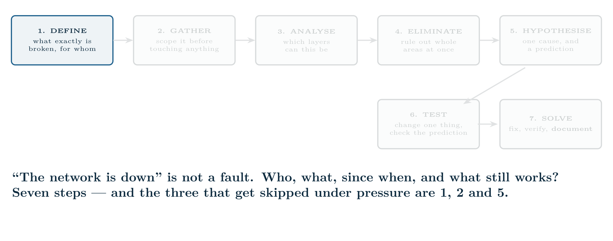
The cycle
CCNA 200-301 v2.0 · Chapter 33. A Troubleshooting Method for the 28 Per Cent
2.4
Notes:
The loop is between 5 and 6, and it is the point. A hypothesis that does not predict correctly is discarded, not patched.

Slide 10
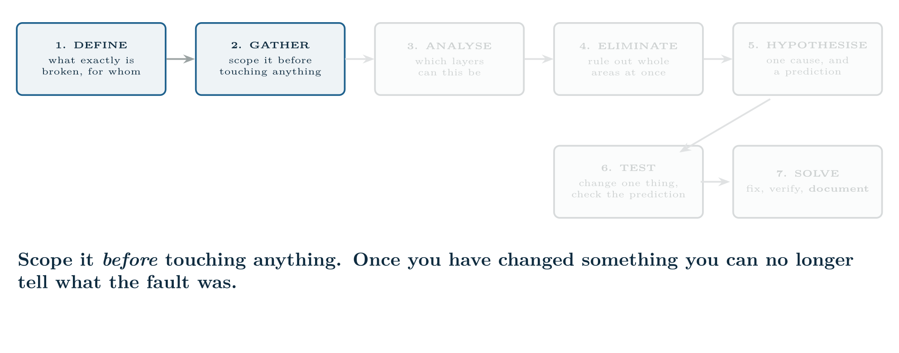
The cycle
CCNA 200-301 v2.0 · Chapter 33. A Troubleshooting Method for the 28 Per Cent
2.4

Slide 11
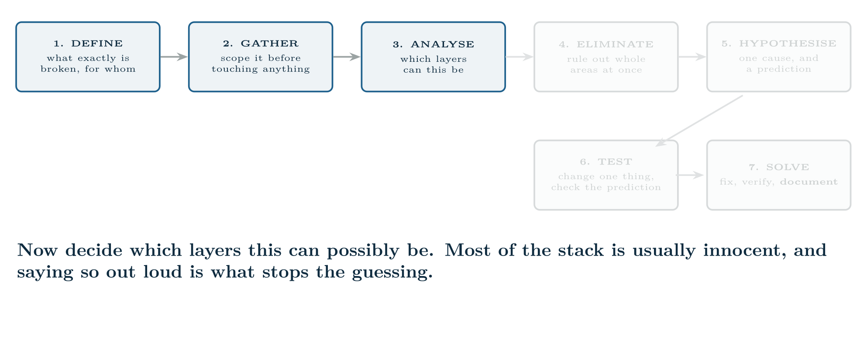
The cycle
CCNA 200-301 v2.0 · Chapter 33. A Troubleshooting Method for the 28 Per Cent
2.4

Slide 12
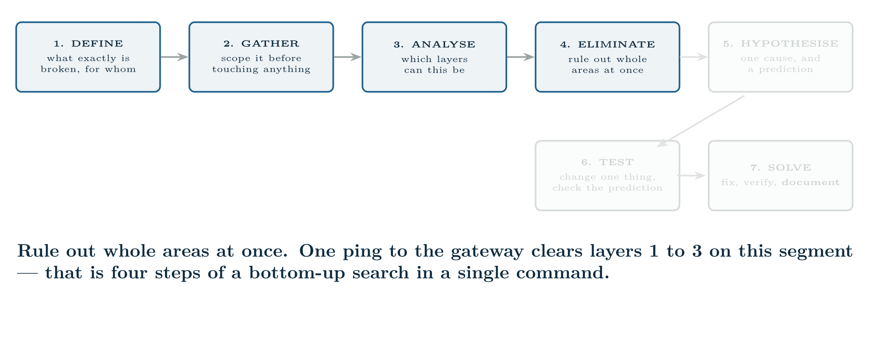
The cycle
CCNA 200-301 v2.0 · Chapter 33. A Troubleshooting Method for the 28 Per Cent
2.4

Slide 13
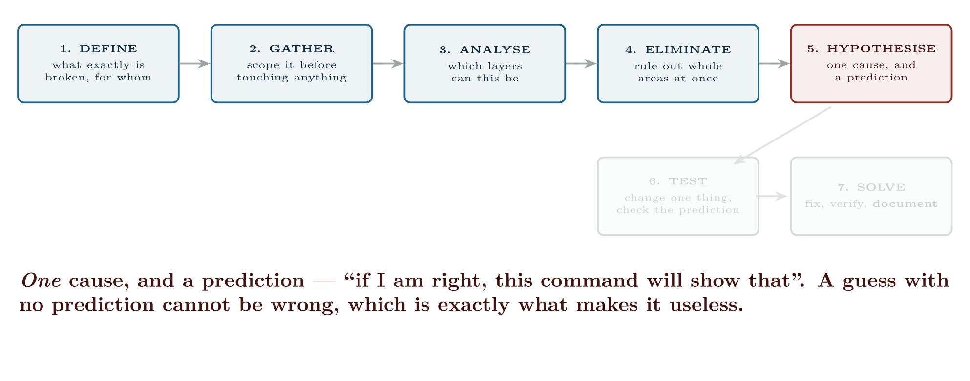
The cycle
CCNA 200-301 v2.0 · Chapter 33. A Troubleshooting Method for the 28 Per Cent
2.4

Slide 14
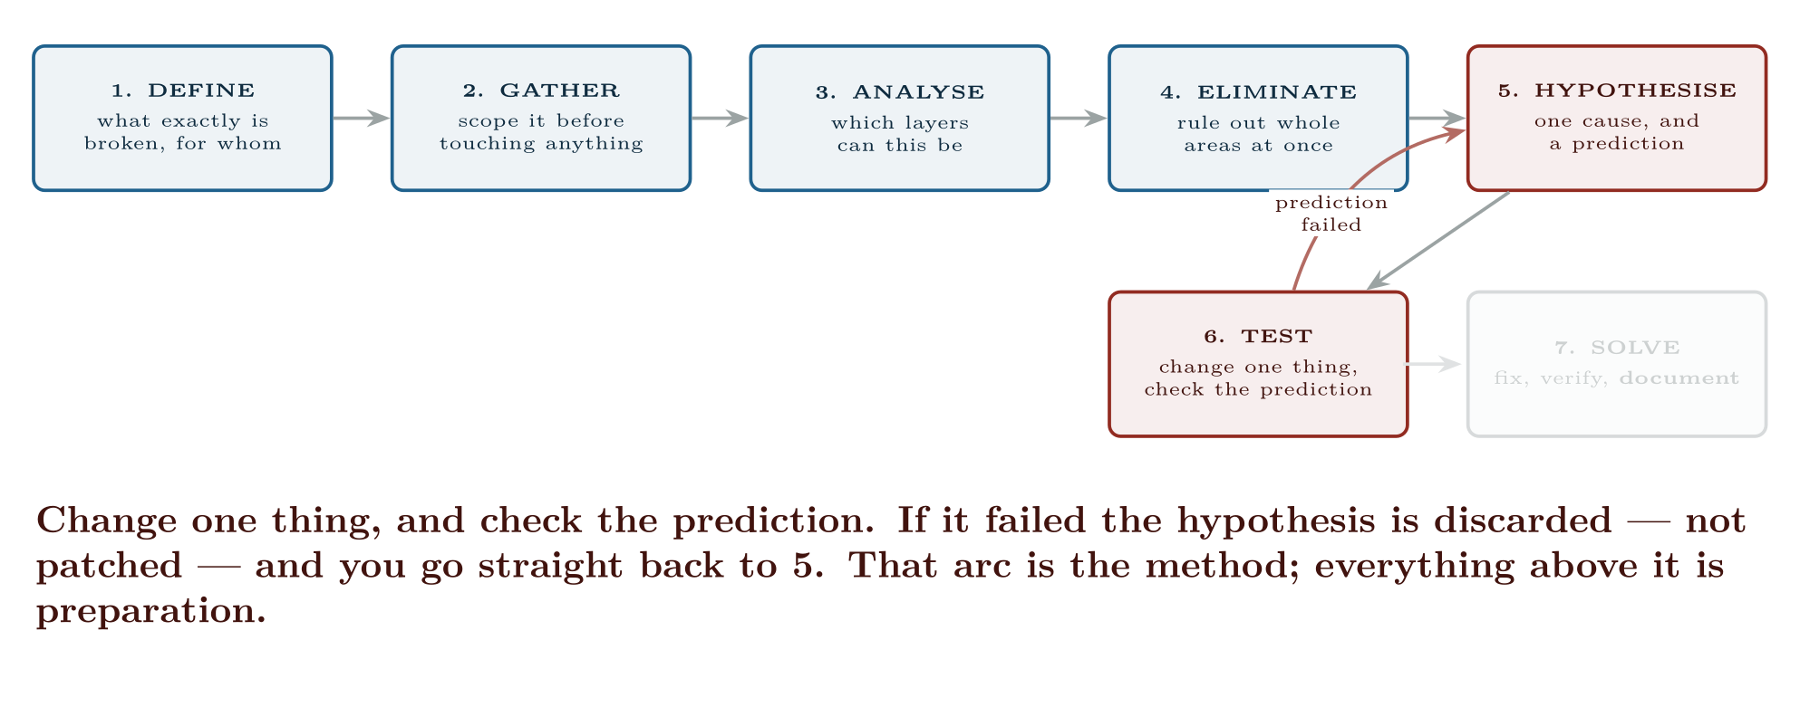
The cycle
CCNA 200-301 v2.0 · Chapter 33. A Troubleshooting Method for the 28 Per Cent
2.4

Slide 15
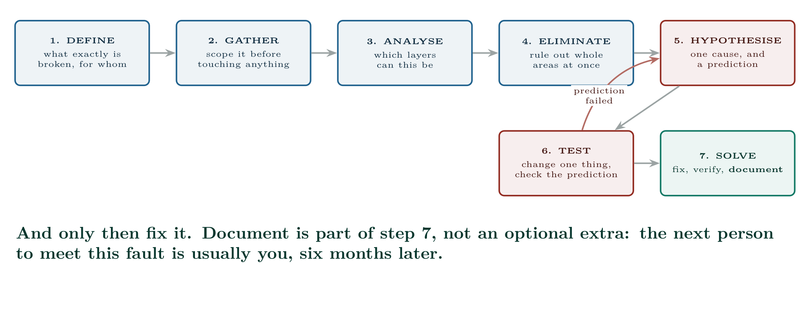
The cycle
CCNA 200-301 v2.0 · Chapter 33. A Troubleshooting Method for the 28 Per Cent
2.4

Slide 16
CONCEPT
Step 5 is where amateurs and professionals separate
“I think it is the trunk allowed list” is not a hypothesis. “I think VLAN 30 is missing from the allowed list on the uplink, in which case show interfaces trunk will not list it, and VLANs 10 and 20 will be unaffected” is one — because it can be wrong, and you will know immediately.
Say what you expect to see before you run the command. It takes three seconds and it converts every check into information whichever way it goes.
CCNA 200-301 v2.0 · Chapter 33. A Troubleshooting Method for the 28 Per Cent
2.4

Slide 17
WATCH OUT
Compare-to-working is under-used and enormously effective
Twenty-four ports configured the same way, one of them broken. Do not reason about it — show running-config interface on both and read the difference.
The same applies to a device: if three hypervisor hosts work and the fourth does not (Chapter 29), the fault is in what is not identical, and that is a much smaller search space than “what could be wrong with a hypervisor uplink”.
Whenever a working comparison exists, use it first. It converts an open-ended diagnosis into a diff.
CCNA 200-301 v2.0 · Chapter 33. A Troubleshooting Method for the 28 Per Cent
2.4

Slide 18
CONCEPT
“What changed?” is the highest-yield question in operations
A network that worked on Monday and fails on Tuesday was changed. The change may be undocumented, may have been made by someone else, may not look related, and the person who made it may sincerely believe it could not have caused this.
Ask anyway, ask broadly, and check the evidence rather than the recollection: show logging for %SYS-5-CONFIG_I messages (Chapter 30), show archive config differences, and the change record.
The answer is often “nothing”, and it is often wrong.
CCNA 200-301 v2.0 · Chapter 33. A Troubleshooting Method for the 28 Per Cent
2.4
Notes:
Four questions, asked before any command, routinely eliminate most of the possible causes.

Slide 19
WATCH OUT
The exception, and know that you are taking it
Under a major outage there is pressure to restore service first and understand later. That is a legitimate decision — but take it deliberately, say out loud that you are taking it, and capture what you can as you go. The failure is not choosing speed; it is choosing speed by accident and having no idea afterwards what you did.
CCNA 200-301 v2.0 · Chapter 33. A Troubleshooting Method for the 28 Per Cent
2.4
Notes:
Three rules. They are boring, they are what separates a twenty-minute fault from a three-hour one, and they are equally true in an exam simulation. Record before you change. Capture the current state — show running-config, the relevant show output, the exact symptom. A configuration you overwrote without reading is evidence you destroyed, and if the change makes things worse you cannot get back. Change one thing at a time. Two simultaneous changes that fix the fault leave you not knowing which one did, and one of them may have introduced tomorrow’s problem. Undo what did not help. An accumulation of speculative changes is how a network becomes undiagnosable. If your prediction was wrong, put it back before trying the next idea.

Slide 20
Handing it over
CCNA 200-301 v2.0 · Chapter 33. A Troubleshooting Method for the 28 Per Cent
2.4

Slide 21
COMMON PITFALLS · Handing it over
Common pitfalls
• Starting to type before scoping. Four questions first.
• Checking what broke last time. Familiarity is not evidence.
• No prediction before a change. You learn nothing from the result.
• Two changes at once. Now you do not know which worked.
• Leaving failed changes in place. They become the next fault.
• Fixing the first fault found and declaring victory without re-testing the original symptom.
• Ignoring an available working comparison.
CCNA 200-301 v2.0 · Chapter 33. A Troubleshooting Method for the 28 Per Cent
2.4
Notes:
Where to go in this volume, given what the user actually said. Faults outlive shifts. A handover that says “still looking at the VLAN issue” wastes the next person’s first hour. The symptom, precisely, and who is affected. What has been ruled out, and the evidence that ruled it out. This is the most valuable part and the most often omitted. What has been changed, including anything not yet undone. The current hypothesis and the next test.

Slide 22
COMMON PITFALLS · Handing it over
Common pitfalls (continued)
• Believing “nothing changed”. Check the logs.
• Not writing it down. You will meet this fault again.
CCNA 200-301 v2.0 · Chapter 33. A Troubleshooting Method for the 28 Per Cent
2.4

Slide 23
BREAK & FIX · SYMPTOM
Chapter 33
Two faults at once, and fixing the first one changes nothing.
Users on the second floor report that the file server is unreachable. You find that the uplink from SW2 has VLAN 20 missing from its trunk allowed list, which would certainly do it. You add it, confirm show interfaces trunk now lists VLAN 20 — and the users report no improvement at all.
The instinct is to assume the fix did not take, and to re-check the trunk. Resist it: you verified it, and it is correct. A correct fix that does not resolve the symptom means your hypothesis explained a real fault, but not this one.
Go back to scoping, which is where the answer was all along.
CCNA 200-301 v2.0 · Chapter 33. A Troubleshooting Method for the 28 Per Cent
2.4

Slide 24
BREAK & FIX · YOUR MOVE
Chapter 33
Two faults at once, and fixing the first one changes nothing.
What would you check first — and what do you expect to see?
CCNA 200-301 v2.0 · Chapter 33. A Troubleshooting Method for the 28 Per Cent
2.4
Notes:
Pause here. Take two or three answers before advancing. The point is the prediction, not the command.

Slide 25
BREAK & FIX · EVIDENCE
Chapter 33
show ip route 10.20.0.0
R1#
% Network not in table
CCNA 200-301 v2.0 · Chapter 33. A Troubleshooting Method for the 28 Per Cent
2.4
Notes:
Read it aloud. Ask what single field decides the answer.

Slide 26
BREAK & FIX · YOUR MOVE
Chapter 33
What is the fault — and what does this output rule out?
CCNA 200-301 v2.0 · Chapter 33. A Troubleshooting Method for the 28 Per Cent
2.4
Notes:
The elimination matters as much as the answer.

Slide 27
BREAK & FIX · DIAGNOSIS
Chapter 33
Why it is doing that
Diagnosis. The server’s subnet is not in the routing table. Its route was lost overnight — and that is why nobody can reach it, from any floor.
The missing VLAN on SW2’s trunk was a second, genuine, unrelated fault. It had been there for weeks without being noticed, because nothing in VLAN 20 on the second floor had needed the uplink until the server was investigated. Finding it was useful. Believing it was the cause was the error.
CCNA 200-301 v2.0 · Chapter 33. A Troubleshooting Method for the 28 Per Cent
2.4

Slide 28
BREAK & FIX · THE FIX
Chapter 33
And the lesson
The lesson, and it is the one this chapter exists for. Two things went wrong here, and only one of them was reported:
CCNA 200-301 v2.0 · Chapter 33. A Troubleshooting Method for the 28 Per Cent
2.4

Slide 29
LAB · PACKET TRACER OR CML, IN PAIRS
Faults you did not create
Platform note. The value here is entirely in not knowing the fault, so this lab must be done in pairs or by exchanging saved files. Working alone on a fault you injected yourself teaches nothing.
Topology. Any multi-VLAN, multi-router topology from Parts II and III that both of you have working.
1. Each of you takes a working copy and injects three faults from different layers — one physical or layer 2, one layer 3, one a service (DHCP, DNS, NAT or an ACL). Record them privately. At least one should be silent, producing no log message.
2. Exchange files. Before running a single command, write down your scoping questions and what each possible answer would eliminate.
3. Diagnose. For every check, write the prediction before you run it, and whether it held. Keep this record — it is the deliverable.
4. Fix one fault at a time and re-test the original symptom after each. Note any case where a correct fix did not change the symptom, and what you concluded.
CCNA 200-301 v2.0 · Chapter 33. A Troubleshooting Method for the 28 Per Cent
2.4

Slide 30
LAB · PACKET TRACER OR CML, IN PAIRS
Faults you did not create (continued)
5. Time yourself. Compare against your partner on the same set of faults.
6. Write the handover you would give if you ran out of time halfway.
7. Round 2. Inject three more, but this time include two faults on the same path so that fixing one changes nothing. This is the Break & Fix above, and it is the most valuable version of this exercise.
8. Round 3. Inject one fault into one of twenty-four identically configured ports. Time how long it takes with reasoning versus with a configuration diff.
9. Extension. Build a one-page fault-finding card for your own use: the four scoping questions, the five methods, and the symptom index trimmed to what you personally forget.
CCNA 200-301 v2.0 · Chapter 33. A Troubleshooting Method for the 28 Per Cent
2.4

Slide 31
CHECKPOINT 1 of 6
Give the seven steps of the cycle and say which two form a loop.
Discuss · then advance
Notes:
Ask the room. Do not advance until somebody commits to an answer.

Slide 32
ANSWER
Checkpoint 1 of 6
Give the seven steps of the cycle and say which two form a loop.
Define, gather, analyse, eliminate, hypothesise, test, solve. Steps 5 and 6 form the loop — a hypothesis whose prediction fails is discarded and replaced, not patched.
CCNA 200-301 v2.0 · Chapter 33. A Troubleshooting Method for the 28 Per Cent
2.4

Slide 33
CHECKPOINT 2 of 6
Name the five structured methods and give the symptom that selects each.
Discuss · then advance
Notes:
Ask the room. Do not advance until somebody commits to an answer.

Slide 34
ANSWER
Checkpoint 2 of 6
Name the five structured methods and give the symptom that selects each.
Bottom-up for a suspected physical or hardware fault, or when nothing works. Top-down when one application fails and everything else is fine. Divide and conquer as the default when you have no strong prior. Follow the path when two specific points cannot reach each other. Compare working to broken whenever an identical working case exists.
CCNA 200-301 v2.0 · Chapter 33. A Troubleshooting Method for the 28 Per Cent
2.4

Slide 35
CHECKPOINT 3 of 6
What are the four scoping questions, and what does each eliminate?
Discuss · then advance
Notes:
Ask the room. Do not advance until somebody commits to an answer.

Slide 36
ANSWER
Checkpoint 3 of 6
What are the four scoping questions, and what does each eliminate?
One user or many? — sets the whole search space. Has it ever worked? — separates a build fault from a change fault. What changed? — finds the cause of most faults in previously working networks. Does it fail by name but work by address? — answers “is this DNS” in one test.
CCNA 200-301 v2.0 · Chapter 33. A Troubleshooting Method for the 28 Per Cent
2.4

Slide 37
CHECKPOINT 4 of 6
Why must you state a prediction before making a change?
Discuss · then advance
Notes:
Ask the room. Do not advance until somebody commits to an answer.

Slide 38
ANSWER
Checkpoint 4 of 6
Why must you state a prediction before making a change?
Because it converts a check into information whichever way it goes. Without a prediction, a fix that does not resolve the symptom reads as “the fix did not work” rather than “the hypothesis was wrong”, and you re-check something already correct.
CCNA 200-301 v2.0 · Chapter 33. A Troubleshooting Method for the 28 Per Cent
2.4

Slide 39
CHECKPOINT 5 of 6
A correct fix does not resolve the reported symptom. What does this tell you, and what should you do next?
Discuss · then advance
Notes:
Ask the room. Do not advance until somebody commits to an answer.

Slide 40
ANSWER
Checkpoint 5 of 6
A correct fix does not resolve the reported symptom. What does this tell you, and what should you do next?
Either the hypothesis was wrong, or there is more than one fault. Go back to scoping rather than re-checking the thing you just verified — and keep the fix if it corrected a genuine defect, but record it separately.
CCNA 200-301 v2.0 · Chapter 33. A Troubleshooting Method for the 28 Per Cent
2.4

Slide 41
CHECKPOINT 6 of 6
What are the four things a handover must contain?
Discuss · then advance
Notes:
Ask the room. Do not advance until somebody commits to an answer.

Slide 42
ANSWER
Checkpoint 6 of 6
What are the four things a handover must contain?
The precise symptom and who is affected; what has been ruled out and the evidence for it; what has been changed, including anything not yet undone; and the current hypothesis with the next test.
CCNA 200-301 v2.0 · Chapter 33. A Troubleshooting Method for the 28 Per Cent
2.4

Slide 43
CHAPTER SUMMARY
What to take away
• Define, gather, analyse, eliminate, hypothesise, test, solve — and loop between hypothesis and test until the prediction holds.
• A hypothesis must predict something that could be wrong. State it before you run the command.
• Five methods: bottom-up for physical, top-down for one application, divide and conquer as the default, follow the path between two points, and compare-to-working whenever an identical working case exists.
• Scope first: one user or many, has it ever worked, what changed, does it fail by name but work by address.
CCNA 200-301 v2.0 · Chapter 33. A Troubleshooting Method for the 28 Per Cent
2.4

Slide 44
CHAPTER SUMMARY
What to take away (continued)
• “What changed” is the highest-yield question, and “nothing” is often wrong. Check show logging and the archive diff.
• Record before changing, change one thing, undo what did not help.
• A correct fix that does not resolve the symptom means the hypothesis was wrong — or that there is more than one fault.
• A handover states the symptom, what has been ruled out and how, what was changed, and the next test.
CCNA 200-301 v2.0 · Chapter 33. A Troubleshooting Method for the 28 Per Cent
2.4

Slide 45
Where we got to
• Define, gather, analyse, eliminate, hypothesise, test, solve — and loop between hypothesis and test until the prediction holds.
• A hypothesis must predict something that could be wrong. State it before you run the command.
• Five methods: bottom-up for physical, top-down for one application, divide and conquer as the default, follow the path between two points, and compare-to-working whenever an identical working case exists.
• Scope first: one user or many, has it ever worked, what changed, does it fail by name but work by address.
NEXT
Chapter 34 — Exam Strategy

