Slide 1
SC4063 PART 2
DELIVERABLE 3
• • •
Agent Demo & Presentation — Network Forensic AI Pipeline

Slide 2
INTRODUCTION
Problem — manual PCAP forensic analysis does not scale to long-running captures
Solution — agent-based, multi-stage pipeline that automates PCAP analysis end-to-end
11-phase pipeline: ingestion → extraction → AI reasoning → correlation → reporting
Integrates protocol analyzers (DNS, HTTP, TLS, beaconing, IOC) with a local LLM
Output: structured findings, MITRE ATT&CK mapping and campaign-level insights

Slide 3
1.
AGENT ARCHITECTURE

Slide 4
HIGH-LEVEL ARCHITECTURE
LAYER 1 · Web Interface
Flask · SSE · HTML/CSS/JS
▼
LAYER 2 · Ingestion (P1–4)
Python · capinfos · SQLite
▼
LAYER 3 · Extraction (P5)
tshark · Python multiprocessing (4 workers)
▼
LAYER 4 · AI Reasoning (P6–10)
Ollama · Llama 3.1 · JSON Schema · MITRE ATT&CK
▼
LAYER 5 · Correlation & Report
Mermaid · Markdown · JSON

Slide 5
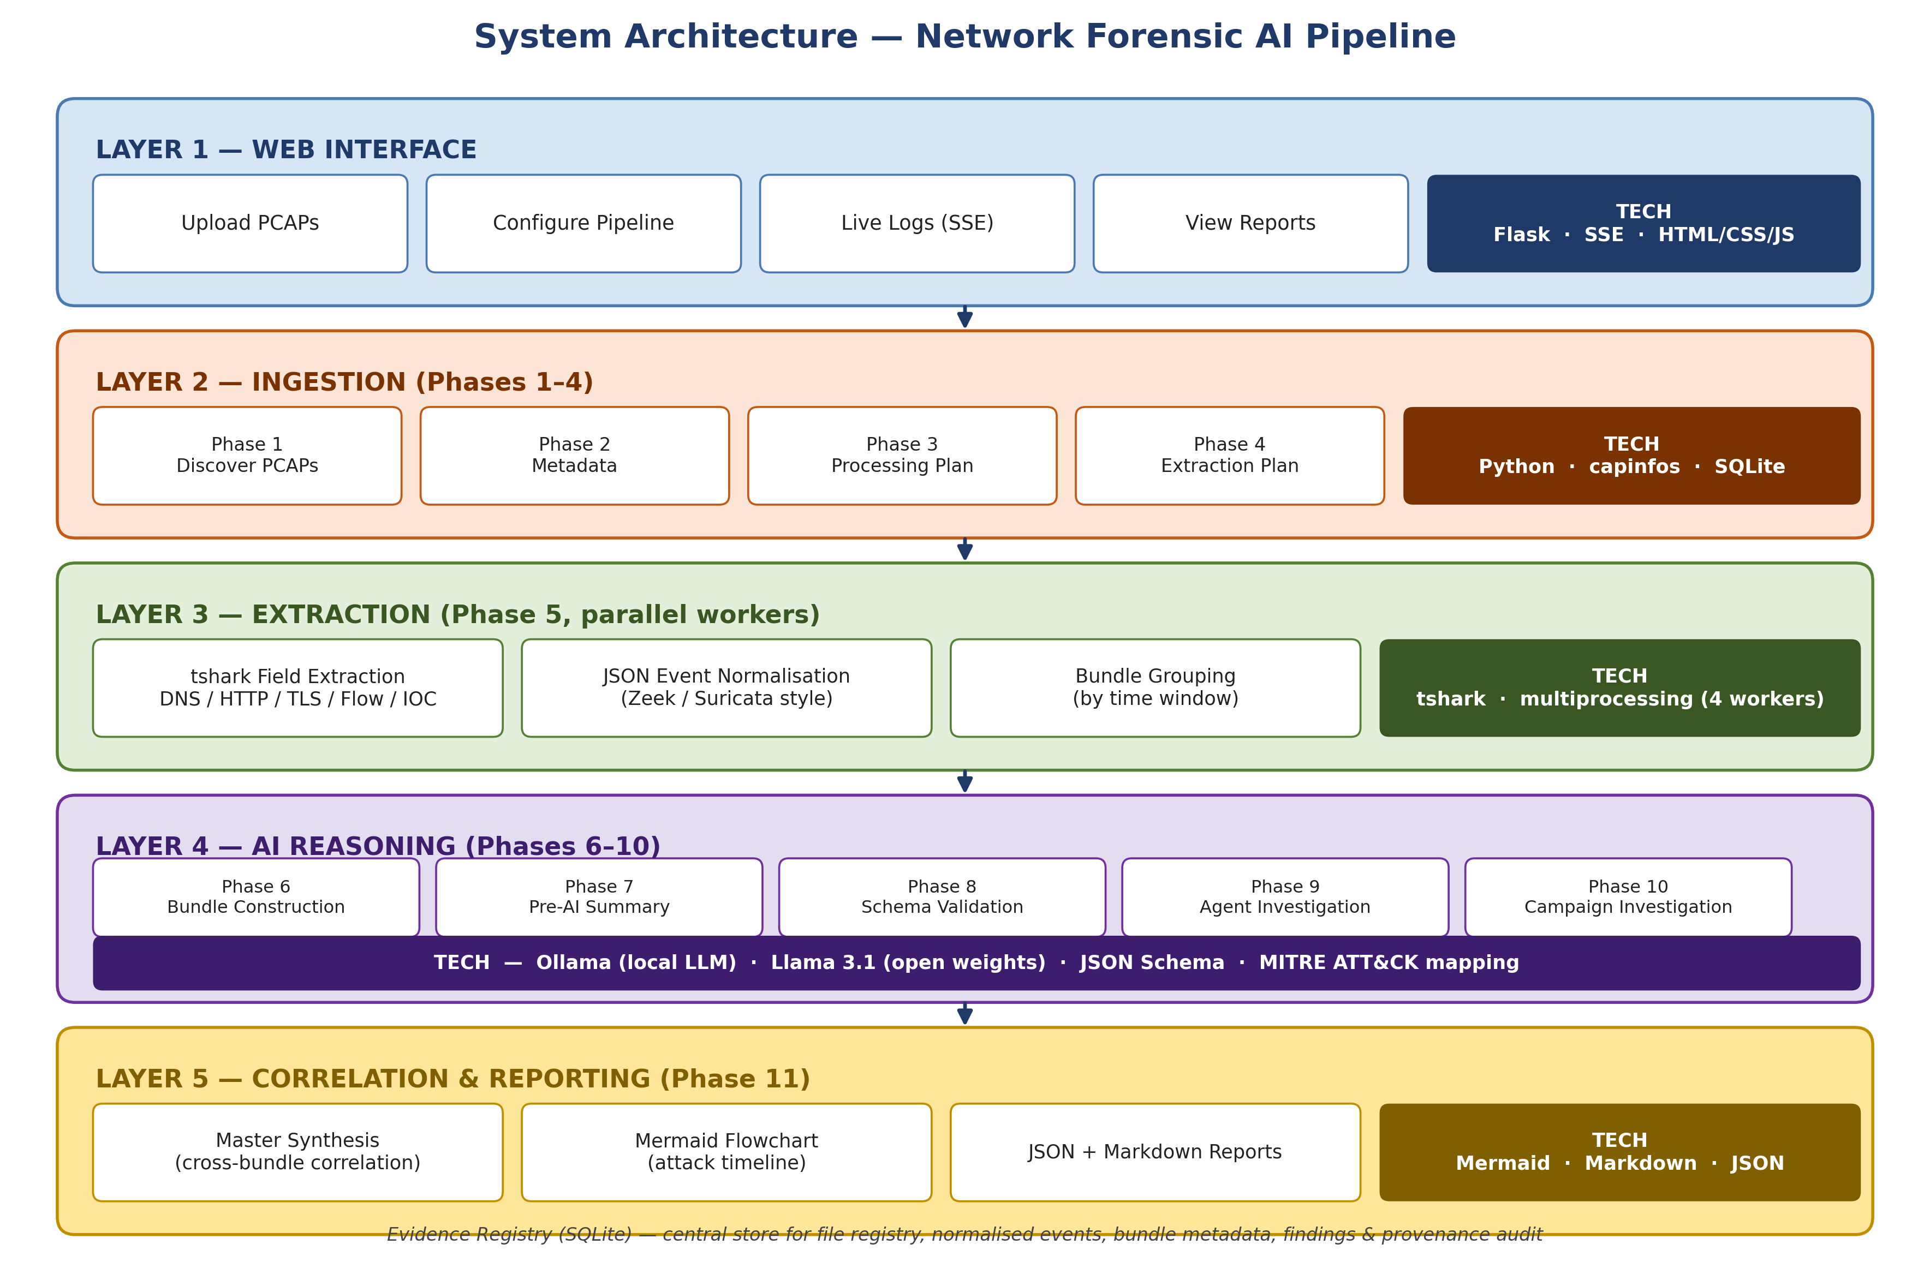
DETAILED COMPONENTS & DATA FLOW
Tech stack labelled per layer · Evidence Registry (SQLite) is the central audit store

Slide 6
TOOLS AVAILABLE TO THE AGENT
DNS Analyzer
Flags DGA-like domains, long / rare TLDs, NXDOMAIN bursts
HTTP Analyzer
Inspects headers, suspicious User-Agents, abnormal verbs / paths
TLS Analyzer
Missing SNI, self-signed certs, JA3 fingerprints
Beaconing Detector
Periodic callback intervals (C2 patterns)
IOC / Threat Intel
Known-bad IPs and domains enrichment
Ollama + Llama 3.1
Local LLM — narrative synthesis & MITRE mapping

Slide 7
DECISION-MAKING LOGIC
Summary
›
DNS / HTTP / TLS
›
IOC
›
MITRE Mapping
›
Findings
Fixed investigation order — prevents the LLM from choosing unsafe or unvalidated actions
Agent dynamically selects analyzers based on extracted evidence
Results from one module guide the next investigation step
Correlation engine links related events across protocols and time
Hypothesis engine generates and ranks possible attack scenarios

Slide 8
2.
DEMONSTRATION

Slide 9
DEMO DATASET — LATEST RUN
Metric | Value
PCAP files processed | 119
Total network events | 4,898
Bundles formed | 52
Date range | Dec 3, 2025 – Jan 29, 2026
Run timestamp | 2026-04-16
Single end-to-end run analysed nearly 5,000 events across 119 PCAPs spanning ~2 months

Slide 10
DEMO FLOW — 7 STEPS
# | Action | What Happens
1 | Upload PCAPs | Drag & drop → stored to input_pcaps/
2 | Configure pipeline | Phase selector, worker count, agentic toggle → POST /api/pipeline/start
3 | Watch live logs | SSE EventSource streams ring buffer + live phase output
4 | Phase 5 extracts evidence | tshark runs in parallel (4 workers); JSON events written to SQLite
5 | Phases 6–9 reason over bundles | Llama 3.1 (Ollama) maps findings to MITRE ATT&CK
6 | Phase 11 synthesises master report | Aggregates 52 bundles → 83 findings; generates Mermaid flowchart
7 | Browse results in web UI | Per-bundle findings + master report + interactive flowchart

Slide 11
GENERATED OUTPUTS
83
10
11
5
Findings
Campaign findings
Flagged for review
MITRE techniques
53 HIGH · 30 MEDIUM
cross-bundle correlation
human-in-the-loop
T1133 · T1078 · T1021 · T1071 · T1573
TOP ATTACKER
88.214.25.115 → 10.128.239.57:3389 (RDP brute-force, persistent)
Finding types: External Sensitive Access · Suspicious TLS Session · Potential Data Exfiltration · Suspicious DNS · Known Bad IP

Slide 12
3.
KEY CHALLENGES

Slide 13
TECHNICAL CHALLENGES
Large PCAP processing is slow and resource-heavy
Correlation across multiple extractor outputs is hard (time, host, protocol, port)
Uses normalised Zeek/Suricata-style events but relies on fixed external tools (capinfos, tshark)
Phase 5 (tshark extraction) dominates runtime at 99.8% — the bottleneck is extraction, not AI reasoning

Slide 14
FALSE POSITIVES / MISSED DETECTIONS
Legitimate traffic (CDNs, software updates, public APIs) may appear suspicious
Stealthy attacks (low-and-slow, encrypted C2) can evade behavioural detection
TLS encryption hides payloads — analysis is limited to metadata (SNI, certs, JA3 fingerprints)
Normal admin tools (RDP, SSH) overlap with attacker tradecraft and trigger flags

Slide 15
TOOL LIMITATIONS
Extractors provide raw evidence, not conclusions
Solid conclusions require correlating multiple analyzers (DNS + TLS + Beaconing + IOC)
Detection accuracy depends on PCAP quality — missing or partial captures reduce coverage
Local LLM (Llama 3.1) has limited context window — bundles must stay within a time budget

Slide 16
SCALING / PERFORMANCE ISSUES
Large PCAPs increase processing time and storage requirements
Sequential pipeline phases add latency; only Phase 5 currently parallelises
Deeper analysis (more analyzers per bundle) increases compute cost
Trade-off triangle: speed vs coverage vs confidence
Mitigated via 4 parallel workers in Phase 5 → 6.4× speedup (see Cost section)

Slide 17
4.
GUARDRAILS & SAFETY CONTROLS

Slide 18
FOUR-LAYER SAFETY STACK
1
Hallucination prevention
Evidence-driven reasoning · no raw PCAP access · structured data only
2
Agent constraints
Fixed workflow · AgentInterface API only · no DB queries or shell exec
3
Validation
Multi-factor scoring · cross-signal correlation · minimum evidence threshold
4
Human-in-the-loop
High-risk / low-confidence findings → analyst review queue

Slide 19
CAN WE TRUST AI FINDINGS?
AGENT FINDING
RAW PCAP EVENTS
Finding: Suspicious TLS Session
Evidence: 10.128.239.57 → 88.214.25.115:34985
Confidence: 0.73 (MEDIUM)
MITRE: T1573, T1071
tls event
src: 10.128.239.57
dst: 88.214.25.115
dst_port: 34985
sni: (null)
flow event
10.128.239.57:3389 →
88.214.25.115:34985
Does it match?
→
Every claim must be independently verified against indexed raw PCAP data

Slide 20
VALIDATION METHODOLOGY
1
2
3
Index Raw Events
Check Each Evidence Item
Record Pass / Fail
Parse each bundle's ai_handoff_bundles JSON. Build lookup sets: DNS domains, TLS (src,dst,port) tuples, flow pairs, all IPs.
For every evidence item in every finding, run source-specific checks (DNS, TLS, beaconing) against the index.
Each item is marked Grounded or Ungrounded. Failures log the exact reason for audit purposes.

Slide 21
VALIDATION RESULTS — ZERO HALLUCINATIONS
52
34
361
100%
Total Bundles
Processed
Bundles with
Findings
Evidence Items
Checked
Grounding
Rate
Outcome | Count | Detail
Bundles PASS — all evidence grounded | 34 / 34 | All passing
Bundles FAIL — any ungrounded evidence | 0 / 34 | None
Evidence items grounded | 361 / 361 | 100.0 %
Evidence items ungrounded (hallucinated) | 0 / 361 | 0 %

Slide 22
HUMAN-IN-THE-LOOP
11 of 83 findings auto-flagged for analyst review
Reports include: confidence level, evidence items, FP/FN risk, limitations
Agent = decision support, not replacement for the analyst
Conservative defaults: low-confidence findings are downgraded, never auto-actioned
11
findings flagged
for human review
from 83 total — 13.3 %

Slide 23
5.
COST & EFFICIENCY

Slide 24
BUILD COST — $0
Component | Cost
Python · Flask · tshark · SQLite | $0 — open source
Ollama (local LLM runtime) | $0 — runs offline
Llama 3.1 model weights | $0 — open weights, downloaded once
Cloud APIs (OpenAI, Anthropic, …) | $0 — not used
TOTAL BUILD COST | $0
No vendor lock-in, zero recurring cost, runs fully offline

Slide 25
RUNNING COST — BASELINE vs OPTIMISED
Metric | Baseline (1 worker) | Optimised (4 workers) | Improvement
Runtime | 10.06 hrs | 1.57 hrs | 6.4× faster
Total elapsed | 36,216 s | 5,645 s | −84 %
Phase 5 workers | 1 | 4 | 4× parallel
Findings produced | 46 | 83 | +80 %
Est. compute cost* | ~$0.50 | ~$0.078 | 84 % cheaper
* Estimated at $0.05/hr for local compute (electricity + machine amortisation)

Slide 26
WHERE DOES THE TIME GO?
99.8 %
of total runtime
comes from Phase 5 — tshark evidence extraction.
AI reasoning (Phases 6–11) costs less than 3 seconds combined.

Slide 27
TRADE-OFFS — SPEED · ACCURACY · COST
SPEED
ACCURACY
COST
$
4 parallel workers in Phase 5 (configurable in the web UI). Scales to 8 / 16 workers on more powerful hardware.
Rule-based detection + LLM verification. 83 findings with 100 % grounding in evidence; 11 flagged for review.
Local LLM (Ollama + Llama 3.1) → zero marginal cost per run. No cloud API, no vendor lock-in.

Slide 28
CONCLUSION
EFFECTIVE
83 findings across 119 PCAPs · 5 MITRE techniques · real RDP brute-force campaign surfaced automatically
SAFE
100 % grounding rate (361 / 361 evidence items) · 11 findings flagged for human review
CHEAP
$0 build cost · 1.57-hour runtime · runs fully offline on local hardware
THANK YOU

