Slide 1
Customer Booking Prediction – Machine Learning Report
Dataset Preparation, Model Training & Evaluation
Chaudhry Mustafa Mudasser

Slide 2
Data Preparation
No missing values found in dataset
Label Encoding applied (‘sales_channel’, ‘trip_type’)
Target Encoding on ‘route’ and ‘booking_origin’
Removed entries where encoded mean = 0
Observed class imbalance → applied SMOTE + Tomek links
Performed 80/20 train-test split

Slide 3
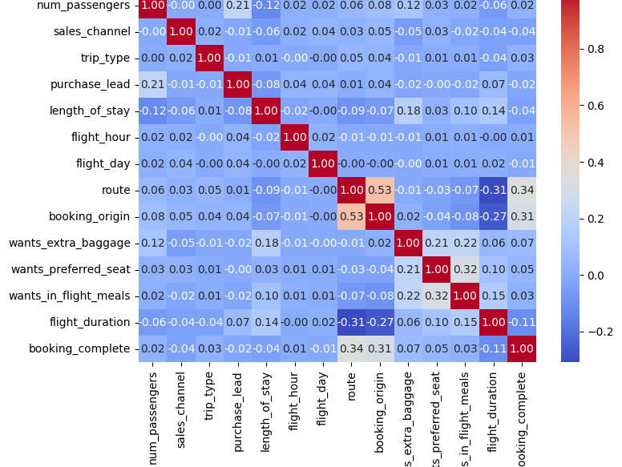
Correlation

Slide 4
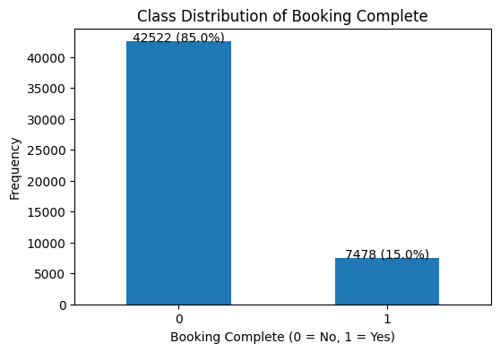
CLass Distribution

Slide 5
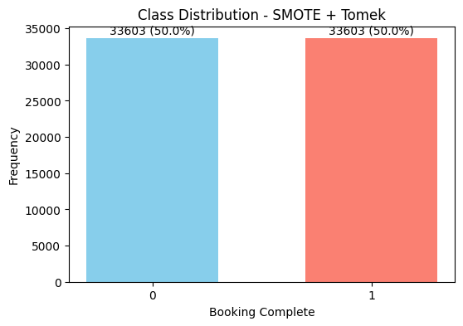
CLass distribution after Smote+Tomek

Slide 6
Model 1: Random Forest (Baseline)
6-Fold CV Results:
Accuracy: 0.8967
Precision: 0.8960
Recall: 0.8976
F1: 0.8968
ROC-AUC: 0.9647
Test (Threshold = 0.40):
Accuracy: 0.7870
Precision: 0.3601
Recall: 0.5455
F1: 0.4338
ROC-AUC: 0.7942

Slide 7
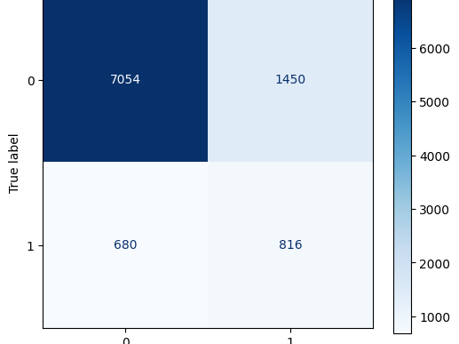
Confusion Matrix

Slide 8
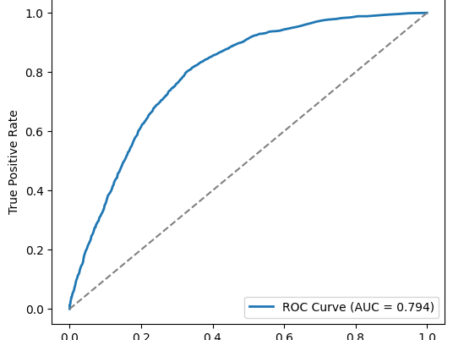
ROC curve

Slide 9
Model 2: Random Forest (Tuned Parameters)
6-Fold CV Results:
Accuracy: 0.8520
Precision: 0.8250
Recall: 0.8936
F1: 0.8579
ROC-AUC: 0.9406
Test (Threshold = 0.40):
Accuracy: 0.7405
Precision: 0.3274
Recall: 0.6965
F1: 0.4454
ROC-AUC: 0.7854

Slide 10
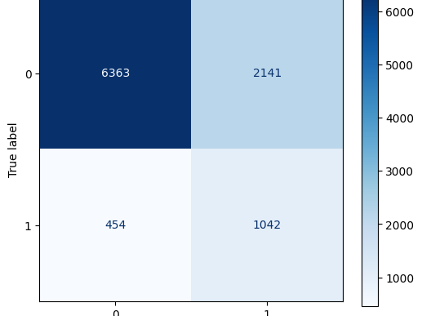
Confusion matrix

Slide 11
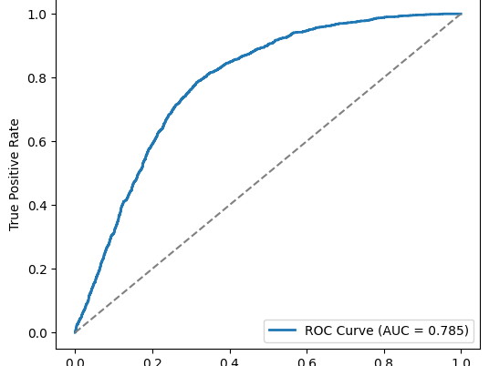
ROC curve

Slide 12
Model 3: Random Forest (RandomizedSearchCV)
Best Parameters: {n_estimators=134, max_depth=14, min_samples_leaf=8, min_samples_split=8, max_features=None}
Best Inner CV F1: 0.8696
Test (Threshold = 0.40):
Accuracy: 0.7888
Precision: 0.3550
Recall: 0.5040
F1: 0.4166
ROC-AUC: 0.7917

Slide 13
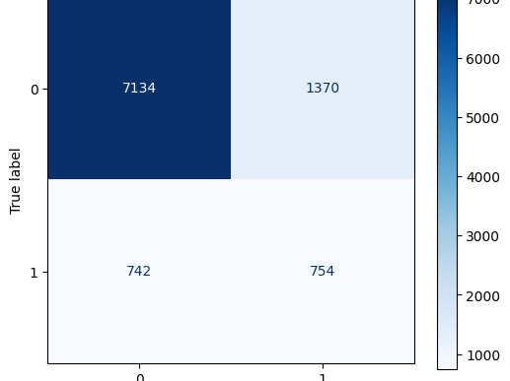
Correlation

Slide 14
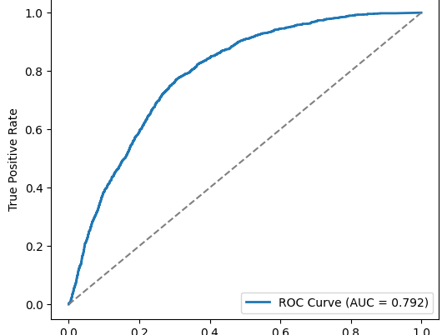
ROC Curve

Slide 15
Model 4: Random Forest (Feature Dropped)
6-Fold CV Results:
Accuracy: 0.8998
Precision: 0.9105
Recall: 0.8868
F1: 0.8985
ROC-AUC: 0.9648
Test (Threshold = 0.40):
Accuracy: 0.7953
Precision: 0.3582
Recall: 0.4652
F1: 0.4048
ROC-AUC: 0.7873

Slide 16

Confusion matrix

Slide 17
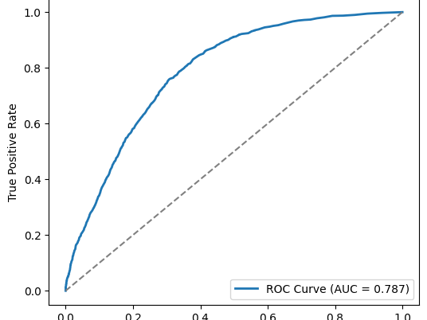
ROC Curve

Slide 18
Comparison & Selected Model
Compared across models at Threshold = 0.40
All models showed trade-offs between precision & recall
Selected Model: Random Forest (Baseline)
Reason for Threshold 0.40:
Improves recall → captures more true bookings
Keeps precision at an acceptable trade-off.
Maximizes the F1 compared to stricter thresholds.

Slide 19
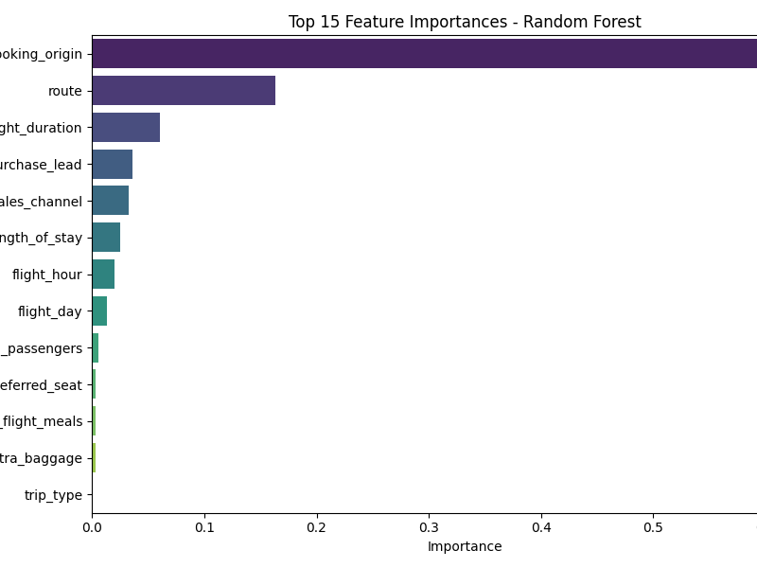
Feature Importance

Slide 20
Key Insights
Data balancing (SMOTE+Tomek) improved class fairness
Dropping weak features improved metrics
Final Model (Threshold=0.40) balances accuracy & recall
Top drivers shown in feature importance chart

