Slide 1
 | Mean +- Sigma
Vision | -0.000756 +- 0.000144236
Vision Grid | 0.004516 +- 0.000197292
Stylus | -0.00895 +- 0.00014
Vision | -0.0009 +- 0.000436807
Vision Grid | 0.004229 +- 0.000232613
Stylus | -0.00864 +- 7e-05
Vision | -0.001404 +- 0.000120681
Vision Grid | 0.003584 +- 0.000206068
Stylus | -0.00854 +- 0.000104403

Slide 2
 | Vision | Vision Grid | Stylus
Vision | 0.000144 0.000648 0.000504 | -0.005272 -0.004985 -0.00434 -0.005129 -0.004484 -0.004988 | 0.008194 0.007884 0.007784 0.00774 0.00764 0.007136
Vision Grid |  | 0.000287 0.000932 0.000645 | 0.013466 0.013156 0.013056 0.012869 0.012769 0.012124
Stylus |  |  | -0.00031 -0.00041 -0.0001

Slide 3
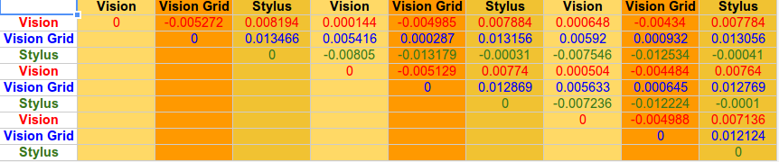

Slide 4
Vision with movement: -0.001385 +- 0.000255274

