Slide 1
PXL Simulators Statuses
Fast: StPixelFastSimMaker.
Slow: DIGMAPS or Fast version of Very Slow.
Very Slow: Xin Li's C++ version of (Shengdong Li +Howard Matis) work.

Slide 2
Fast: StPixelFastSimMaker
Smear the local x and z of hits with a guassian.
Smearing resolutions:
TDataSet *set = GetDataBase("Calibrations/tracker");
St_HitError *pixelTableSet = (St_HitError *)set->Find("PixelHitError");”
Add PileUp hits.
From: TFile f_pileup("pileup.root");
Available:
StMcPixelHit
StMcPixelHitCollection
Smeared hits are stored in: StRnDHitCollection
Work needed:
1) Move IST and FGT hits smearing out of this class.
2) StPixelHit/StPixelHitCollection instead of StRndHit* ?
3) Tune smearing resolutions and pileup later?
4) So far, not much code refactoring needed.

Slide 3
Very Slow Simulator
* Full simulation of ionization electrons diffusion in Si.
* Original work done by Shengdong Li and Howard Matis.
* Later adapted by Xin Li and re-written in C++. ~20min per track.
* Based on the full simulation, Xin Li and summer student Alex made a faster version (~2 sec per track) . At the heart has two types of lookup tables:
1) Tables for correct deposited energy in thin Si based on Bichsel straggling functions.
2) Tables for charge collection probability based on the full simulation.
The full simulator and the faster version have been shown to work well for some preliminary version of the sensor. All details (and Shengdong thesis) are available here: http://www.physics.purdue.edu/~wxie/HFT_sim/
I found an early version of the C++ code:
/star/u/lixin044/HFT/
Any final version checked in CVS?

Slide 4
Very Slow Simulator
I need the code for the Very Slow simulator for two reasons:
1) To see if we can run it again to make tables for Ultimate-2 sensor, and maybe eventually use it to study the efficiency of our final Slow Simulator and probably the smearing resolutions of the Fast Simulator.
2) A shortcut to getting the strangling functions for the deposited energy. Details later in the slides.

Slide 5
Slow Simulator and DIGMAPS
Previous slides and documentation
http://www.star.bnl.gov/protected/heavy/mstftsm/HFT/PXL_Simulators/
Beam test with 120 GeV/c pions => \beta\gamma ~860 done at CERN with Ultimate-1
DIGMAPS tuned to beam test results. Tunning parameters:
1) Charge collection PDF 12 parameters. Fixed by beam test.
2) Interdependent parameters (as I will show in the following slides):
“Effective” Epitaxial Thickness.
Deposited energy model parameters.
3) Noise level. Fixed by beam test.
4) ADC thresholds. As desired.
DIGMAPS shown to match the beam test results, a sample shown next page. More in the documentation, link above.

Slide 6
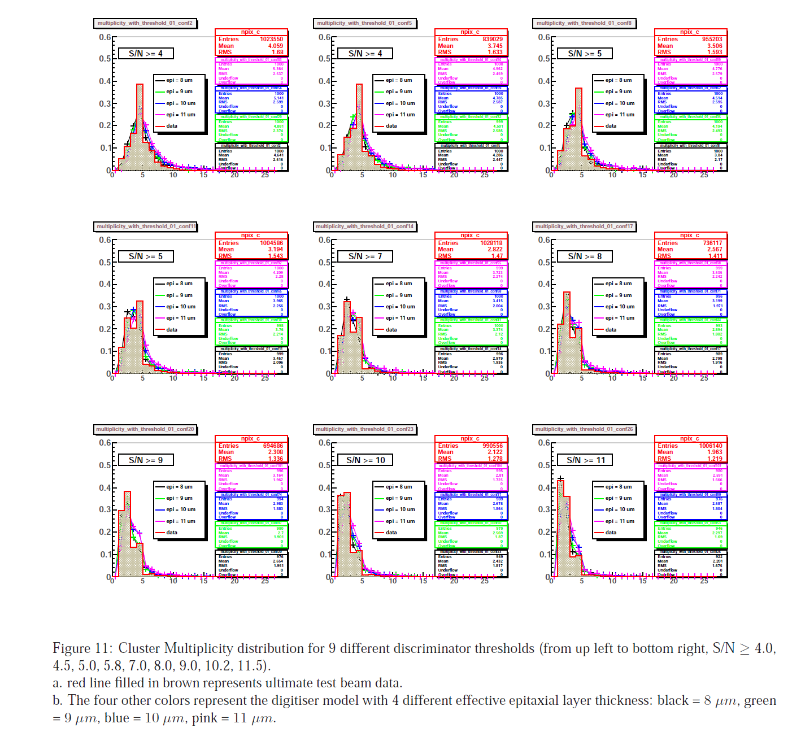

Slide 7
Slow Simulator and DIGMAPS
Visualized DIGMAPS output:
- - - - - - - - - - - - - - - - - - - - -
- - - - - - - - 0 0 0 0 - - - - - - - - - <----- shape of the cluster in the matrix after digitisation
- - - - - - - - 0 1 1 0 - - - - - - - - -
- - - - - - - - - 1 1 0 - - - - - - - - - <---- "1" pixels passing the discri threshold.
- - - - - - - - - 0 1 0 - - - - - - - - - <---- "0" pixels which collected some charge but didn't pass the ADC/discri threshold
- - - - - - - - - 0 0 - 0 - - - - - - - -
- - - - - - - - - - - - - - - - - - - - -
- - - - - - - - - - - - - - - - - - - - -
- - - - - - - - - - - - - - - - - - - - -

Slide 8
Slow Simulator and DIGMAPS
DIGMAPS can reproduce beam test data for MIPs' \beta\gamma ~860
At STAR we have protons and kaons with \beta\gamma ~ 0.1-0.2
Since DIGMAPS can simulate MIPs', it is not a problem.
However:
1) Is the cluster multiplicity important for cluster finding and resolution?
2) Is the cluster shape important for tracking different particle species?
Any “Yes” means we need to revisit the energy deposition model.

Slide 9
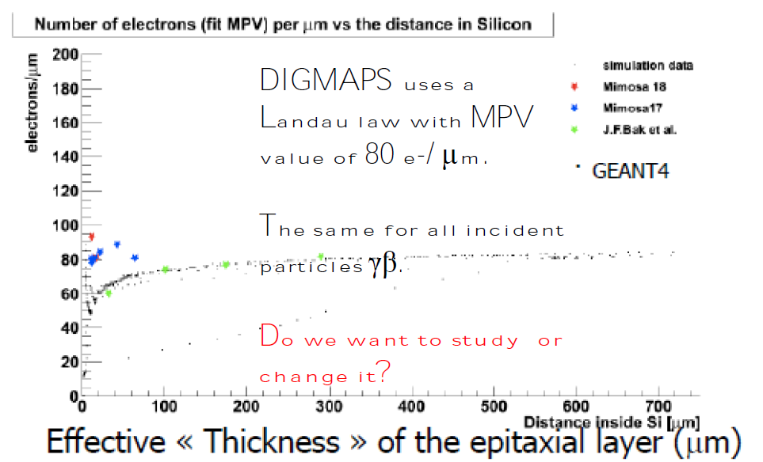
Energy deposition in thin Si
This is a well known problem, see:
Shengdong Li Howard Matis work.
Xin Li's work.
Hans Bichsel, Rev. Mod. Phys. 60, 663 (1988).

Slide 10
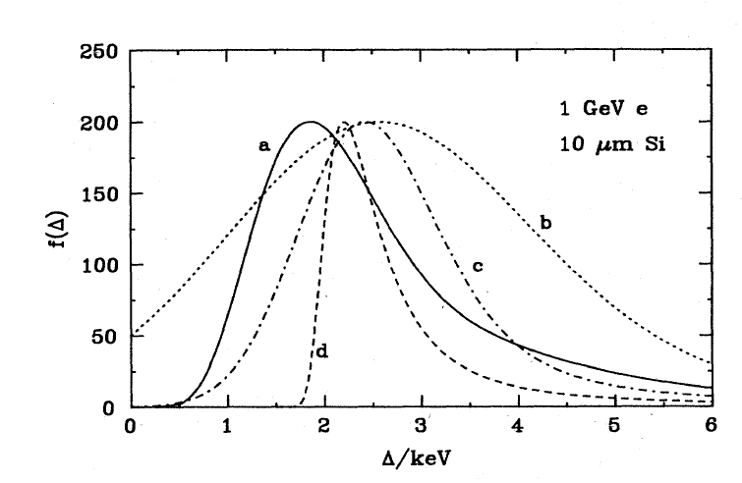
Energy deposition in thin Si
Hans Bichsel, Rev.Mod.Phys. 60, 663(1988)
Showed that Landau (similar to curve d)
does not give the correct straggling function in thin Si (solid line).
DIGMAPS approach was to change the “effective” epitaxial thickness to match data.
Epitaxial thickness = 15um
Eff. epi. thickness = 9um
Then fixed the energy deposition PDF to
Landau. It is interesting that the Landua MPV and width used in DIGMAPS are the same parameters shown by Bichsel to be wrong.
Shengdong, Howard and later Xin Li used lookup tables to get the correct straggling functions.
No closed form for real straggling function.

Slide 11
Slow simulator/DIGMAPS Summary
1) With fixed parameters and for MIP's (\beta\gamma ~860) DIGMAPS matches the beam test data.
2) Since DIGMAPS is modular (three separate components: energy deposition + charge collection + digitization) we can go ahead and plan how to implement in STAR framework and change the energy deposition later.
3) The energy deposition and \beta\gamma dependence can be studied and implemented as per Bichsel study.
4) Photons and Neutral particles? (See backup slide).

Slide 12
Thanks
Thank you for listening.
Many thanks for the Berkeley group for their invitation and for the RNC group for their kind hospitality.
Also, thanks for Xin Dong and Hao Qiu for introducing me to the PXL sensors and ladders face-to-face :-)
Happy Holidays!
– Mustafa

Slide 13
Backup

Slide 14
Simulating Photons
For high energy photons and neutral particles
No good reference to our knowledge.
possible way to deal with it:
* For high energy photons (E>1MeV) where pair production and Compton scattering dominant:
1) Use Bischsel distribution if we know the pair production vertex or the Compton scattering origin for high energy photons and the electron tracks direction (need to check it).
2) For low energy gamma-rays below 1MeV where p.e. effect dominant,
use the energy deposition from GEANT. 1MeV may be below the lower threshold of GEANT tracking. And may have negligible effect. Need to check it.
* Neglect contribution from other neutral particles since they are rare.
Except from Xin Li's slides
http://www.physics.purdue.edu/~wxie/HFT_sim/HFT_simulation_xinli.ppt

