Slide 1
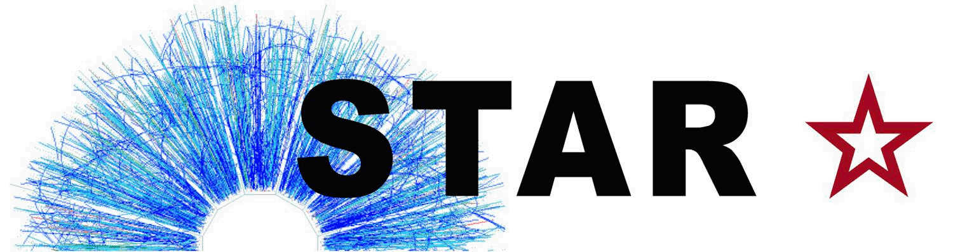


On projecting TPC tracks
on PXL real geometry
Mustafa Mustafa
LBL
XXXXXXX
2014, Dec., XX

Slide 2
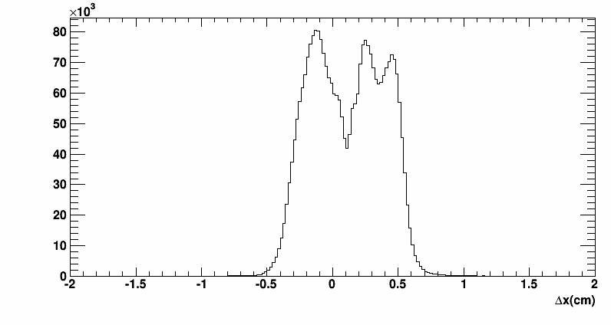
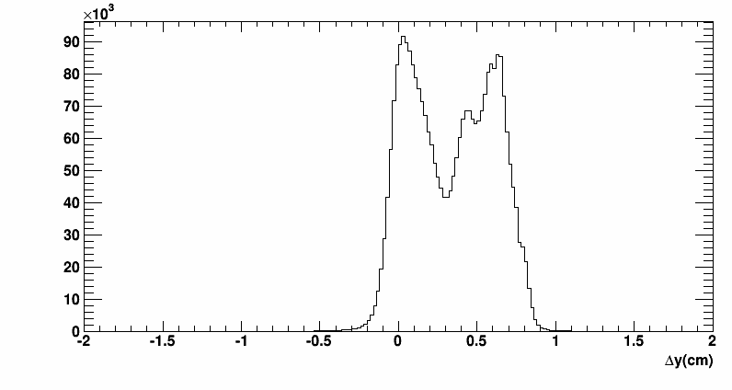
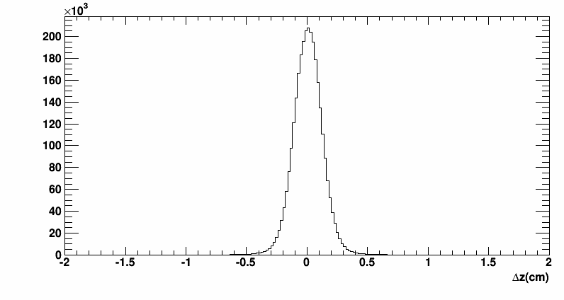
Does TpcRS introduce any systematics?
- I simply looked at (rcTpcHit-mcTpcHit) for those hits which are associated with a track (nCommon>10).
- We currently use id association.
- I ran my code over some UU K⁻ embedding production which I found on disk (request # 20142801).
- For a more accurate study I would need to look at the difference of rcTrack and mcTrack projections to some, say PXL.
- The plots below give an initial idea.
- The peaks in x and y are likely due to the finite pad size.
- I will follow up on this later.

