Slide 1
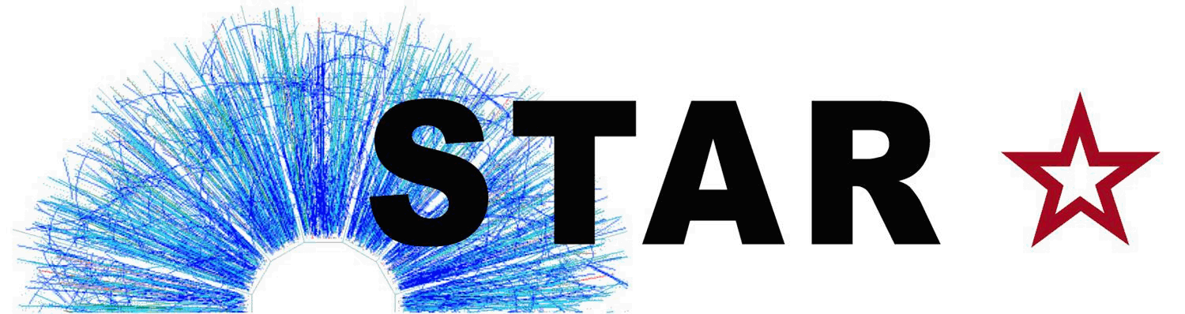

Update on DIGMAPS and StPixelFastSimMaker
Mustafa Mustafa
Purdue University

Slide 2
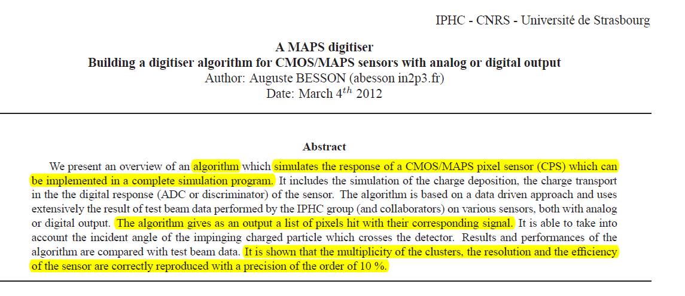
We received an “unfinished” version of DIGMAPS documentation

Slide 3
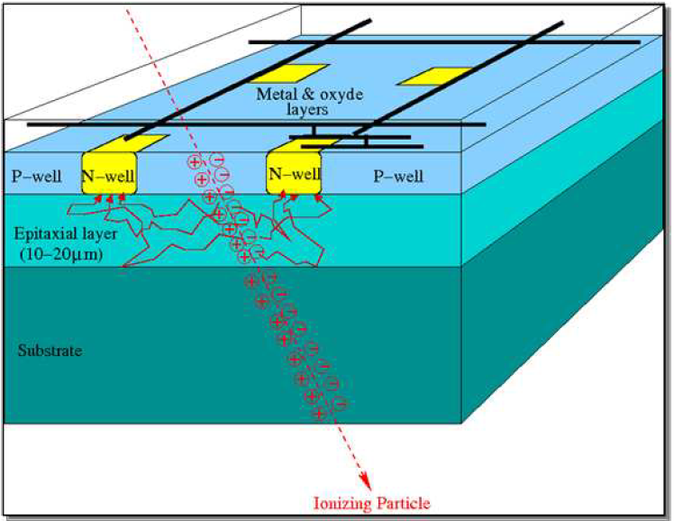
DIGMAPS strategy
Energy deposition
Deposited energy is converted into electron-hole pair (3.6 eV/e-)
Charge transport
Charge transport up to N-well charge collecting diodes through thermal diffusion
Digitisation
Digital conversion of the collected charge (Descriminator
/ADC)

Slide 4
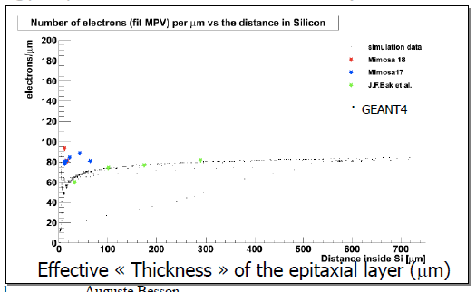
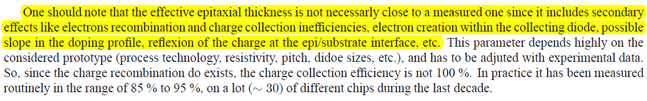
Energy deposition
DIGMAPS uses a Landau law with MPV value of 80 e-/ μm.
The same for all incident particles γβ.
Do we want to study or change it?
Auguste showed before that Geant does not compute deposited energy very well for very thin material. ULTIMATE epitaxial layer thickness is 15μm.
What is the effective epitaxial thickness for ultimate?
Is it temperature dependent?

Slide 5
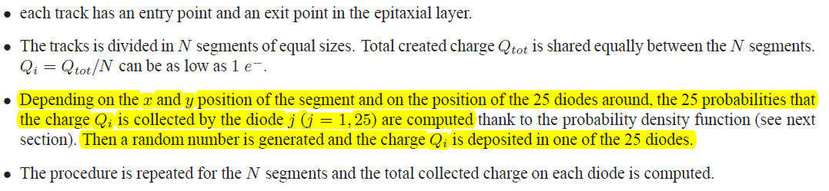
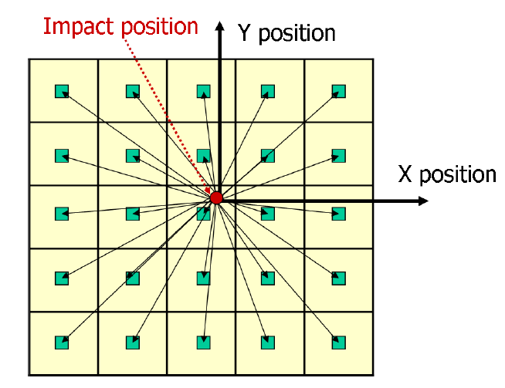
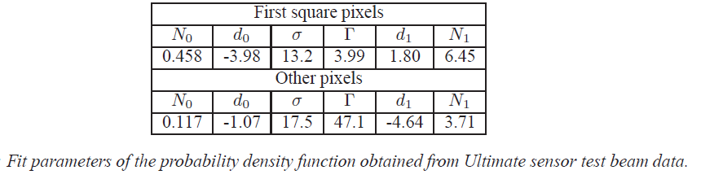
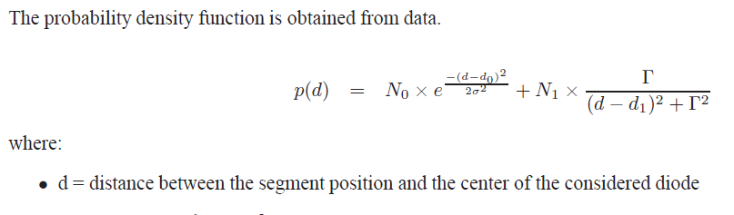
Charge Transport (DIGMAPS Core)
Parameters fitted to ULTIMATE-1 beam studies. According to Xianming these should be the same for ULTIMATE-2

Slide 6
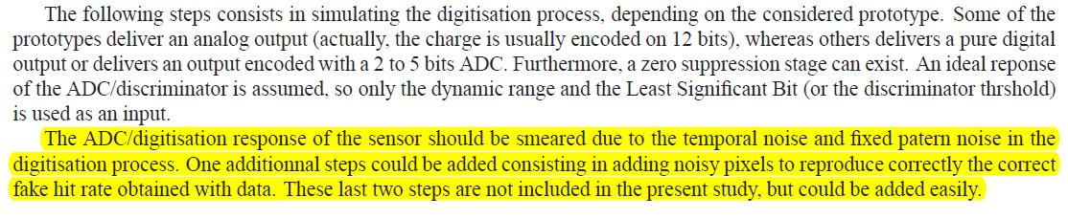
Digitisation
According to Marc Winter (IPHC)
Typical Noise performance is 12-14 e- ENC
I will need to have a closer look at the code and other documents to see how the digitisation is done for ULTIMATE-2.

Slide 7
ULTIMATE specifications input to the DIGMAPS:
xNPxl * yNPxl = 928 x 960
pitch = 20.7 μm
noise per pixel = 13.7 e-
epitaxial thickness = 12.2 μm
Diffusion range & reflexion coefficients.
Temp. 30deg. ?
According to Auguste’s comparison of DIGMAPS cluster multiplicity output to beam study data:
Are we planning to do any other studies? Or just use Auguste’s tunning of DIGMAPS?

Slide 8
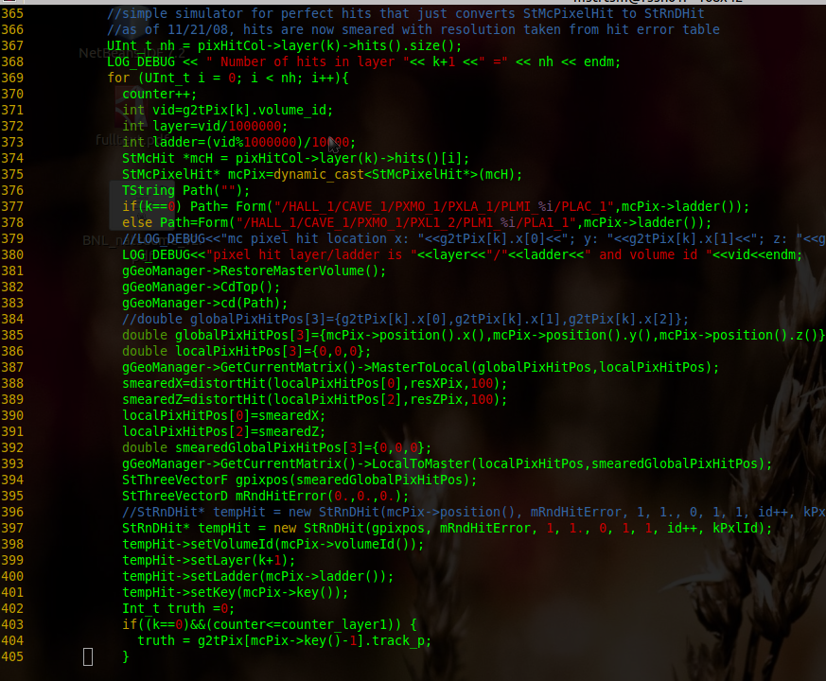
Integration with StPixelFastSimMaker
This is the core of the current version of StPixelFastSimMaker
The least invasive update will be to replace this part of the code with input from DIGMAPS.
What kind of input?
Fit function? Hash table? Do we need any DB information? Deposited energy from Geant?
I will look deeper into DIGMAPS code and study our options to integrate it with STAR software.

