Slide 1


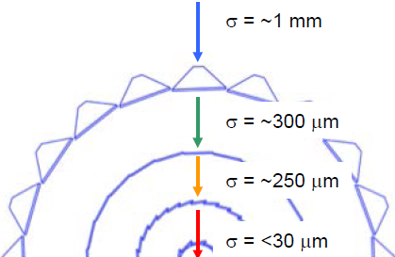
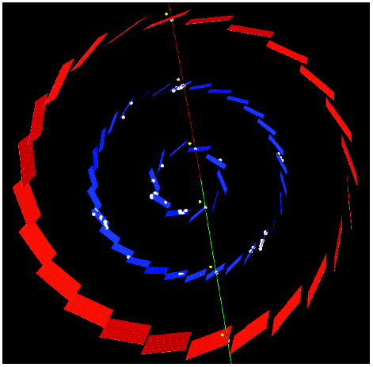
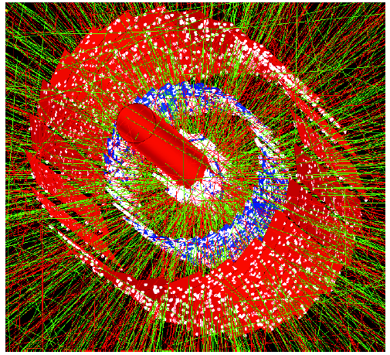

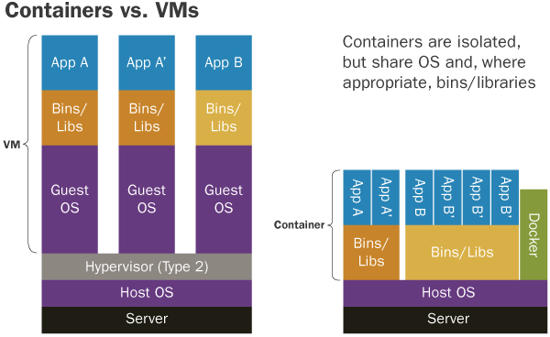
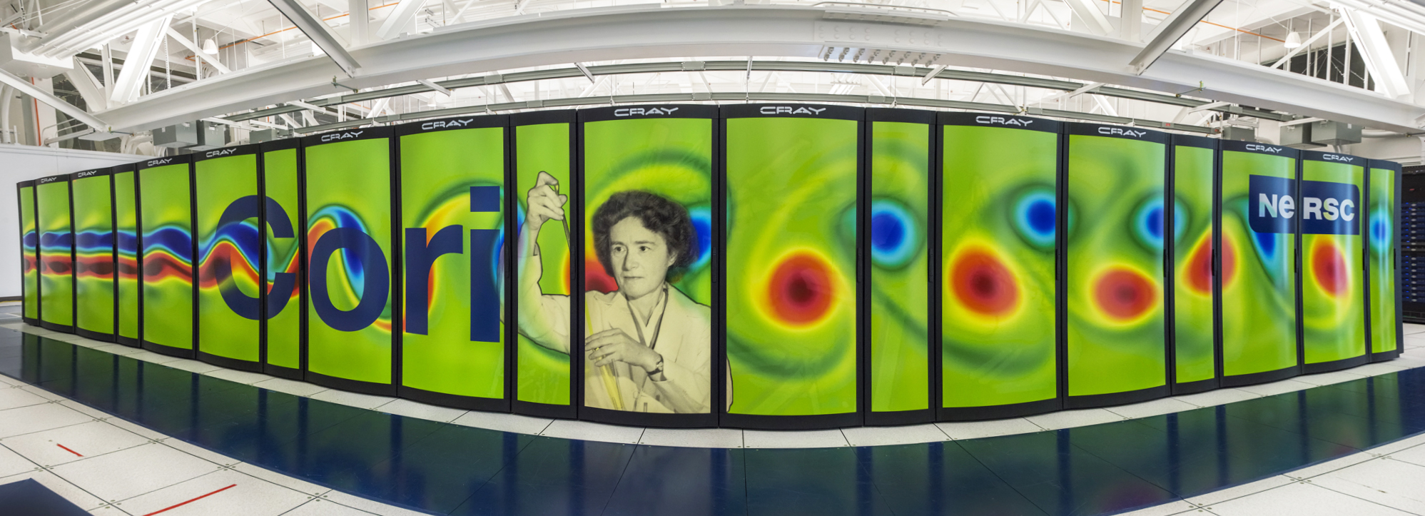
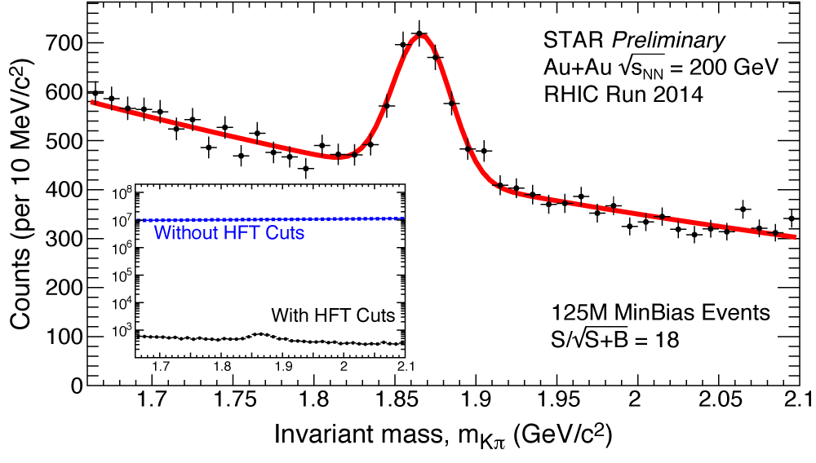
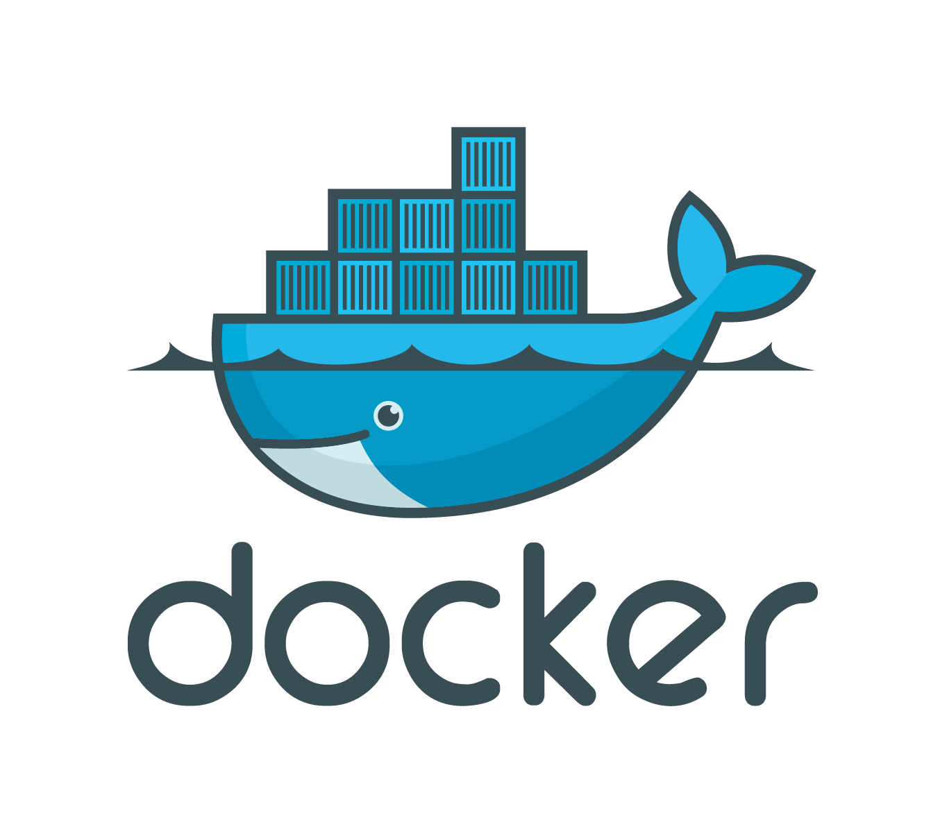


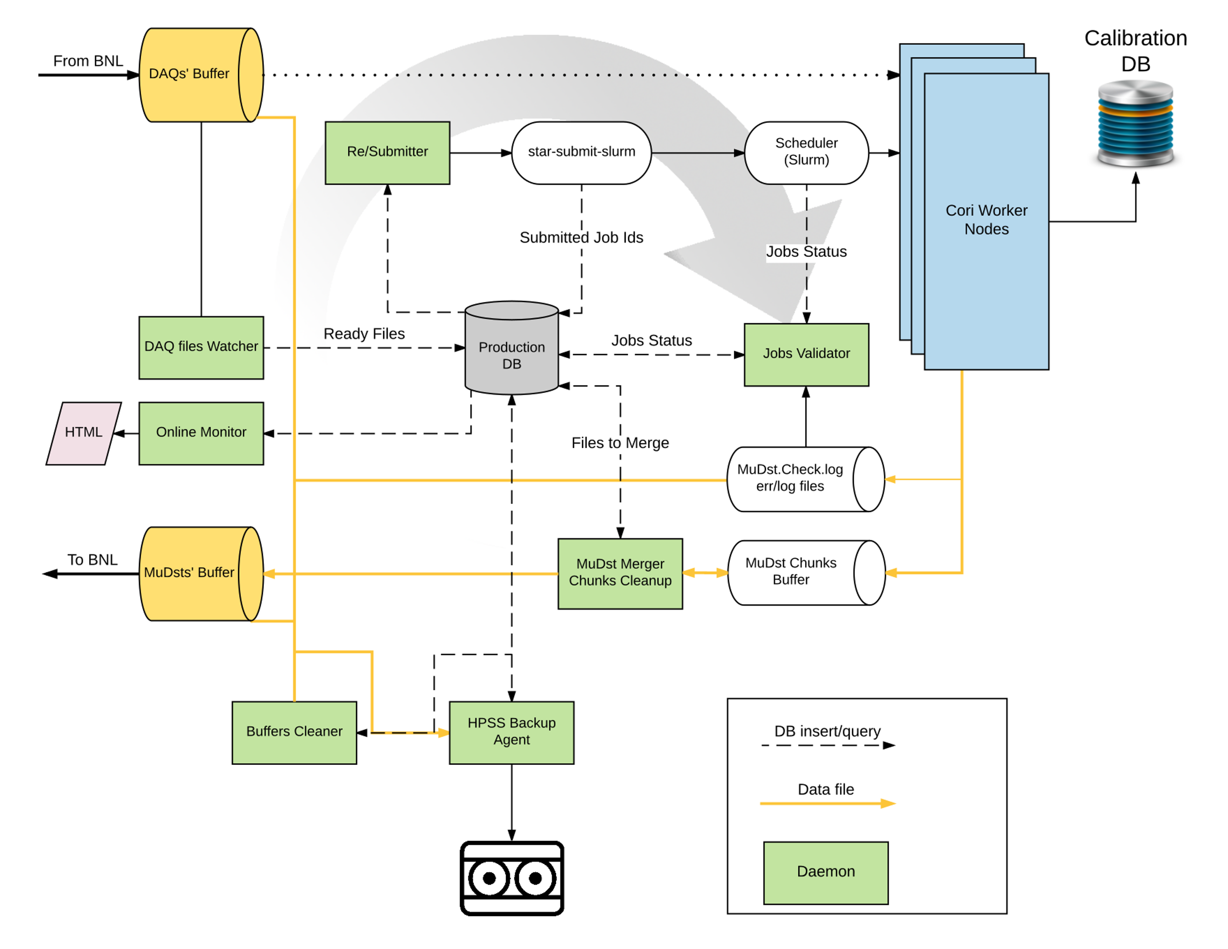
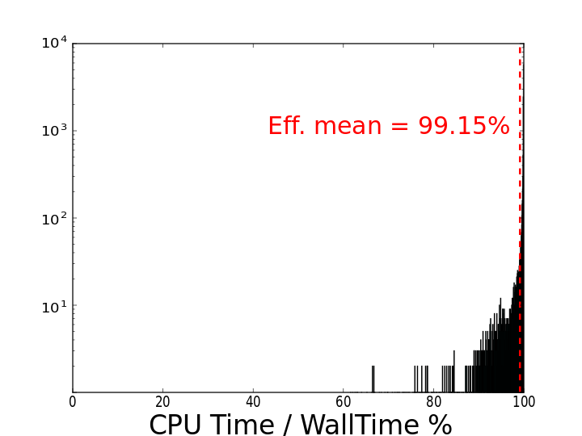
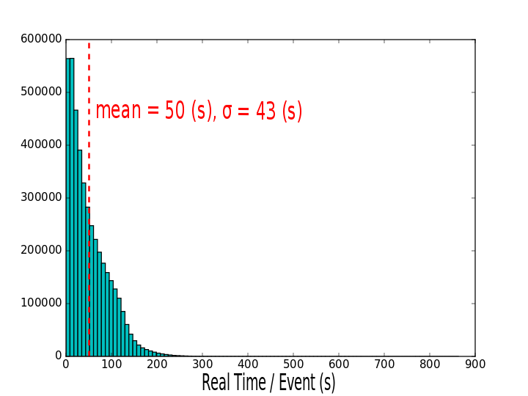
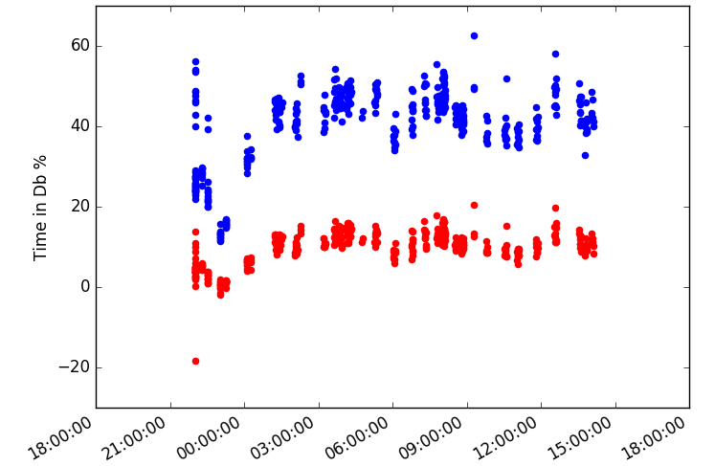
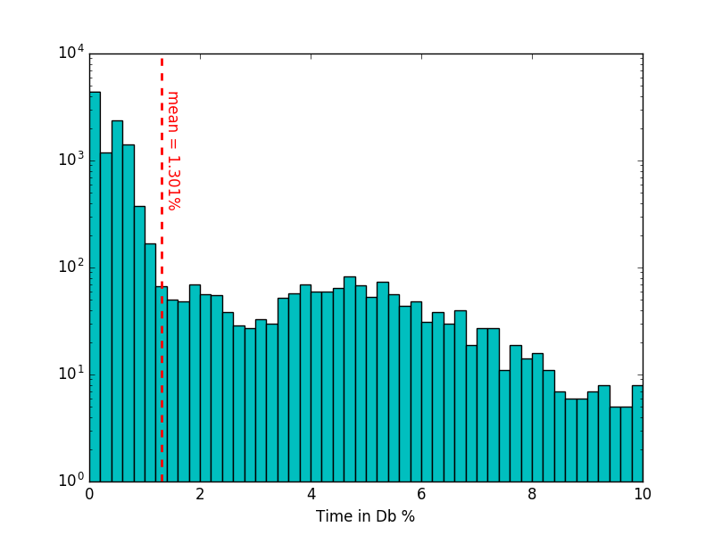
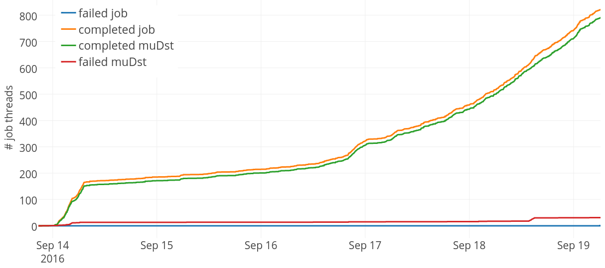
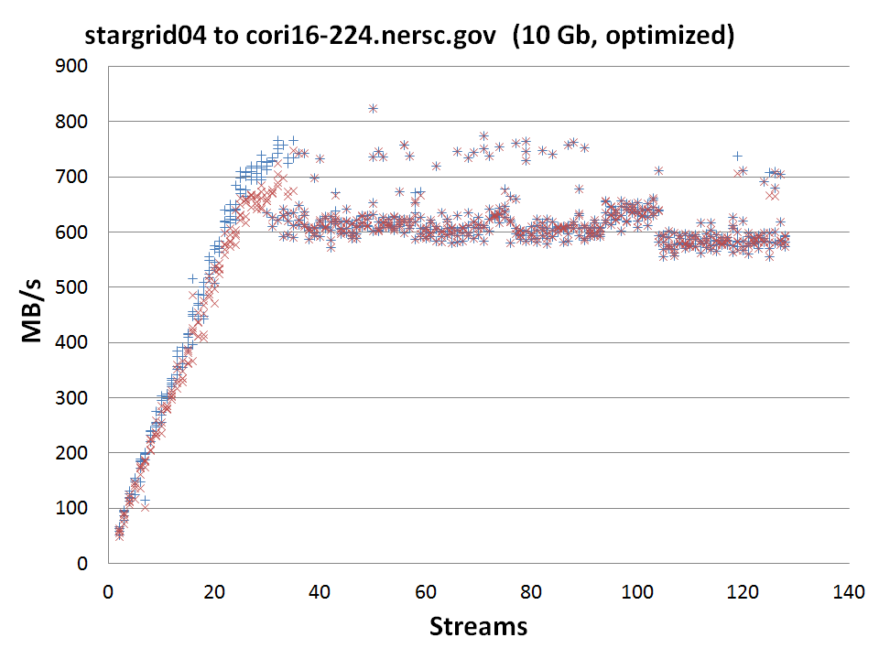
STAR Data Production at NERSC/Cori
An adaptable Docker container approach for HPC
Mustafa Mustafa, Jefferson Porter, Jan Balewski
Lawrence Berkeley National Lab
Jérôme Lauret
Brookhaven National Lab
Heavy Flavor Tracker
Motivation & Idea
Docker/Shifter
Challenge: the increasing sizes of data collected by HEP/NP experiments lead to an increasing demand on computing capacity that is challenging to meet by scaling the conventional clusters solution.
Tracking inward with gradually
improved resolution
Cosmic ray event
Au+Au event
Quark Gluon Plasma is the expected state of nuclear matter under extreme temperature and pressure. It is the state of all the matter in the universe a few micro-seconds after the big bang before it proceeds to be confined in protons and neutrons as we know it now.
Measurements of D mesons flow help us understand the degree of thermalization of the Quark Gluon Plasma and to constrain its transport parameters.
Heavy Flavor Tracker with State of the art MAPS Pixel sensors technology, allows for ~20μm resolution on secondary decay vertices
Installed at STAR in year 2014 and collected 3B Au+Au events
Opportunity: new generation HPC facilities provide vast computing resources with adequate memory and network connectivity for data intensive application. These facilities can allow for on-demand expansion of HEP/NP data production capacity that significantly shorten the time needed to get physics ready data and thus accelerate the pace of scientific discovery.
HPC systems provide vast resources for computation and data intensive applications. However, for technical and logistic reasons, their software is not readily customizable for specific project needs.
With a Docker enabled system we can push STAR software/environment with the job to the computing node.
Shifter [1] is a NERSC project to bring docker-like virtualization functionality on cray compute nodes to allow custom software stack deployment.
D⁰ → K π
Cori, second generation exa-scale facility at NERSC
Idea: Linux containers enabled HPC systems can provide the right virtual environment for experiments to run their customized software stack, ensuring reproducibility and high walltime efficiency.
In this poster: we report on the first test of STAR real-data production utilizing Docker/Shifter containers on Cori Phase I supercomputer at NERSC.
See “Using Shifter to Bring Containerized CVMFS to HPC”,
Lisa Gerhardt,
Wed., 12 Oct 2016, 12:30, id: 293.
+4 orders of magnitude reduction in combinatorial background
For the first time we can study charm hadron chemistry in heavy-ion collisions (D⁰/D⁺⁻, D_{s} , Λ_{c})
[1] D. M. Jacobsen and R. S. Canon, “Contain This, Unleashing Docker for HPC”, Cray User Group 2015, April 23, 2015.
Scalable Access to Database
Production Pipeline
Performance
STAR data production software uses a MySQL service for detector online running parameters and calibrations. The location of this DB is critical for scaling the number of jobs to the throughput planned at Cori.
For a large scale production STAR can place the DB as:
A network isolated DB service
A snapshot local DB server at the computing node
Full payload local DB server at the computing node
Each approach comes with its own advantages. The location of the DB is an important part of the end-to-end workflow optimization.
Pipeline design objectives:
Modularity to enable end-to-end optimization
Need to be ready for all Cori downtime scenarios
  Jobs cold start capability
  daemons failure tolerance
Continuous monitoring
To handle a target throughput ~10k cores / week → ~100TB / week transferred over ESnet
Archive input and output files to HPSS
We carried a real job production test that used ~100k CPU hours to test the different units integration and calculate the overall success rate:
J = Successful job completion
O = Good output file with +98% of events produced
Success Rate (SR) = J * O
Generally, an SR > 95% is enough to qualify the workflow and computing facility to be real data production quality.
Network isolated DB service:
Unpredictable network conditions → Not easy to scale to projected throughput.
An example of a bad incident: 45% of walltime spent in DB
~45% of production time in DB
Time in Db %
16 production processes + 1 MySQL server per 16 CPU cores → +99% walltime efficiency
50s / Au+Au event is comparable to 48s without a local MySQL CPU overhead
Local DB server at the compute node:
Pros:
  No network routing → trivial scalability with number of jobs
Local DB server: <2% of walltime spent in DB
Cons:
  Have to start the server from scratch for every job
      Some tables take a long time to cache (a particular table makes ~30k queries) → solved with perCacheNode feature of shifter (XFS file)
  Time taken to copy payload at the beginning of the job
  Consumes cpu allocation
Time in Db %
< 4% failure → SR > 96%
A solution has been identified to increase the SR to the +99% range
Trivial DB scalability with a local MySQL server per job
NY-CA Data Transfer over ESnet
Summary & Outlook
For best utilization of CPU resources we need a reliable data transfer between BNL and NERSC → 100TB / 10k CPUs / week → ~200 MB/s
Design and implementation:
Automated finite state workflow → allows us to achieve high overall fidelity
One input raw data file is mapped to multiple process at the node (a simple mapreduce pattern)
Multi-threaded design (12 daemon threads). All daemons are configurable using json files
Central production DB (MongoDb)
  communicate/control system states
  Provides persistent storage of pipeline states (all daemons are stateless)
Slurm for job submission. Jobs resources utilization also gathered from slurm and log files to allow monitoring and further tunning (no heartbeat from jobs)
Continuous online pipeline monitoring
  Python Flask app running on portal-auth.ners.gov responds to web-base users queries to MongoDB
  JavaScript runs in browser end renders numbers into either tables or graphs
Docker/Shifter + HPC can carry HEP/NP data production at a large scale
  Shifter enabled Cori and Edison at NERSC offer such an opportunity
Network bandwidth optimization is essential for end-to-end optimization: ESnet enables transfer of large amounts of data across the continent
+99% walltime efficiency demonstrated
Production plan:
STAR collected a 3Pb of Au+Au collision data during RHIC run 2016 → +50M CPU hours
We requested to process 50% of the data at Cori
  Transfer 1.5Pb into Cori, ~1Pb output data → ESnet
  Use 25M CPU hours
Full integration test with NY-CA transfer pipe
Reliable 600 MB/sec transfer
Improvement by 500%
ESnet + optimized end points and transfer protocol provides 600 MB/s transfer rate, a 5x improvement over the vanilla system rate of ~120 MB/s
Large scale test is on way to ensure reliability of the connection at this rate

