Slide 1
Learning Emerging Behaviors of Dynamic Multi-Agent Systems using Graph Neural Networks
Week 1 progress: a boids flocking simulation
Mustafa Nazeer
Mentor: Dr. Diego Patino
June 16, 2026
Figures and code produced with AI assistance, disclosed per course policy.

Slide 2
Emergent behavior from local rules
• Many agent systems (flocks, herds, crowds, traffic) show group behavior that no single agent is told to produce.
• Reynolds' boids (1987): three local rules produce flocking, separation, alignment, and cohesion.
• Project goal: a Graph Neural Network that learns these interaction rules from agent trajectories.
• This week: build the rule based simulation that generates that behavior and the data the network would learn from.

Slide 3
A boids simulation with our own rules
• Pure Python (numpy, scipy, matplotlib); 120 boids in a 60 by 60 wraparound world.
• The classic three rules plus avoidance of circular obstacles.
• Custom rule: a predator that triggers collective escape and splitting.
• Inverse distance separation keeps the flock spaced out instead of collapsing to a point.
• Reproducible, with a unit tested core of 24 passing tests.

Slide 4
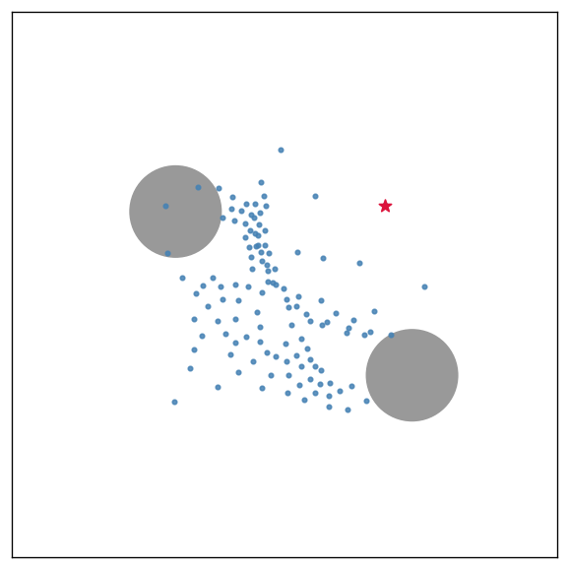
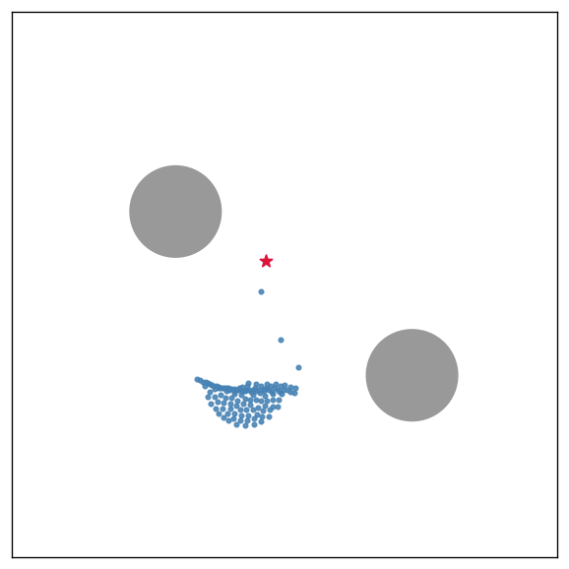
Collective escape from a predator
• The flock forms and flows around obstacles as one coordinated group.
• A predator (red star) chases the nearest boids; nearby boids flee.
• The flock splits, scatters, then streams back together while fleeing.
Animated version: flock_escape.gif
Flocking and obstacle avoidance
Splitting and escape

Slide 5
Results and findings
• From random starts, the boids organize themselves into one coherent, aligned flock within roughly 40 frames.
• At rest the flock moves almost perfectly in unison as a single group, with clear spacing between individuals rather than collapsing to a point.
• The flock reliably flows around the obstacles without collisions.
• The predator drives a clear collective response: the flock splits, alignment breaks down, and the boids scatter as they flee, then stream back together once it passes.
• These findings are measurable, not just visual, which is what makes the behavior learnable by the planned Graph Neural Network.

Slide 6
Next steps
• Port the model to NVIDIA Isaac Sim on a GPU machine, and add a 3D environment.
• Validate against real flocking datasets.
• Build the Graph Neural Network that learns these interaction rules from trajectories.
• Note: built in Python first because the development machine has no NVIDIA GPU.

