Slide 1
Learning Emerging Behaviors of Dynamic Multi-Agent Systems using Graph Neural Networks
Progress: Food foraging and a truly infinite world
Mustafa Nazeer and Joel Pampam
Mentor: Dr. Diego Patino
August 6, 2026

Slide 2
What you asked us for on July 28
• A new behavioral simulation that is neither leader follower or predator prey
• A truly infinite world
• Keep learning about Graph Neural Networks, and look for a relevant real dataset

Slide 3
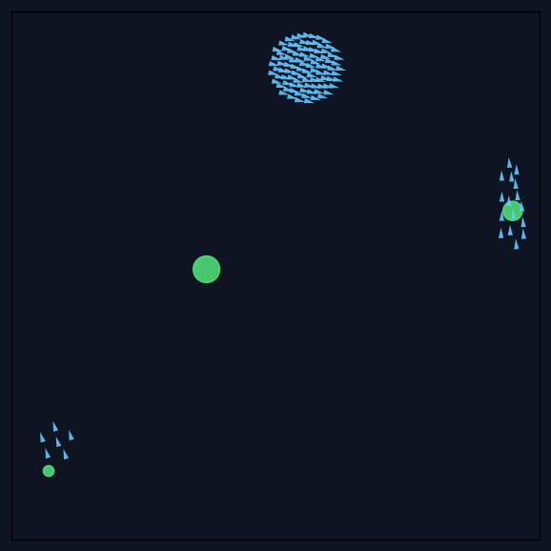
Food foraging, the third behavior
• A few food sources sit in the world, and every boid steers toward the nearest one it can sense
• Eating drains a source a little each step, an exhausted source disappears and a fresh one appears at a seeded random spot, so the flock re targets
• Separation, alignment, and cohesion stay active for every agent, which was your condition for all the new behaviors.
Green circles are food sources. They shrink as the flock eats them.

Slide 4
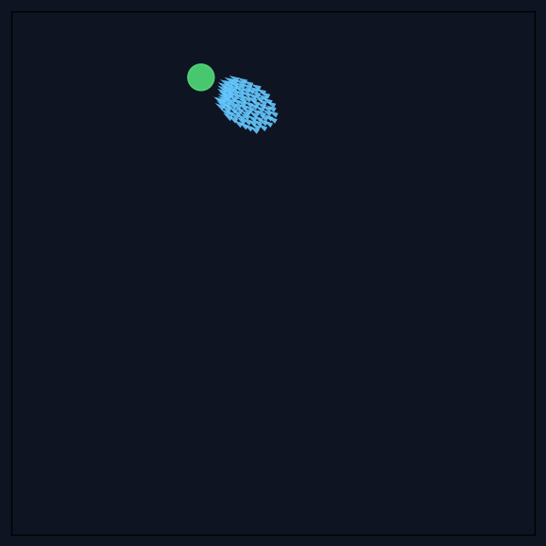
A truly infinite world
• The world now has a third mode with no edges at all, positions are unbounded and nothing ever bounces or wraps.
• The camera follows the flock so the animation stays readable while the flock travels
• Food respawns near the flock rather than back at the origin, so foraging keeps working however far the flock roams
Step 280: the flock has drifted far outside the original 60 by 60 spawn area. The camera follows it.

Slide 5
What we checked, where things stand, what is next
• With the food pull enabled the flock visibly converges on sources and stays near them, with it disabled boids drift past food as if it were not there
• Running the same configuration twice produces identical data, which is what makes the dataset trustworthy.
• Status: cluster access is secured. Dr. Cesar Torres has not replied to our funding email, nor to the follow up Joel sent.
• Real data: we surveyed public datasets. None label which agents are actually interacting, so our simulation stays the same and real data becomes the test of whether a model transfers. Some datasets: zebrafish with video, pigeon flocks attacked by a robotic falcon, and pedestrian crowds.

Slide 6
Questions for you
• Funding: Dr. Cesar Torres has not answered our email or Joel's follow up. How would you like us to proceed?
• Data: do you agree that the simulation stays our supervised training data, since no public dataset labels which agents are interacting?

