Slide 1
Learning Emerging Behaviors of Dynamic Multi-Agent Systems using Graph Neural Networks
Progress: Leader-Follower behavior and a configuration file
Mustafa Nazeer and Joel Pampam
Mentor: Dr. Diego Patino
July 28, 2026

Slide 2
What you asked us for on July 21
• A configuration file, with a separate radius for every rule and switches to turn rules on and off.
• Options for worlds beyond the infinite wraparound one, and a purpose for the agents.
• Learn how Graph Neural Networks work, and start using PyTorch Geometric.
• Two of these are finished and are the subject of these slides

Slide 3
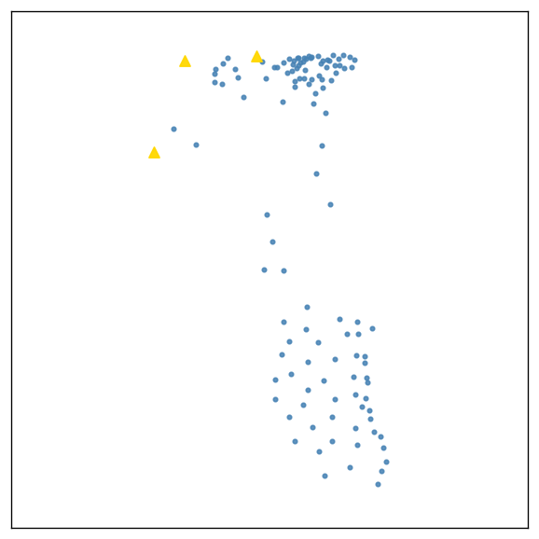
Leader-Follower, implemented twice
• Joel built his own Leader-Follower simulation in Pygame, with wandering leaders, predators, obstacles, and a live border toggle.
• Mustafa built a separate one inside the existing numpy simulation
• In both, a chosen number of leaders drift on their own heading and every other agent steers toward its nearest leader within a follow radius
• In both, leaders and followers alike still run separation, alignment, and cohesion
Leaders in gold. Every follower is attached to one of them.

Slide 4
What the behavior adds to the data
• The follow radius is deliberately wider than the cohesion radius, so a leader pulls from further away than ordinary flocking reaches.

Slide 5
The configuration file
• All tunable values moved out of the code and into a configuration file.
• Every rule has its own radius and its own on and off switch, so any rule can be removed from an experiment without editing code.
• A rule switched off is not computed at all

Slide 6
What we checked, and what is next
• Turning rules off changes the flock in the way the theory predicts. Without separation the flock collapses in on itself, and with only separation it never forms a flock at all.
• With following switched off, leaders wander away from the group, but with it on, the group stays with them.
• Next: Graph Neural Networks. Reading how they work and why they differ from a CNN, then building a first model with PyTorch Geometric on the data we are now recording.

