Slide 1
Preboot Execution Environment(PXE), Dynamic Host Configuration pr.(DHCP)

Slide 2
01
DHCP

Slide 3
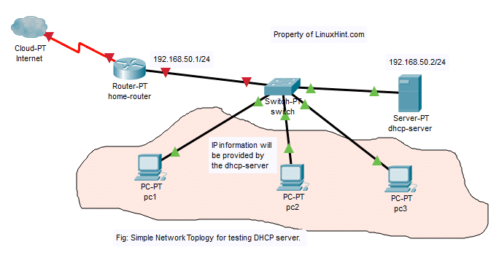
INTRODUCTION
You can give a brief description of the topic you want to talk about here. For example, if you want to talk about Mercury, you can say that it’s the smallest planet in the entire Solar System

Slide 4
DHCP : used for distribute Ip for any device that enter the network .
DHCP also can assign:
1-IP Address
2-Subnet mask
3-Gateway
4-DNS Server
5-Domain name
6-Hostname
7-Other parameters.

Slide 5
We can also make reservation for some ip’s.
We can control lease time.
we use package for install Dhcp(DHCP).
1-config file in /etc/dhcp/dhcpd.confg

Slide 6
What we do exactly
Create a network connection in the same network
THEM
Edit in dhcp.confg and add our configuration like (rang , Gateway,domain name )
US

Slide 7
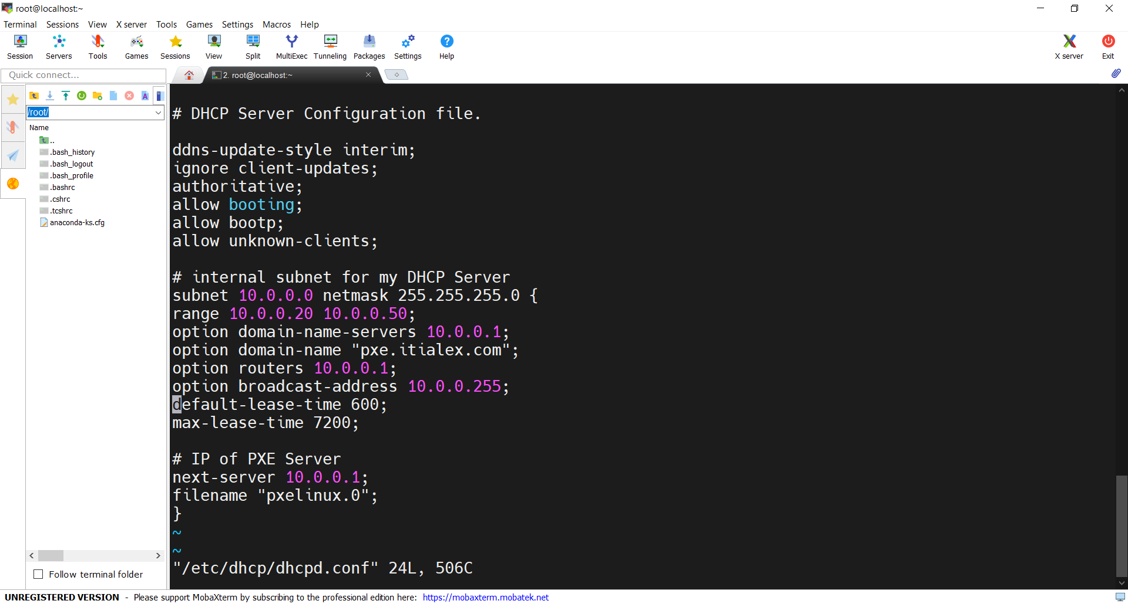

Slide 8
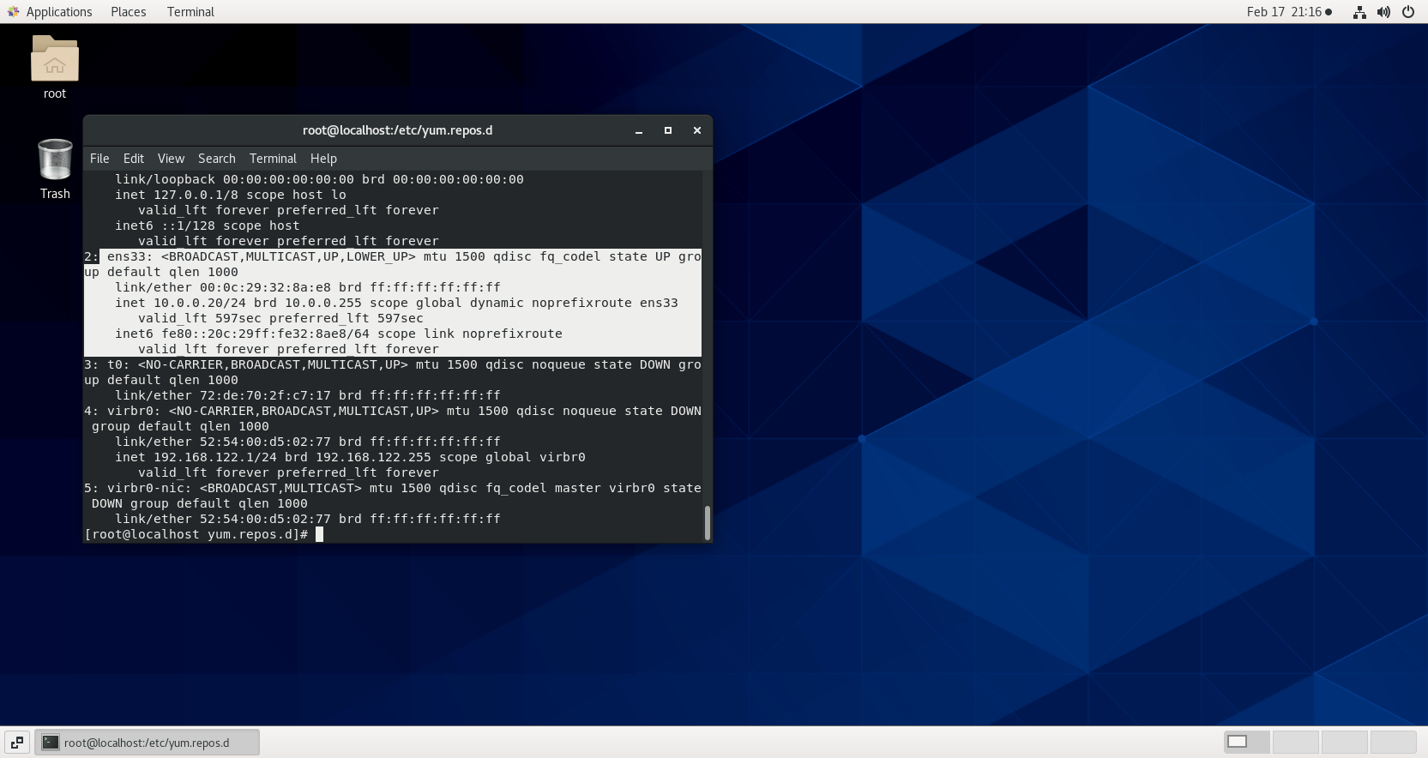

Slide 9
02
PXE

Slide 10
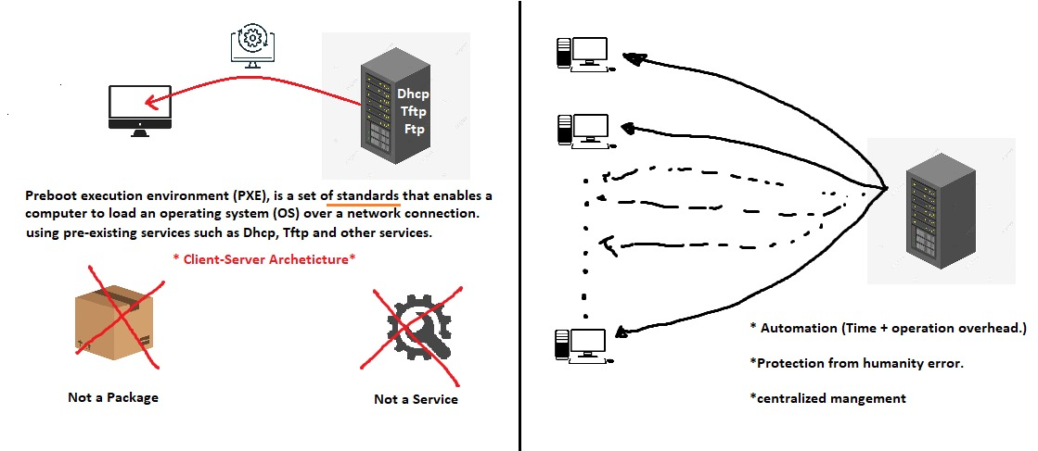

Slide 11
pxe : allow computer to boot from the server over network.
Pxe uses some protocols to work such as : Dhcp , tftp
*but also we want some other packages to help us configure pxe(syslinux , xinetd ).

Slide 12
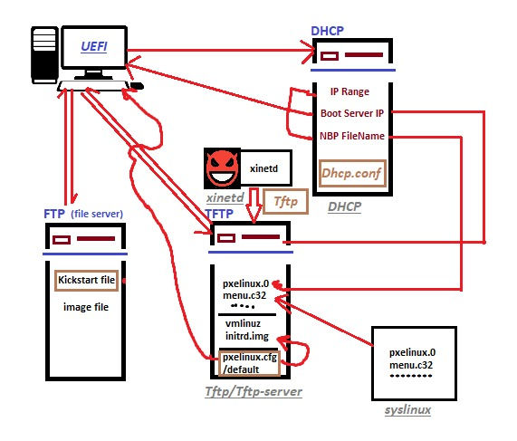

Slide 13
Packages
1-Dhcp: to assign ip to computers in network
2-tftp: is a simplified alternative to FTP that provides no authentication and is most often used to transfer configurations to and from network devices , used to share pxe boot files over network
3-syslinux: get bootloader for pex and other configuration (menu.c32, memdisk).
4-Xinitd: Whenever a packet comes over the network to a server on a particular port, inetd is responsible to check it and launch the appropriate program to handle the connection request

Slide 14
1- we mount our iso in local server using ftp /var/lip/pub , to use it with pex.
2-copy 2 important files from iso to tftp
1- vmlinuz (which is compressed img of kernel)
2-initrd (initial root file system in memory)
3-then we share kickstart file in ftb server to fully automate the installation , and passing with it the location of our iso ftp://10.0.0.1

Slide 15
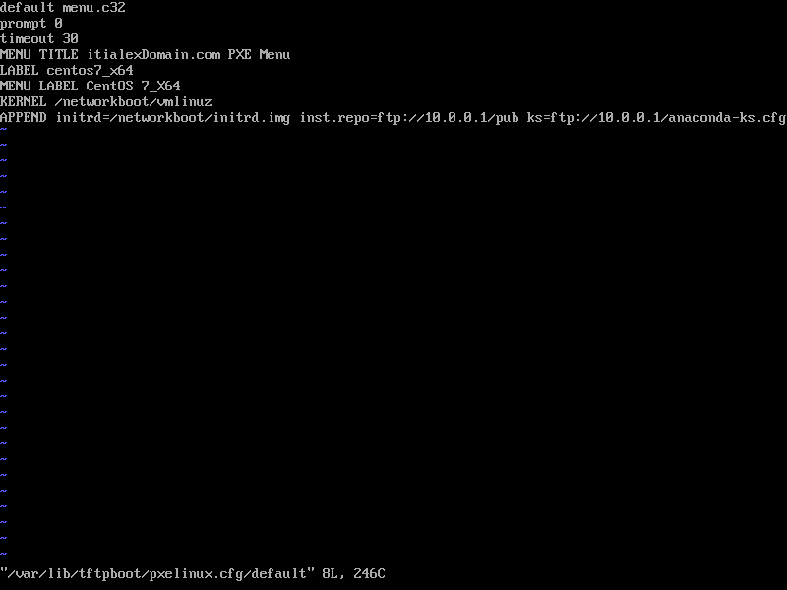

Slide 16
4- create menu entry for pxe
5-appadn in this menu kickstart file,iso location
6-start and enable required services
7-create a new machine in vm ,now everything is automated👍✔

Slide 17
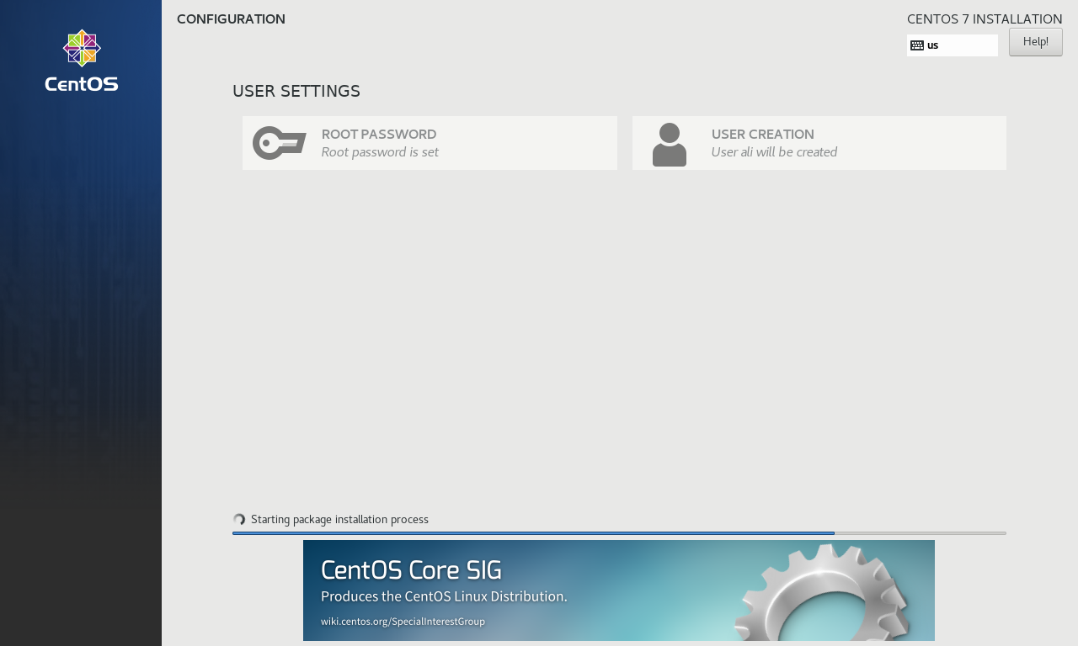
INTELLIGENT AUTOMATION
IPA TODAY
INFRASTRUCTURE
WORKFORCE
Mercury is the closest planet to the Sun and the smallest of them all
Venus has a beautiful name and is the second planet from the Sun
Despite being red, Mars is actually a cold place. It’s full of iron oxide dust

Slide 18
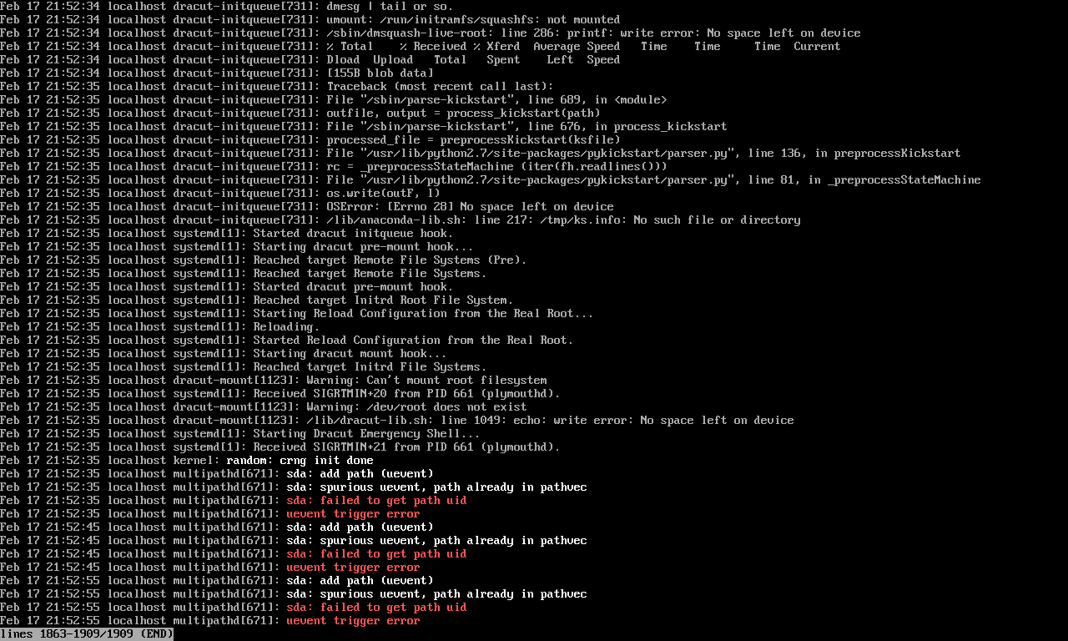
APPLICATIONS
VENUS
JUPITER
MARS
SATURN
Venus is the second planet from the Sun
It’s the biggest planet in the Solar System
Despite being red, Mars is a cold place
Saturn is a gas giant and has several rings

Slide 19
THANKS!
23-Mustafa Ibrahim
30-ziad elgondy
16-Mansour

