Slide 1
Optimizing MNIST Classification Using CUDA
Accelerating Deep Learning on GPU Architectures
By: Saad Nadeem, Mustafa Iqbal, Hassaan Anwar
Instructor: Imran Ashraf
Course: High Performance Computing Using GPUs

Slide 2
Project Overview
Goal: Speed up MNIST digit classification using neural networks
Dataset: 60k training + 10k testing images (28×28 grayscale)
Baseline: Sequential CPU version in C
Objective: Optimize step-by-step using CUDA, OpenACC, and cuBLAS
Evaluation Metrics:
Execution time
Accuracy
GPU utilization

Slide 3
V1 – Sequential Implementation
Written in pure C
1 hidden layer (128 neurons), ReLU + Softmax
Training per sample (no batching)
All math done via nested loops
Execution Time: 23.48s
Use Case: Performance baseline for all GPU versions

Slide 4
V2 – Naive CUDA Implementation
Matrix ops, activations, gradients parallelized via CUDA
Per-sample training
Kernels: matrixMul, relu, softmax, gradients, updateParams
Problems:
Frequent host-device transfers
Heavy use of atomicAdd
No shared memory, no coalescing
Execution Time: 37.63s (worse than sequential)
Speedup: 0.62× (slower)

Slide 5
V3 – Optimized CUDA (Batched)
Key Optimizations:
Double buffering + asynchronous parameter updates
Memory-mapped I/O
Kernel fusion (FC + ReLU)
Static gradient buffers
Pinned memory, aligned allocation
Batch Size Magic:
Speed and accuracy trade-off emerged
Best balance at batch size = 32
Execution Time: 0.675s Speedup vs V1: 34.79× Accuracy: 91.25%

Slide 6
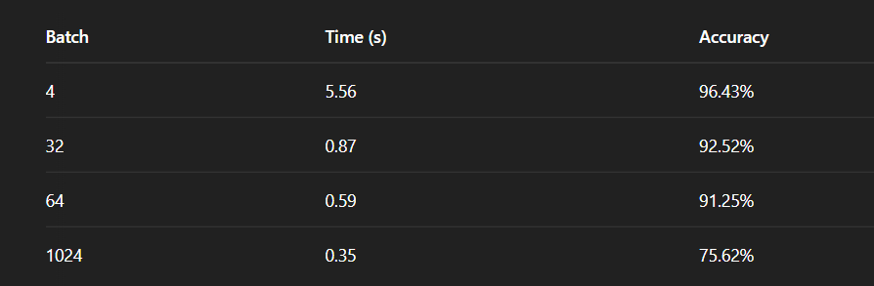
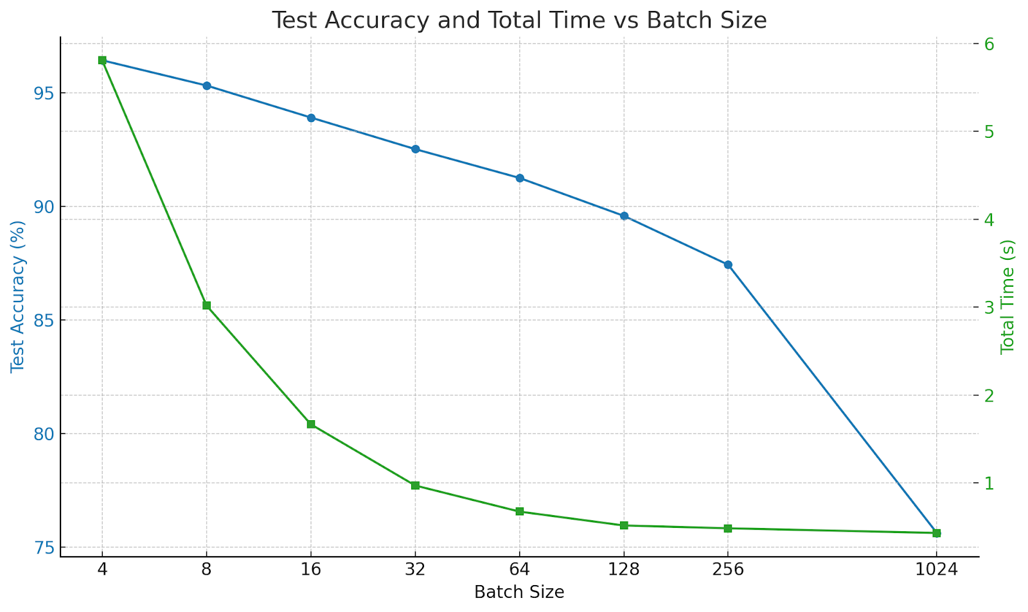
Batch Size Impact
Smaller batches = more accurate, slower
Larger batches = faster, less accurate
Best trade-off at batch size 32–64

Slide 7
V4 – Tensor Core via WMMA
Used __half + wmma::mma_sync
Full rewrite of matrix ops in FP16
Faster execution, but…
Problems:
Huge accuracy drop due to precision loss
No FP32 support
Loss scaling/mixed precision needed for stability
Conclusion: Fast but not viable for MNIST (accuracy-critical)

Slide 8
V5 – OpenAcc
Ported forward/softmax to GPU using OpenACC
#pragma acc parallel loop, acc_malloc, acc_memcpy_to_device
Backprop still on CPU
Strengths:
Easy to write
Speedup on forward pass
Limitations:
CPU-bound backward pass
No batching, no kernel fusion
Limited acceleration overall

Slide 9
V6 – cuBLAS + TF32 Tensor Cores
Used cublasGemmEx with CUBLAS_TF32_TENSOR_OP_MATH
Efficient forward/backward with vendor-optimized matrix ops
Key Features:
Batch-aware cuBLAS calls
addBiasWithOptionalReLU – merged operations
Kernel + transfer overlap with custom streams
Execution Time: 1.033s Speedup vs V1: 22.73× Accuracy: 91.30%

Slide 10
Bottlenecks & Learnings
Key Bottlenecks Identified:
Per-sample training (V1–V2)
Excessive cudaMemcpy, cudaMalloc
No batching = no parallelism
What Worked:
Batching (huge impact)
Kernel fusion
Double buffering
Tensor Cores (only with precision care)

Slide 11
Conclusion & Takeaways
CUDA accelerates training drastically, if used wisely
Batch size tuning is critical for performance + accuracy balance
cuBLAS (V6) is the cleanest, most scalable solution
Manual Tensor Core usage (WMMA) needs precision techniques
OpenACC is accessible but limited for full-model speedups

Slide 12
THANK YOU
Any Questions?

