Slide 1

Akatsuki Website Overview

Slide 2
Website Structure Overview
• Frontend: HTML/CSS embedded in PHP files
• Backend: PHP handles logic and database communication
• Database: MySQL for storing clothes, users, and reviews
• Admin panel, login system, review functionality included
• Dynamic pages: index, product list, contact, my reviews

Slide 3
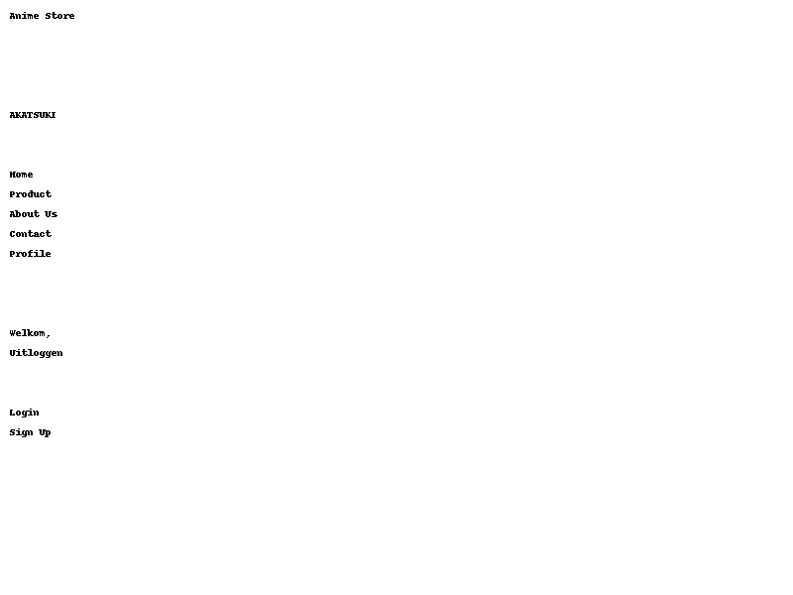
Page: Index

Slide 4
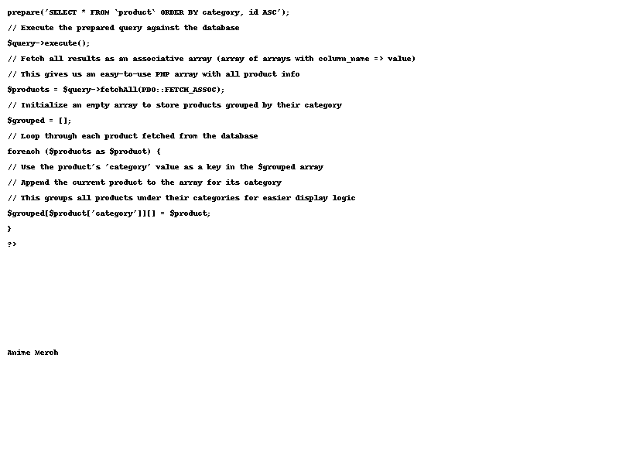
Page: Product

Slide 5
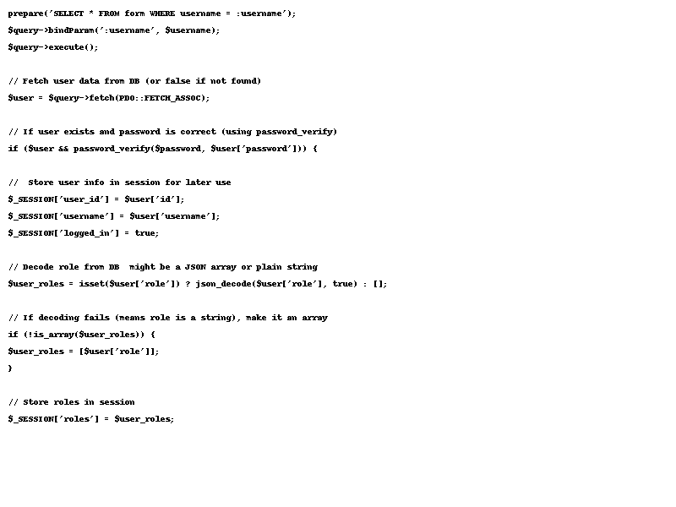
Page: Log In

Slide 6
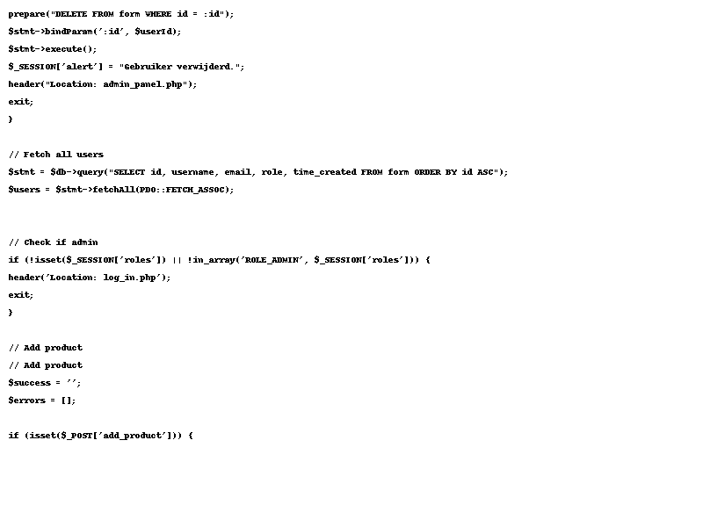
Page: Admin Panel

Slide 7
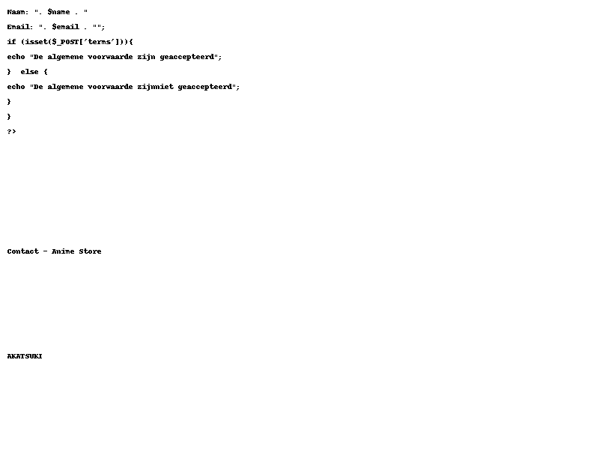
Page: Contact

Slide 8
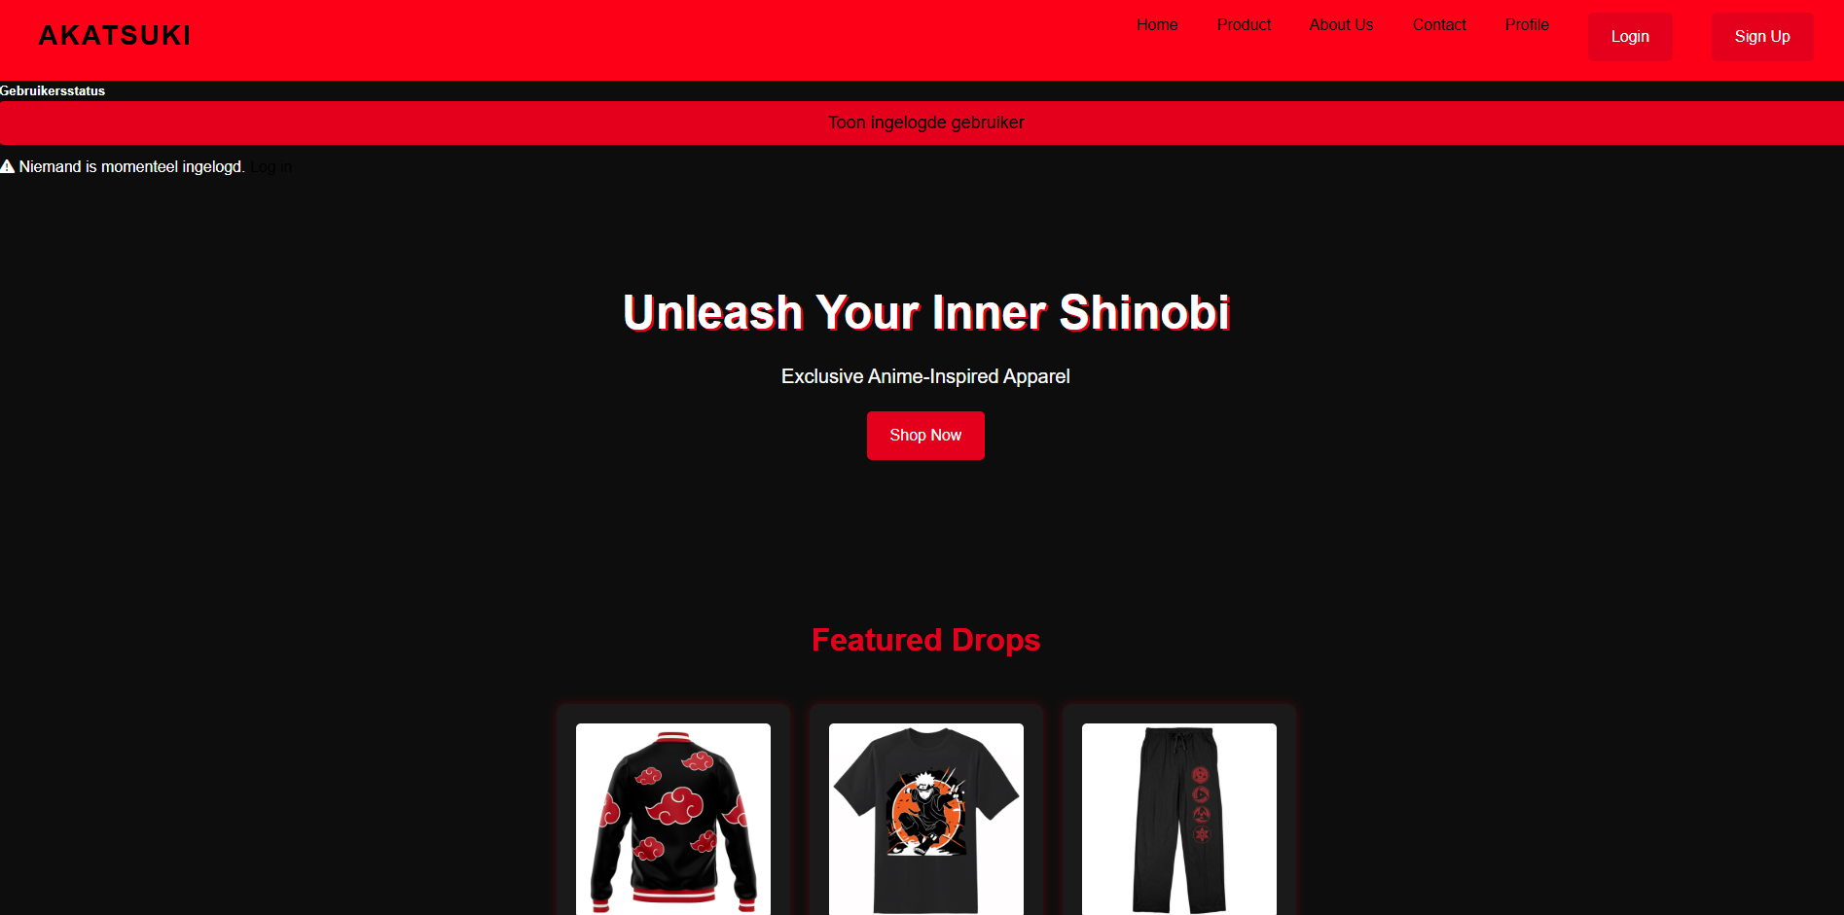
Website layout

Slide 9
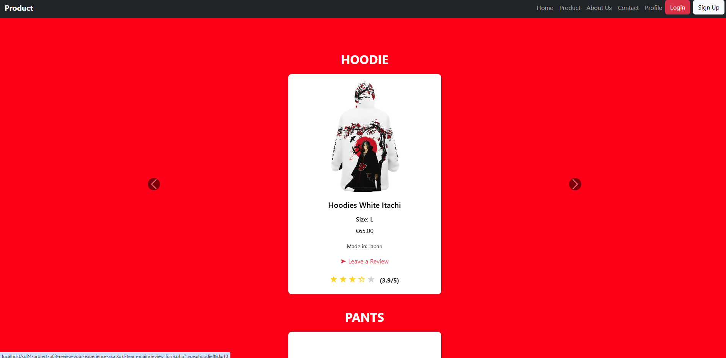
Website layout

Slide 10
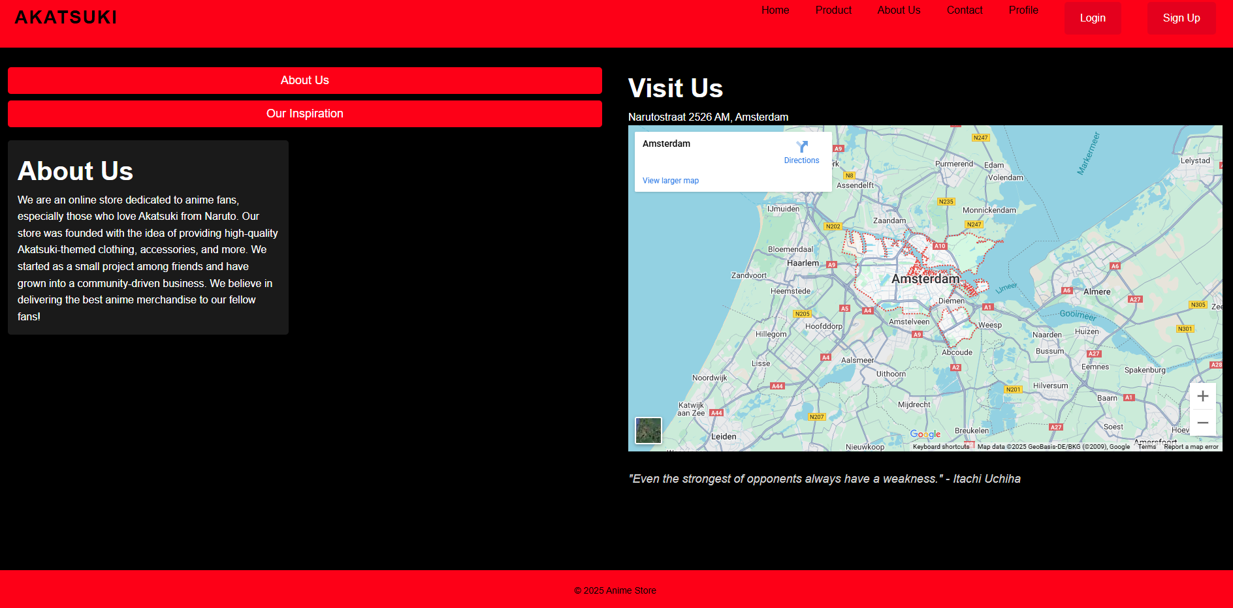
Website layout

Slide 11
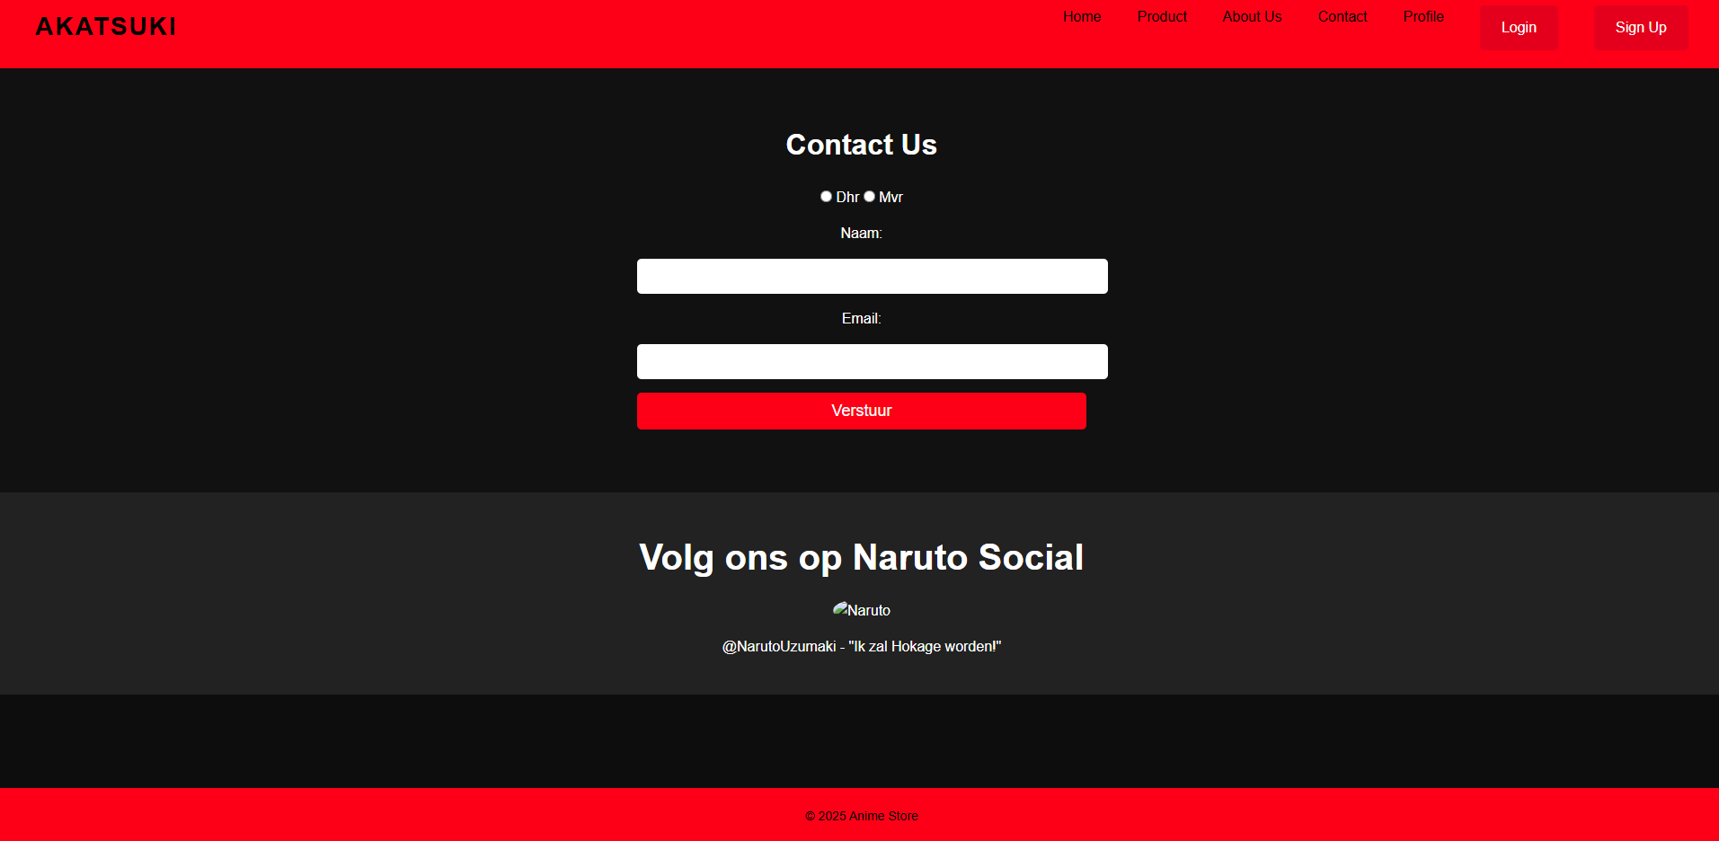
Website layout

Slide 12
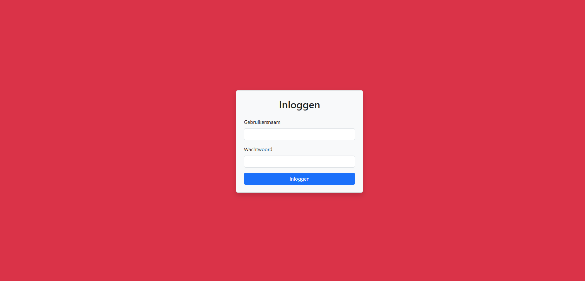
Website layout

Slide 13
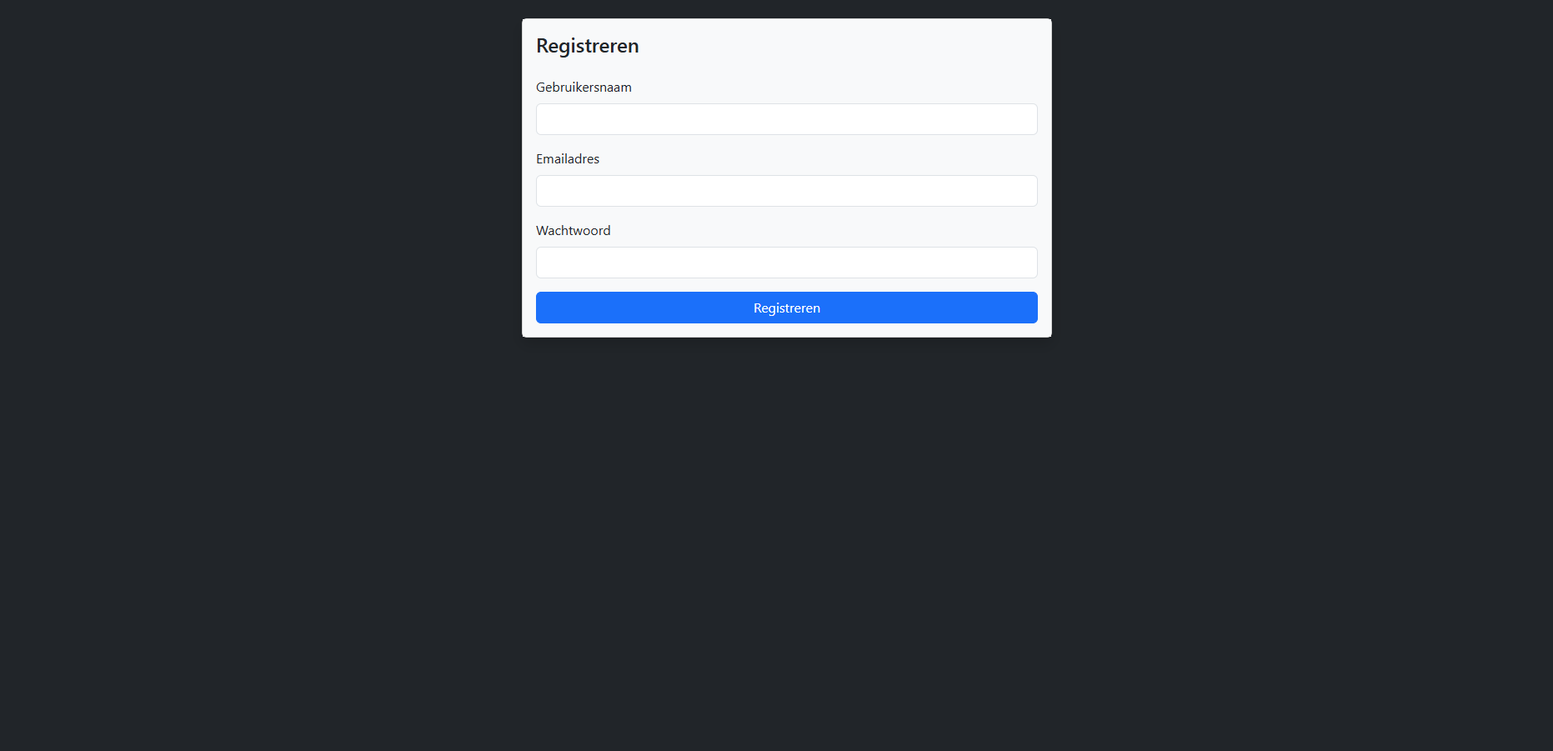
Website layout

Slide 14
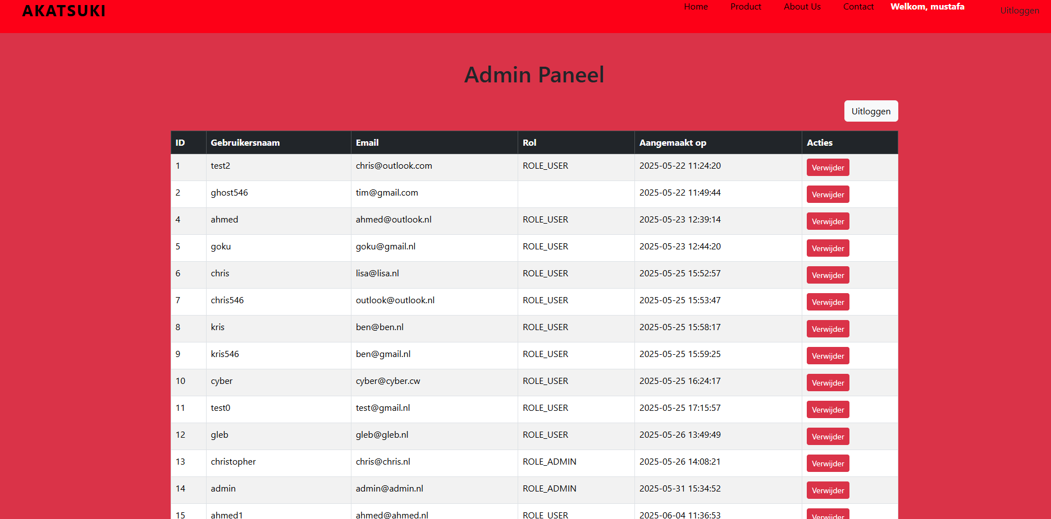
Website layout

Slide 15
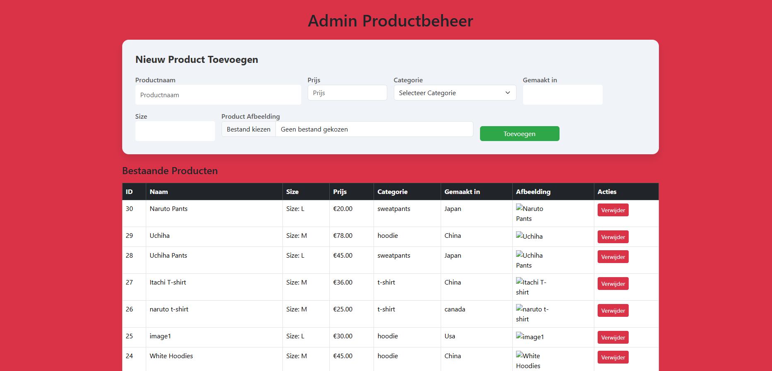
Website layout

Slide 16
Thank You for Watching!
• Any questions about the website’s functionality?
• We're happy to explain.
• Contact us at: mustafa.khedoe7@outlook.com

