Slide 1

Akatsuki Website Overview

Slide 2
Website Structure Overview
• Frontend: HTML/CSS embedded in PHP files
• Backend: PHP handles logic and database communication
• Database: MySQL for storing clothes, users, and reviews
• Admin panel, login system, review functionality included
• Dynamic pages: index, product list, contact, my reviews

Slide 3
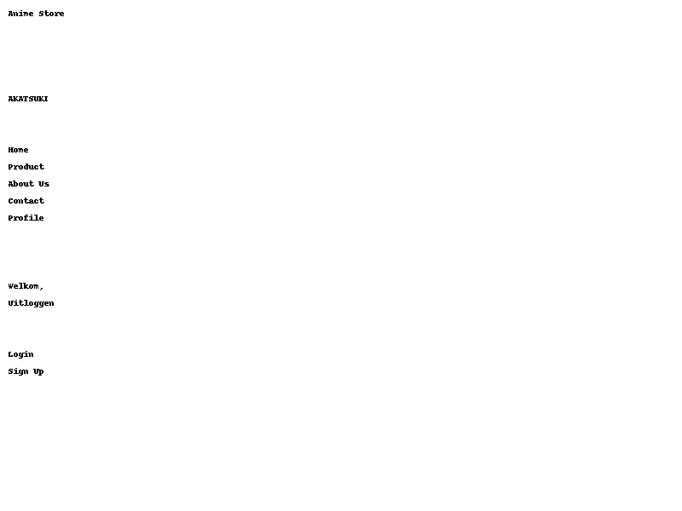
Page: Index

Slide 4
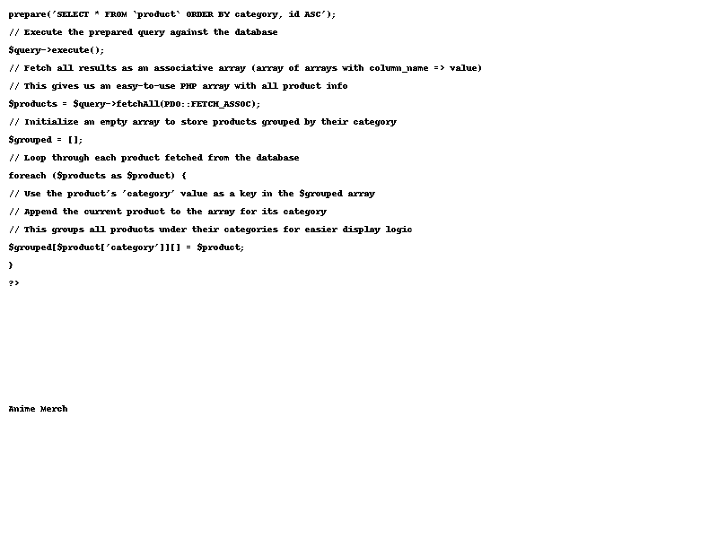
Page: Product

Slide 5
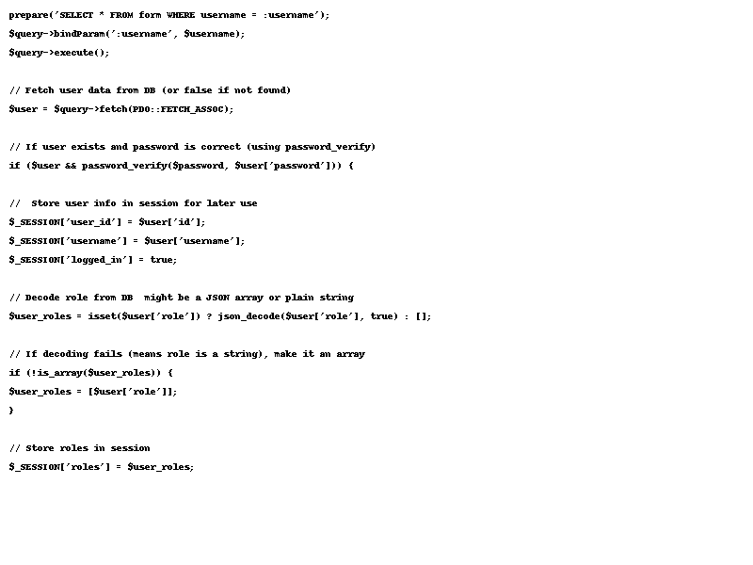
Page: Log In

Slide 6
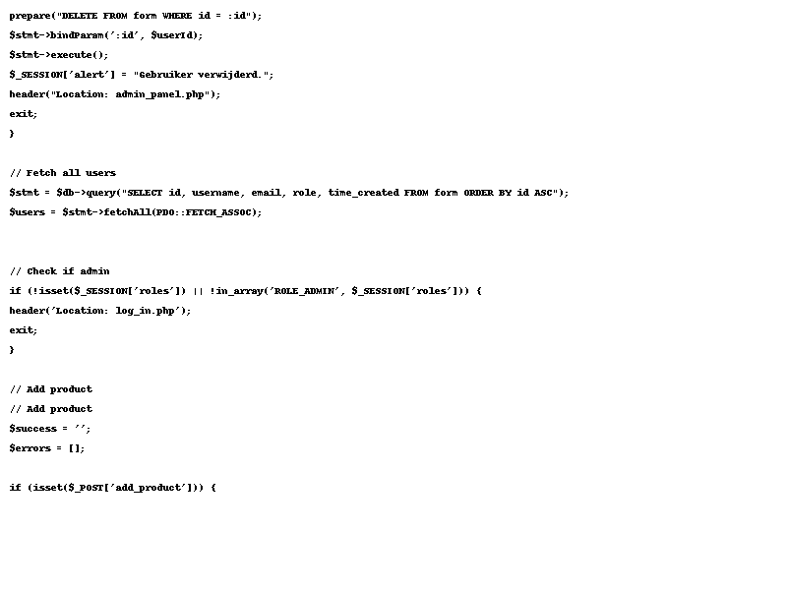
Page: Admin Panel

Slide 7
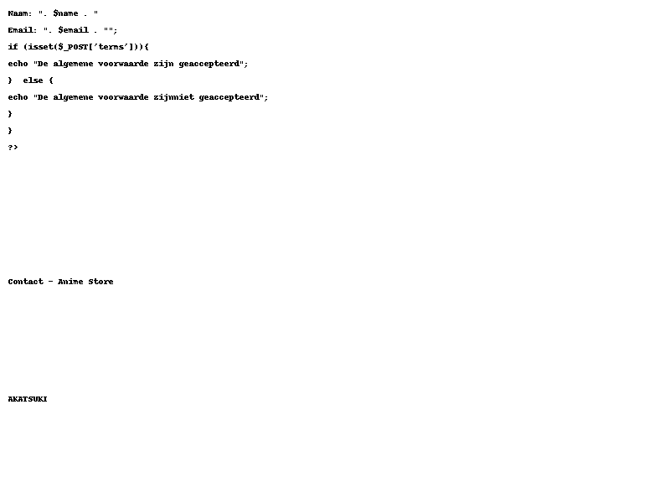
Page: Contact

Slide 8
Thank You for Watching!
• Any questions about the website’s functionality?
• We're happy to explain.
• Contact us at: mustafa.khedoe7@outlook.com

