Slide 1
Computer Programming week 7
Instructor:
Abdul Aziz
Assistant Professor
(Computer Science Department)
National University- FAST (KHI Campus)

Slide 2
acknowledgment
- Publish material by Virtual University of Pakistan.
- Publish material by Deitel & Deitel.
- Publish material by Robert Lafore.

Slide 3
Inheritance
A child inherits characteristics of its parents
Besides inherited characteristics, a child may have its own unique characteristics

Slide 4
Inheritance in Classes
If a class B inherits from class A then it contains all the characteristics (information structure and behaviour) of class A
The parent class is called base class and the child class is called derived class
Besides inherited characteristics, derived class may have its own unique characteristics

Slide 5
Example – Inheritance
Person
Student
Doctor
Teacher

Slide 6
Example – Inheritance
Shape
Line
Triangle
Circle

Slide 7
Inheritance – “IS A” or “IS A KIND OF” Relationship
Each derived class is a special kind of its base class

Slide 8
Example – “IS A” Relationship
Person
name
age
gender
eat
walk
Student
Teacher
Doctor
program
studyYear
designation
salary
designation
salary
study
heldExam
teach
takeExam
checkUp
prescribe

Slide 9
Example – “IS A” Relationship
Shape
color
coord
draw
rotate
setColor
Triangle
Circle
radius
Line
angle
draw
computeArea
length
draw
computeArea
draw

Slide 10
Inheritance – Advantages
Reuse
Less redundancy
Increased maintainability

Slide 11
Reuse with Inheritance
Main purpose of inheritance is reuse
We can easily add new classes by inheriting from existing classes
Select an existing class closer to the desired functionality
Create a new class and inherit it from the selected class
Add to and/or modify the inherited functionality

Slide 12
Example Reuse
Shape
color
coord
draw
rotate
setColor
Triangle
Circle
radius
Line
angle
draw
computeArea
length
draw
computeArea
draw

Slide 13
Example Reuse
Person
name
age
gender
eat
walk
Student
Teacher
Doctor
program
studyYear
designation
salary
designation
salary
study
heldExam
teach
takeExam
checkUp
prescribe

Slide 14
Example Reuse
Person
name
age
gender
eat
walk
Student
Teacher
Doctor
program
studyYear
designation
salary
designation
salary
study
heldExam
teach
takeExam
checkUp
prescribe

Slide 15
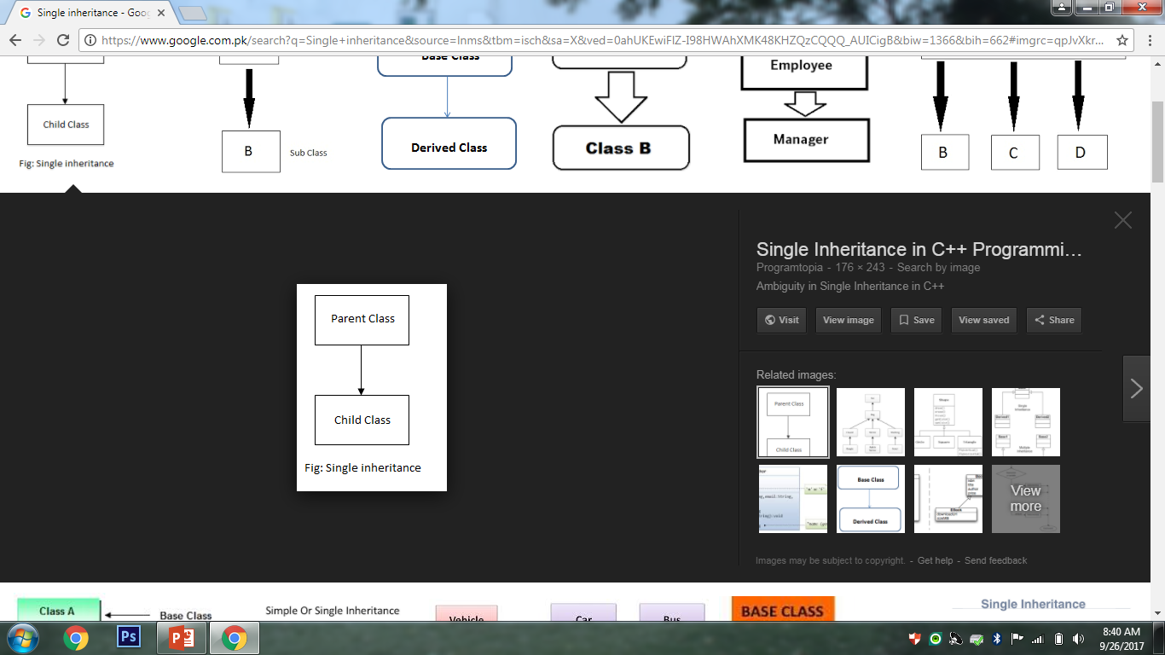
Types of Inheritance
1 – Single Inheritance

Slide 16
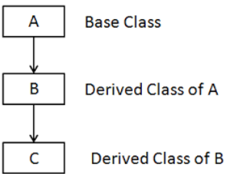
2 – Multi Level

Slide 17
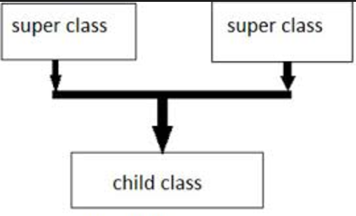
3 - Multiple

Slide 18
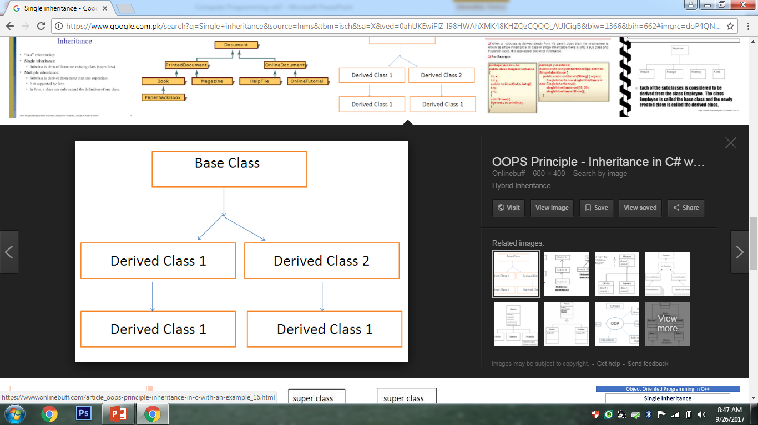
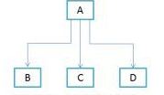
4 – Hierarchical

Slide 19
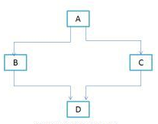
5 - Hybrid

Slide 20
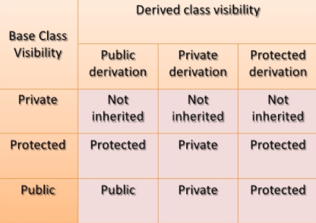
Defining a Derived class with visibility mode
Visibility Mode
1- Public
2- Private
3- Protected

