Slide 1
DIGITAL LOGIC DESIGN
EE(109)
LECTURE-26
DATE: 10TH APRIL, 2018

Slide 2
Chapter No:7
Latches and Flip Flop

Slide 3
TOPICS
1. Latches
2. Flip-Flops
3. Flip-Flop Operating Characteristics
4. Flip-Flop Applications

Slide 4

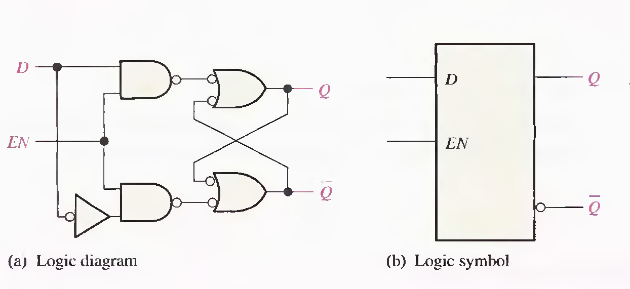
Gated D latch is differs from the S-R latch because it has only one input in addition to EN. This input is called the D (data) input. When the D input is HIGH and the EN input is HIGH, the latch will set. When the D input is LOW and EN is HIGH, the latch will reset. Stated another way, the output Q follows the input D when EN is HIGH.

Slide 5
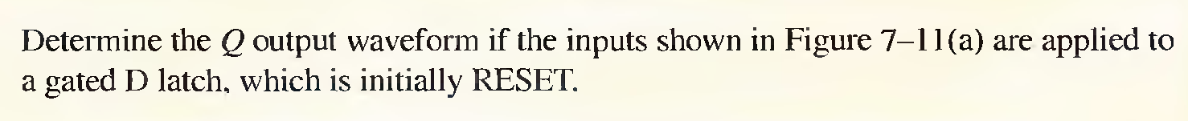
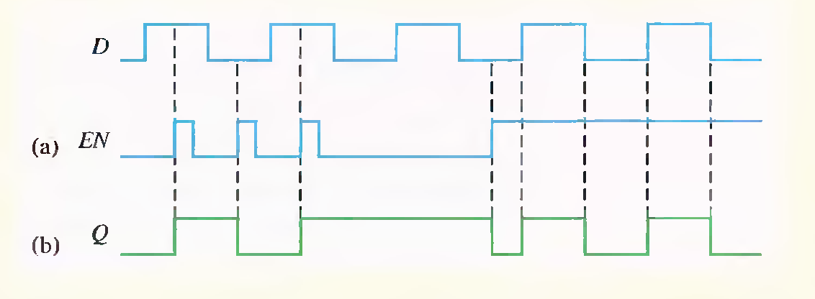

Slide 6


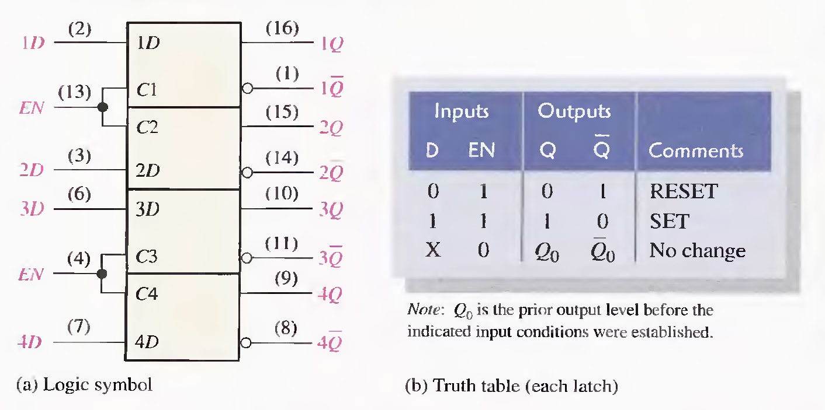

Slide 7

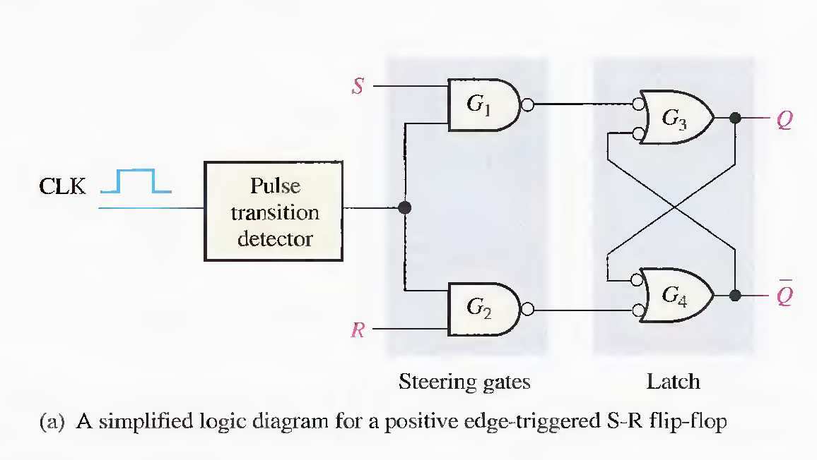
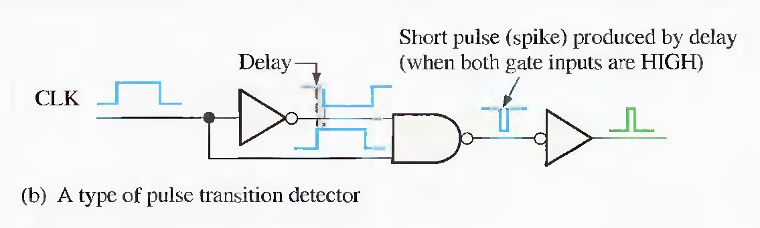

Slide 8

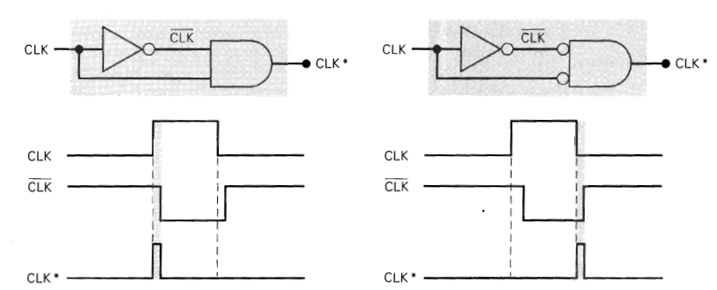
A type of Pulse Transition detector

Slide 9
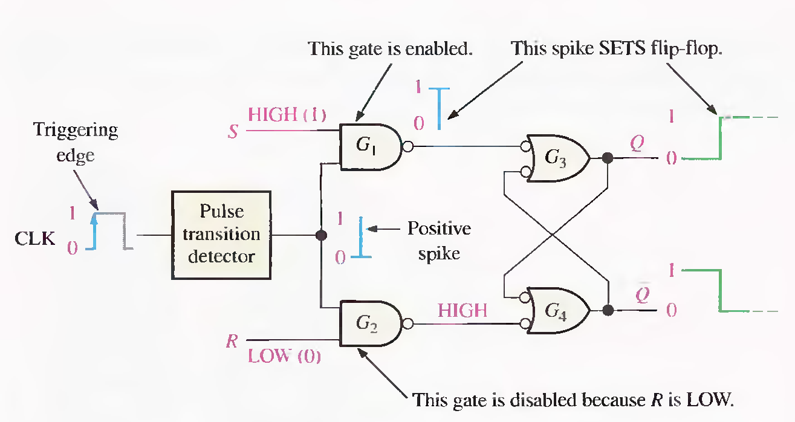
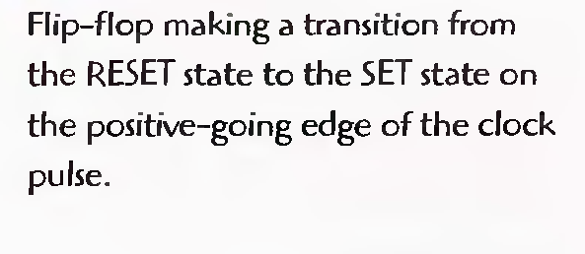
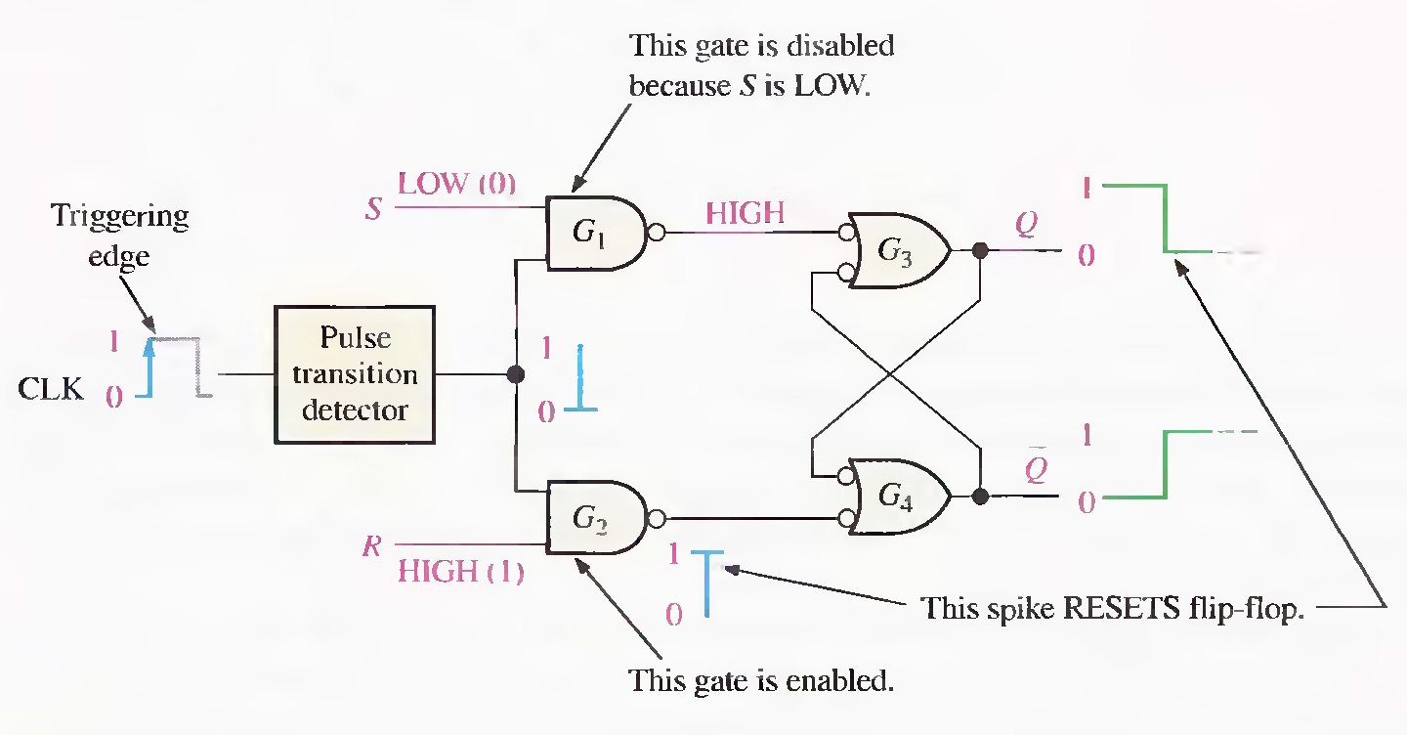
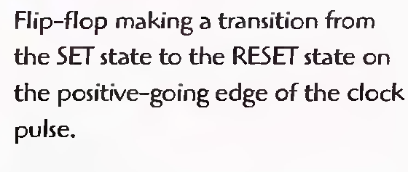

Slide 10

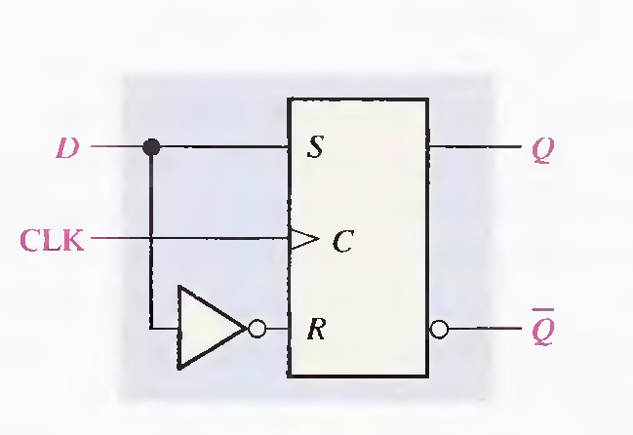
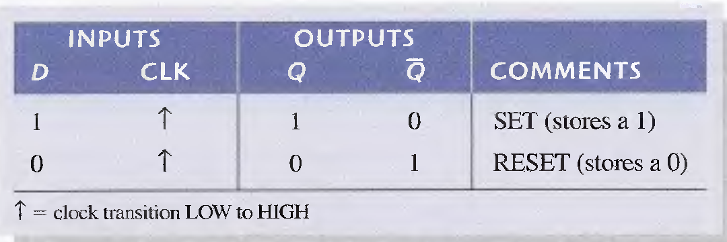
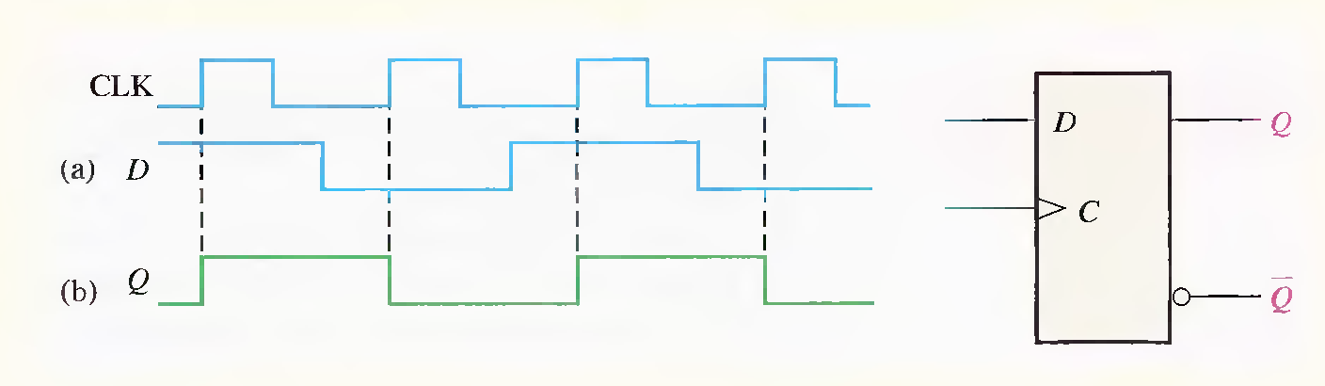

Slide 11

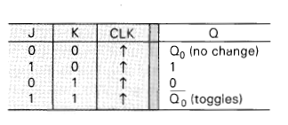
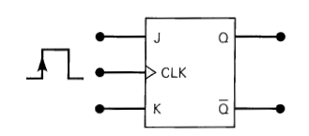
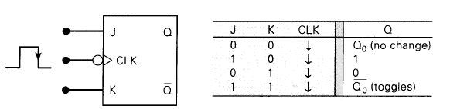
The J and K inputs control the state of the FF in the same ways as the S and C input do for the clocked S-C Flip Flop except one major difference:
The J=K=1 condition does not result in an ambiguous output.
For this condition J=K=1, the FF will always go to its opposite state upon the positive transition of the clock signal. This is called the
Toggle Mode of operation.

Slide 12
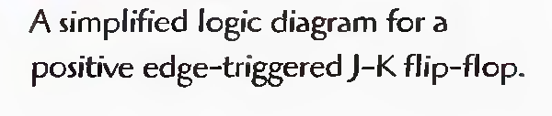
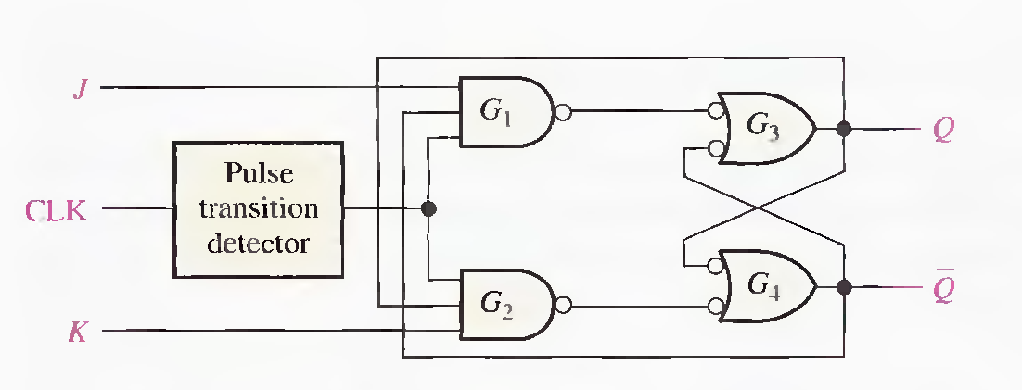
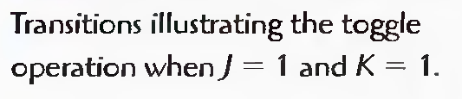
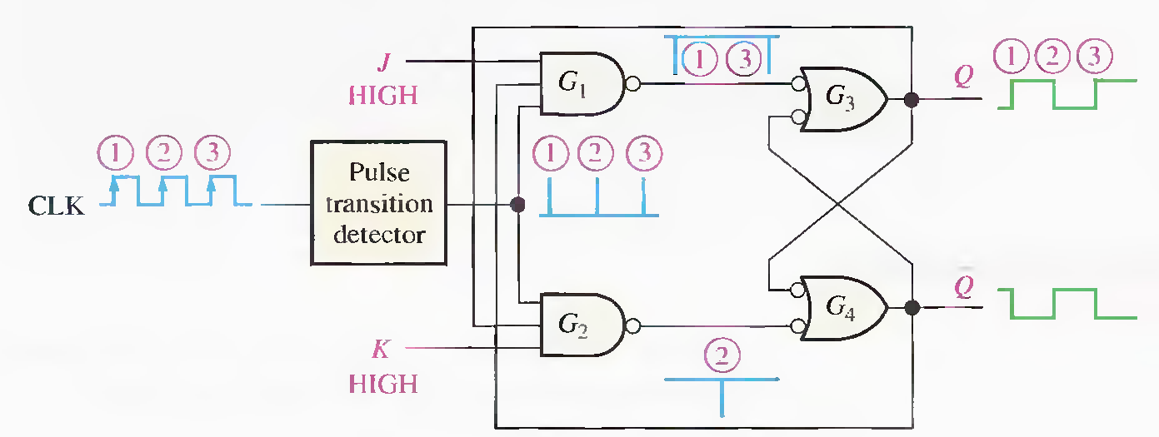

Slide 13

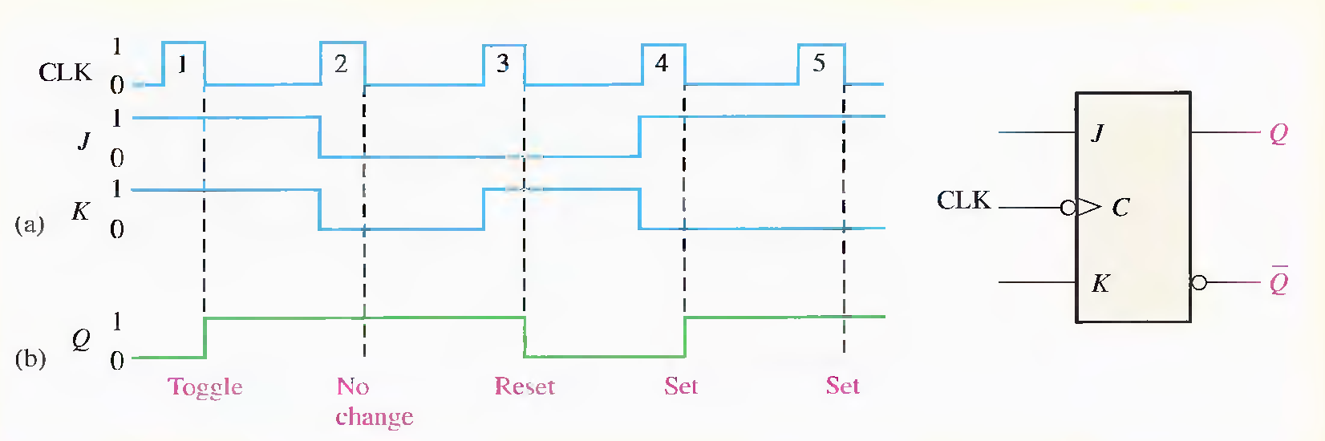

Slide 14
