Slide 1

COMPUTER ARCHITECTURE
BS (CS) Core Course
Fall 2019
Prof. Dr. Hasina Khatoon

Slide 2
Objectives and Goals
Gain a working knowledge of architecture of a computer subsystem and the general principles that affect their performance
Analyze the performance of systems and quantify performance measurements
Gain knowledge about advanced architectural features that boost the performance of processors
Identify bottlenecks to performance and explore possible solutions
Study the major trends towards parallelism with respect to a single processor and with multicore architecture
Obtain an overview of new and emerging architectures and their trends

Slide 3
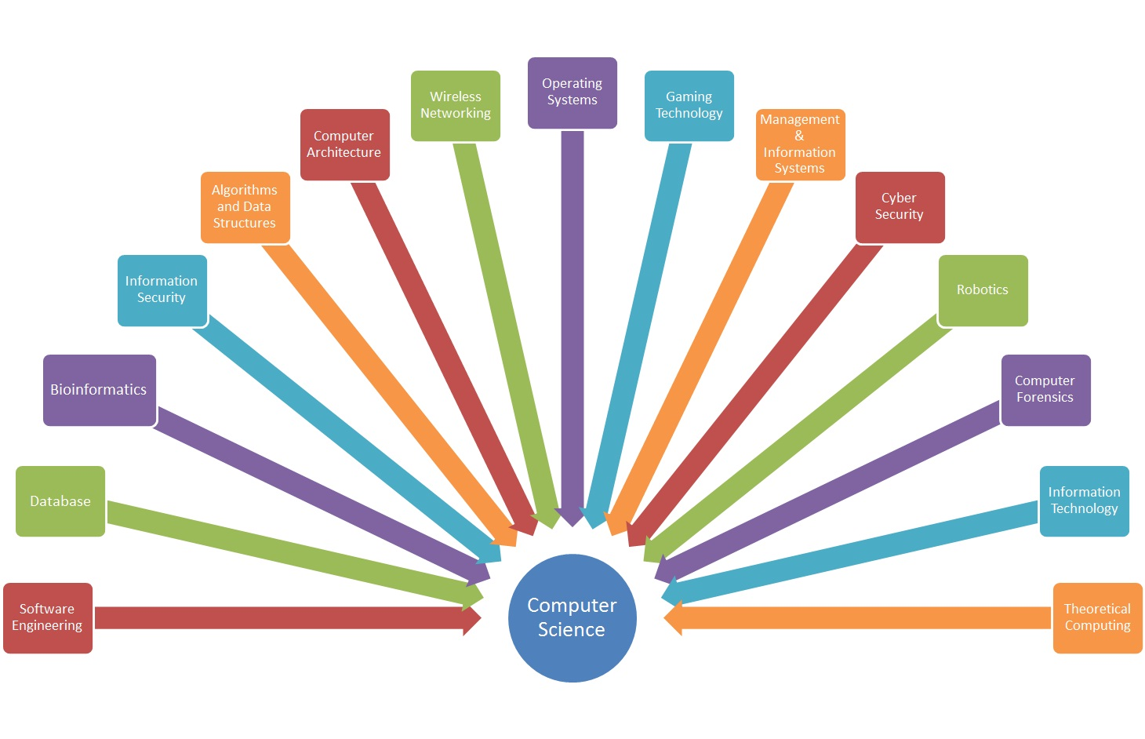
Areas of Computer Science

Slide 4
Computer Architecture - Syllabus
Contents and Tentative Sequence
Fundamentals of Quantitative Design
Trends, Measuring Performance, ISA Principles, Amdahl’s law, CPU Performance Equation
Instruction Set Principles
Classes of ISA, Role of Compiler, RISC V Architecture
Basic Concepts of Pipelining of Processors
Pipeline hazards, Exception handling, Pipelines for Multicycle Instructions, Superscalar Processors
Instruction-Level Parallelism and Dynamic Scheduling of Pipelines
Scoreboard and Tomasulo’s Algorithm
Recent trends in the architecture of processors

Slide 5
Computer Architecture - Syllabus
Memory Hierarchy Design
Review of Cache design, Cache optimizations, Main memory optimizations, Recent trends in memory hierarchy design, Introduction to cache coherence issues
Parallelism in Computer Architecture
Data-level parallelism, Thread-level parallelism
Advanced Architectural features and parallelism
Vector Architecture, SIMD extensions, GPUs, VLIW, EPIC, Multicore Processors, DSAs
Text Book
Computer Architecture: A Quantitative Approach
By Hennessy & Patterson Sixth Edition
Notes:
EPIC – explicitly parallel Instruction Computing

Slide 6
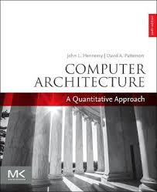
Textbook

Slide 7
Computer Architecture – Syllabus
Reference Books
Computer Organization & Design : The Hardware/ Software Interface By Patterson & Hennessy
Computer Organization and Architecture, Designing for Performance by William Stallings, 8th Edition
Computer Architecture and Organization
By John P. Hayes
Computer Architecture By Morris Mano
Evaluation Criteria
Final 50%
Term Exams (Two) 15% each
Quiz + Assignments 5%
Project 15%
Notes:
EPIC – Explicitly Parallel Instruction Computing

Slide 8
Related Courses
Parallel
Processing
COAL
Computer
Architecture
High
Performance
Computing
FPGAs,
Computer aided
Logic design
Computer
Based
Sysems
Computer Based Systems

Slide 9
Computer Architecture - Syllabus
Course pre-requisites
Digital logic design
Computer Organization and Assembly Language
Operating system basics
Lectures shall be uploaded on Slate at the end of every week
Attendance is mandatory (100%)
Contact Hours
As per time table
My Office hours (Tentative)
Monday and Thursday: 2:00 pm to 3:30 pm

