Slide 1
Introduction and Quantitative Analysis
Classes of Computers
Trends in Technology and Implementation
Measuring and Reporting Performance
Quantitative Principles of Computer Design

Slide 2

Introduction
Computers based on recent processors have focused on two critical performance improvement techniques
Exploit Instruction-level parallelism
Pipelining and superscalar execution
Use of caches
Effects of sustained growth in performance
Significant enhancement in the capability available to computer users
New classes of computers have emerged
Microprocessor-based computers are dominating the entire range of computer design
The developments have a major impact on software development
Notes:
Recent are RISC-based processors
Performance growth in the 17 years (show diagram)

Slide 3
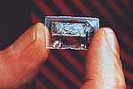
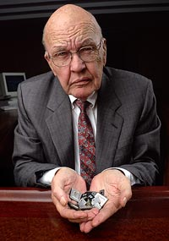
Semiconductor History
Date | Event | Comments
1947 | 1st transistor | Bell Labs
1958 | 1st IC | Jack Kilby (MSEE ’50) @TI Winner of 2000 Nobel prize
1971 | 1st microprocessor | Intel (calculator market)
1974 | Intel 4004 | 2300 transistors
1978 | Intel 8086 | 29K transistors
1989 | Intel 80486 | 1M transistors
1995 | Intel Pentium Pro | 5.5M transistors
2006 | Intel Montecito | 1.7B transistors
2015 | Oracle SPARC M7 | 10B+ transistors
Notes:
If transistors were the size of a penny, 1.7B transistors would fill 9 school buses.
Instead, the Montecito chip is the size of a penny.

Slide 4
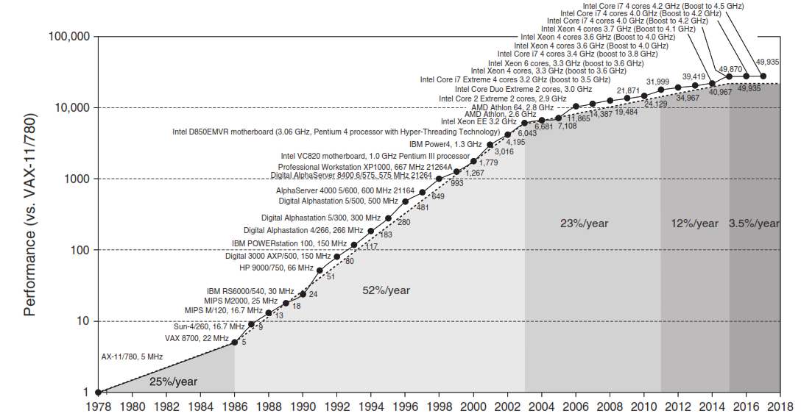

Slide 5
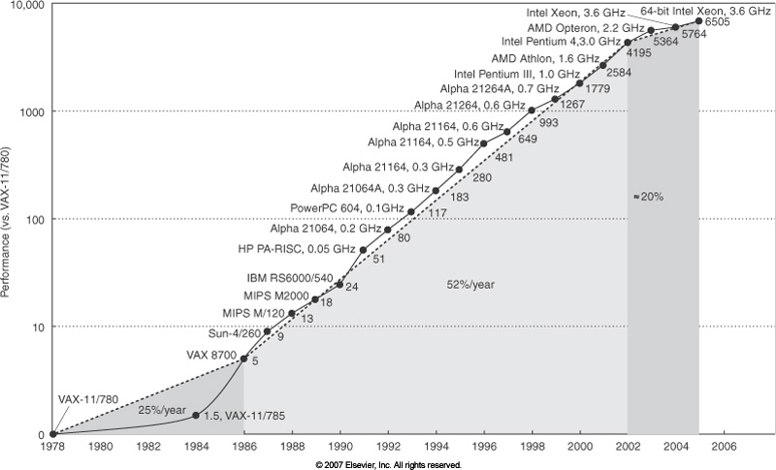
Trends: The End of the Uniprocessor Era
Hardware and software, ILP!
Intel cancelled high performance uniprocessor, joined IBM and Sun for multiple processors
Hardware based

Slide 6
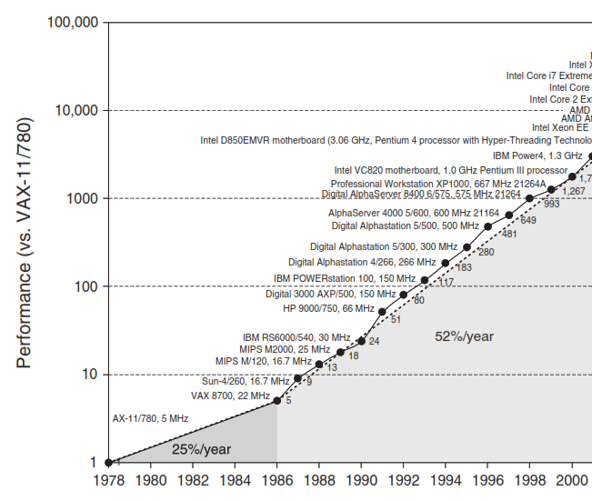

Slide 7
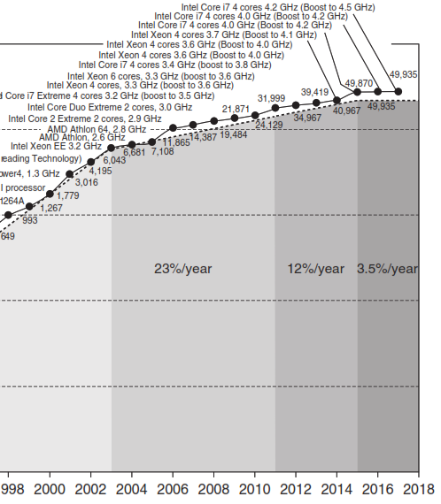

Slide 8
Introduction
Performance is traded with productivity
Strategy for software development has also changed
Software as a service (SaaS) is used instead of the conventional shrink-wrapped software
Nature of applications have also undergone a change
Shift from ILP (Instruction-Level Parallelism) to DLP (Data-Level Parallelism) and TLP (Thread- Level Parallelism)
There is also an extensive use of RLP (Request-Level Parallelism)
ILP has been implicit but TLP, DLP and RLP are explicit parallelism
The major burden for exploitation of this shift is on the programmers

Slide 9
Introduction
Combination of the following factors result in decrease in processor performance improvement
Slowdown in Moore’s Law and end of Dennard scaling
Replacement of single power-hungry processor with several energy-efficient processors
The limits to multiprocessing
The overall processor performance improvement has slowed down
Specialization is a solution to the problem
Several Domain specific cores
Domain specific architectures (DSAs)
Notes:
Dennard scaling: power density is constant for a given area of silicon, even if the number of transistors increase due to diminishing size – ended in 2004

Slide 10
Classes of Computers
Five different computing markets characterized by different
Applications
Requirements
Computing Technologies
Internet of Things/ Embedded Computers
Personal Mobile Devices (PMDs)
Desktop computing
Servers
Clusters/Warehouse-scale Computers
Important characteristics of each of the classes

Slide 11
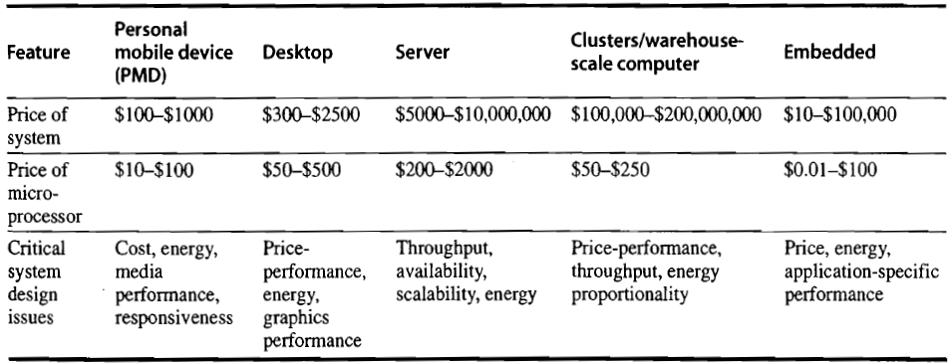
Classes of Computers Characteristics of Computer Classes Computer Classes and Their Characteristics
Internet of Things/

Slide 12
Classes of Computers
Internet of things/ Embedded Computers
Computers lodged in other devices
IoT refers to embedded computer that are connected to the Internet
Lead to a wide variety of smart applications
Augmented with sensors and actuators
Embedded systems have largest range of processing power and cost
Price is the key factor in the design of these computers
Evaluation of performance is not very well-defined in this class of computing

Slide 13
Personal Mobile Devices (PMDs)
Collection of wireless devices with multimedia user interfaces
Cost is of prime concern
There should be a limited total power consumption
Applications are mostly web-based and media-oriented
Responsiveness and predictability are the key characteristics
Real-time performance requirements are high
Minimize memory and use energy efficiently
Code size should be optimal
Data size is application dependent

