Slide 1
Introduction and Quantitative Analysis
Classes of Computers
Trends in Technology and Implementation
Measuring and Reporting Performance
Quantitative Principles of Computer Design

Slide 2

Personal Mobile Devices (PMDs)
Collection of wireless devices with multimedia user interfaces
Cost is of prime concern
There should be a limited total power consumption
Applications are mostly web-based and media-oriented
Responsiveness and predictability are the key characteristics
Real-time performance requirements are high
Minimize memory and use energy efficiently
Code size should be optimal
Data size is application dependent

Slide 3
Classes of Computers
Desktop Computing
Largest market
Optimized in price/performance
More than half of desktops today are battery-operated laptop computers
Newest, highest performance and cost-reduced microprocessors first appear in desktop computers
Well characterized in terms of applications and benchmarking
Servers
Provides larger scale and more reliable file and computing services
Backbone of large-scale enterprise computing

Slide 4
Classes of Computers
Servers are characterized by
Availability
Scalability
Throughput
Cluster/Warehouse-Scale Computers
Clusters are collections of desktop computers or servers connected by local area networks to act as a single large computer
Due to growth of SaaS
A large cluster is referred to as warehouse-scale computer (WSC)
Power and cooling are essential aspects
Availability is critical

Slide 5
Classes of Computers
WSCs emphasize
Interactive applications
Large-scale storage
Dependability
High Internet bandwidth
Classes of Parallelism and Parallel Architectures
Parallelism is present at multiple levels
Parallelism in applications
DLP: Many data items can be operated on at the same time
TLP: Tasks of work are created that can operate in parallel
Computer hardware can exploit these parallelism in four ways

Slide 6
Classes of Parallelism
Instruction-Level Parallelism through
Pipelining and speculative execution
Exploits parallelism among instructions
Vector Architectures, Graphic Processor Units (GPUs)and multimedia instruction sets
Exploits DLP by applying a single instruction on a collection of data in parallel
Thread-Level Parallelism
Exploits DLP or Task Level Parallelism in a tightly coupled hardware model that allows interaction among parallel threads
Request-Level Parallelism
Exploits parallelism among largely decoupled tasks specified by the programmer or the OS

Slide 7
Classes of Parallel Computers
Flynn’s classified all computers into four categories on the basis of instruction and data streams
❶ SISD: Single Instruction Stream, Single Data Stream
This is the uniprocessor – exploits ILP
Includes pipelined and superscalar processors
❷ SIMD: Single Instruction Stream, Multiple Data Streams
Same instruction is executed by multiple processors using different data streams
Exploits data-level parallelism
Each processor has its own data memory but there is single instruction memory and control processor
Multimedia extensions, vector architectures and GPUs
These are special purpose processors

Slide 8
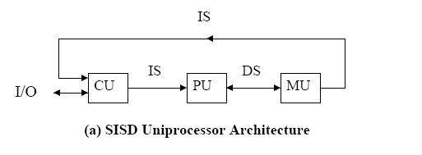

Slide 9
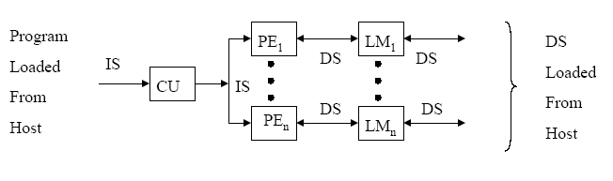
SIMD Architecture

Slide 10
Classes of Parallel Computers
❸ MISD: Multiple Instruction Streams, Single Data Stream
No commercial machine has been built to date
❹ MIMD: Multiple Instructions Streams, Multiple Data Streams
Each processor fetches its own instructions and operates on its own data
Tightly and loosely-coupled MIMDs
Exploits thread-level or request-level parallelism
The above taxonomy is a coarse model
Hybrid of the above categories are common
MIMD is the architecture of choice for general purpose multiprocessors

Slide 11
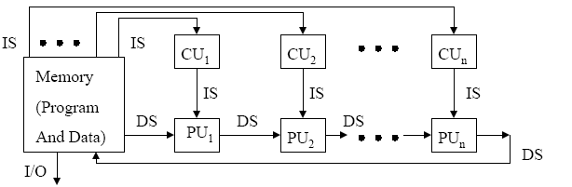
MISD Architecture

Slide 12
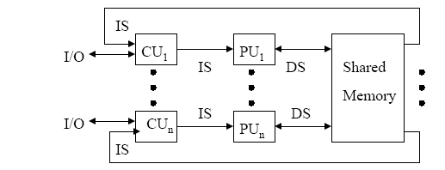
MIMD Architecture

Slide 13
Defining Computer Architecture
Traditional definition: “The term architecture is used here to describe the attributes of a system as seen by the programmer, i.e., the conceptual structure and functional behavior as distinct from the organization of the dataflow and controls, the logic design, and the physical implementation.” Gene Amdahl
IBM Journal of R&D, April 1964
The art of assembling logical elements into a computing device; the specification of the relation between parts of a computer system

Slide 14
Defining Computer Architecture
Computer architecture is a specification detailing how a set of software and hardware technology standards interact to form a computer system or platform
Computer Architecture is the science and art of selecting and interconnecting hardware components to create computers that meet functional, performance and cost goals.
WWW Computer Architecture Page

Slide 15
Defining Computer Architecture
Task of a designer
Maximize performance with energy efficiency
Aspects to consider
Instruction set design Logic Design
Functional organization Implementation
Instruction set Architecture
Programmer-visible instruction set
Boundary between hardware and software
Seven dimensions of ISA
Class of ISA
General purpose register (GPR) architecture:
Operands are either registers or memory locations
Two versions of GPR architecture
Register-memory - Intel 80x86
Notes:
Register-memory: access memory also as a part of ALU instructions

Slide 16
Instruction Set Architecture
Load-store RISC V
Access memory only through load and store instructions
2. Memory addressing
Byte addressing for all memory addresses
Operands must be aligned
A mod s = 0
3. Addressing modes
Specify the address of a memory object
RISC V supports three addressing modes:
Register, Immediate and Displacement
Intel 80x86 supports
The above three plus almost thirty more addressing modes

Slide 17
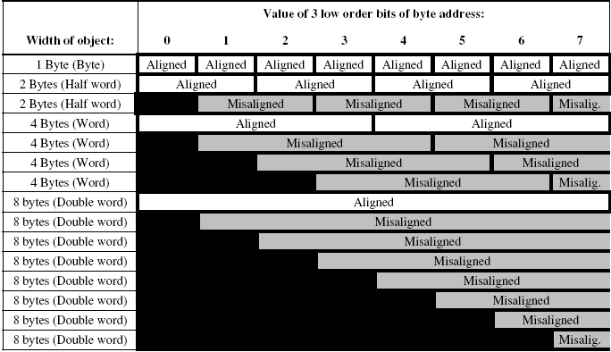
Aligned and misaligned addresses for byte addressed computers

Slide 18
Instruction Set Architecture
4. Types and Sizes of operands
All processors support: 8-bit (ASCII character)
16-bit (Unicode char. or HW)
32-bit (integer or word)
64-bit (double word or long)
IEEE 754 floating point 32-bit (single precision) and 64-bit (double precision)
5. Operations
RISC processors have lesser and simple operations
Easy-to-pipeline ISA
CISC have richer and larger set of operations
Data transfer, arithmetic and logic, control and floating-point operations
RISC-V vs 80x86 operations

Slide 19
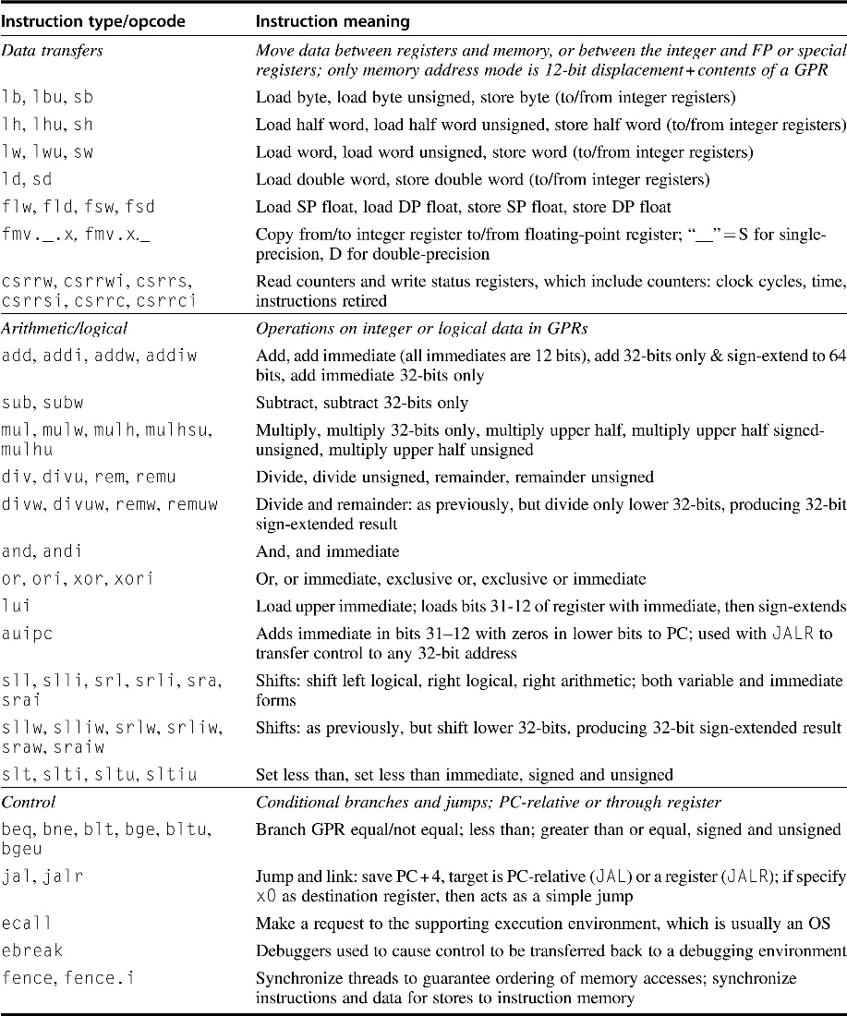

Slide 20
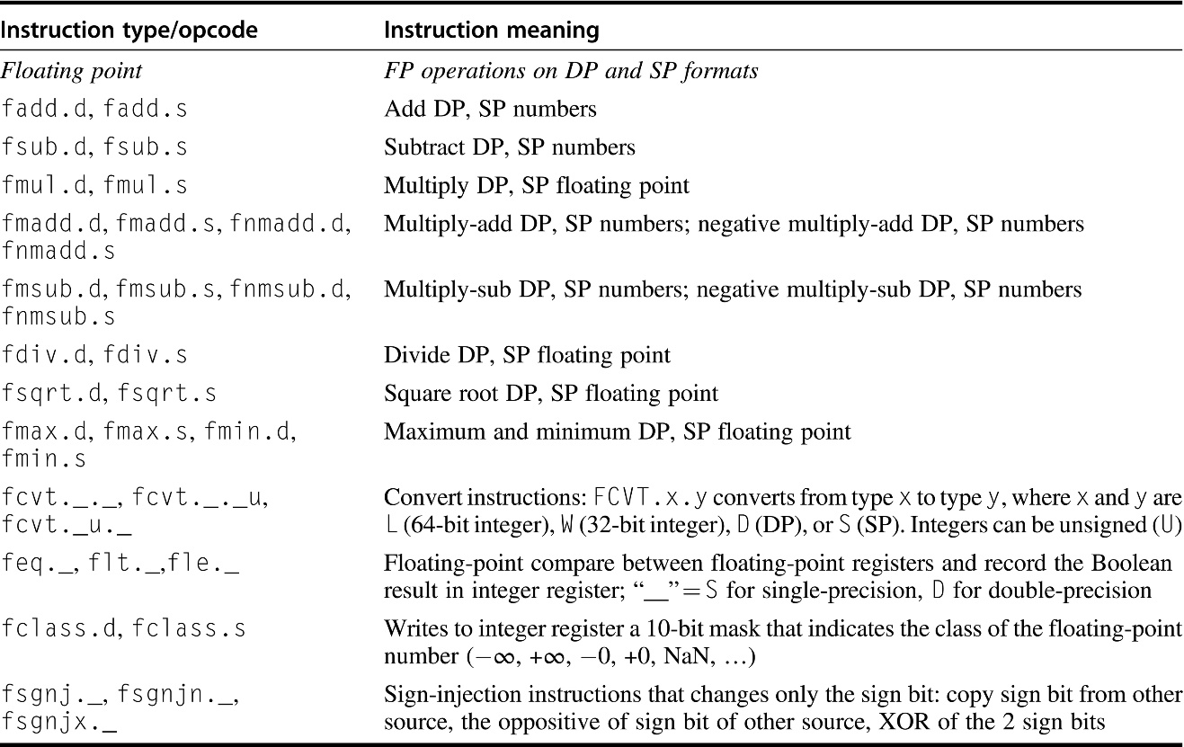

Slide 21
Instruction Set Architecture
6. Control flow instructions
All ISAs support
Conditional branches
Unconditional jumps
Calls and returns
PC-relative addressing mode is used for control flow instructions – branch address
Branch condition
RISC V tests the contents of a register
80x86 tests condition code bits (flags register)
Return address for call instruction
Stored in a register in RISC V
Placed on the runtime stack in 80x86 processor

Slide 22
Instruction Set Architecture
7. Encoding an ISA
There are two basic choices
Fixed-length instructions
Variable-length instructions
RISC V has fixed-length instructions of 4 bytes
Simplifies instruction decoding
80x86 has variable-length instructions of 1 to 18 bytes
Takes less space as compared to fixed-length instructions
Instruction set of RISC V
Instruction format of RISC V

Slide 23
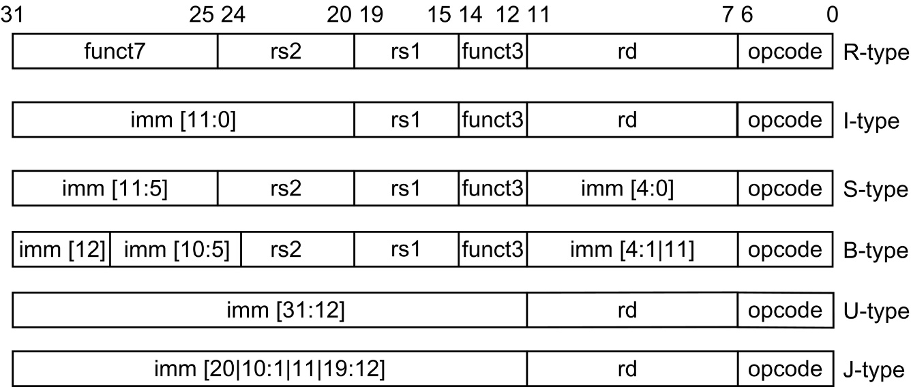
RISC V Instruction Formats

Slide 24
Goals and Functional Requirements
Components for implementation of a computer
Organization and hardware
Organization or micro architecture
High level aspects of a computer’s design
Hardware
Specifics of a computer that includes
Detailed logic design
Packaging technology used
Architecture covers all three aspects of computer design
ISA
Organization or micro architecture
Hardware
Functional requirements that need to be fulfilled
Notes:
High level aspects: memory system, memory interconnect, design of internal processor or CPU

Slide 25
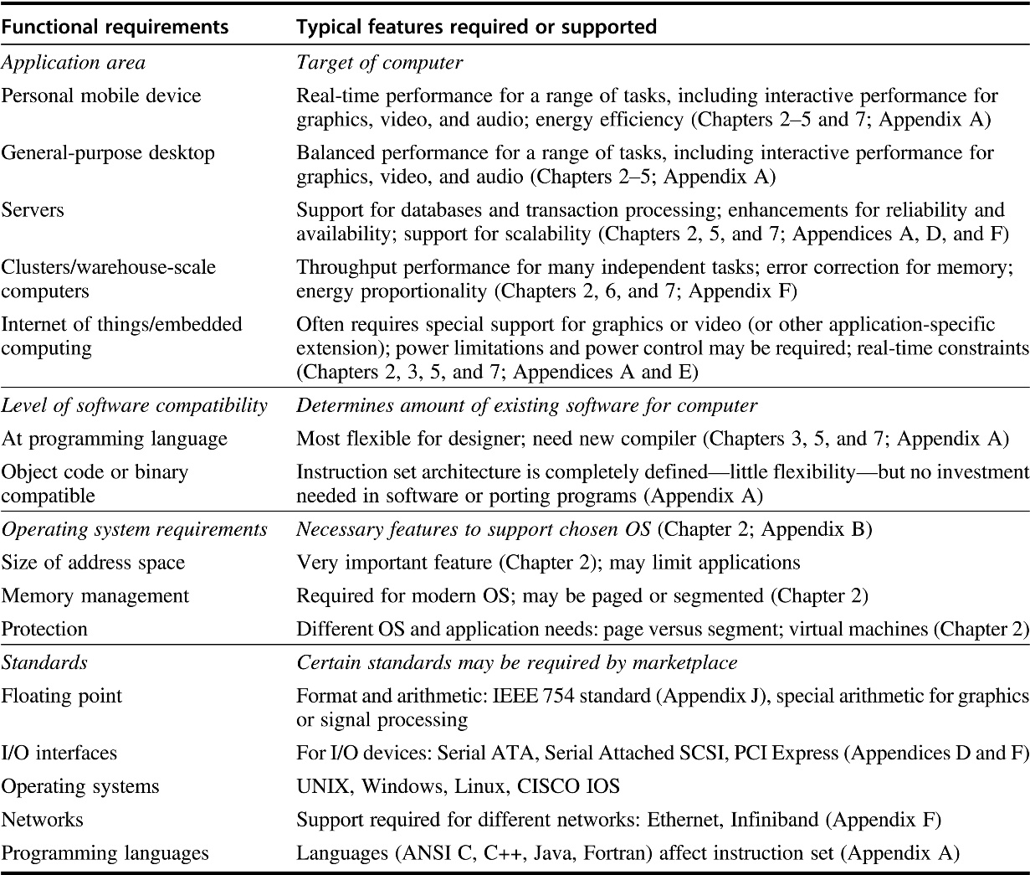

Slide 26
Trends in Technology
ISA must be designed to survive rapid changes in technology
Designer must be aware of changes in implementation technology
Five critical implementation technologies that change very fast
IC Logic Technology
Transistor density increased by 35% per year
Transistor count increased by 40% to 55% /yr
Moore’s law has slowed down
Semiconductor DRAM
Capacity increased by about 25% to 40% per year
Cycle time has improved slowly
Capacity is also reaching its limit
Semiconductor Flash (EEPROM)
Standard storage device in PMDs
Notes:
Moore’s law has slowed down and the pace is much slower

Slide 27
Trends in Technology
Capacity has increased by 50% to 60% per year
Doubles every two years
Magnetic Disk technology
Density increased by about 40% per year
Reached the capacity wall
Network Technology
Rapidly changing area with a high growth rate
Performance Trends: Bandwidth over Latency
Bandwidth or throughput
Total amount of work done in a given time
Latency or response time
Time between start and completion of an event
Bandwidth grows by at least the square of the improvement in latency
Designers must plan accordingly

Slide 28
Trends in Technology
Scaling of Transistor Performance and Wires
More related to VLSI technology
Feature size has reduced from 10 microns (1971) to .016 microns in 2017 and 7 nanometer chips are expected to be available soon
Density of transistors increases quadratically with a linear decrease in feature size
Performance is a complex issue
As a first approximation, transistor performance improves linearly with decreasing feature size
Wire delay scales poorly with decrease in feature size
Power consumption plays an important role

Slide 29
Other Trends
Trends in Power and Energy in ICs
Distributing the power, removing the heat and preventing hot spots are major challenges
Power is dissipated as heat and must be removed
A large number of pins of the IC is consumed in power and ground connections
Amount of power consumed, maximum power and its effect on clock frequency are other main issues

Slide 30
Other Trends
Trends in Cost
Cost sensitive designs are significant
Major theme in computer industry has been to increase performance and lower the cost
Maintain good cost-performance ratio
Major factors that influence the cost of a computer
Yield: The percentage of manufactured devices that survive the testing procedure
Cost of an Integrated Circuit
Reading assignment

