Slide 1

Instruction Set Principles Appendix A
Classifying ISA
Design alternatives available to the instruction set architect
Role of Compiler
The RISC-V ISA

Slide 2
The Role of Compilers
Goals of a compiler
Correctness
Speed of compiled code
Fast compilation
Debugging support
Interoperability among languages
Passes reduce complexity but enforces ordering of some transformations over others
Phase ordering problem is encountered
Procedure inlining
Global common sub-expression elimination
For optimized performance, register allocation should be done
Classification of Optimizations
ISA has a greater impact on optimizations

Slide 3
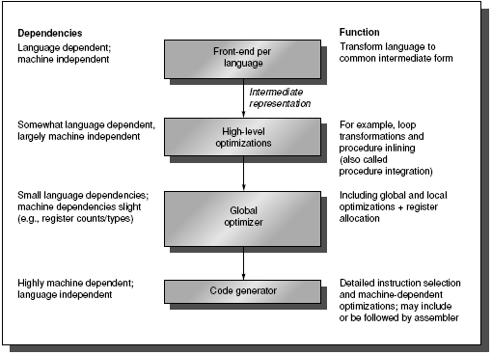
Passes of compilers

Slide 4
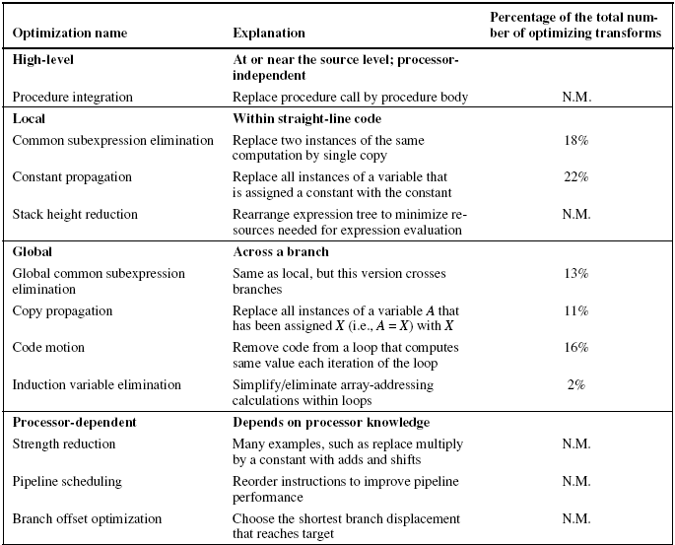
Major types of compiler optimizations

Slide 5
The Role of Compilers
Register Allocation:
How many registers are sufficient?
Allocation uses graph coloring technique
Works well only when the number of registers is greater than 16
Optimized code gives better and accurate analysis of frequency of occurrence
How can the Architect help the Compiler Writer?
Use basic principle
Make the frequent case fast and make the rare case correct
Instruction set properties that make it easier for a compiler to generate efficient and correct code

Slide 6
The Role of Compilers
Desired Instruction Set properties that help the compiler writer:
Provide Regularity
Primary components of an instruction set should be orthogonal
Helps simplify code generation
2. Provide primitives, not solutions
Special features that “match” a particular semantics are rarely used
3. Simplify tradeoffs among alternatives
Cache and pipelining have made the problem more complex
4. Provide instructions that bind the quantities known at compile time as constants

Slide 7
The Role of Compilers
Compiler Support (or Lack of) for Multimedia Instructions
SIMD instructions are rarely used
SIMD instructions tend to be solutions
These are not primitive operations
Vector architecture have vector registers and their own compilers to support SIMD operations
Gather/Scatter operations add to the overhead
SIMD instructions may be found in hand-coded libraries rather than in compiled code

Slide 8
Instruction Set Principles and Examples
Putting It All Together: The RISC V Architecture
Recommendations /observations of all the previous discussions are considered
Both 32-bit and 64-bit instruction sets are provided
RV64 provides 64-bit instruction set
RV32 provides the 32-bit instruction set
A number of extensions are available for a variety of features e.g. floating point
Review of popular RISC architecture features
GPR and load/store architecture with 32 registers
Displacement, immediate and register indirect addressing modes; fixed length instruction encoding
Implements simple, most frequently used instructions

Slide 9
Instruction Set Principles and Examples
RISC V emphasizes the basic principles of RISC architecture
A simple load/store instruction set
Design for pipelining efficiency with fixed length instruction set encoding
Efficiency as a compiler target
Easy to understand architecture
RISC-V instruction set organization
Organized as three base instruction sets
32- or 64-bit integers and a variety of optional extensions
RISC-V base and all extensions
RV64IMAFD, also called RV64G shall be used

Slide 10
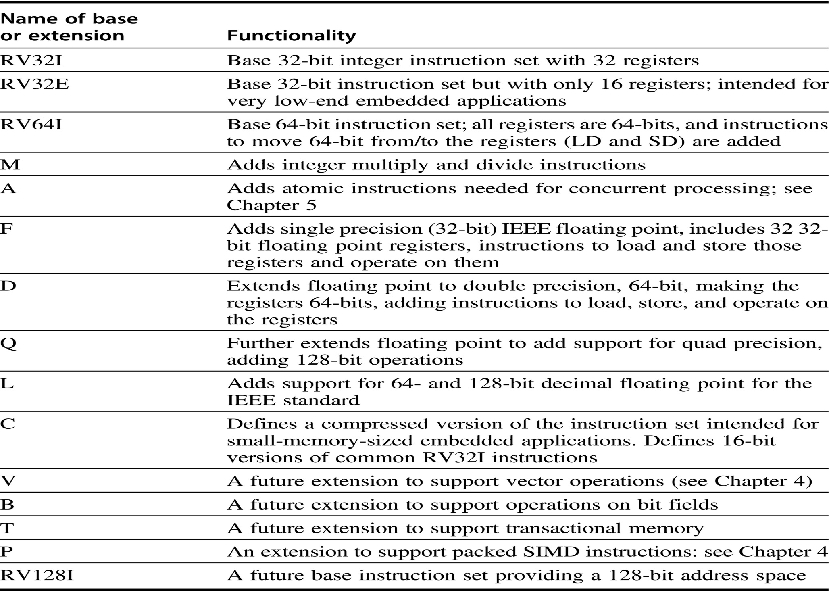
RISC-V Base Instruction Sets and possible Extensions

Slide 11
The RISC-V Architecture
Registers for RISC-V
Thirty two 64-bit Registers – integer registers
x0, x1, …, x31 Content of x0 is always 0
Thirty two Floating-Point Registers: f0, f1, .., f31
Can be used both as single precision and double precision registers
Special registers: e.g. floating-point status register
Instructions are available that can transfer to and from GPR and FPR
Data Types for RISC-V
8, 16, 32 and 64-bit integers
32 and 64-bit IEEE Floating-Point format
All operands for ALU operations are 64-bit integers

Slide 12
The RISC-V Architecture
Any other size operands are either sign or zero-extended
Addressing Modes for RISC-V Data Transfers
Immediate and displacement modes with 12-bit fields
Register Indirect mode and Direct mode of addressing can be obtained by use of various fields
Byte addressable memory with 64-bit address
Uses Little Endian byte numbering
Memory accesses need not be aligned but aligned accesses are faster
RISC-V Instruction Format
All instructions are 32 bit fixed length
Primary op-code is 7-bits
Addressing mode is encoded in the op-code

Slide 13
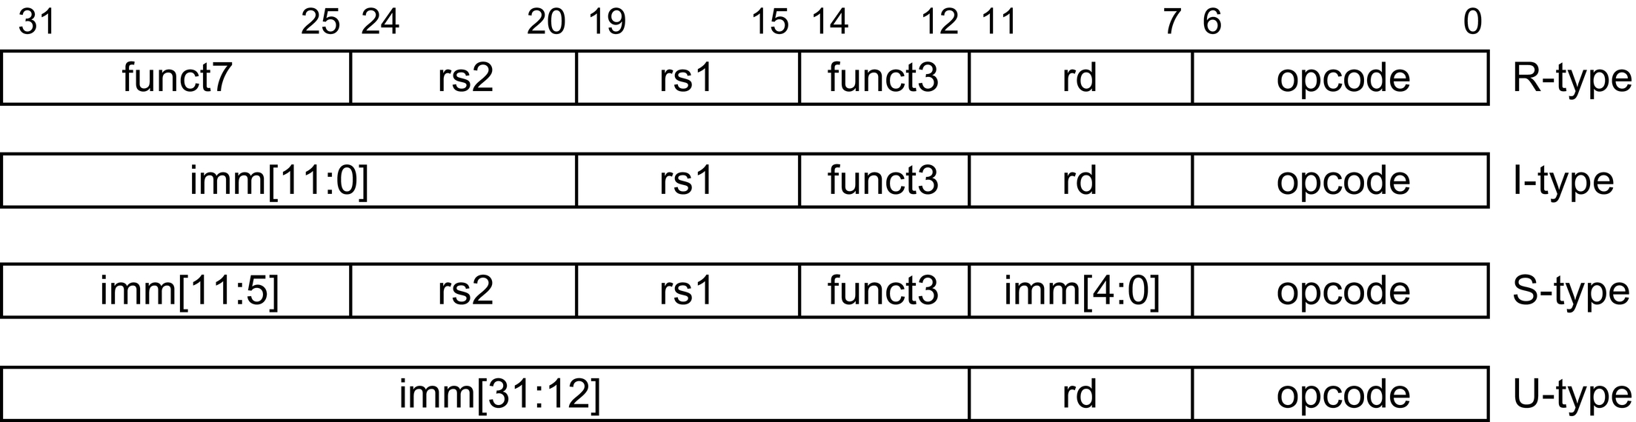
Instruction layout for RISC-V
Four major types of instructions

Slide 14
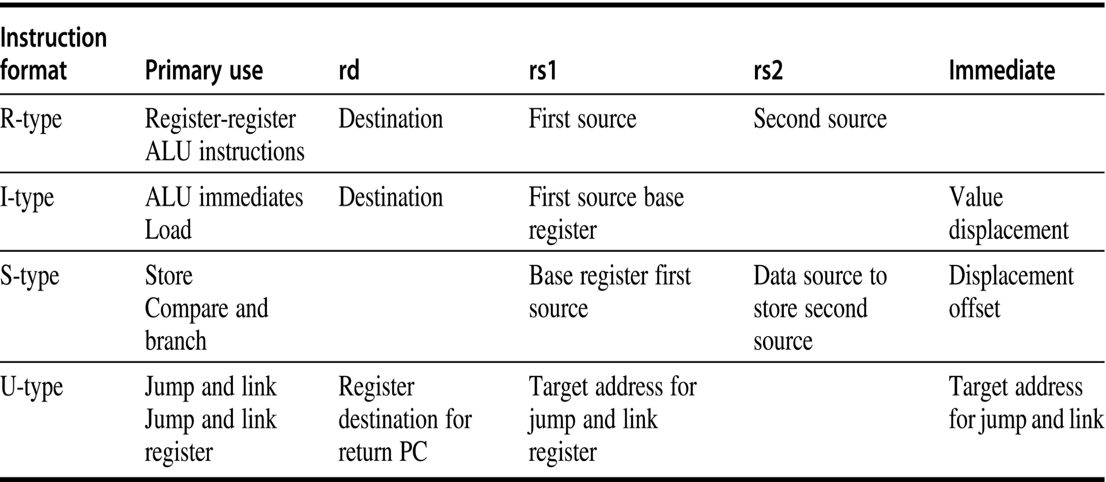
Instruction layout for RISC-V
Fields of each instruction type

Slide 15
The RISC-V Architecture
Operations in RISC-V
Supports Simple operations
Four classes of instructions
ALU Operations
Branches and Jumps
Loads and Stores
Floating-point Operations
Description language is used to describe operations
RISC-V Control Flow Instructions
All branches are conditional
Condition is specified by the instruction
Jump-and-link and Jump-and-Link register
Return address is saved in register specified by rd field of the instruction

Slide 16
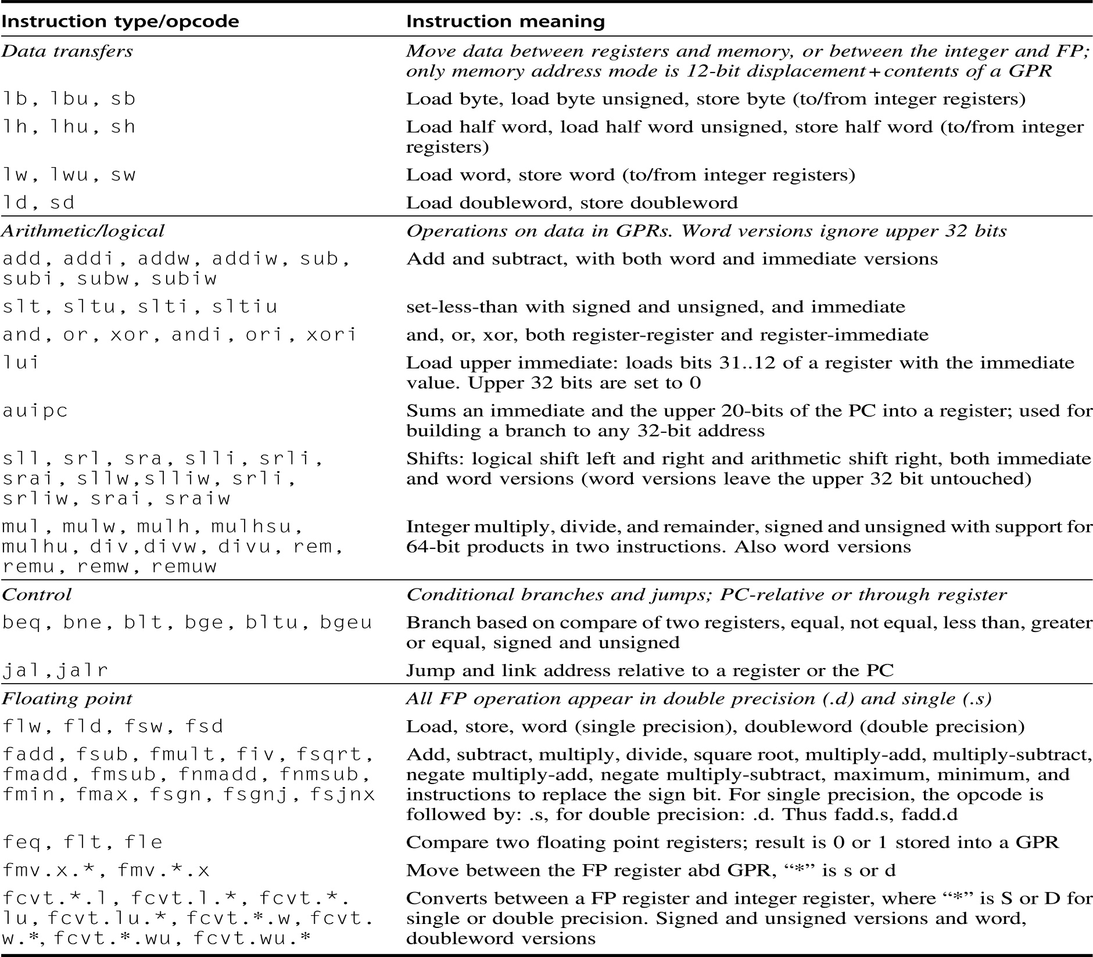
RISC-V INSTR

Slide 17
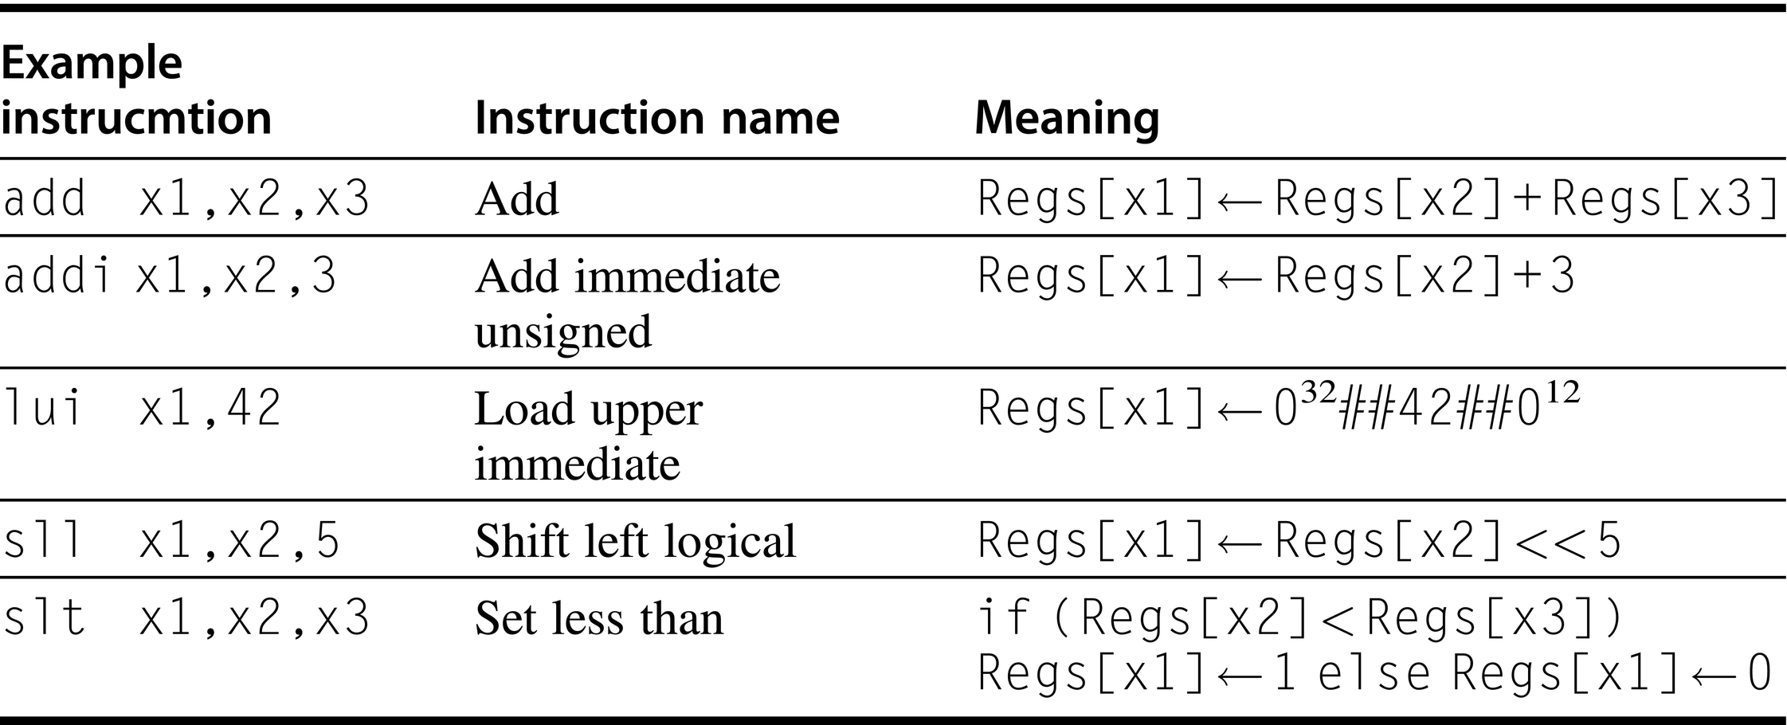
RISC-V ALU Instructions

Slide 18
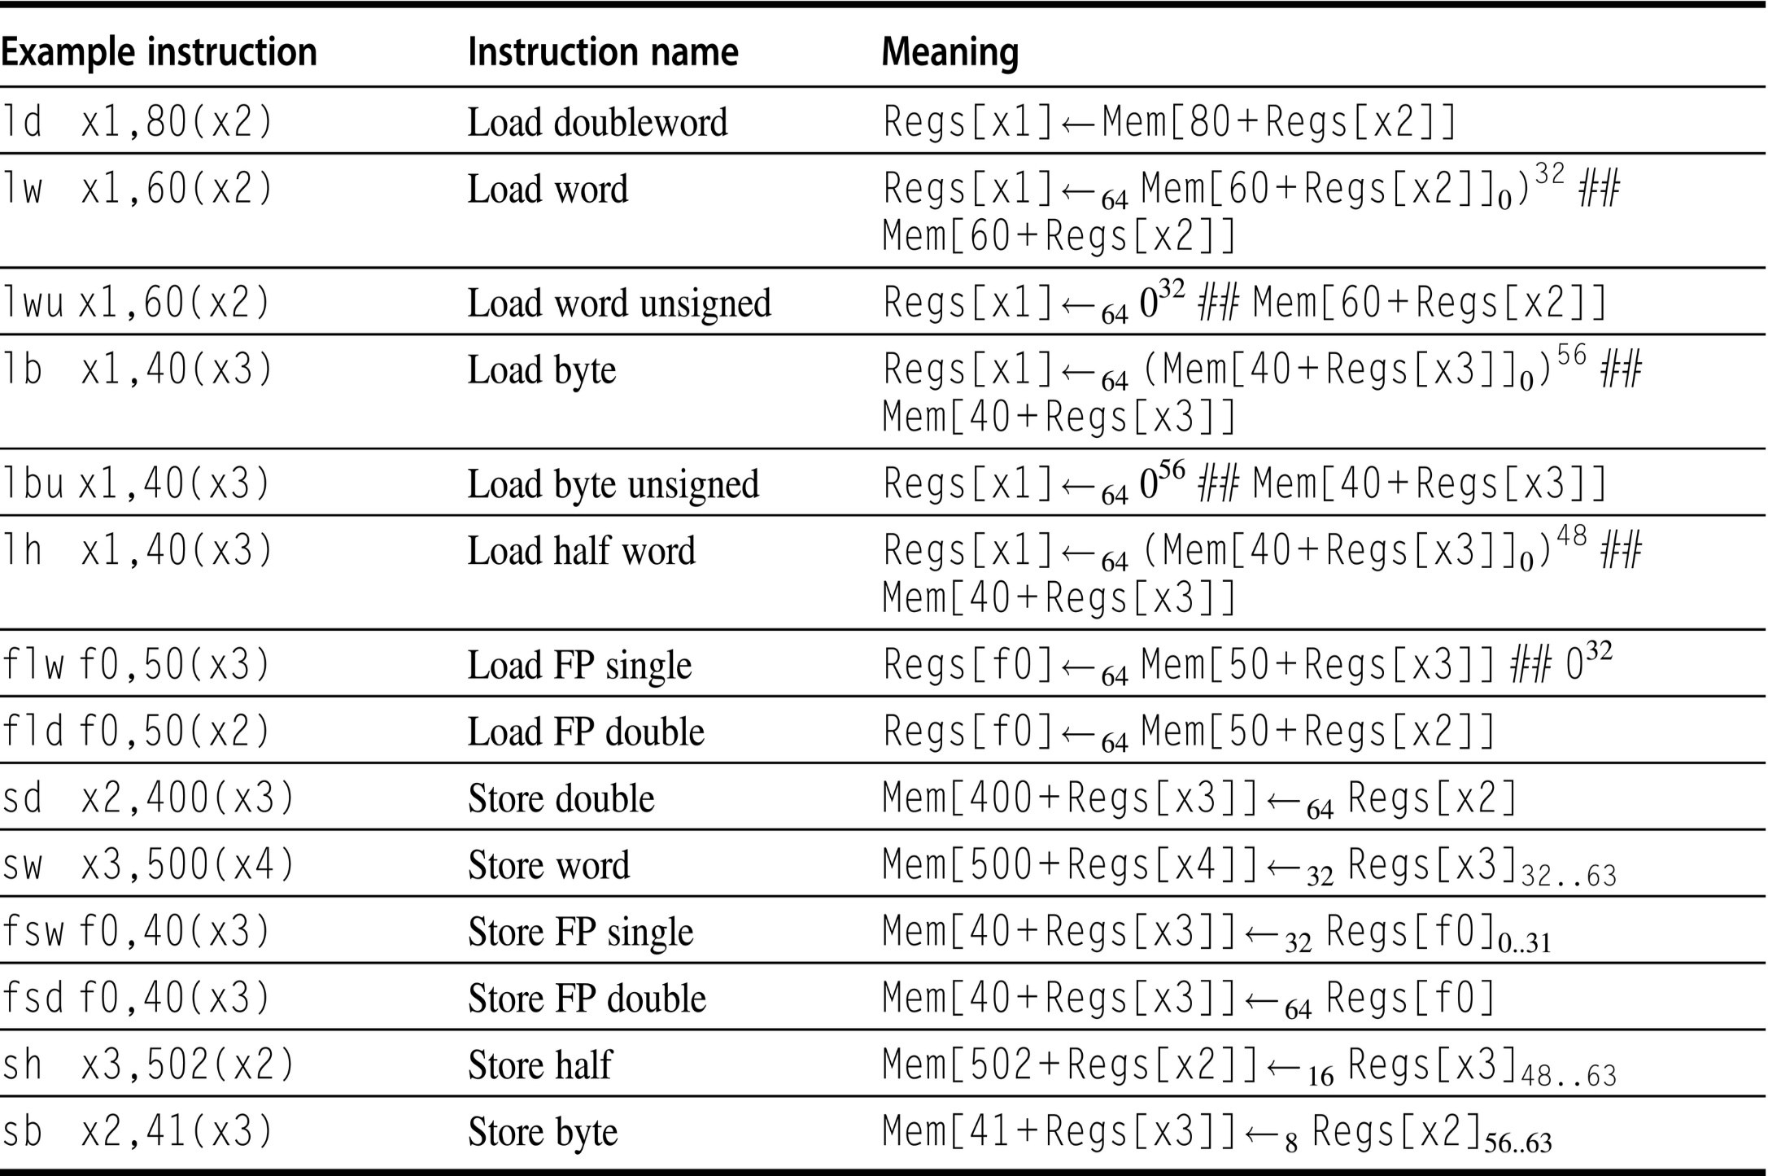
RISC-V Load/Store Instructions

Slide 19
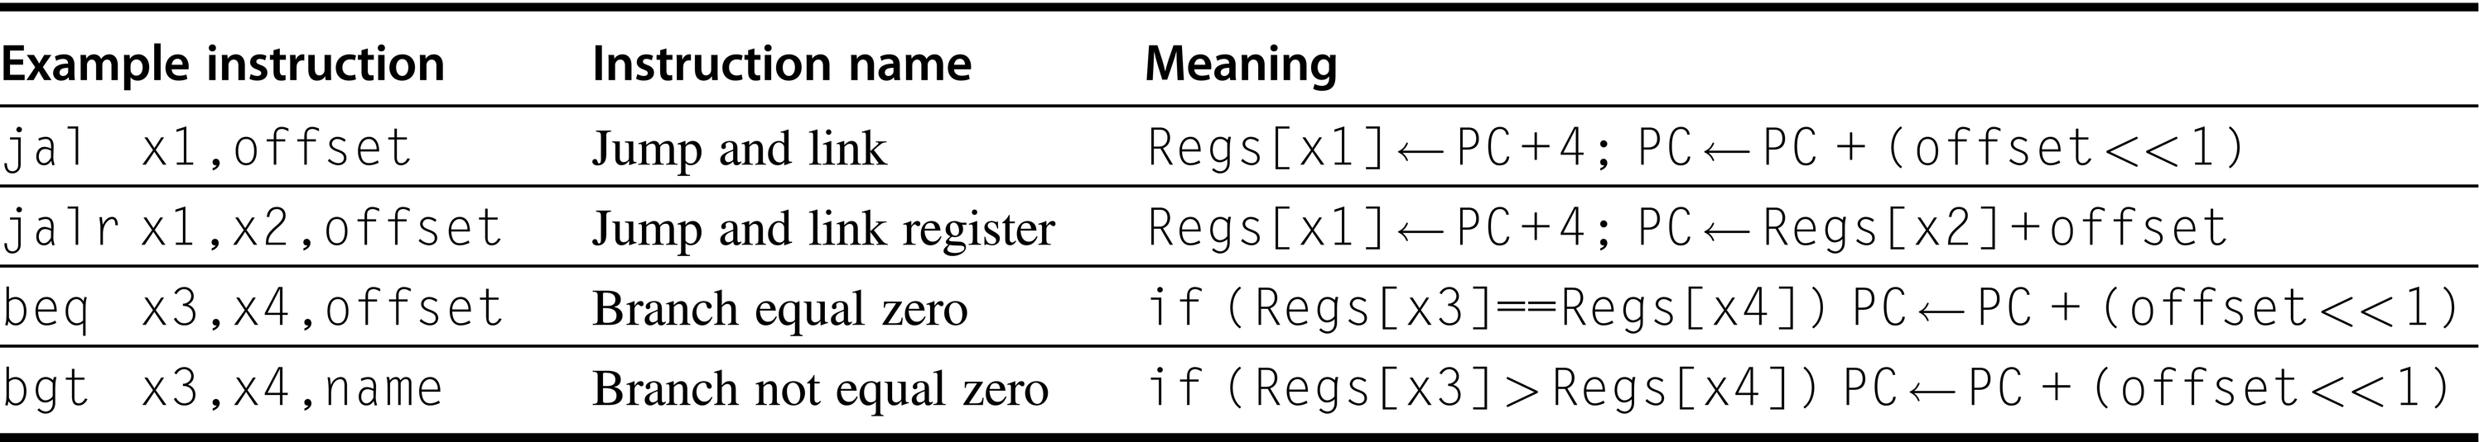
RISC-V Control Flow Instructions

Slide 20
The MIPS Architecture
RISC-V Floating-point Operations
Floating-point instructions manipulate floating-point registers
Floating point instructions begin with letter f
Suffix d is for double and s for single precision
Conversions from integer to floating-point and vice versa
Floating-point compares set an integer register
Floating-point status registers record the status of various floating-point operations
RISC-V Instruction Set Usage

