Slide 1

Instruction Set Principles Appendix A
Classifying ISA
Design alternatives available to the instruction set architect
Role of Compiler
The RISC-V ISA

Slide 2
The RISC V Architecture
RISC-V Floating-point Operations
Floating-point instructions manipulate floating-point registers
Floating point instructions begin with letter f
Floating-point arithmetic operations:
Suffix d is for double and s for single precision
Conversions from integer to floating-point and vice versa
Floating-point compares set an integer register
Floating-point status registers record the status of various floating-point operations
RISC-V Instruction Set Usage

Slide 3
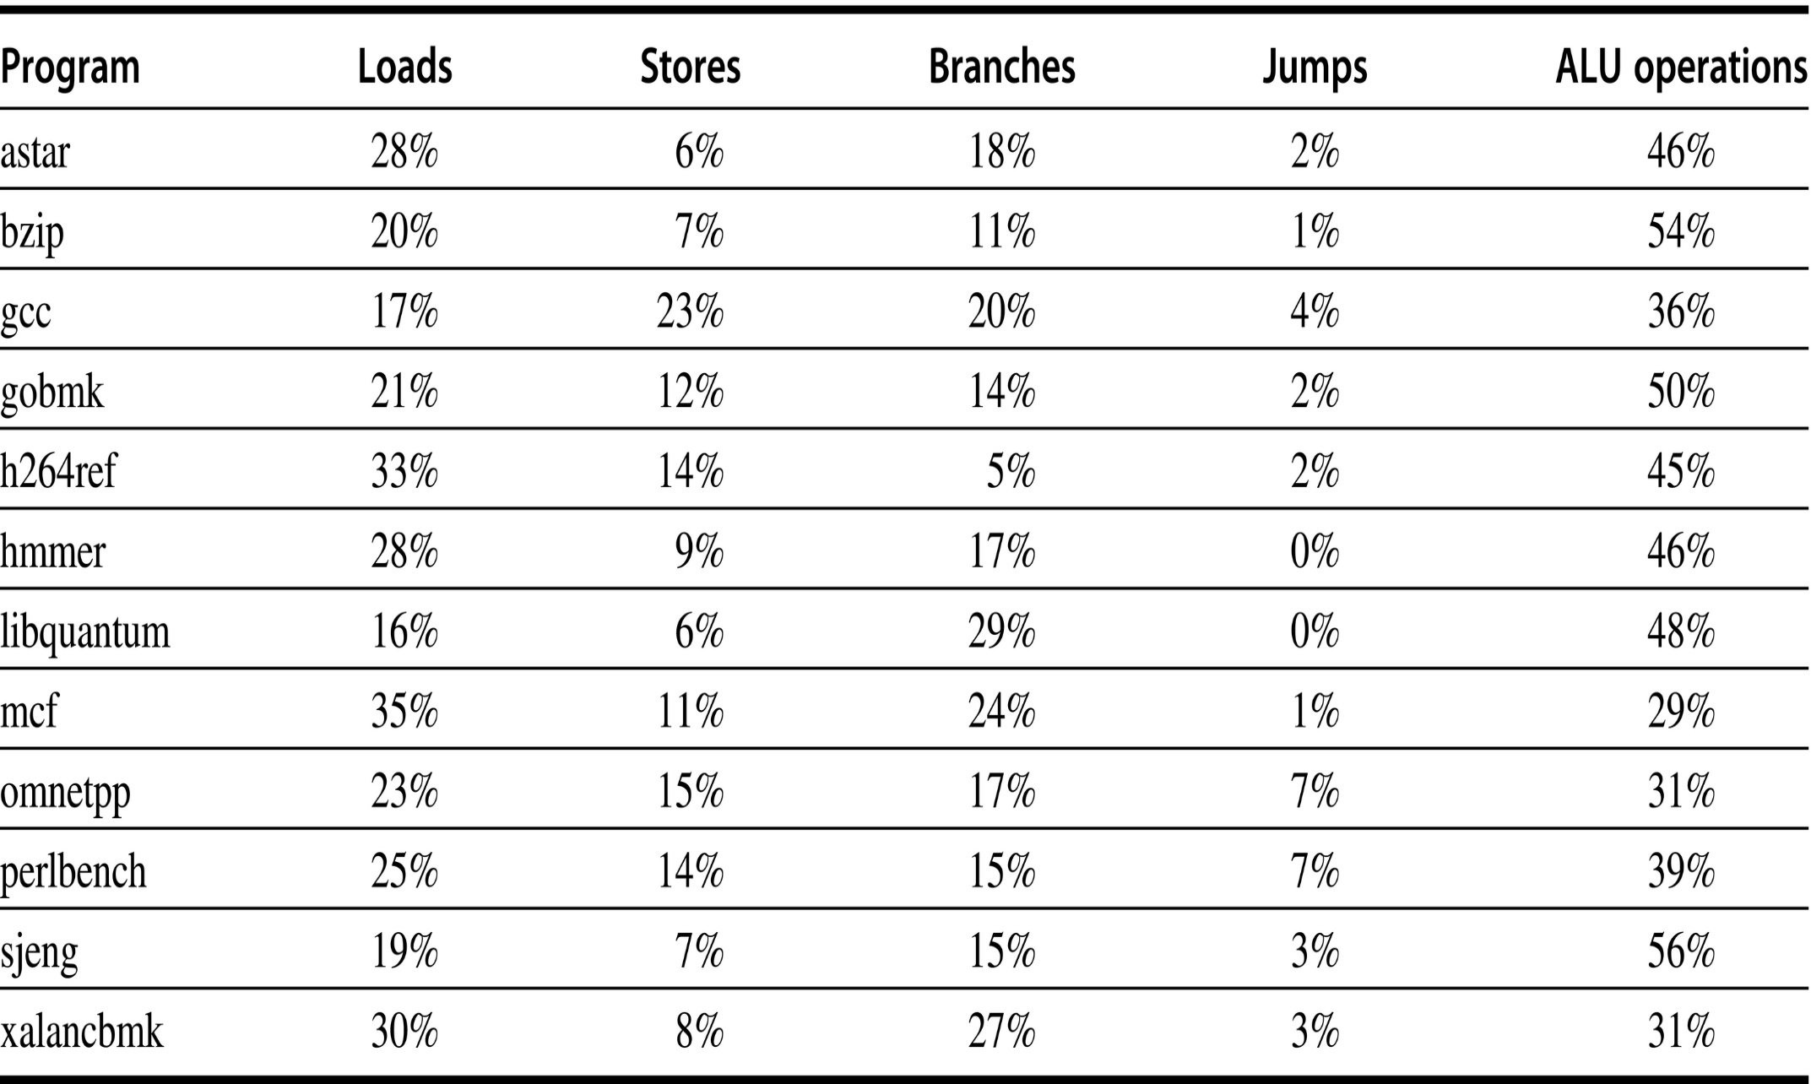
RISC-V dynamic instruction mix for the SPECint2006 programs

Slide 4
Fallacies and Pitfalls
Fallacy #1: There is such a thing as a typical program
Programs vary widely in how they use an instruction set
Fallacy #2: An architecture with flaws cannot be successful
80x86 is a typical counter-example
Fallacy #3: You can design a flawless architecture
All architecture involve trade-offs
Pitfall #1: Designing a “high-level” instruction set feature specifically oriented to support a high-level language structure
Most often the instructions are overkill

Slide 5
Fallacies and Pitfalls
Pitfall #2: Innovating at the instruction set architecture to reduce code size without accounting for the compiler
Compilers may not follow the designer’s strategy
Concluding Remarks
ISA changes in 90s
Address size doubles
Optimization of conditional branches via conditional execution
Optimization of cache performance via prefetch
Support for multimedia
Faster floating-point operations

Slide 6
Pipelining: Basic and Intermediate Concepts Appendix C
Basics of Pipelining
Implementation of Pipeline
Hazards and their Solutions
Exception Handling
Pipeline with Floating-Point Instructions
Dynamic Scheduling of Pipelines

Slide 7

Principles of Pipelining
What is Pipelining?
An implementation technique where multiple instructions are overlapped in execution
Each step completes a part of instruction
All stages must be ready to proceed at the same time
Throughput of a pipeline
How often an instruction exits a pipeline?
Number of instructions completed per unit time
Pipeline Processor Cycle
Time required to move an instruction one step down the pipeline
Determined by the slowest stage
Pipe stage or pipe segment

Slide 8
Introduction to Pipelining
For perfectly balanced set of stages
Time/Instruction in a pipelined processor =
Time/instruction on an unpipelined machine Number of Pipe Stages
Or Speedup from pipelining = Number of Pipe Stages
Limitations
Pipeline stages are not perfectly balanced
Pipelining involves some overhead
Pipelining yields reduction in average execution time/instruction
By decreasing CPI
A speedup technique that is not visible to programmers

Slide 9
Introduction to Pipelining
The Basics of the RISC-V Instruction Set
All operations are performed on registers and the entire register is involved
Only load/store instructions access memory
Processor comprises of only a few instruction formats and has single length instructions
Focus would be on three classes of integer subset of RISC architecture instructions
Integer ALU Instructions
Load/Store word Instructions
Branch Instructions
A Simple Implementation of a RISC Instruction Set
Implementation on a non-pipelined machine
An instruction takes at most 5-clock cycles

Slide 10
Introduction to Pipelining
IF (Instruction Fetch Cycle)
Send contents of PC to memory
Fetch current instruction from memory
Update PC by adding 4
ID (Instruction Decode/ Register Fetch Cycle)
Decode operation code
Fetch registers given by the source specifiers
Do equality test on registers for a possible branch
Sign-extend the immediate field
Compute (possible) branch target address
Fixed field decoding allows all the above operations to be performed in parallel
Some of the operations may not be required

Slide 11
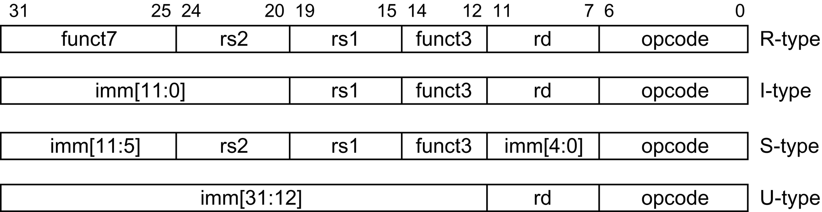
Instruction layout for RISC-V
Four major types of instructions

Slide 12
Introduction to Pipelining
EX (Execution/Effective Address Cycle)
ALU operates on operands
Any one of the following operations is performed
Memory reference instruction
Effective address is calculated
Register-Register ALU instruction
Performs ALU operation on operands
Register-immediate ALU instruction
Performs operations on operand and sign- extended immediate data
Conditional branch
Determine whether the condition is true
MEM (Memory Access Cycle)
Active only for load/store instructions

Slide 13
Introduction to Pipelining
Load: Read operand from memory
Store: Store a register content into memory
WB (Write Back Cycle)
Register-Register ALU instructions or Load instructions are the only active instructions
Writes the result from ALU or from memory
Overall execution cycles
Branch Instructions: 3 cycles (12%)
Store Instructions: 4 cycles (10%)
All other Instructions: 5 cycles
Average CPI is 4.66 clock cycles (approx.)
Not an optimal implementation

Slide 14
Introduction to Pipelining
The Classic 5-stage Pipeline for a RISC Processor
Start a new instruction every clock cycle
Instructions overlap should not conflict with use of resources
Data path pipeline shows no conflicts due to three features
Separate instruction and data caches
Memory bandwidth is 5-times the bandwidth required in a non-pipelined machine
Register File is accessed in two stages
Two reads and one write in every cycle
Write is performed in first half and read is performed in the second half of the cycle
PC is incremented in every cycle to start a new instruction

Slide 15
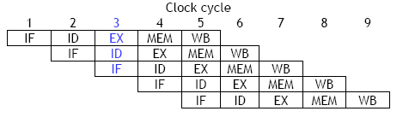
Simple RISC Pipeline
I1(i)
I2(i+1)
I3(i+2)
I4(i+3)
I5(i+4)

Slide 16
Visualizing Pipelining – Series of data paths shifted in time
Time (clock cycles)
Cycle 1
Cycle 2
Cycle 3
Cycle 4
Cycle 5
Cycle 6
Cycle 7
I
n
s
t
r.
O
r
d
e
r
Ifetch
Reg
ALU
DMem
Reg
Ifetch
Reg
ALU
DMem
Reg
Ifetch
Reg
ALU
DMem
Reg
Ifetch
Reg
ALU
DMem
Reg

Slide 17
Introduction to Pipelining
Separate ALU is required to calculate branch target address in ID
Instructions should not interfere with each other
Introduce pipeline registers between successive stages
Pipeline registers also carry intermediate results from one stage to another
Basic Performance Issues in Pipelining
Throughput increases but every instruction takes longer to execute as compared to a non-pipelined machine
Limits the depth of the pipeline
Imbalance among pipe stages contribute to overheads
Clock cycle time is determined from the delay of the slowest stage

Slide 18
Introduction to Pipelining
Pipeline register delay and clock skew are other overheads
Pipeline registers add setup time
Time that a register input must be stable before a clock signal that triggers a write occurs
Clock skew is the maximum delay between the time when the clock arrives at any two registers
Imposes a lower limit on the clock cycle time
Example
Speedup from pipelining over a non-pipelined architecture, clock skew and setup time = 0.1 ns
Clock cycle = 0.5 ns; ALU instr. (40%) = 4 cycles
Branch instr. (20%) = 4 cycles;
Memory instr. (40%) = 5 cycles

Slide 19
Principles of Pipelining
The Major Hurdles of Pipelining – Pipeline Hazards
Hazards are situations that prevent the next instruction in the instruction stream from executing during its designated clock cycle
Reduce performance from the ideal speedup gained by pipelining
There are three classes of pipeline hazards
Structural Hazards
Occurs due to resource conflicts
Hardware cannot support all possible combinations of instructions simultaneously in overlapped execution
Data Hazards
When an instruction depends on the results of a previous instruction in a way that is exposed by the overlapping of instructions in the pipeline

Slide 20
Pipeline Hazards
Control Hazards
Arise from the pipelining of branches and other instructions that change the PC
Hazards can make it necessary to stall the pipeline
Stall in a pipelined machine requires that some instructions are allowed to proceed while others are delayed
All instructions issued later in the pipeline than the stalled instruction are also stalled
Instructions issued earlier must continue
No new instructions are fetched during the stall

Slide 21
Pipeline Hazards
Performance of Pipelines with Stalls
Pipeline speedup =
Average Instruction time w/o pipeline
Average Instruction time with pipeline
= CPI w/o pipelining * clock cycle w/o pipelining
CPI with pipelining * clock cycle with pipelining
Ideal CPI = CPI without pipelining ≈ 1
Pipeline depth
Pipeline Speedup =
Clock cycle w/o pipelining * Ideal CPI * Pipeline depth
Clock cycle with pipelining * (Ideal CPI + pipeline stall cycles)

Slide 22
Pipeline Hazards
Pipeline Speedup =
Ideal CPI * Pipeline depth
Ideal CPI + pipeline stall cycles
Pipeline Speedup =
Pipeline depth
1 + pipeline stall cycles
If there are no stalls, the speedup is given by
The number of pipe stages

Slide 23
Pipeline Hazards
Structural Hazards
If some combinations of instruction cannot be accommodated due to resource conflicts, there is a structural hazard in the processor
There are two types of structural hazards
Arises when some functional unit is not fully pipelined
A sequence of instructions that all use that functional unit cannot be sequentially initiated
Some resource has not been duplicated enough to allow all combinations of instructions in the pipeline to execute
The pipeline will stall one of the instructions until the required unit becomes available

Slide 24
One Memory Port/Structural Hazard
Time (clock cycles)
Cycle 1
Cycle 2
Cycle 3
Cycle 4
Cycle 5
Cycle 6
Cycle 7
I
n
s
t
r.
O
r
d
e
r
Load
Ifetch
Reg
DMem
Reg
ALU
DMem
Instr 1
Ifetch
Reg
ALU
DMem
Reg
Instr 2
Ifetch
Reg
ALU
DMem
Reg
Instr 3
Ifetch
Reg
ALU
DMem
Reg
Instr 4
Structural Hazard

Slide 25
Pipeline Hazards
Data Hazards
Occur when the order of access to operands is changed by the pipeline versus the normal order encountered by sequentially executing instructions
Occur because instructions are overlapped in execution
Assume i occurs before j and both use register x
Three different types of data hazards occur
Read after Write (RAW)
When the read of register x by j occurs before write by I
j would use the wrong value of x
2. Write after Read (WAR)
Read of x by i takes place after a write by j to x
i uses the wrong value of x

Slide 26
Pipeline Hazards
This hazard is not possible in a simple, five stage integer pipeline
It may occur
When instructions are reordered
In dynamically scheduled pipelines
3. Write after Write (WAW)
Write by i into x takes place after write to x by j
All later instructions get the wrong value of x
This hazard is not possible in a simple, five stage, integer pipeline
Focus only on RAW hazards
Example code and the hazards that may occur

Slide 27
Data Hazards
Time (clock cycles)
IF
ID/RF
EX
MEM
WB
I
n
s
t
r.
O
r
d
e
r
DADD R1,R2,R3
Reg
Ifetch
Reg
ALU
DMem
DSUB R4,R1,R5
Ifetch
Reg
ALU
DMem
Reg
AND R6,R1,R7
Ifetch
Reg
ALU
DMem
Reg
OR R8,R1,R9
Ifetch
Reg
ALU
DMem
Reg
XOR R10,R1,R11
Ifetch
Reg
ALU
DMem
Reg

Slide 28
Pipeline Hazards
Solution
Simple hardware technique called forwarding, bypassing or short-circuiting
Key insight
Result is needed by successive instructions only after it has been produced
Minimizing data hazards by forwarding
Data hazards requiring stalls
Load instruction followed by an instruction that uses the load output
Add pipeline interlock to preserve the correct execution pattern
Pipeline interlock detects hazard and stalls the pipeline until the hazard is cleared – CPI increases

Slide 29
Forwarding to Avoid Data Hazard
Time (clock cycles)
I
n
s
t
r.
O
r
d
e
r
DADD R1,R2,R3
Ifetch
Reg
ALU
DMem
Reg
DSUB R4,R1,R3
Ifetch
Reg
ALU
DMem
Reg
AND R6,R1,R7
Ifetch
Reg
ALU
DMem
Reg
OR R8,R1,R9
Ifetch
Reg
ALU
DMem
Reg
XOR R10,R1,R11
Ifetch
Reg
ALU
DMem
Reg

Slide 30
Forwarding to Avoid Data Hazard
Time (clock cycles)
I
n
s
t
r.
O
r
d
e
r
DADD R1,R2,R3
Ifetch
Reg
ALU
DMem
Reg
DSUB R4,R1,R3
Ifetch
Reg
ALU
DMem
Reg
AND R6,R1,R7
Ifetch
Reg
ALU
DMem
Reg
OR R8,R1,R9
Ifetch
Reg
ALU
DMem
Reg
XOR R10,R1,R11
Ifetch
Reg
ALU
DMem
Reg

Slide 31
Forwarding to Avoid Data Hazard
Time (clock cycles)
I
n
s
t
r.
O
r
d
e
r
DADD R1,R2,R3
Ifetch
Reg
ALU
DMem
Reg
DSUB R4,R1,R3
Ifetch
Reg
ALU
DMem
Reg
AND R6,R1,R7
Ifetch
Reg
ALU
DMem
Reg
OR R8,R1,R9
Ifetch
Reg
ALU
DMem
Reg
XOR R10,R1,R11
Ifetch
Reg
ALU
DMem
Reg

Slide 32
Data Hazard Even with Forwarding
Time (clock cycles)
I
n
s
t
r.
O
r
d
e
r
LD R1,0(R2)
Ifetch
Reg
ALU
DMem
Reg
DSUB R4,R1,R6
Ifetch
Reg
ALU
DMem
Reg
AND R6,R1,R7
Ifetch
Reg
ALU
DMem
Reg
OR R8,R1,R9
Ifetch
Reg
ALU
DMem
Reg

Slide 33
Data Hazard Even with Forwarding
Time (clock cycles)
I
n
s
t
r.
O
r
d
e
r
LD R1,0(R2)
Ifetch
Reg
ALU
DMem
Reg
DSUB R4,R1,R6
Ifetch
Reg
ALU
DMem
Reg
AND R6,R1,R7
Ifetch
Reg
ALU
DMem
Reg
OR R8,R1,R9
Ifetch
Reg
ALU
DMem
Reg

Slide 34
Data Hazard Even with Forwarding
Time (clock cycles)
I
n
s
t
r.
O
r
d
e
r
LD R1,0(R2)
Ifetch
Reg
ALU
DMem
Reg
DSUB R4,R1,R6
Ifetch
Reg
ALU
DMem
Reg
AND R6,R1,R7
Ifetch
Reg
ALU
DMem
Reg
OR R8,R1,R9
Ifetch
Reg
ALU
DMem
Reg

Slide 35
Resolving the Load Data Hazard
Time (clock cycles)
I
n
s
t
r.
O
r
d
e
r
LD R1, 0(R2)
Ifetch
Reg
ALU
DMem
Reg
Bubble
DSUB R4,R1,R6
Ifetch
Reg
ALU
DMem
Reg
Bubble
AND R6,R1,R7
Ifetch
Reg
ALU
DMem
Reg
Bubble
OR R8,R1,R9
Ifetch
Reg
ALU
DMem

Slide 36
Resolving the Load Data Hazard
Time (clock cycles)
I
n
s
t
r.
O
r
d
e
r
LD R1, 0(R2)
Ifetch
Reg
ALU
DMem
Reg
Bubble
DSUB R4,R1,R6
Ifetch
Reg
ALU
DMem
Reg
Bubble
AND R6,R1,R7
Ifetch
Reg
ALU
DMem
Reg
Bubble
OR R8,R1,R9
Ifetch
Reg
ALU
DMem

