Slide 1
Pipelining: Basic and Intermediate Concepts Appendix C
Basics of Pipelining
Implementation of Pipeline
Hazards and their Solutions
Exception Handling
Pipeline with Floating-Point Instructions
Dynamic Scheduling of Pipelines

Slide 2

What Makes Pipelining Hard to Implement?
Restartable processors
If a processor’s pipeline provides to it the ability to handle the exception and restart the program without affecting its correctness and execution
Stopping and Restarting Execution
Most difficult exceptions have two properties
They occur within instructions
They must be restartable
When an exception occurs, save the pipeline state by the following steps
Force a trap instruction into the pipeline on the next IF
Until the trap is taken, turn off all writes for the faulting instruction and for all instructions that follow in the pipeline

Slide 3
What Makes Pipelining Hard to Implement?
Prevents any state changes for instructions that will not be completed until the exception is handled
After the exception handling routine receives control, it immediately saves the PC of the faulting instruction
A pipeline is said to have precise exception, if the pipeline can be stopped so that the instructions before the faulting instruction are completed and those after it can be restarted from scratch
Simpler for integer instructions but is complex to maintain for floating point instructions
Floating point instructions run for many cycles
Operations often complete out-of-order

Slide 4
What Makes Pipelining Hard to Implement?
Precise exception mode and fast mode of execution
Supporting precise exception is a requirement in many systems
Exceptions in RISC-V
RISC-V pipeline stages and the ‘problem’ exceptions raised
Multiple exceptions can occur in the same pipeline cycle
Exceptions may occur out-of-order
Hardware posts all exceptions in a status vector and is checked in the WB stage
Turn off all writes before the WB stage
Exceptions are handled in order
Works well for int. pipeline but not for fl-pt. pipeline

Slide 5
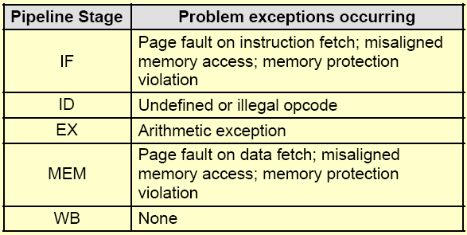
Exceptions that may occur in RISC-V pipeline

Slide 6
What Makes Pipelining Hard to Implement?
Instruction Set Complications
When an instruction is guaranteed to complete, it is said to be committed
RISC-V writes at the end of integer pipeline
End of MEM or beginning of WB cycle
Precise exceptions are easy to implement and straightforward for RISC-V integer pipeline
Processors that write in the early stages of pipeline
Rollback the instruction or write is deferred till the end
Memory state changes?
String copy operations of Intel 80x86, IBM 360
States are kept in registers so that restoration is possible

Slide 7
What Makes Pipelining Hard to Implement?
Some processors may need extra states to be saved
Condition code and its setting time creates more problems
Condition code is also treated as an operand
Instruction taking varying number of cycles to execute
Pipeline the micro-instruction execution
Micro-instructions are simple instructions used in sequence to implement a more complex instruction set
Used in the Intel processors to give it RISC like characteristic
Simpler instruction sets avoid many of the complications

Slide 8
Pipeline for Multicycle Operations
Extending the RISC-V Integer Pipeline to Handle Multicycle Operations
Basic approach and design alternatives
Performance measurements of a RISC-V FP pipeline
Same pipeline of RISC-V with two changes for FP instructions
EX cycle is repeated as many times as needed to complete the operation
There are multiple floating-point functional units
Assume 4-separate functional units
Main integer unit: Handles loads, stores, integer ALU operations and branches
FP and integer multiplier
FP adder: Handles FP add, subtract and conversion
FP and integer divider

Slide 9
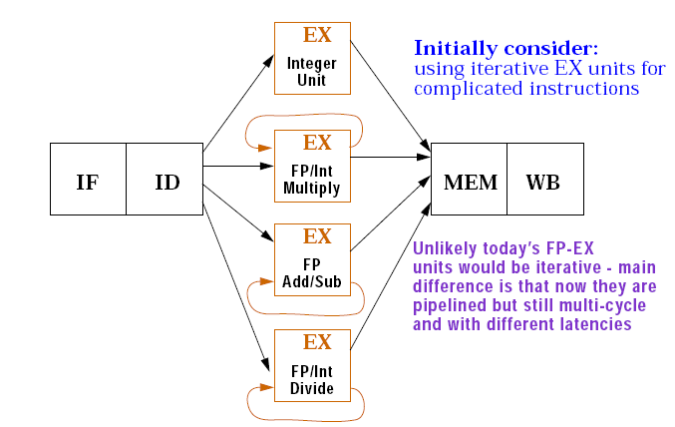
RISC-V pipeline with three additional unpipelined, floating point, functional units

Slide 10
Pipeline for Multicycle Operations
If the execution stages of functional units are not pipelined
EX stage has number of clock delays larger than 1
Allow pipelining of some stages and allow multiple ongoing operations
Latency and initiation interval or repeat interval
Latency: The number of intervening cycles between an instruction that produces a result and an instruction that uses the result
Initiation or repeat interval: The number of cycles that must elapse between issuing two operations of the same type
Latencies and initiation intervals for the given functional units

Slide 11
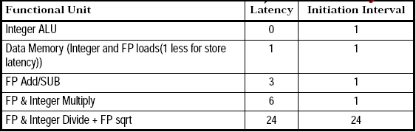
Latencies and Initiation Intervals for Functional Units
✗
25

Slide 12
Pipeline for Multicycle Operations
The latency and repeat interval added will result in pipelining of some functional units
Additional pipeline registers are introduced and modification of the connections to those registers are done
A1/A2, A2/A3, A3/A4, etc.
Hazards and Forwarding in Longer Latency Pipelines
A number of different aspects to the hazards detection and forwarding logic
Structural hazards can occur because the divide unit is not fully pipelined
Since instructions have varying running times, the number of register writes per cycle may be larger than 1
WAW hazards are possible but WAR hazard is not possible

Slide 13
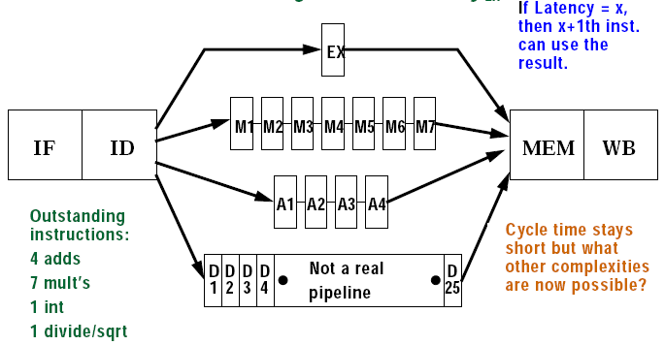
A pipeline that supports multicycle FP operations

Slide 14
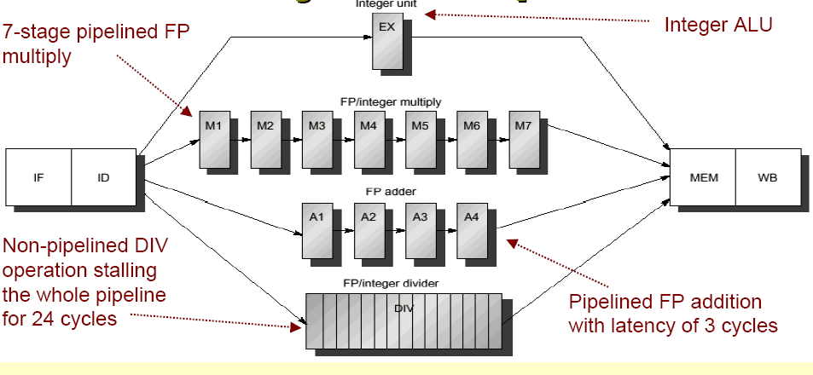
Multicycle FP operations

Slide 15
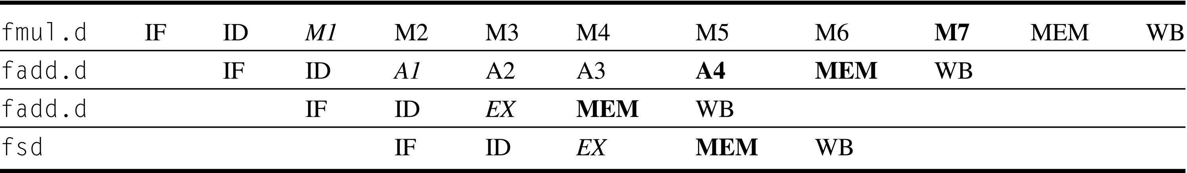
Pipeline timing of a set of independent instructions
fld.d

Slide 16
Pipeline for Multicycle Operations
4. Instructions can complete in a different order than issued, causing problems with exceptions
5. Stalls for RAW hazards will be more frequent because of longer latency of operations
Potential impact of RAW hazards
Problems arising from writes
Since floating point register file has only one write port, it may result in higher number of structural hazards
Increase the number of write ports
Additional write port will be used rarely
Structural hazard is acceptable
Implement Interlock to handle the above
There are two ways to implement this interlock

Slide 17
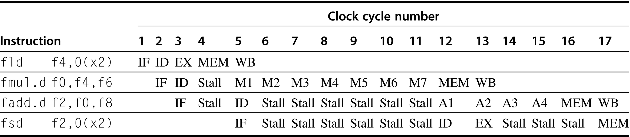
FP code sequence with stalls for RAW hazards

Slide 18
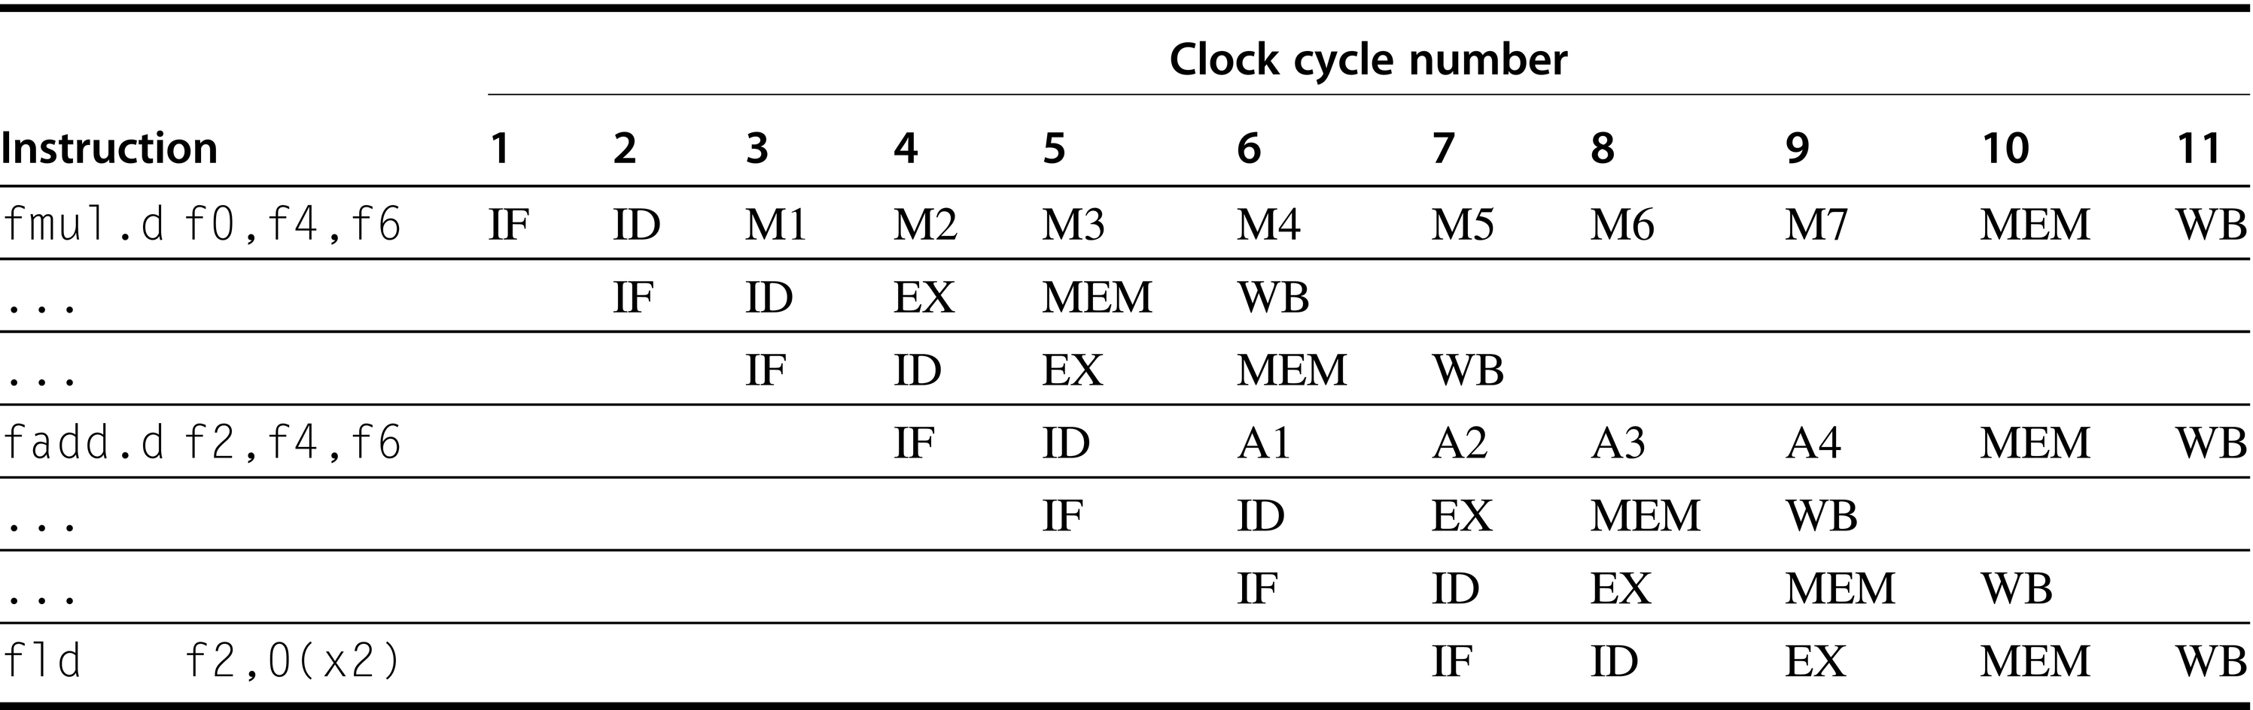
Three instructions want to perform WB to FP register file simultaneously

Slide 19
Pipeline for Multicycle Operations
Track the use of write port in the ID stage and stall an instruction before it issues
Implemented with a shift register
Indicates when already issued instructions will use the register file
Maintains the property of stalling instructions only in the ID stage
Cost is the shift register and the write conflict logic
Stall the conflicting instruction when it tries to enter either MEM or WB stage
Give priority to the unit with the longest latency
Advantage - Detect the conflict at MEM stage where it is easy to see
Disadvantage - Complicates pipeline control as stalls can now arise from two places

Slide 20
Pipeline for Multicycle Operations
Possibility of WAW hazards:
WAW hazard occur only when a useless instruction is executed
Need to detect and handle it
There are two possible ways to handle WAW hazards
Delay the issue of load instruction until the ADD.D enters MEM
Stamp out the result of ADD.D by detecting the hazard and changing the control so that ADD.D does not write its result
It is difficult to detect this hazard
Use a simpler solution
If an instruction in ID wants to write the same register as an instruction already issued, do not issue the instruction

Slide 21
Pipeline for Multicycle Operations
Possible Hazards to deal with
Hazards among FP instructions
Hazards between a FP and an integer instruction
Only FP load-stores and FP-integer register moves
Separate register files
Three checks that must be performed in the ID stage before an instruction issue can take place
Check for structural hazards:
Wait until the required functional unit is not busy
Make sure the register write port is available when it will be needed
ii. Check for a RAW data hazard:
Wait until the source registers are not listed as pending destinations in a pipeline register that will not be available when this instruction needs the result

Slide 22
Pipeline for Multicycle Operations
iii. Check for a WAW data hazard: Determine if any instruction in A1, A2,.., A4; D; M1,.., M7 has the same destination register as this instruction
Hazard detection and forwarding logic are similar to the RISC-V integer pipeline although it is more complex than the former
Multicycle FP operations also introduce problems for exception mechanisms
Maintaining Precise Exceptions
An instruction issued earlier completes after an instruction issued later
Out-of-order completion
Imprecise exceptions can occur

Slide 23
Pipeline for Multicycle Operations
Four approaches are used to deal with this problem
Ignore the problem and settle for imprecise exception
IEEE floating point standard requires precise exception
Two-mode implementation is seen in most processors
Buffer the results of an operation until all the operations that were issued earlier are complete
Expensive when difference in running times among operations is large
Two viable variations
History file: Keep track of original values of registers
Future file: Keeps the newer values of registers
Update later from the future file

Slide 24
Pipeline for Multicycle Operations
Allow the exception to become imprecise
Keep enough information so that trap handling routines can create a precise sequence for the exception
Need to know the operations in the pipeline and their PCs
Only floating point instructions overlap need to be handled
A hybrid scheme
Allows the instruction issue to continue only if it is certain that all instructions before the issuing instruction will complete without causing an exception
May require to stall the CPU to maintain precise exceptions

Slide 25
Pipeline for Multicycle Operations
Performance of a RISC-V Floating Point Pipeline
Number of stalls increase due to greater number of hazards
There are four classes of stalls
FP result stalls
FP compare stalls
Load and branch delay
Floating point structural delays
Compiler tries to schedule both load and FP delays
The total number of stalls per instruction varies from 0.65 to 1.21

Slide 26
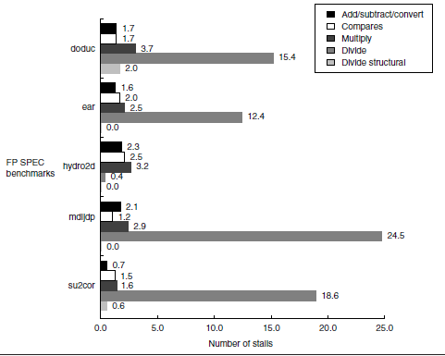
Stalls per FP operations for each major type of FP operations

Slide 27
Putting It All Together
The MIPS R4000 Pipeline
R4000 implements MIPS64
Uses a deeper pipeline
Cache access is made in multiple cycles reducing the clock cycle time
This type of deeper pipeline is referred to as superpipeline
Function of each stage of the pipeline
IF: First half of instruction fetch
PC selection and initiation of I-cache access
IS: Second half of instruction fetch
Completes I-cache access
RF: ID and Register fetch
Hazard checking and I-cache hit detection

Slide 28
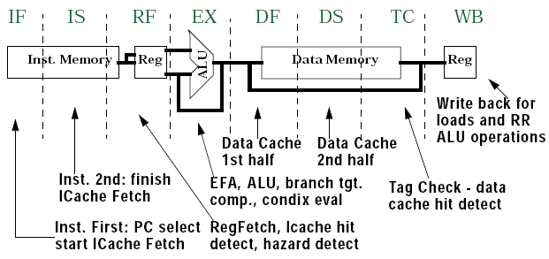
8-stage Pipeline of R4000

Slide 29
Putting It All Together – MIPS R4000 Pipeline
EX: Execution cycle, includes:
Effective address calculation
ALU operation
Branch target computation
Condition evaluation
DF: First half of data fetch
First half of D-cache access
DS: Second half of data fetch
Completion of D-cache access
TC: Tag check
D-cache access hit or miss is determined
WB: Write back for loads and register-register operations
Substantial increase in amount of forwarding required

