Slide 1
Instruction-Level Parallelism and Its Exploitation
Instruction-Level Parallelism
Types of Dependences
Compiler Techniques for Exposing ILP
Dynamic Branch Prediction
Dynamic Scheduling of Pipelines

Slide 2

Loop Unrolling and Pipeline Scheduling
Example code for loop unrolling
for (i = 999; i >= 0; i = i - 1)
x[i] = x[i] + s;
Loop: fld f0, 0(x1)
fadd.d f4, f0, f2
fsd f4, 0(x1)
addi x1, x1, -8
bne x1, x2, Loop
Use latencies to calculate the total time to execute one iteration of the loop - 9 clock cycles
By scheduling, the time required is only 7 clock cycles
The ILP and the basic block size can be increased by using loop unrolling
Scheduling also improves with this technique

Slide 3
Loop Unrolling and Pipeline Scheduling
Loop unrolling requires a number of transformations in the code
Use register renaming
Determine whether the load and store instructions have the same or different addresses
An intelligent compiler is required
Limits to the gains of loop unrolling
Decrease in amount of overhead with each unroll
Code size limitations
This will be of concern in embedded systems
May be of concern if it increases I-cache miss rate
Compiler limitations
Potential shortfall in registers-Register pressure

Slide 4
Reducing Branch Costs with Advanced Branch Prediction
Loop unrolling is one method for reducing branch hazards
Predicting the behavior of branches can also reduce the performance losses
Prediction can be done both statically and dynamically
Static prediction can be used to assist dynamic predictors
The first technique predicts dynamically about a branch behavior in isolation
Dynamic Branch Prediction and Branch-Prediction Buffers
Simplest scheme is the branch-prediction buffer or branch history table

Slide 5
Reducing Branch Costs through Prediction
Branch-prediction buffer
A small memory indexed by the lower portion of the address of the branch instruction
Memory contains a bit that indicates whether the branch was recently taken or not
The scheme is useful for reducing the branch delay when it is longer than the time to compute the target PC
Prediction is a hint that may turn out to be wrong
In case of wrong prediction, prediction bit is inverted and stored back
Performance shortcoming of simple 1-bit scheme
Even if a branch is almost always taken, a wrong prediction is made twice before the correct prediction when the branch is not taken

Slide 6
Reducing Branch Costs through Prediction
Solution
Use a 2-bit prediction scheme
A prediction must miss twice before it is changed
Finite state processor for a 2-bit prediction scheme
Branch-prediction buffer implementation options
A small, special cache accessed with the instruction address during the IF stage
A pair of bits attached to each block in the I-cache and fetched with the instruction
Prediction accuracy?
With 4096 entries, SPEC89 shows an accuracy ranging from 99% to 82%
A misprediction rate of 1% to 18% takes place
Larger buffer can produce better results

Slide 7
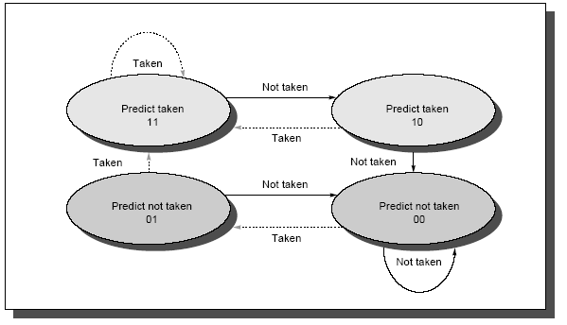
States in a 2-bit prediction scheme

Slide 8
Reducing Branch Costs through Prediction
Accuracy for integer programs is lower than for loop-intensive scientific programs
Increase the accuracy by
Increasing the size of buffer OR
Increasing the accuracy of the scheme
Increasing the size of buffer or increasing the number of bits may not have a significant impact on the accuracy
Predictor structure should also be examined
Correlating Branch Predictors
The 2-bit predictor scheme uses only the recent behavior of a single branch to predict the future behavior of that branch

Slide 9
Reducing Branch Costs with Prediction
Using the recent behavior of other branches can improve the accuracy of prediction
if (aa==2) ADDI x3, x1, -2 ; branch b1 aa=0; BNEZ x3, L1 ; (aa != 2)
if (bb==2) ADD x1, x0, x0 ; aa = 0 bb=0; L1: ADDI x3, x2, -2
if (aa!=bb) { BNEZ x3, L2 ; branch b2
; (bb != 2) ADD x2, x0, x0 ; bb = 0 L2: SUB x3, x1, x2 ; x3=aa – bb
BEQZ x3, L3 ; branch b3
Correlating predictors or two-level predictors
The most recent branches behavior is used to decide how to predict a given branch
(1,2) predictor: Uses the behavior of the last branch to choose from a pair of 2-bit predictors to predict

Slide 10
Reducing Branch Costs with Prediction
(m, n) predictor uses the behavior of the last m branches to choose from 2^{m} branch predictors, each of which is an n-bit predictor for a single branch
Global history of the most recent m branches are saved in an m-bit shift register
Branch prediction buffer is indexed after concatenating the lower order bits from the branch address with the m-bit global history
A (2,2) global buffer with 64 entries
4 lower order bits of branch address concatenated with 2 global bits
Compare (0,2) predictor with 4K entries to (2,2) predictor with 1K entries
Performance of correlating predictor is much better than a simple 2-bit predictor with the same total number of state bits

Slide 11
Reducing Branch Costs with Prediction
Tournament Predictors
Adaptively Combining Local and Global Predictors
Use multiple predictors
One based on global information
One based on local information
Combine them with a selector
Tournament predictors achieve better accuracy at medium sizes (8K to 32K bits)
Make use of large number of prediction bits effectively
Existing tournament predictors
Use a 2-bit saturating counter per branch

Slide 12
Reducing Branch Costs with Prediction
Choose among two different predictors based on which predictor was most effective in recent predictions
Saturating counter requires two mispredictions before changing the identity of the preferred predictor
Advantage of a tournament predictor
Its ability to select the right predictor for a particular branch
Performance of three different predictors
Tournament predictors using 30K bits are standard in processors
Importance of branch prediction has increased

Slide 13
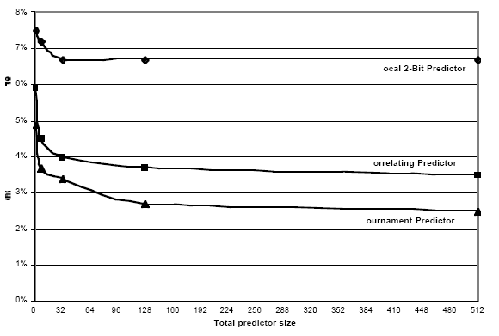
Misprediction Rate for three different predictors on SPEC89 as the total number of bits is increased
Conditional branch misprediction rate
L
C
T

Slide 14
Overcoming Data Hazards with Dynamic Scheduling
Static Scheduling uses compiler approach
Dynamic Scheduling
Hardware rearranges the instruction execution to reduce stalls while maintaining data flow and exception behavior
Advantages
Enables handling of cases where dependences are unknown at compile time
Allows the processor to tolerate unpredictable delays
Allows code that was compiled with one pipeline in mind to run efficiently on a different pipeline
There is a significant increase in hardware complexity
Does not remove data dependence but tries to avoid stalls in the presence of dependences

Slide 15
Overcoming Data Hazards with Dynamic Scheduling
Dynamic Scheduling: The Idea
In-order instruction issue and execution
If an instruction is stalled in the pipeline all the later instructions are stalled and cannot proceed
Performance limitations can be eliminated by not requiring instructions to execute in-order
Instruction issue process can be separated in two parts
Check for structural hazards
Wait for the absence of a data hazard
In-order instruction issue but out-of-order execution or out-of-order completion
Introduces the possibility of WAW and WAR hazards
Register naming can be used to avoid these problems
Complications arise in handling exceptions

Slide 16
Example codes
fdiv.d f0, f2, f4
fadd.d f10, f0, f8
fsub.d f12,f8,f14
fsub.d is not dependent, issue before fadd.d
fdiv.d f0,f2,f4
fmul.d f6,f0,f8
fadd.d f0,f10,f14
fadd.d is not dependent, but the antidependence makes it impossible to issue earlier without register renaming

Slide 17
Overcoming Data Hazards with Dynamic Scheduling
Imprecise exceptions can occur because of two possibilities
❶ The pipeline may have already completed instructions that are later in the program order than the instruction causing the exception
The pipeline may have not yet completed some instructions that are earlier in program order than the instruction causing the exception
Imprecise exceptions make it difficult to restart execution after an exception
Speculation can be used as a solution to this problem
To allow out-of-order execution, ID is split into two stages
Issue: Decode instructions and check for structural hazards
Read operands: Wait until no data hazards, then read operands

Slide 18
Overcoming Data Hazards with Dynamic Scheduling
There is a need to distinguish when an instruction begins execution and when it completes execution
EX stage may take multiple cycles depending on the instruction type
Multiple instructions will be in execution at the same time
This requires multiple functional units, pipelined functional units or both
Scoreboarding technique
Allows instructions to execute out-of-order when there are sufficient resources and no data dependences
Tomasulo’s scheme
A more sophisticated technique that allows out-of-order execution of instructions
It consists of several enhancements over scoreboard

Slide 19
Dynamic Scheduling with a Scoreboard
In-order issue and out-of-order execution
The goal of a scoreboard is to maintain an execution rate of one instruction per clock cycle by executing an instruction as early as possible
Processor has multiple functional units
CDC 6600 characteristics and the assumptions for RISC V
CDC 6600 processor implemented scoreboard
16 separate functional units
4 floating-point units
5 units for memory references
7 units for integer operations
RISC V architecture is used to illustrate scoreboard

Slide 20
Dynamic Scheduling with a Scoreboard
For simplicity, we take 5 functional units
2 floating-point multiplier
1 floating-point adder
1 floating-point divide unit
1 integer unit
Scoreboard takes full responsibility for instruction issue and execution including all hazard detection
Centralized technique
Every instruction goes through scoreboard where a record of the data dependences is constructed
This step corresponds to instruction issue
Replaces part of the ID step in the RISC V pipeline
All hazard detection and resolution is centralized in the scoreboard

Slide 21
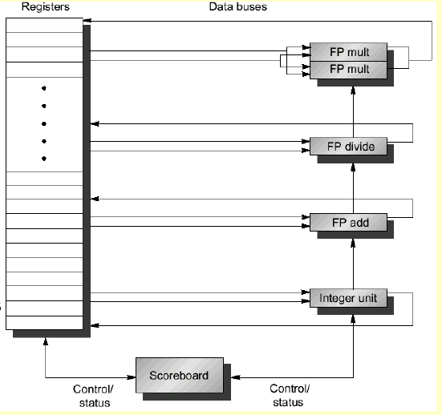
Structure of a RISC V Processor with Scoreboard

Slide 22
Dynamic Scheduling with a Scoreboard
Each instruction goes through four steps during execution, ignoring MEM step
❶ Issue
If a functional unit for the instruction is free and no other active instruction has the same destination register
Scoreboard issues the instruction to the functional unit and updates its internal data structure
If a structural or WAW hazard exists, instruction issue stalls
No further instructions are issued until these hazards are cleared
❷ Read operands
Scoreboard monitors the availability of source operands

Slide 23
Dynamic Scheduling with a Scoreboard
A source operand is available, if no earlier issued active instruction is going to write it
When the source operands are available, scoreboard allows the functional unit to proceed
RAW hazards are resolved dynamically in this step
Functions of the ID step of RISC V simple pipeline is completed with this step
❸ Execution
The functional unit begins execution
The scoreboard is notified when the result is ready
❹ Write Result
Scoreboard checks for WAR hazards and stalls the completing instruction, if necessary

Slide 24
Dynamic Scheduling with a Scoreboard
A completing instruction cannot be allowed to write when
There is an instruction that has not read its operands that precedes the completing instruction, AND
One of the operands is the same register as the result of the completing instruction
Scoreboard allows the functional unit to write the result if there is no WAR hazard
Scoreboard does not take advantage of forwarding
Registers are read only when both are available
Problem
There are only a limited number of source operand buses and result buses to the register file
Gives rise to structural hazard

Slide 25
Dynamic Scheduling with a Scoreboard
Scoreboard should ensure that the number of functional units allowed to proceed into steps 2 and 4 do not exceed the number of buses available
Problem is resolved by using data trunks in CDC6600
There are three parts of scoreboard
Instruction status
Indicates in which of the four steps of execution the instruction is in
Functional unit status
Indicates the state of the functional unit
Register result status
Indicates which functional unit will write each register

Slide 26
Dynamic Scheduling Using Tomasulo’s Approach
This method was used in the IBM 360/91 floating-point unit to allow out-of-order execution
The scheme tracks down when the operands for instructions are available to minimize RAW hazards
Combines key elements of scoreboarding scheme with the introduction of register renaming to minimize WAW and WAR hazards
Limitations of IBM 360/91
No cache was used at the time
There were limited number of floating-point registers
Only four floating-point registers
Instructions suffered from long memory accesses and long floating-point delays
Tomasulo’s approach was designed to overcome the above mentioned limitations

Slide 27
Dynamic Scheduling Using Tomasulo’s Approach
Use the RISC V pipelined floating point units to illustrate the approach
Architectural differences between RISC V and IBM 360/91
Register-memory instructions in IBM 360/91
Tomasulo’s algorithm uses load functional unit
IBM 360/91 had pipelined functional units
Modified RISC V has multiple functional units
In static scheduling, compiler uses register renaming to avoid WAW and WAR hazards
This function is provided by the reservation stations in Tomasulo’s scheme, which buffer the operands of instructions waiting to issue
A reservation station (RS) fetches and buffers an operand as soon as it is available, instead of fetching it from the register

Slide 28
Register Renaming
fdiv.d f0,f2,f4
fadd.d f6,f0,f8
fsd f6,0(x1)
fsub.d f8,f10,f14
fmul.d f6,f10,f8
name dependence with f6
antidependence
Output dependence

Slide 29
Register Renaming
fdiv.d f0,f2,f4
fadd.d S,f0,f8
fsd S,0(x1)
fsub.d T,f10,f14
fmul.d f6,f10,T
Now only RAW hazards remain, which can be strictly ordered

Slide 30
Dynamic Scheduling Using Tomasulo’s Approach
Pending instructions designate the RS that will provide their input
When successive writes to a register overlap in execution, only the last one is actually used to update the register
As instructions are issued, the register specifiers for pending operands are renamed to the names of the RS
Use of a reservation station rather than a centralized register file leads to the following properties
Hazard detection and execution control are distributed
The information held in the reservation stations at each functional unit determine when an instruction can begin execution at that unit
Control is centralized in scoreboard

Slide 31
Dynamic Scheduling Using Tomasulo’s Approach
The results are passed directly to the functional units from the reservation stations, not through registers
This bypassing is done with a common result bus
Common data bus (CDB of 360/91) allows all units waiting for an operand to be loaded simultaneously
More than one CDB will be needed for multiple issue pipelines having multiple functional units
Basic structure of a Tomasulo-based RISC V processor
There are three steps in an instruction execution cycle each taking an arbitrary number of cycles
❶ Issue
Get the next instruction from the instruction queue
Issue the instruction if there is a matching and available RS
Send the operands to the RS if these are in the registers

Slide 32
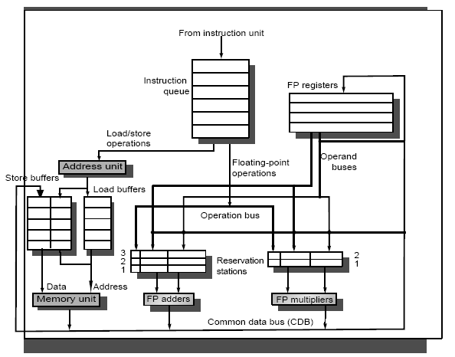
Structure of RISC V Floating-point Unit using Tomasulo’s Algorithm

Slide 33
Dynamic Scheduling Using Tomasulo’s Approach
If the operands are not in registers, keep track of the functional units that will produce the operands
A structural hazard exists if there is no empty RS or an empty load/store buffer
This stage is sometimes called dispatch
This step also performs the renaming of registers, eliminating WAR and WAW hazards
❷ Execute
If one or more of the operands are not yet available, monitor the CDB
If and when both operands are available, execute the operation
This step avoids RAW hazards
If more than one instruction become ready for execution in the same functional unit, one of them is chosen randomly

Slide 34
Dynamic Scheduling Using Tomasulo’s Approach
Load and store instructions require a two-step execution
First step
Calculate the effective address and place the address in the load or store buffer
Second step
Execute loads as soon as the memory unit is available
Stores wait for the value to be stored before being sent to the memory unit
Both load and store are maintained in the program order
❸ Write result
When the result is available, write it
On the CDB

Slide 35
Dynamic Scheduling Using Tomasulo’s Approach
Into the registers, into the RS and store buffers that are waiting for this result
Stores also write data to memory during this step
Data structure used to detect and eliminate hazards are attached
To the RS
To the register file, and
To the load/store buffers
Different information is attached to different objects
All data structures contain a tag field per entry
Names for an extended set of virtual registers used for renaming
Describes which RS contains the instruction that will produce the result needed as a source operand

Slide 36
Dynamic Scheduling Using Tomasulo’s Approach
Once the instruction is issued and is waiting for source operands, it refers to the operands by the reservation station number
Each RS has seven fields
Op: Operations to be performed on source operands S1 and S2
Qj, Qk: The RS that produce the source operands
‘0’ indicates that source operands are available
Vj, Vk: The value of source operands
Busy: This RS and its accompanying FU are occupied
Field A: Hold information for memory address calculation for a load or store
Register file or store buffer require a field, Qi
The number of RS that contains the operation whose result should be stored into this register or in memory

Slide 37
Dynamic Scheduling Using Tomasulo’s Approach
The load and store buffers each require a busy field indicating when a buffer is available
There is another field A which holds the result of the effective address once the first step of execution has been completed
Dynamic Scheduling: Examples and the Algorithm
The information tables for a given code sequence
Two major advantages of Tomasulo’s scheme
Distribution of hazard detection logic
Distributed RS and use of CDB
Instructions can be issued simultaneously by broadcast of the result on the CDB as multiple instructions may become ready
Elimination of stalls for WAW and WAR hazards
This is done by renaming registers with RS and storing operands in RS as soon as they are available

Slide 38
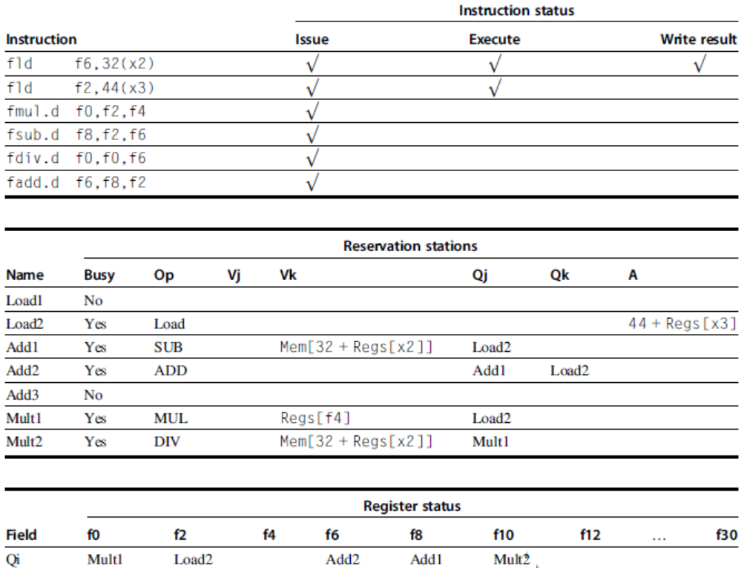
Reservation Station & Register Tags - All instructions are issued – Only the first instruction has completed

Slide 39
Reservation Station & Register Tags - All instructions are issued – Only the first instruction has completed
issue execute write
result
fld f6, 32(x2) √
fld f6, 44(x3)
fmul.d f0, f2, f4
fsub.d f8, f2, f6
fdiv.d f0, f0, f6
fadd.d f6, f8, f2

Slide 40
Reservation Station fields
Busy op Vj Vk Qj Qk A
Add1
Add2
Add3
Mul1
Mul2
Load1
Load2

Slide 41
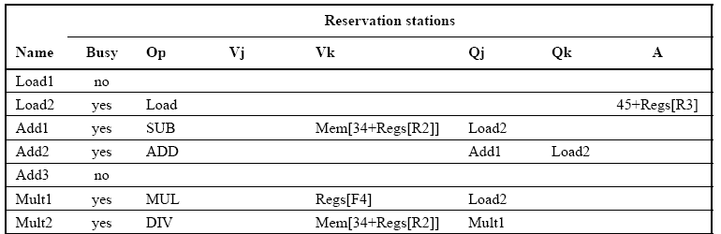
Reservation Station fields

Slide 42
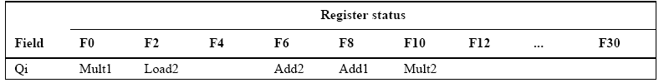
Register Tags

Slide 43
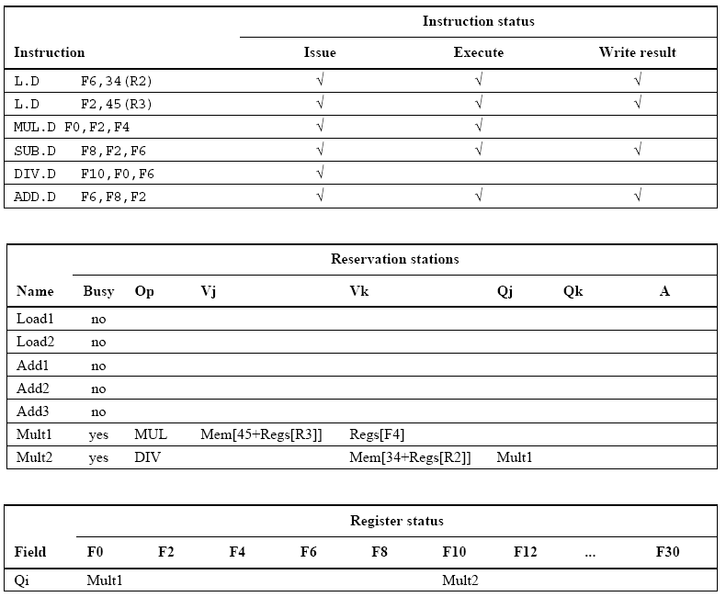
Only MUL and DIV Instructions are not complete

Slide 44
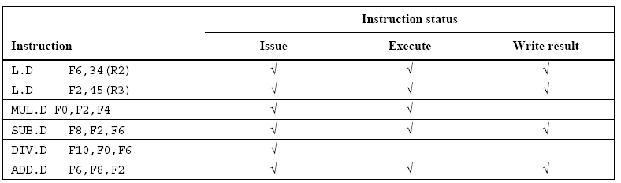
Instruction status (for reference only)

Slide 45
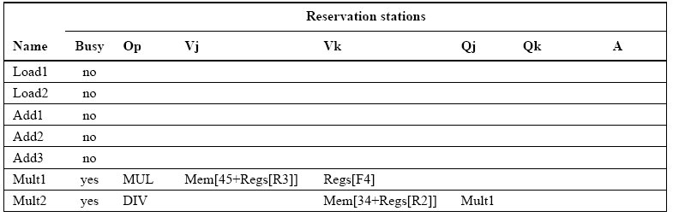
Reservation Stations Fields

Slide 46
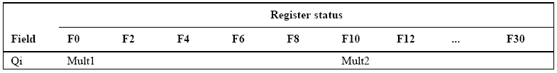
Register Tags

