Slide 1
Instruction-Level Parallelism and Its Exploitation
Instruction-Level Parallelism
Types of Dependences
Compiler Techniques for Exposing ILP
Dynamic Branch Prediction
Dynamic Scheduling of Pipelines

Slide 2

Dynamic Scheduling Using Tomasulo’s Approach
The load and store buffers each require a busy field indicating when a buffer is available
There is another field A which holds the result of the effective address once the first step of execution has been completed
Dynamic Scheduling: Examples and the Algorithm
The information tables for a given code sequence
Two major advantages of Tomasulo’s scheme
Distribution of hazard detection logic
Distributed RS and use of CDB
Instructions can be issued simultaneously by broadcast of the result on the CDB as multiple instructions may become ready
Elimination of stalls for WAW and WAR hazards
This is done by renaming registers with RS and storing operands in RS as soon as they are available

Slide 3
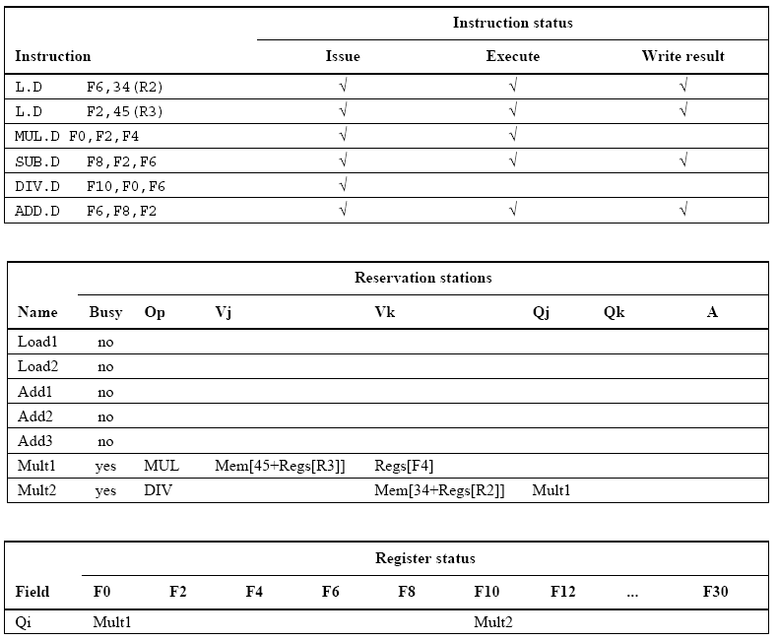
Only MUL and DIV Instructions are not complete

Slide 4
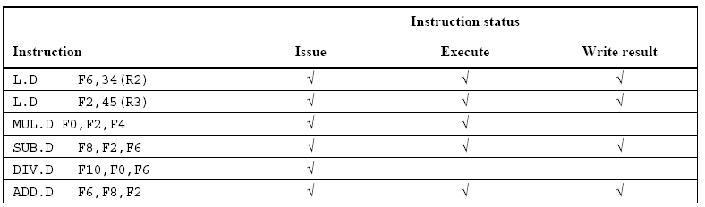
Instruction status (for reference only)

Slide 5
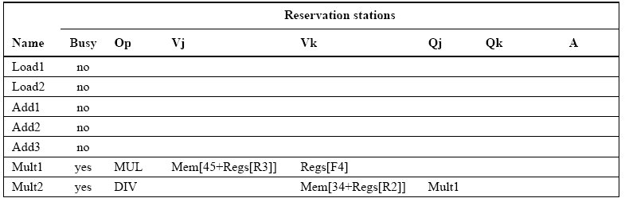
Reservation Stations Fields

Slide 6
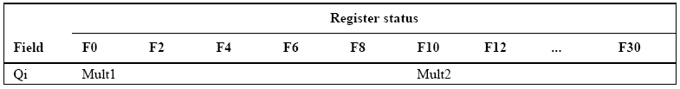
Register Tags

Slide 7
Dynamic Scheduling Using Tomasulo’s Approach
Tomasulo’s Algorithm: A Loop-Based Example
The full power of eliminating WAW and WAR hazards through dynamic renaming of registers is seen in a loop
Loop: fld f0, 0(x1)
fmul.d f4, f0, f2
fsd f4, 0(x1)
addi x1, x1, - 8
bne x1, x2, Loop
Two successive iterations of a loop predicting branches are taken
A load and a store can safely be done in a different order provided they access different addresses
Compute the effective memory addresses in program order

Slide 8
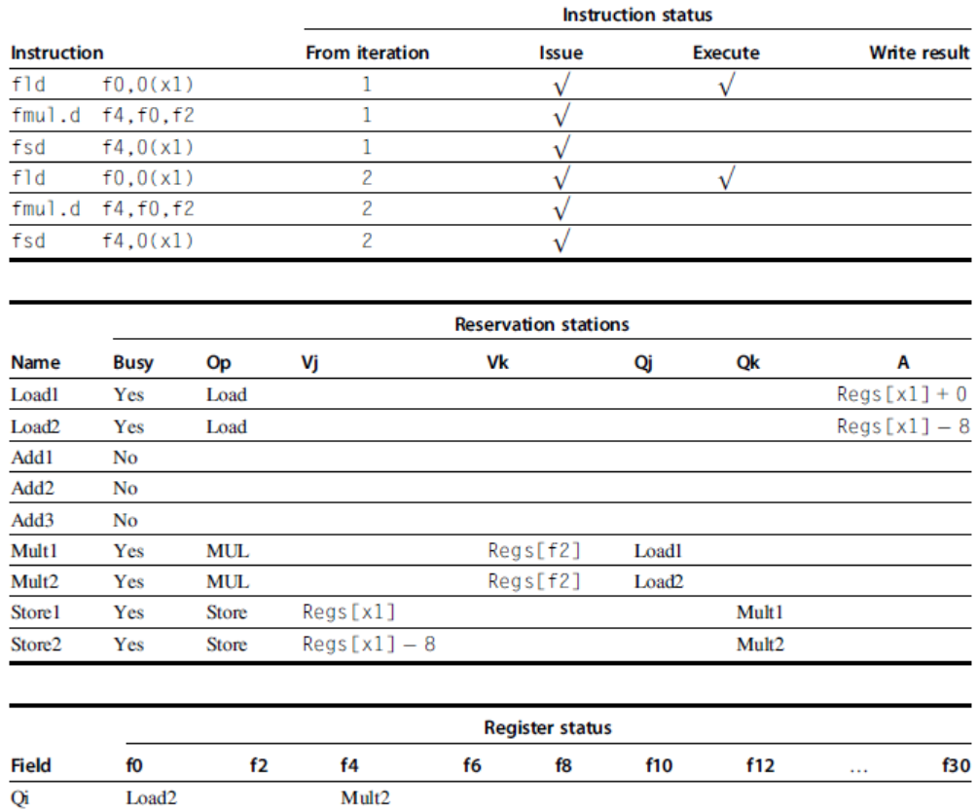
Two active iterations of the loop with no instructions yet completed

Slide 9
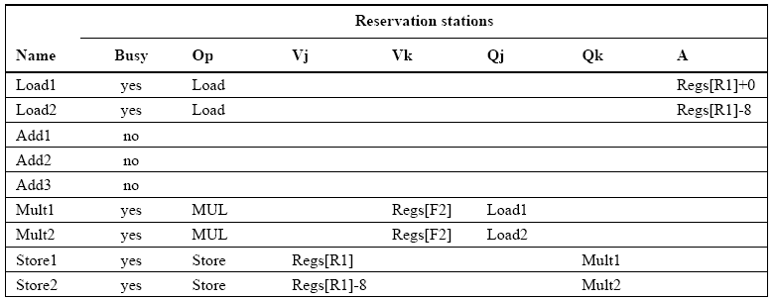
Reservation stations fields

Slide 10
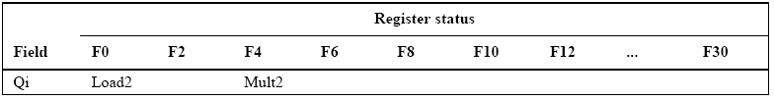
Register Status

Slide 11
Dynamic Scheduling Using Tomasulo’s Approach
Examine the addresses in all active store buffers whenever a load instruction’s effective address computation is complete
If a matching store buffer address is detected, load instruction is not sent to the load buffer until the conflicting store completes
Stores operate in a similar manner, except that check is extended to both load and store buffers
Dynamically scheduled pipelines give high performance provided branches are predicted accurately
Major drawbacks of the approach
Complexity of the algorithm requires large amount of hardware

Slide 12
Dynamic Scheduling Using Tomasulo’s Approach
Each RS must contain an associative buffer that must run at high speed as well as complex control logic
Performance can be limited by a single CDB
This is a widely adopted approach in multiple-issue processors since the 90’s for several reasons
Achieves high performance independent of a specific pipeline structure
Presence of caches have further enhanced dynamic scheduling advantages
Register renaming and dynamic scheduling are more important for difficult-to-schedule code
Dynamic scheduling is a key component of speculation

Slide 13
Review of Memory Hierarchy Design Appendix B
Cache Mapping and Performance
Six Basic Cache Optimizations
Virtual Memory
Protection

Slide 14
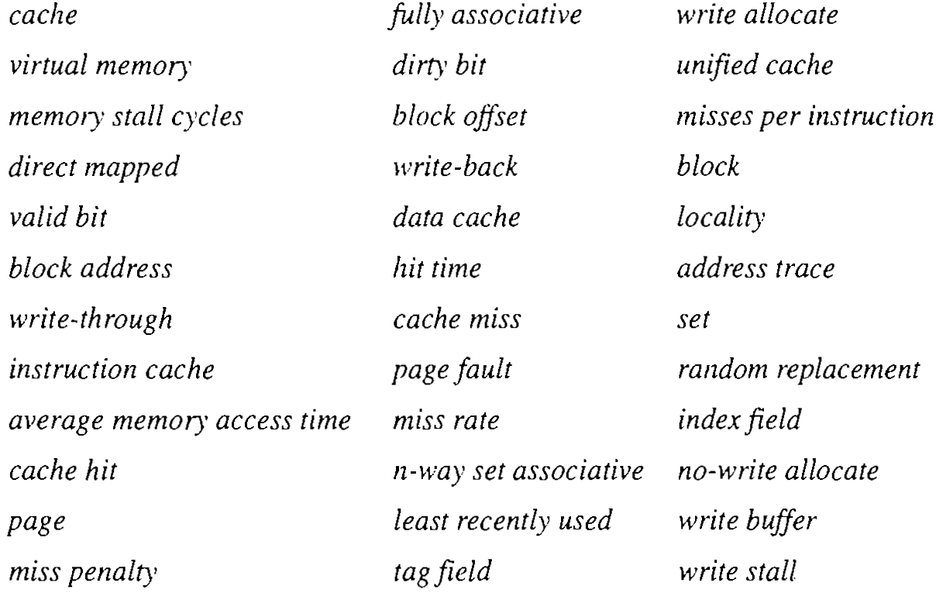
Cache related Terms reviewed briefly

Slide 15

Introduction
Memory hierarchy takes advantage of locality
Cache is the name given to the highest or the first level of memory hierarchy
Term used whenever buffering is employed to reuse commonly occurring items
File cache, name cache, etc.
Cache hit: The processor finds the requested data item in the cache
Cache miss: When the requested data item is not in the cache
Cache block or cache line
Principle of Locality
Temporal locality tells us that it is likely to need the currently used words again in the near future

Slide 16
Introduction
Spatial locality indicates that there is a high probability that the other data in the block will be needed soon
Time to service a cache miss, referred to as miss penalty, is dependent on
Memory latency
Memory bandwidth
Memory latency determines the time to retrieve the first word of the block
Bandwidth determines the time to retrieve the rest of the block
Cache miss is handled by hardware
Virtual memory technique helps is reducing the actual memory needs
Page and page fault
Page fault is handled through software

Slide 17
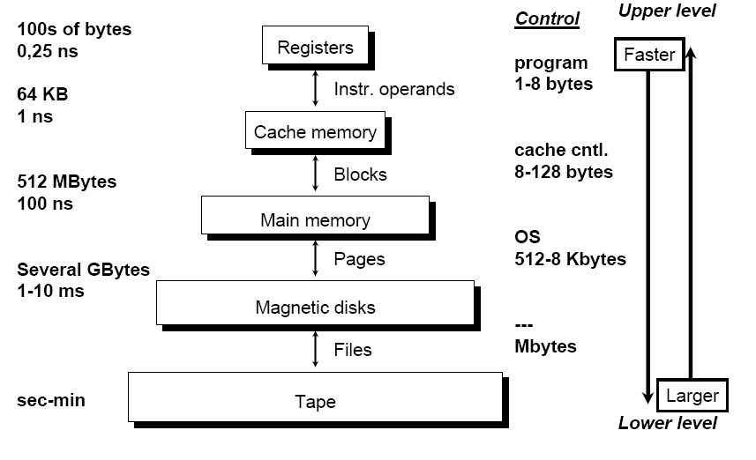
The Typical Levels of Memory Hierarchy

Slide 18
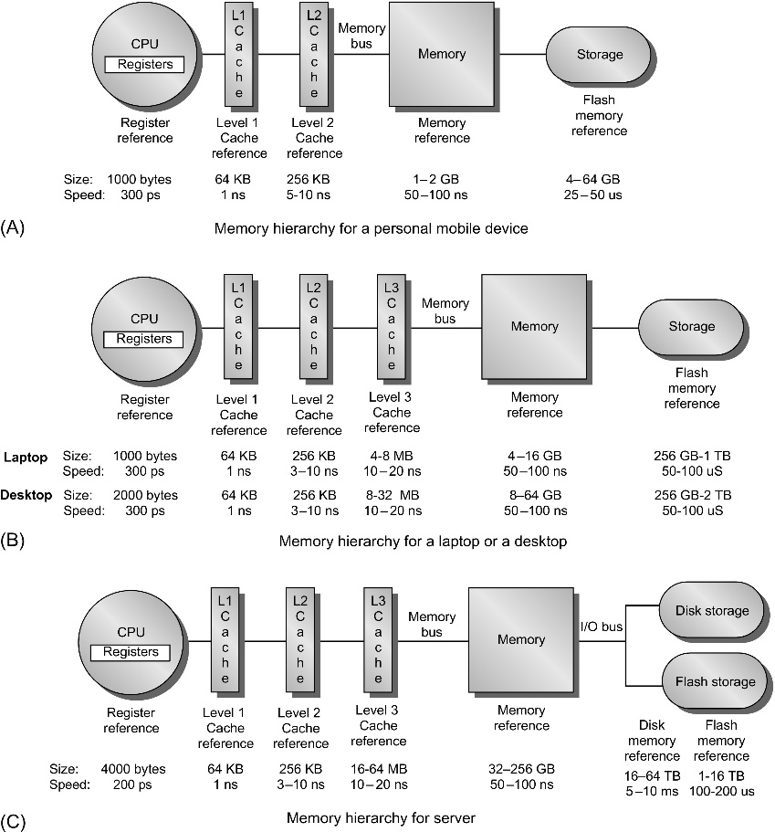
The Typical Levels of Memory Hierarchy

Slide 19
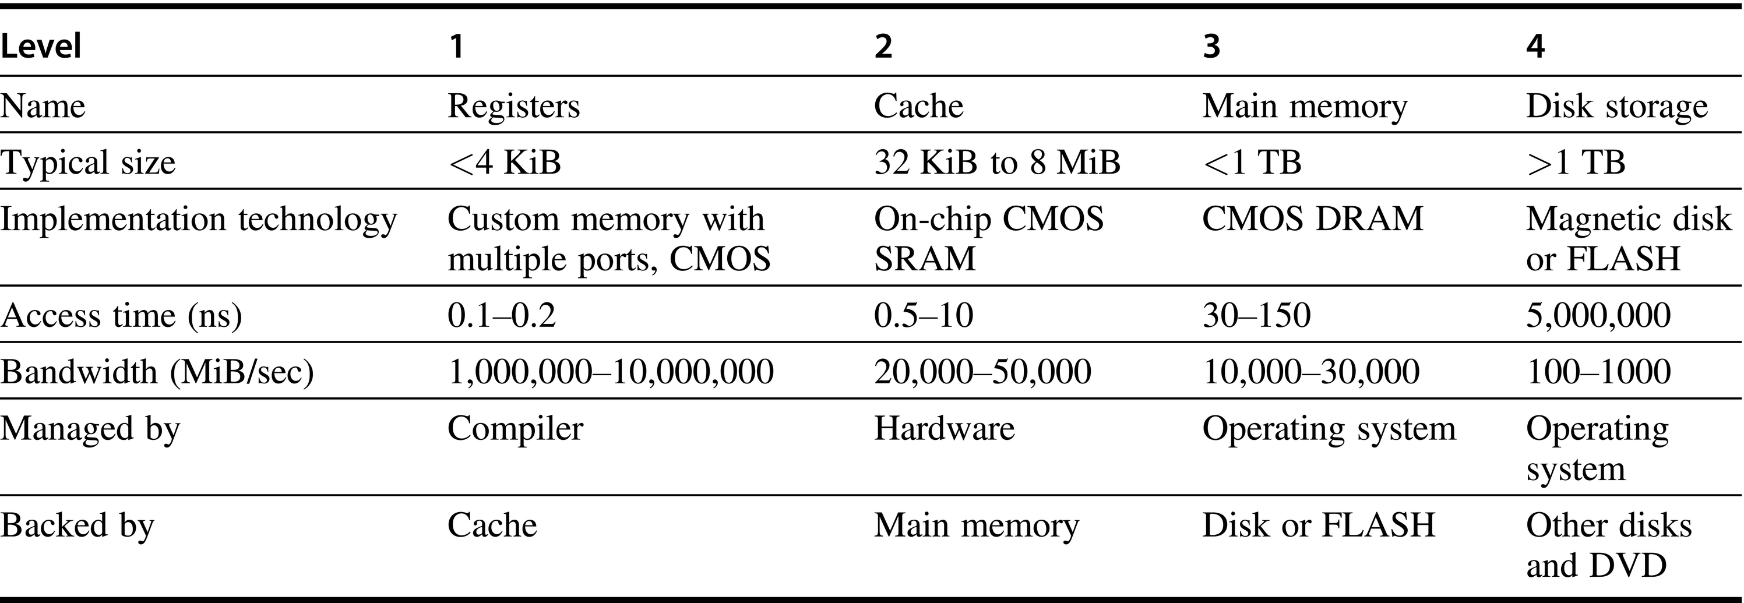
The Typical Levels of Memory Hierarchy

Slide 20
Introduction
Cache Performance Review
Expand the CPU execution time equation by including the number of clock cycles the CPU spends waiting for a memory access called Memory stall cycles
CPU execution time =
(CPU clock cycles + Memory stall cycles) * clock cycle time
The equation assumes that
All memory stalls are due to cache miss
CPU clock cycles include the time to handle a cache hit
Memory stall clock cycles depends on
Number of misses
The cost per miss - Miss Penalty

Slide 21
Introduction
Memory stall cycles = Number of Misses x Miss Penalty
= IC x Misses/Instruction x Miss Penalty
= IC x (Memory accesses)/Instruction x Miss Rate x Miss Penalty
The components of the equation can be easily measured
The number of memory references can be calculated in the same manner as the IC was measured
Although miss penalty is a variable number, it is often used as a constant
Miss rate is the fraction of cache accesses that results in a miss
It can be measured through cache simulators
Many microprocessors provide hardware to count the number of misses and memory references

Slide 22
Introduction
Miss rates and miss penalties are often different for reads and writes
Memory stall clock cycles is then defined as
Memory stall clock cycles = IC x Reads/ instruction x Read miss rate x Read miss penalty + IC x Writes / instruction x Write miss rate x Write miss penalty
Memory stall clock cycles = IC x (Memory accesses) / Instruction x Miss rate x Miss penalty
Miss rate is one of the most important measures of cache design
Some designers prefer measuring miss rate as misses per instruction
Misses/Instruction =
Miss rate x (Memory accesses)/Instruction count

Slide 23
Introduction
Advantage of measuring misses/instruction
It is independent of hardware implementation
Disadvantage is that it is architecture dependent
Four Memory Hierarchy Questions
Q1: Where can a block be placed in the upper level?
Block placement
Q2: How is a block found if it is in the upper level?
Block identification
Q3: Which block should be replaced on a miss?
Block replacement
Q4: What happens on a write?
Write strategy

Slide 24
Introduction
Answers to all the four questions help us understand the different tradeoffs of memory hierarchy
Q1: Where can a block be placed in a cache?
This creates three categories of cache organization
Direct Mapped: Each block has only one place it can appear in the cache
(Block address) MOD (Number of blocks in cache)
Fully Associative: A block can be placed anywhere in the cache
Set Associative: A block can be placed in a restricted set of places in the cache
Set: A group of blocks in the cache
Block is first mapped onto a set

Slide 25
Introduction
It can then be placed anywhere within the set
Set is chosen by bit selection
(Block address) MOD (Number of sets in cache)
For ‘n’ blocks in a set, cache is n-way set associative
Direct-mapped is one-way set associative
Majority of processor caches today are
Direct-mapped or
Two-way or four-way set associative

Slide 26
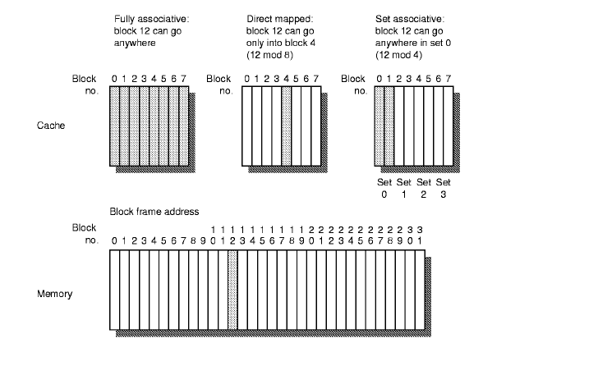
Cache Mapping Techniques

Slide 27
Introduction
Q2: How is a block found if it is in the cache?
Caches have an address tag on each block frame
Tags are matched to check for the desired block
Parallel search is preferred for better speed
Add a valid bit to the tag to indicate whether a cache block has a valid address or not
Relationship of the CPU address to the cache
Block Offset: Selects the desired data from the block
Index: Selects the set or block
Tag: Used for comparison to detect a hit or a miss
Search for all three types of cache mappings in the example

Slide 28
Introduction
If the cache size is same, increasing associativity increases the number of blocks per set
Decreases the size of the index and increases the size of the tag
Q3: Which block should be replaced on a cache miss?
Direct mapped cache gives no choice
Only one block is checked for a hit or a miss and only that block can be replaced
In fully associative and set-associative cache
There are many blocks to choose from
There are three primary strategies for replacement in set associative and fully associative cache

Slide 29
Introduction
If the cache size is same, increasing associativity increases the number of blocks per set
Decreases the size of the index and increases the size of the tag
Q3: Which block should be replaced on a cache miss?
Direct mapped cache gives no choice
Only one block is checked for a hit or a miss and only that block can be replaced
In fully associative and set-associative cache
There are many blocks to choose from
There are three primary strategies for replacement in set associative and fully associative cache

