Slide 1

Review of Memory Hierarchy Design Appendix B
Cache Mapping and Performance
Six Basic Cache Optimizations
Virtual Memory
Protection

Slide 2
Introduction
If the cache size is same, increasing associativity increases the number of blocks per set
Decreases the size of the index and increases the size of the tag
Q3: Which block should be replaced on a cache miss?
Direct mapped cache gives no choice
Only one block is checked for a hit or a miss and only that block can be replaced
In fully associative and set-associative cache
There are many blocks to choose from
There are three primary strategies for replacement in set associative and fully associative cache

Slide 3
Introduction
Random: Simple to build in hardware
Least Recently Used (LRU): This is expensive to implement
First in First out (FIFO): Replace the oldest block as an approximation to LRU
Q4: What happens on a write?
Most of the memory accesses are processor reads
10% stores and 26% loads for RISC V programs
Make the common case fast
Optimize caches for reads
Common case is also the easy case
Block can be read at the same time the tag is read and compared

Slide 4
Introduction
In case of miss, there is no benefit but also no harm
In case of hit, required word is passed on to the CPU immediately
Writes: Modifying a block cannot begin until the tag is checked to see if the address is a hit
Processor specifies the size of the write
Writes normally take longer than reads
Write policies often distinguish cache designs
i. Write Through or Store through: Information is written to both the block in the cache and to the block in the lower-level memory
ii. Write Back or Copy back: Information is written only to the block in the cache

Slide 5
Introduction
Modified cache block is written to main memory only when it is replaced
Write-back cache blocks are either clean or dirty blocks
Dirty bit indicates the difference
Write back cache characteristics
Writes occur at the speed of cache memory
Multiple writes to the same block is one write to the memory
Uses less memory bandwidth and saves power
Attractive in multiprocessors and for embedded applications
Preferred by I/O where memory traffic is required to be reduced

Slide 6
Introduction
Characteristics of write through cache
Read miss does not result in write to lower level
Easier to implement
Main memory has the most current copy of data
Simplifies data coherency
Problem of write stall
The CPU must wait to complete write during write through
Write buffers can be used to reduce write stalls
There are two options on a write miss
Write allocate (Fetch on write)
The block is loaded, followed by the write hit actions similar to reads miss
Write miss acts like read miss

Slide 7
Introduction
No write allocate (Write around)
The block is modified only in the lower level memory and is not loaded into the cache
Example
Write Mem[100] Calculate the no.
Write Mem[100] of hits and miss
Read Mem[200] using both the
Write Mem[200] schemes
Write Mem[100]
Either of the two policies can be used with write-through or write-back caches
Write back caches generally use write allocate
Write through caches often use no write allocate policies
An Example: The Opteron Data Cache

Slide 8
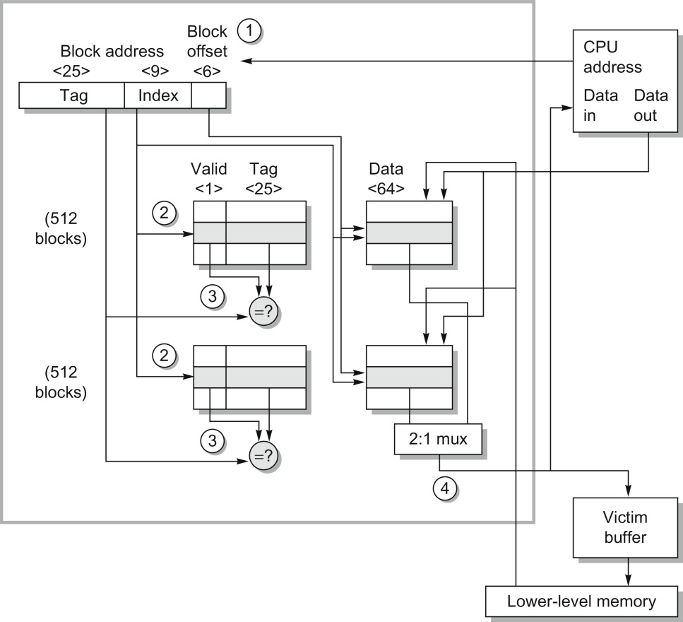
Opteron
data
cache

Slide 9
Cache Performance
An accurate measure of memory hierarchy performance is the average memory access time
Average memory access time =
Hit time + Miss rate x Miss penalty
The components can be measured either in absolute terms or in terms of clock cycles
Average Memory Access Time and Processor Performance
Does the average memory access time due to cache misses predict processor performance?
There are other reasons for stalls
Contention between CPU and I/O for memory access

Slide 10
Cache Performance
Designers tend to conclude that stalls are only due to cache miss
Answer also depends on the processor
In case of in-order execution processors
Stalls may be only due to cache miss
Out-of-order execution processors hide some of the stalls
CPU time can be modeled as
CPU time = (CPU execution clock cycles + memory stall clock cycles) x clock cycle time
Cache behavior has a strong impact on CPU performance

Slide 11
Cache Performance
The lower the CPI_{execution}, the higher the relative impact of a fixed number of cache miss clock cycles
When calculating CPI, the cache miss penalty is measured in CPU clock cycles for a miss
CPU with higher clock rate has a larger number of clock cycles per miss
Importance of the cache for processors with low CPI and high clock rates is greater
Miss Penalty and Out-of-Order Execution Processors
How is the “Miss penalty” measured for an out-of-order execution processor?
Full latency of miss to memory OR
Exposed or non overlapped latency when the processor must stall

Slide 12
Cache Performance
(Memory stall cycles)/ Instruction = Misses/Instruction × (Total miss latency – Overlapped miss latency)
Contention for memory resources in an out-of-order execution processor also cause latency
For miss latency, consider the following:
Length of memory latency: What is the start and end of memory operation in an out-of-order processor?
Length of latency overlap: When is a memory operation stalling the processor?
Complexity of out-of-order execution processors do not allow a single, correct definition
Consistent options should always be used

Slide 13
Six Basic Cache Optimizations
Average memory access time provides the framework to present cache optimizations
Average memory access time =
Hit time + Miss rate × Miss penalty
Six cache optimizations are organized into three categories
Reducing the miss rate (3): Larger block size, larger cache size and higher associativity
Reducing the miss penalty (2): Multilevel caches and giving reads priority over writes
Reducing the time to hit in the cache: By avoiding address translation when indexing the cache
Classical approach to improve cache behavior is to reduce miss rates
All miss are categorized into three categories

Slide 14
Basic Cache Optimizations
Compulsory Miss
First access to a block is not in cache
Also referred to as Cold start misses or first-reference misses
Capacity Miss
Misses due to blocks being discarded and later retrieved, since all blocks cannot be in cache
Conflict Miss
If too many blocks map to the same set or block, blocks are discarded and later retrieved
Direct mapped and set-associative placement strategies have this type of miss
This is also called collision or interference misses
Coherency misses are caused because cache blocks are flushed to maintain coherence in multiprocessors
Relative frequency of all three types of cache miss

Slide 15
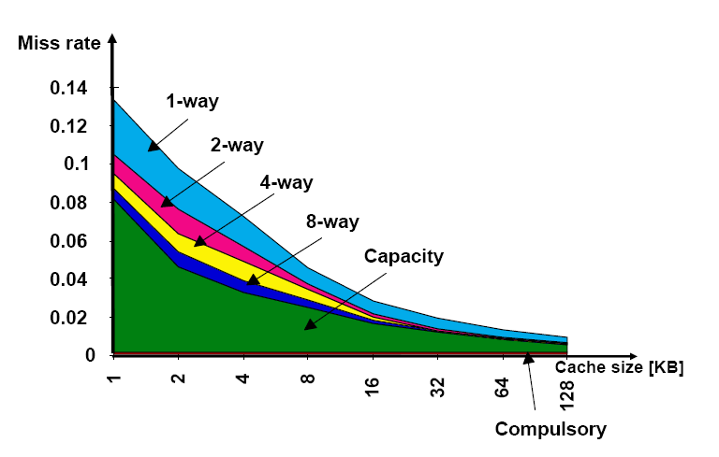
Total Miss Rate According to the Three C’s Absolute Miss Rate

Slide 16
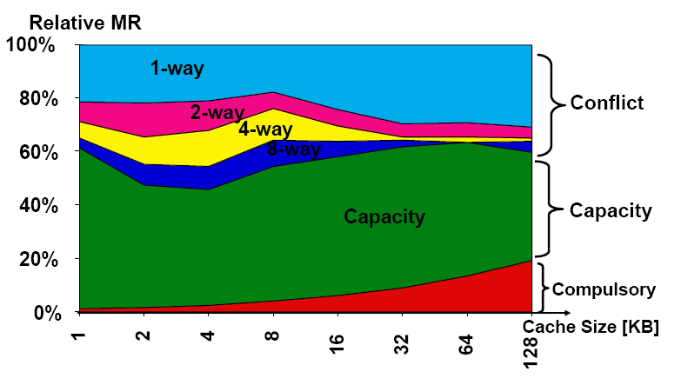
Total Miss rate According to the Three C’s Percentage of miss rate in each category

Slide 17
Basic Cache Optimizations
Remedies
Fully associative placement avoids all conflict misses
Expensive in hardware and may slow access time
Larger cache memory can solve the capacity miss problem
Cache should be large enough to avoid thrashing
Larger blocks reduce compulsory misses, but increase other types of misses
The three C’s give an insight into causes of cache misses
The model ignores the replacement policy
A balanced perspective is desired to improve the overall performance of memory system

Slide 18
Cache Optimizations
First Optimization
Larger Block Size to Reduce Miss Rate
Larger block size also reduces compulsory misses
Larger blocks take advantage of spatial locality
Increases conflict and capacity misses if cache is small
A balance is needed to keep the average memory access time low
Selection of block size depends on both the latency and bandwidth of the lower level memory
High latency and high bandwidth encourage larger block size
Low latency and low bandwidth encourage smaller block size

Slide 19
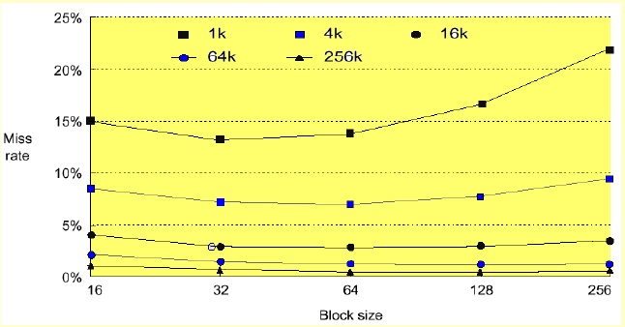
Miss Rate vs Block Size of Five Different Caches

Slide 20
Cache Optimizations
Second Optimization
Larger Caches to Reduce Miss Rate
Reduce capacity misses by increasing the capacity of cache
Drawback is longer hit time and higher cost and power
Technique is more popular in off-chip caches
Third Optimization
Higher Associativity to Reduce Miss Rate
Miss rate improves with higher associativity
Two general rules of thumb can be derived from observations

Slide 21
Cache Optimizations
Eight-way set associative cache is as effective in reducing misses as a fully associative cache for the given cache sizes
2:1 cache rule of thumb:
A direct mapped cache of size N has about the same miss rate as a two-way set associative cache of size N/2
Improving one aspect of average memory access time comes at the expense of another
Greater associativity comes at the expense of increased hit time
Fast processor clock cycle encourages simple cache designs

Slide 22
Cache Optimizations
Fourth Optimization
Multilevel Caches to Reduce Miss Penalty
Improvement in miss penalty is as beneficial as improvement in miss rate
Relative cost of miss penalties have increased over time
Solutions to the performance gap between processor and memory
Should the cache be made faster to keep pace with the speed of processor?
Should the cache be made larger to close the gap between processor and main memory?
Achieve both objectives

Slide 23
Cache Optimizations
First-level cache is made small enough to match the CPU speed
Second-level cache is made large enough to capture all memory accesses
Addition of another level complicates performance analysis
Definitions for second-level cache are more complex
Average memory access time =
Hit time_{L1} + Miss rate_{L1} × Miss penalty_{L1}
Miss penalty_{L1} =
Hit time_{L2} + Miss rate_{L2} × Miss penalty_{L2}
Average memory access time =
Hit time_{L1} + Miss rate_{L1} × (Hit time_{L2} + Miss rate_{L2} × Miss penalty_{L2})

Slide 24
Cache Optimizations
Terms added for a two-level cache system
Local miss rate: Number of misses in a cache divided by the total number of memory accesses to this cache
Miss rate_{L1} and Miss rate_{L2}
Global miss rate: Number of misses in a cache divided by the total number of memory accesses generated by the CPU
Global miss rate of first-level cache is Miss rate_{L1}
Global miss rate of second level cache is
(Miss rate_{L1} × Miss rate_{L2})
Local miss rate is large for second-level cache
Global miss rate is a more useful measure

Slide 25
Cache Optimizations
Miss rates and relative execution time vary with the size of a second-level cache in a particular design
Gain two insights from the study
Global cache miss rate is very similar to the single cache miss rate of the second-level cache, provided that the second-level cache is much larger than the first-level cache
Local cache miss rate is not a good measure of secondary caches
It is a function of the miss rate of first-level cache
This can vary by changing the first-level cache
Global cache miss rate should be used when evaluating second-level caches

Slide 26
Cache Optimizations
Consider the parameters of second-level cache
Size of the second-level cache?
Should be much larger than the first-level cache
Will set associativity improve the performance of second-level cache?
An improvement is seen in terms of miss penalty with the increase in associativity
Multilevel inclusion is a desirable property for consistency
Drawback of inclusion suggests smaller blocks for smaller first-level cache and larger blocks for larger second-level cache
Block size of 64 and 128 bytes used in Pentium 4
More work is done on a second-level miss

Slide 27
Cache Optimizations
Second-level cache must invalidate all first-level blocks that map onto the second-level block to be replaced
Causes a slightly higher first-level miss rate
Many designers keep the same block size for both the cache levels
The essence of all cache designs is balancing fast hits and few misses
Fewer hits go to the second-level cache
This leads to much larger caches and techniques to lower the miss rate
Higher associativity and larger blocks

Slide 28
Cache Optimizations
Fifth Optimization: Giving Priority to Read Misses over Writes to Reduce Miss Penalty
This optimization serves Reads before Writes have been completed
A write buffer of proper size will improve the performance of a write-through cache
Write buffers may hold the updated value of a location needed on a read miss
Read miss waits until the write buffer is empty
An alternative is to check the contents of the write buffer on a read miss and let the read miss continue
The cost of writes in WB cache can also be reduced by using write buffers
While replacing a dirty block on a read miss, the block can be written to the write buffer and later written to memory

Slide 29
Cache Optimizations
Sixth optimization:
Avoiding Address Translation during Indexing of the Cache to Reduce Hit Time
Time is consumed in translation from virtual address to physical address before cache access
Use virtual address cache to avoid the translation time – virtual caches
Distinguish between indexing the cache and comparing the addresses
Problems with virtual address cache
Page-level protection is checked as part of the virtual to physical address translation
Protection feature is not checked if virtual address is used directly
Solution is to copy the protection information from the TLB on a miss

Slide 30
Cache Optimizations
In case of a process switch, the virtual addresses refer to different physical addresses requiring the cache to be flushed
Add a process identifier tag (PID) to the cache tag
OS and user programs may use two different virtual addresses for the same physical address
Synonyms or aliases
Hardware solution to this problem is anti-aliasing
Software solution: Force aliases to share some address bits
I/O typically uses physical addresses
Requires mapping with virtual addresses to interact with a virtual cache

Slide 31
Cache Optimizations
Get the best of both virtual and physical caches
Use part of the page offset to index in the cache
Translation is done while the cache is being read
Virtually indexed and physically tagged cache
Limitation is that a direct-mapped cache should be smaller than or equal to the page size
Summary of Cache Optimizations
Optimization of one aspect may affect the other components
Effect may be positive or negative

Slide 32
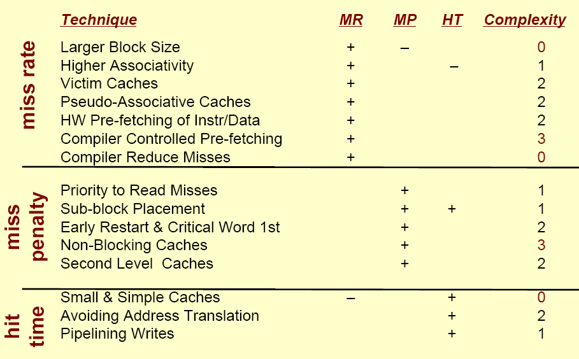
Summary of Cache Optimizations

