Slide 1

Memory Hierarchy Design Appendix B
Cache Mapping and Performance
Six Basic Cache Optimizations
Virtual Memory
Protection

Slide 2
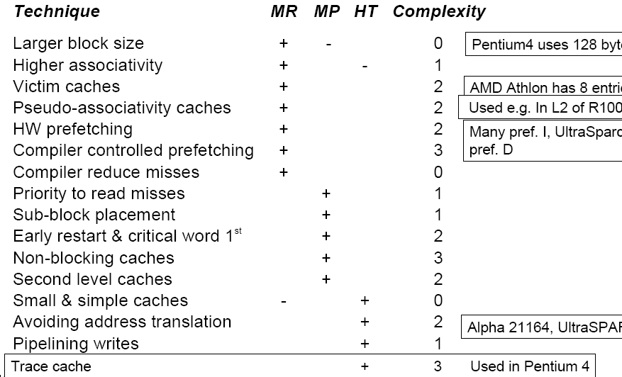
Summary of Cache Optimizations

Slide 3
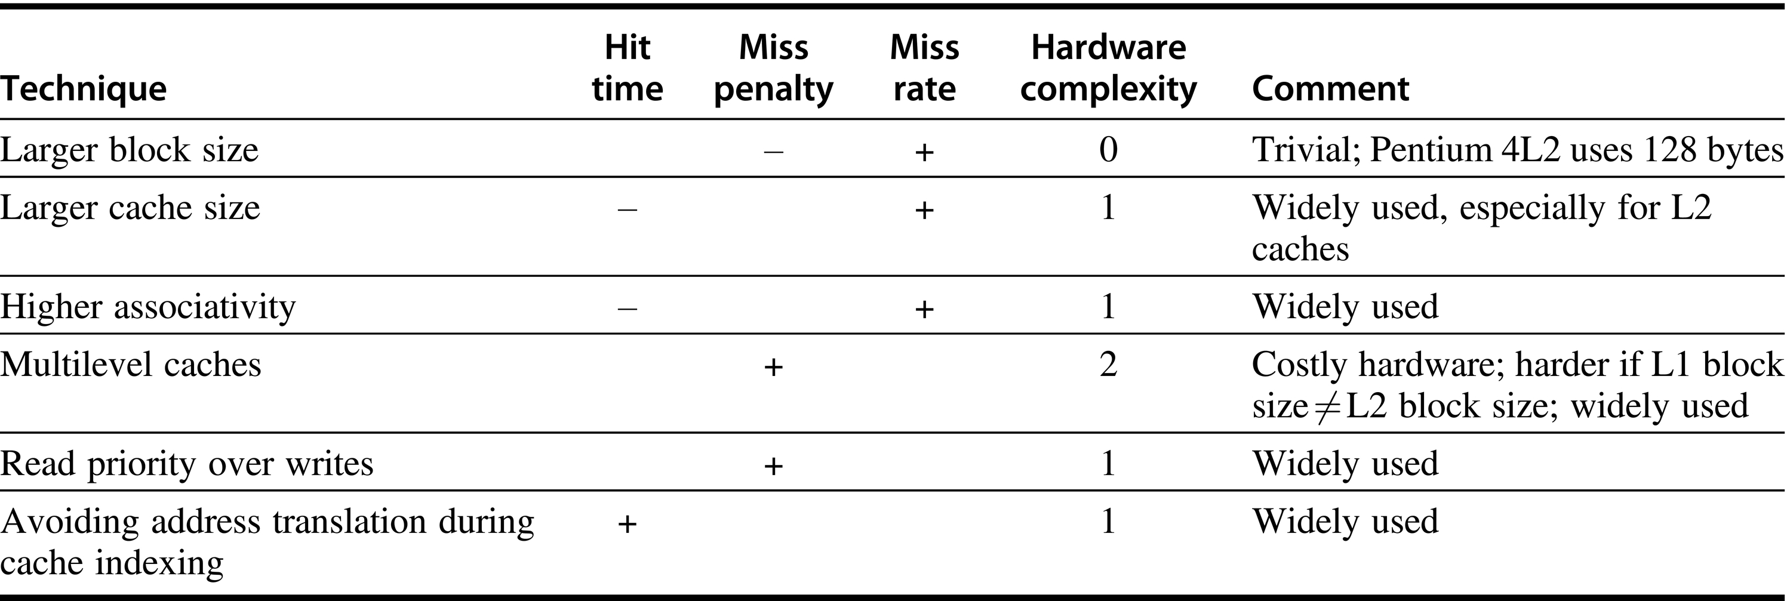
Summary of Cache Optimizations

Slide 4
Virtual Memory
Processes share a small amount of physical memory among themselves
There are usually a large number of processes
Processes also require protection
Virtual memory is a mechanism that helps achieve these objectives
Virtual memory automatically manages two level of memory hierarchy
Main memory and secondary storage
It also simplifies loading through relocation
Commonly used terms
Page or segment
Virtual and physical addresses
Page fault or segment fault
Memory mapping or address translation

Slide 5
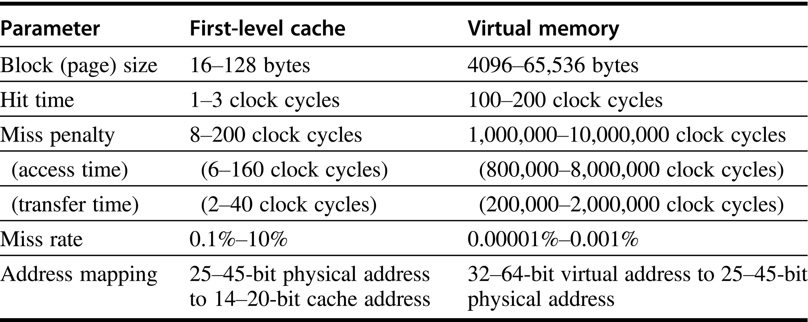
Typical Ranges of Parameters for Caches and Virtual Memory

Slide 6
Virtual Memory
Further differences between cache and virtual memory
Replacement on cache miss is controlled by hardware
Virtual memory replacement is controlled by the OS
Processor address space determines the size of the virtual memory
Cache size is independent of processor address space
Secondary storage acts as backup of main memory and is also used for the file system
Main memory acts as a backup for cache
Virtual memory can be built with both fixed sized pages and variable sized segments
Cache blocks are of fixed size

Slide 7
Virtual Memory
Four Memory Hierarchy Questions
Q1. Where can a block be placed in main memory?
Fully associative mapping is used to reduce miss rate and miss penalty
Q2. How is a block found if it is in main memory?
Index into page table or segment table
TLB reduces the address translation time
Q3. Which block should be replaced on a Virtual Memory miss?
LRU or its modified versions
FIFO, Random, etc.
Q4. What happens on a write?
Write strategy is always write back with modified bit

Slide 8
Virtual Memory
Techniques for Fast Address Translation
Reading Assignment
Selecting a Page Size
Reading Assignment
Protection and Examples of Virtual Memory
A Segmented Virtual Memory Example
Protection in Intel Pentium Processor
Can be covered later if time permits
It is expected that the course on OS has covered an example processor that has features to provide protection among processes

Slide 9
Fallacies and Pitfalls
Pitfalls
Too small an address space
Machines having smaller address space have low life
Ignoring the impact of the OS on the performance of the memory hierarchy
About 25% of stall time is spent in misses in the OS or because of interference of the application programs and the OS
Relying on the OS to change the page size over time
OS designers do not use this strategy

Slide 10
Concluding Remarks
There has been a large (hundredfold) increase in the on-chip cache size to compensate for the increase in main memory latency
Principle of locality reduces the difficulty of building a memory that keeps pace with the faster CPUs
Memory hierarchy designer should choose parameters that work well together
Programmers and compiler writers must be aware of the parameters of the caches and TLBs if they want their programs to run well

Slide 11
Memory Hierarchy Design Chapter 2
Cache Optimization Techniques
Advanced Cache Optimizations
Main Memory Optimizations

Slide 12

Advanced Cache Optimization Techniques
In addition to hit time, miss and miss penalty, power consumption and cache bandwidth are included in the metrics list
Ten Advanced Optimizations classified into five groups
Reducing hit time:
Small and simple first-level cache
Way prediction
Both techniques reduce power consumption
Increasing cache bandwidth:
Pipelined cache
Multibanked cache
Non-blocking cache
Techniques have varying impacts on power consumption

Slide 13
Advanced Cache Optimizations
Reducing the Miss penalty:
Critical word first
Merging write buffer
Techniques have little impact on power
Reducing miss rate
Compiler optimizations
Improves power consumption
Reducing the miss penalty or miss rate via parallelism
Hardware prefetching
Compiler controlled prefetching
Techniques increase power consumption

Slide 14
Reducing Hit Time
First Advanced Optimization
Small and Simple First-level Caches
A time-consuming portion of a cache hit
Use the index portion of the address to read the tag memory
Compare it to the address
Smaller cache
Hardware is faster
Use simple cache
Direct mapped cache
Designer can overlap tag check with the transmission of data
L1 cache today are at least two-way set associative

Slide 15
Reducing Hit Time
Energy consumption is another major factor that has affected the size of the cache
In recent designs, higher associativity is preferred despite energy and access time costs, due to three factors
Impact of longer hit time may not be critical
Most processors take two clock cycles to access cache
Almost all caches are virtually indexed
Cache size is smaller or equal to page size
Higher associativity reduces conflict misses with the introduction of multithreading

Slide 16
Increasing Cache Bandwidth
Third Advanced Optimization
Pipelined Cache Access to increase Cache Bandwidth
Pipeline access to the first level cache
Higher clock cycle at the cost of increased latency
Fast clock cycle time and high bandwidth
Slow hit time
Leads to greater penalty on mispredicted branches
More clock cycles between the issue of load and the use of data
It is easier to pipeline I-cache as compared to D-cache

Slide 17
Increasing Cache Bandwidth
Fourth Advanced Optimization
Nonblocking Cache to Increase Cache Bandwidth
In an out-of-order instruction completion pipelined processor
CPU need not stall on a data cache miss
Non-blocking or lockup-free cache:
Allow data cache to continue to supply cache hits during a miss
Overlap multiple misses: ‘Hit under multiple miss’ or ‘miss under miss’ optimization
Beneficial only if multiple misses can be serviced by the memory
Difficult to evaluate performance of such caches
OOO processors are capable of hiding much of the miss penalty of first-level cache

Slide 18
Increasing Cache Bandwidth
Fifth Advanced Optimization
Multibanked cache
Cache is divided into independent banks for simultaneous accesses
Used at all levels of cache
Mapping of addresses to banks affects the behavior of memory system
Sequential interleaving:
Spread the addresses of the block sequentially across the banks

Slide 19
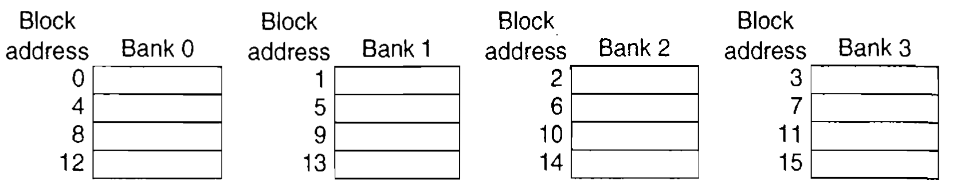
Increasing Cache Bandwidth
Four-way interleaved cache banks using block addressing

Slide 20
Reducing Miss Penalty
Sixth Advanced Optimization
Critical Word First and Early Restart
Based on the observation that the CPU needs just one word of the block at a time - Impatience
Critical word first: Request the missed word first from memory and send it to the CPU as soon as it arrives
Early restart: As soon as the requested word arrives, send the word to the CPU and restart execution
Techniques are beneficial for larger blocks only
Spatial locality complicates the miss penalty calculations
Likelihood of another access to another word of the same block

Slide 21
Reducing Miss Rate
Seventh Advanced Optimization
Compiler Optimizations
Reduces miss rate without any hardware changes
Use optimized software
Improvements in instruction misses
Improvements in data misses
Loop interchange
Some programs have nested loops that access data in memory in non-sequential order
Exchanging the nesting may make the code access data in the order they are stored
Improves cache miss by improving spatial locality
Reordering maximizes use of data in a cache block before they are discarded

Slide 22
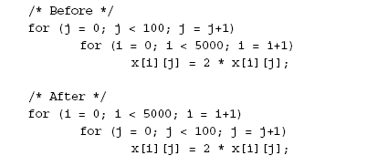
Loop Interchange
A stride of 100 while accessing the main memory
Accesses all words in one cache block before accessing the next block

Slide 23
Reducing Miss Rate
This optimization improves cache performance without affecting the number of instructions executed
Blocking
This optimization reduces cache misses via improved temporal locality
Dealing with multiple arrays
Some are accessed by rows and some by columns
Row major or column major storage?
Blocked algorithms operate on submatrices or blocks
Maximizes access to the data loaded into the cache before it is replaced
Code example without blocking

Slide 24
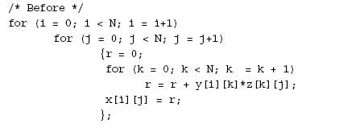
Example to Illustrate Blocking Matrix Multiplication

Slide 25
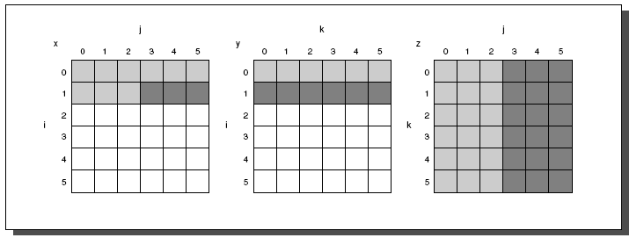
Access Pattern of x, y and z when N=6 and i= 1

Slide 26
Reducing Miss Rate
Compiler Optimizations…
All required elements of x, y and z may not fit in the cache
Original code is modified
Compute on a sub-matrix of size B by B
Blocking factor is used to form a sub-matrix of size B by B
Code example after blocking
Blocking exploits a combination of spatial and temporal locality
Blocking can also help in register allocation

Slide 27
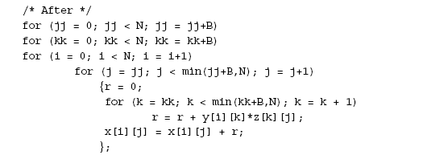
Blocking

Slide 28
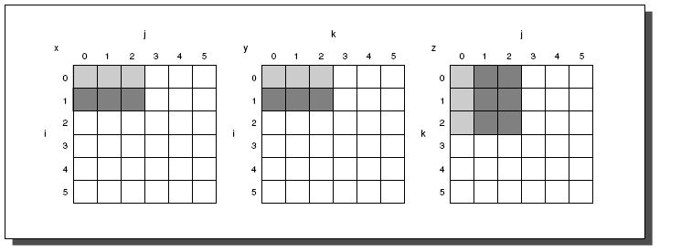
Access Pattern after Blocking

Slide 29
Reducing Miss Penalty or Miss rate via Parallelism
Eighth Advanced Optimization
Hardware Prefetching of Instructions and Data
Prefetch items before they are requested by the processor into cache or into an external buffer
Instruction prefetched by hardware
Fetch two blocks on a miss
The requested block and the next consecutive block
Place the next consecutive block in the instruction stream buffer
Similar approach is used for data accesses
Multiple stream buffers can improve performance
Prefetching relies on utilizing memory bandwidth
If it interferes with demand misses, it lowers performance

Slide 30
Reducing Miss Penalty or Miss rate via Parallelism
Ninth Advanced Optimization
Compiler- Controlled Prefetching to improve Miss Penalty or Miss Rate
Compiler inserts prefetch instructions to request the data before they are needed
Two types
Register prefetch: Loads the value into a register
Cache prefetch: Loads data only into the cache
Either of the above can be faulting or non-faulting
Address does or does not cause an exception for virtual address faults and protection violations

Slide 31
Reducing Miss Penalty or Miss rate via Parallelism
Normal load is considered a ‘faulting register prefetch instruction’
Non faulting prefetches turn into no-ops if they result in an exception
Most effective prefetch is ‘semantically invisible’ to a program
It does not change the contents of registers and memory and it cannot cause virtual memory faults
Most processors offer nonfaulting cache prefetches
Also called nonbinding prefetch
Prefetch instructions incurs an instruction overhead
Overheads must not exceed benefits

Slide 32
Advanced Cache Optimizations
Tenth Advanced Optimization
Using HBM to Extend the Memory Hierarchy
Build massive L4 cache (128MB to 1GB) using DRAMs
Where are the tags placed?
Large number of tags for 64 bytes block size
Increase the block size to 4KB
Storage for tags is reasonably manageable
Problems with large block size
Remaining contents of blocks may not be needed
Cache is used inefficiently
Fragmentation problem
Transferring of large blocks is inefficient

Slide 33
Advanced Cache Optimizations
Use sub-blocking of blocks
Allow parts of the block to be invalidated
Conflict and consistency misses increase due to decrease in the number of blocks
Keep block size smaller
Store the tags for L4 in HBM
Drawback: Each L4 access requires two accesses to DRAM
Discard the solution due to high latency
Another solution
Place the tags and the data in the same row in the HBM SDRAM
Several other solutions has been proposed to resolve the issue

