Slide 1
Memory Hierarchy Design
Cache Optimization Techniques
Advanced Cache Optimizations
Main Memory Optimizations

Slide 2
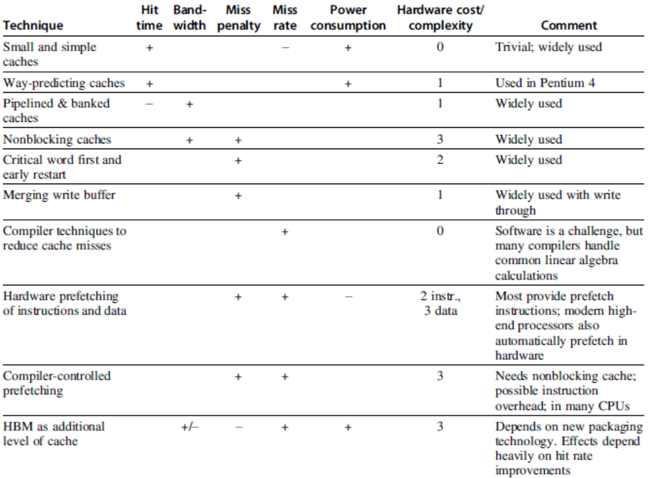
Cache Optimization Summary

Slide 3
Advanced Cache Optimizations
Victim Caches:
What was discarded may be needed again
Recycling
Add a small, fully associative cache between a cache and its refill path
Contains only those blocks that are discarded from a cache because of a miss – victims
Victim cache is checked on a miss to see if they have the desired data before going to the next lower level memory
One to five entry victim cache is effective for improving the miss rate of small, direct-mapped cache

Slide 4

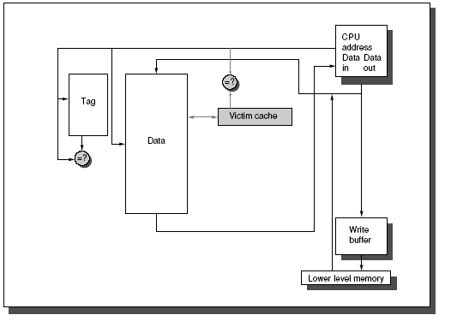
Victim Cache

Slide 5
Main Memory Optimizations – 2.2 of Ch2
Improving Memory Performances inside a DRAM Chip
Take advantage of the nature of DRAMs
Row access and Column access
DRAM buffers a row access and then selects a column
Internal organization of DRAM actually consists of many memory modules
Arrays of memory modules
Innovations due to specific structure of DRAMs
Synchronous DRAM (SDRAM)
Add a clock to the DRAM interface
Avoid the overhead of synchronization at every access
Allow burst transfer mode: Multiple transfers can occur without a new column address

Slide 6
Optimizations inside a DRAM Chip
Banks were introduced in SDRAMs
Helps in power management, improve access time and allow interleaved and overlapped access to different banks
A programmable register holds the number of bytes requested
Many bytes are sent over several cycles per request
Double Data Rate DRAM (DDR) for more bandwidth
Transfer data at both the rising and falling edge of DRAM clock
DDR SDRAMs activate multiple banks internally
DDR Standards – Lower voltage and higher frequency
DDR2, DDR3, GDDR5 and GDR4 innovations

Slide 7
Optimizations inside a DRAM Chip
Packaging Innovation: Stacked or Embedded DRAMs
Multiple DRAMs are placed in a stacked or adjacent fashion embedded within the same chip
Lowers the access latency
Increase the bandwidth
High Bandwidth Memory (HBM)
Stacking directly on the CPU or stacking only the DRAMs and abuts (be adjacent to) with the CPU
In some applications, it may be possible to package enough DRAM internally
A version of Nvidia GPU
HBM use as an additional cache level

Slide 8
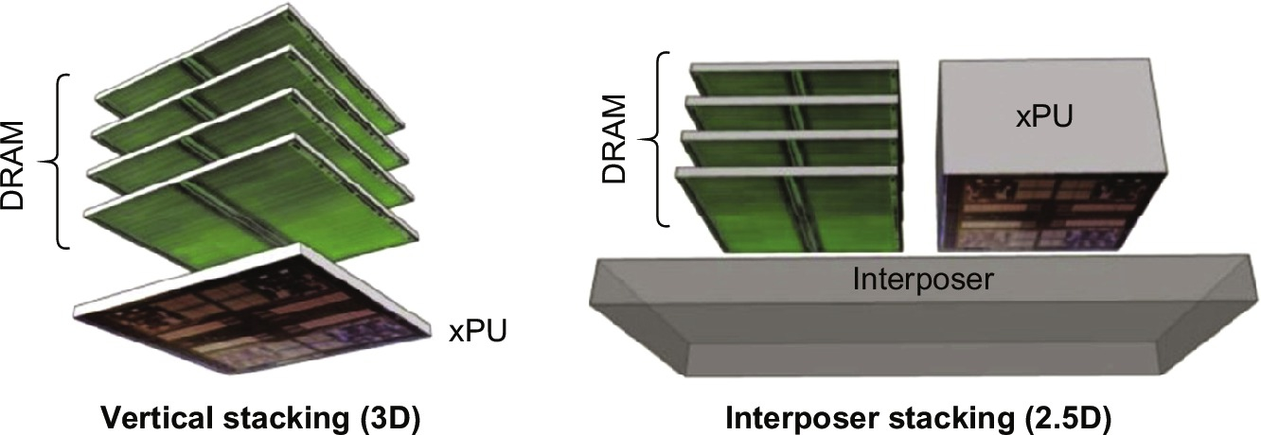
Packaging Innovation for a DRAM Chip
Two forms of die stacking

Slide 9
Thread-Level Parallelism
Multi-core Designs (2003)
Chapter 5

Slide 10
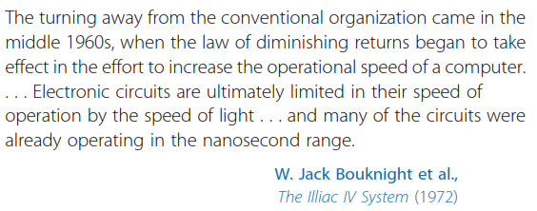
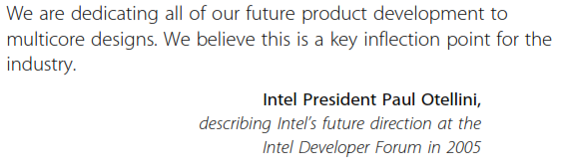
Thread-Level Parallelism

Slide 11
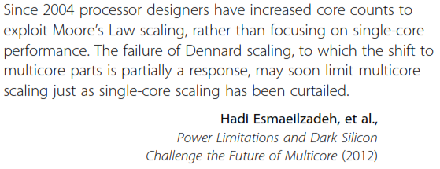
Thread-Level Parallelism
Multi-core Designs (2003)
Need for Parallel Architecture
A Taxonomy of Parallel Architectures
Models for Communication

Slide 12

Introduction to Parallel Architecture
Performance of uniprocessors has improved at the highest rate during the 1986-2003 period
Importance of multiprocessors have grown over the years to achieve higher than available performance
Increased importance of multiprocessing reflects several major factors
Improve performance faster than what the basic technology allows
A growing interest in high end servers
A growth in data intensive applications
An improved understanding of the use of multiprocessors effectively in exploiting parallelism
Replication has a better design leverage than others
Major focus would be on thread-level parallelism
Exploited through MIMDs

Slide 13
Introduction to Parallel Architecture
Multiprocessors are defined as
Computers consisting of tightly coupled processors
Coordination and usage is controlled by a single operating system
Share memory through shared address space
There are two software models to exploit TLP
Execution of a tightly coupled set of threads
Collaborating on a single task - Parallel processing
Execution of multiple, relatively independent processes
Originate from one or more users
Request-level parallelism
Both multiprogramming and single application running on multiple servers

Slide 14
Introduction to Parallel Architecture
Size range from two to dozens of processors
Communicate/coordinate through shared memory
Single-chip systems with multiple cores
Multicore
Multiple-chip systems with multicore chips
An ultrascale computer: Warehouse-scale computer
Large-scale systems with very large number of processors – clusters that grows to 1000’s of Ps
Processes large number of independent requests
OR Highly parallel, compute intensive tasks
Multicomputers
Large-scale multiprocessor systems
Less tightly-coupled than multiprocessors but more tightly-coupled than warehouse-scale computers

Slide 15
Introduction to Parallel Architecture
Focus on mainstream of multiprocessor design
Multiprocessors with small to medium number of processors – 4 to 32
Multiprocessor Architecture: Issues and Approach
n threads or processes should be present in programs to execute on an MIMD with n processors
Multiple threads are created by the programmer
OR By the Operating systems OR compiler
Grain size
Amount of computation assigned to a thread
Important factor to exploit
Fine-grained and coarse-grained threads

Slide 16
Multiprocessor Architecture
Threads may consist of hundreds to millions of instructions that can be executed in parallel
Threads can also be used to exploit data level parallelism, but the overhead is higher than in SIMD computers or with a GPU
Grain size must be sufficiently large to exploit parallelism efficiently
Existing shared-memory multiprocessors are categorized into two classes depending on the number of processors involved
This determines the memory organization and interconnect strategy

Slide 17
Multiprocessor Architecture
Based on the memory organization, there are two major types
1. Centralized shared memory multiprocessors
Processors share a single centralized memory
Consists of a small to moderate number of processors, typically 32 or fewer
The multiprocessors are also called UMAs (Uniform Memory Access) or Symmetric Multiprocessors (SMPs)
Most of the existing multicores are SMPs
Processors memory interconnect is a bus
This is not a scalable architecture
2. Multiprocessors with physically distributed memory
Consists of large number of processors

Slide 18
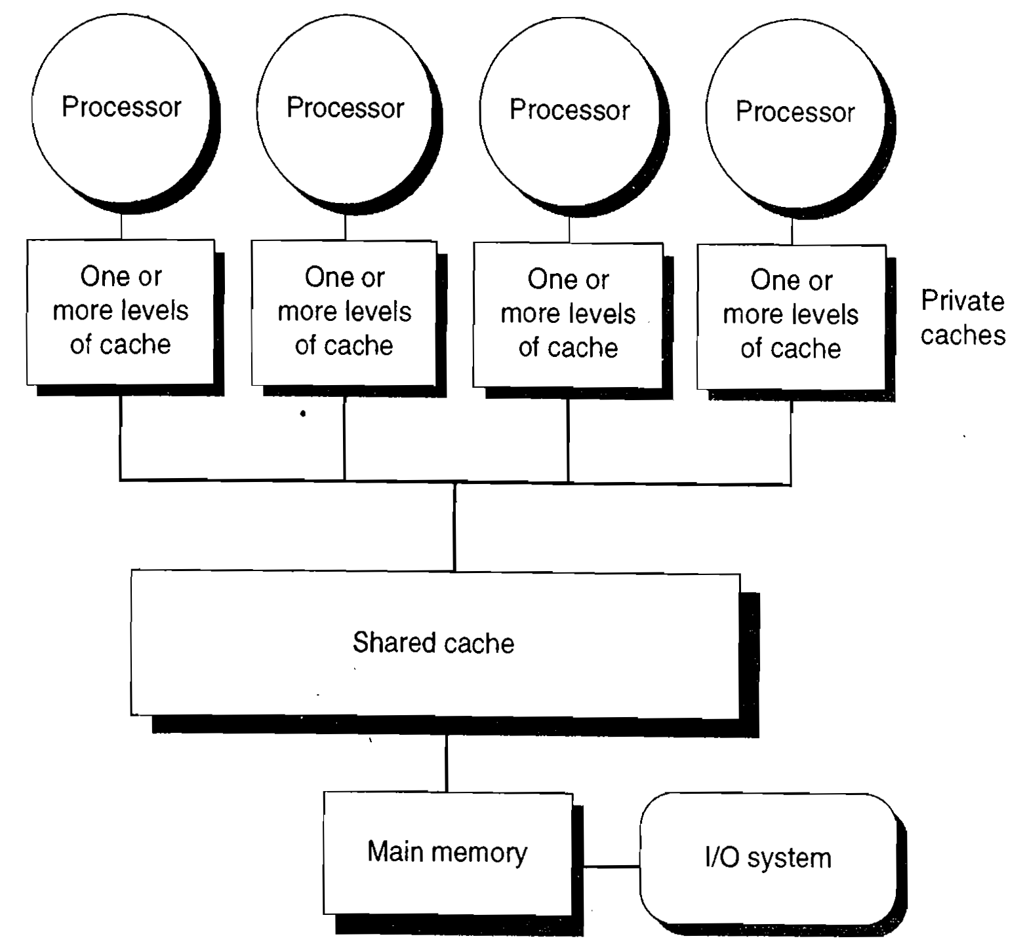
Centralized Shared Memory Multiprocessor

Slide 19
Multiprocessor Architectures
To support larger number of processors
Memory is also distributed to support the bandwidth demands
Distributed memory has two benefits
i. It is a cost-effective way to scale the memory bandwidth
Most accesses at a node are to the local memory
ii. It reduces the latency for accesses to the local memory
Also called Distributed Shared Memory (DSM) or scalable shared memory architecture
Referred to as NUMA: Non uniform memory access
Access to local memory is the fastest
Data transfer among processors becomes more complex

Slide 20
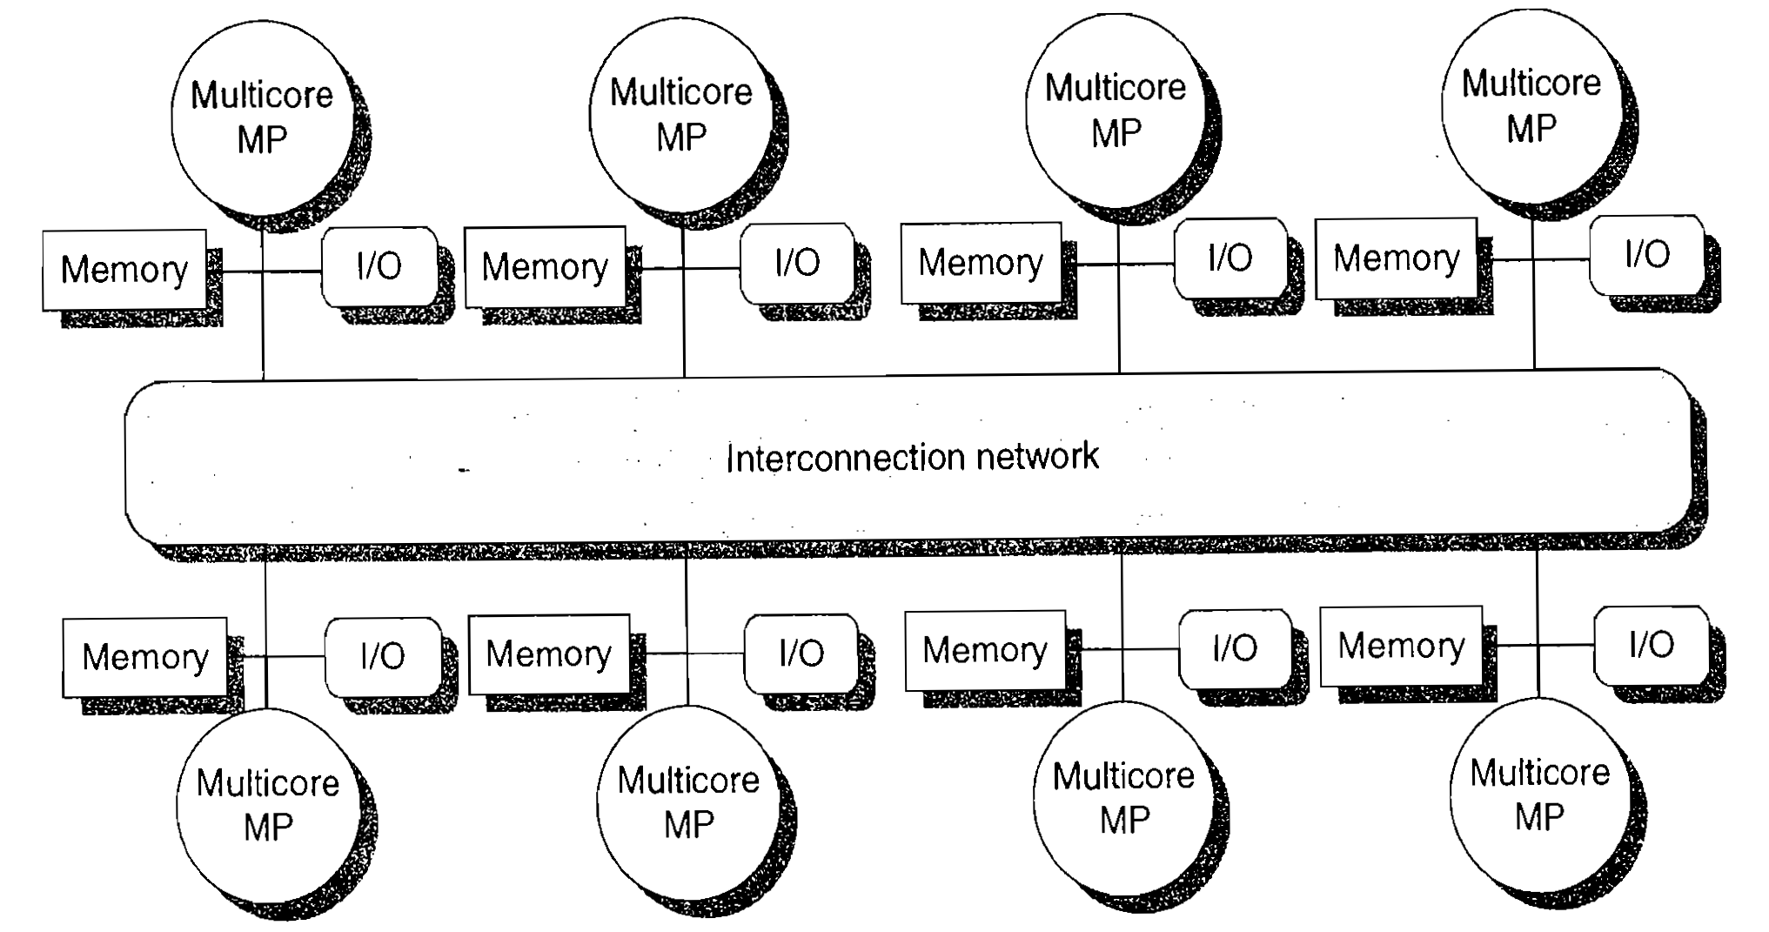
Distributed Memory Multiprocessor

Slide 21
Multiprocessor Architecture
Both DSM and SMP are shared-address space multiprocessors
Address space is used to communicate data implicitly using load and store instructions
Clusters or warehouse-scale computers look like individual computers connected by a network that do not share memory
Message passing protocols are used to communicate data among processors
Applications of multiprocessors range from
Running independent tasks with no communication
TO
Running parallel programs where threads must communicate to complete a task

