Slide 1
Thread-Level Parallelism
Multi-core Designs (2003)
Need for Parallel Architecture
A Taxonomy of Parallel Architectures
Models for Communication

Slide 2

Multiprocessor Architecture
Based on the memory organization, there are two major types
1. Centralized shared memory multiprocessors
Processors share a single centralized memory
Consists of a small to moderate number of processors, typically 32 or fewer
The multiprocessors are also called UMAs (Uniform Memory Access) or Symmetric Multiprocessors (SMPs)
Most of the existing multicores are SMPs
Processors memory interconnect is a bus
This is not a scalable architecture
2. Multiprocessors with physically distributed memory
Consists of large number of processors

Slide 3
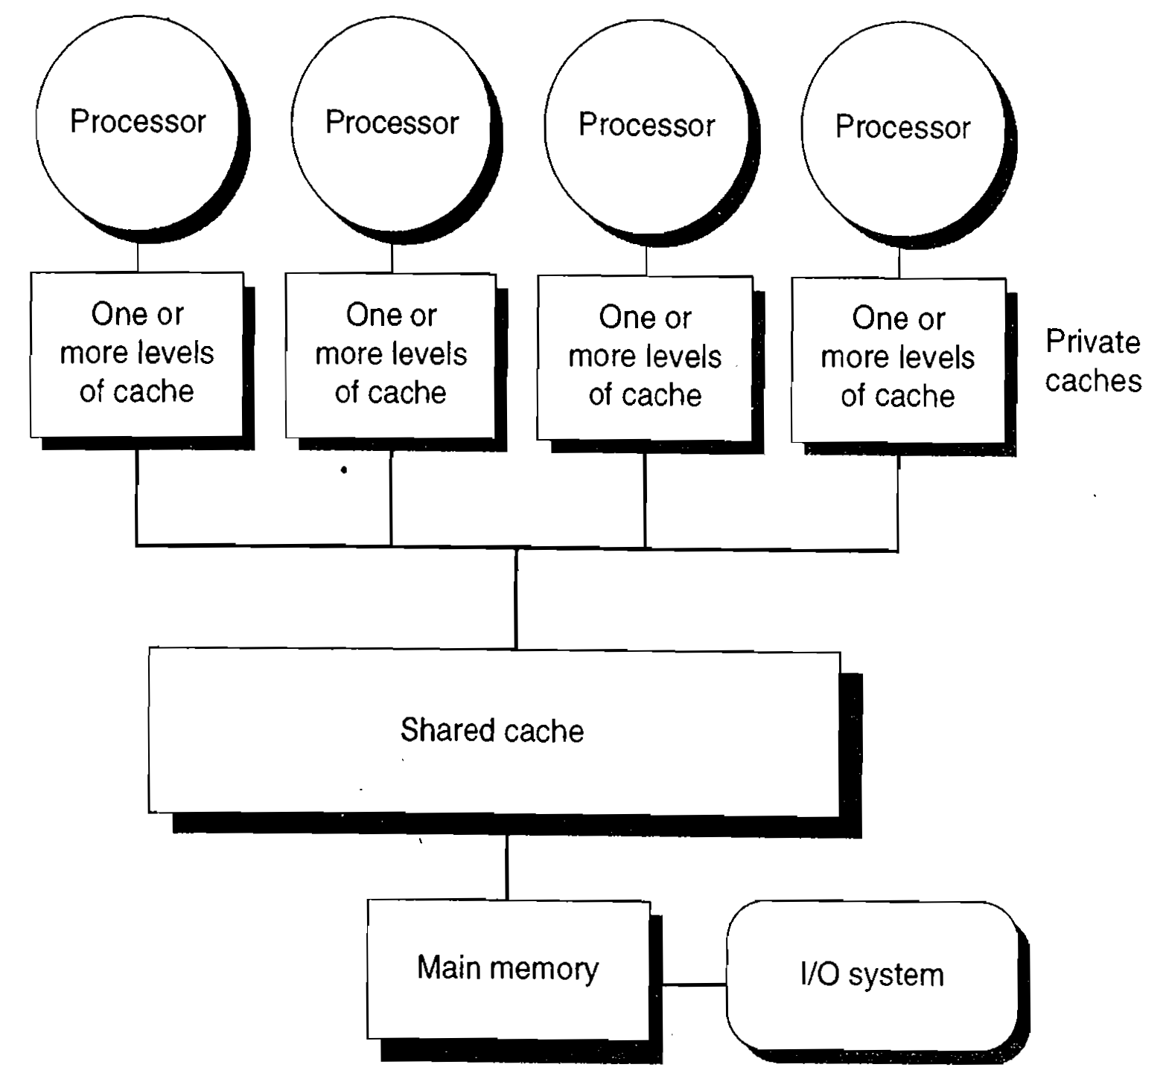
Centralized Shared Memory Multiprocessor

Slide 4
Multiprocessor Architectures
To support larger number of processors
Memory is also distributed to support the bandwidth demands
Distributed memory has two benefits
i. It is a cost-effective way to scale the memory bandwidth
Most accesses at a node are to the local memory
ii. It reduces the latency for accesses to the local memory
Also called Distributed Shared Memory (DSM) or scalable shared memory architecture
Referred to as NUMA: Non uniform memory access
Access to local memory is the fastest
Data transfer among processors becomes more complex

Slide 5
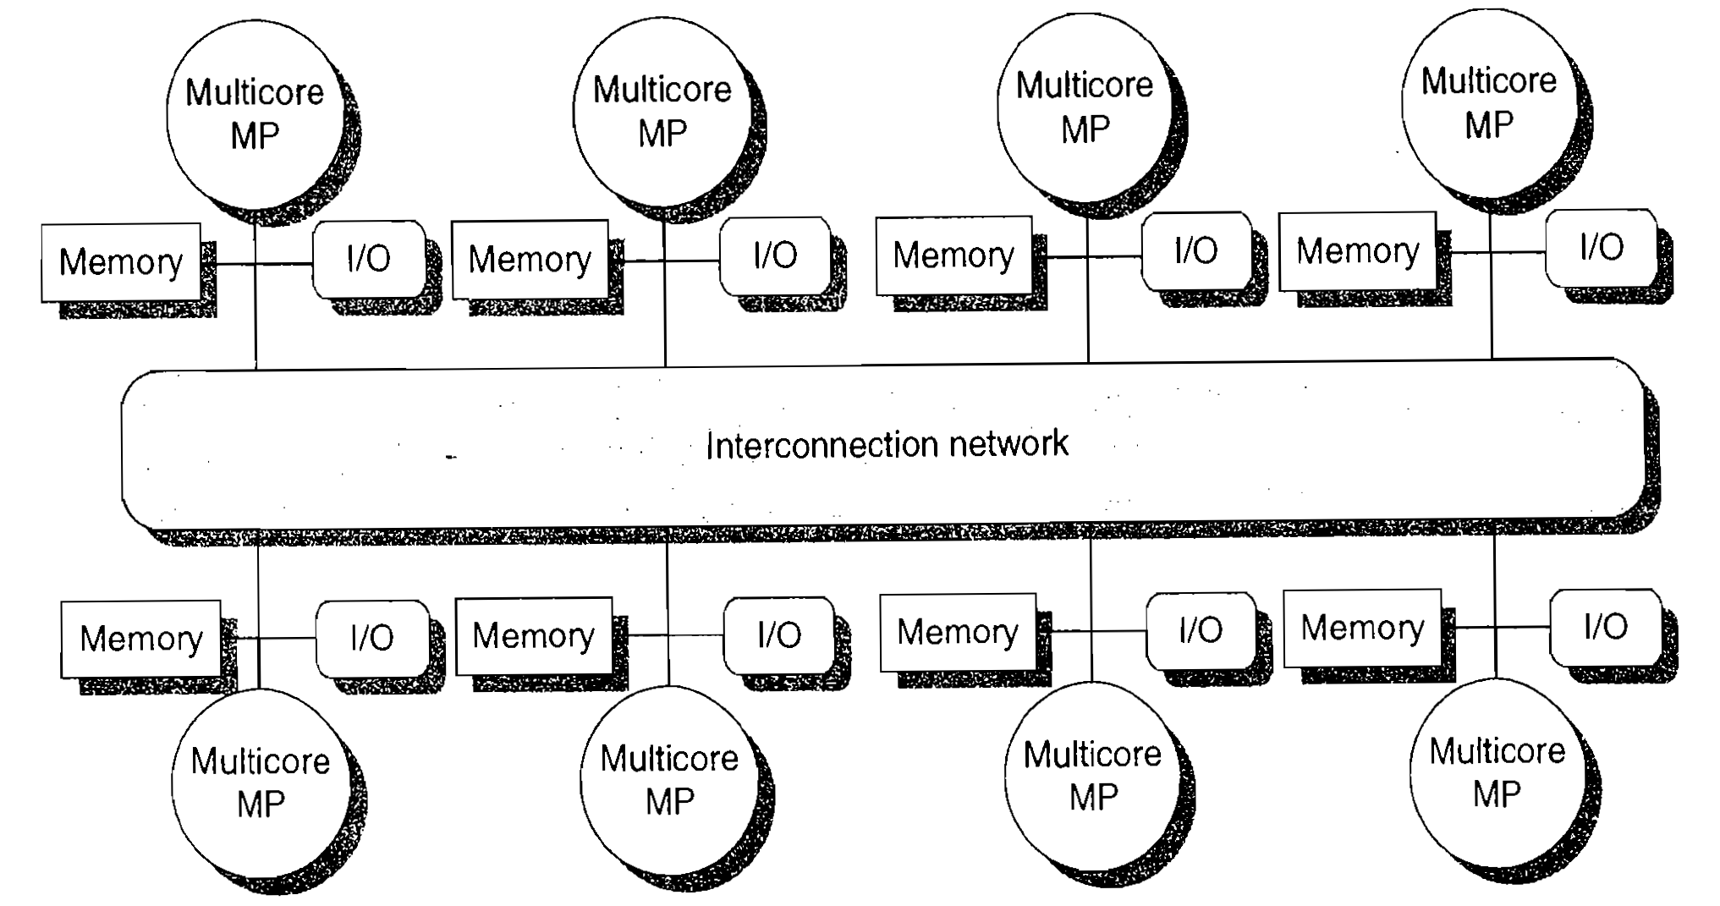
Distributed Memory Multiprocessor

Slide 6
Multiprocessor Architecture
Both DSM and SMP are shared-address space multiprocessors
Address space is used to communicate data implicitly using load and store instructions
Clusters or warehouse-scale computers look like individual computers connected by a network that do not share memory
Message passing protocols are used to communicate data among processors
Applications of multiprocessors range from
Running independent tasks with no communication
TO
Running parallel programs where threads must communicate to complete a task

Slide 7
Challenges of Parallel Processing
There are two important challenges of parallel processing
Limited parallelism available in programs
This makes it difficult to achieve good speedups in a parallel processor
Relatively high cost of communications introduces large latency of remote access in a parallel processor
Time required for communication depends on
The communication mechanism
The type of interconnection network
The scale of the multiprocessor
Limited parallelism can be resolved by
Developing new algorithms having better parallel performance

Slide 8
Challenges of Parallel Processing
Software development efforts should be geared towards parallelism
Parallelizing compilers
Reducing the impact of long latency that requires effort by both the architect and the programmer
Reduce the frequency of remote access by
Hardware mechanism such as caching of shared data
Software mechanisms such as restructuring of data to make more accesses local
Tolerate the long latency by using
Prefetching or multithreading

Slide 9
Cache Coherence Problem
Multiprocessor cache coherence
What is cache coherence problem and can it happen in single processor architecture?
Cache coherence problem in Multiprocessors?
Caching of both shared and private data is performed to reduce the long latency of access
Private data and shared data
More than one processors’ cache contain shared data
Results in latency and contention reduction
Introduces cache coherence problem
Memory system is coherent if
A read returns the most recently written value of that data

Slide 10
Example Cache Coherence Problem
P
1
P
2
P
3
u
= ?
u
= ?
3
$
4
$
5
$
u
:5
u
:5
u
= 7
1
I/O devices
u
:5
2
Memory

Slide 11
Cache Coherence Problem
Protocols to maintain coherence for multiple processors are called cache coherence protocols
Two classes of protocols are used to maintain cache coherence
Snoopy protocols are based on broadcast media like bus
Directory based protocols that can be applied on any network
Most SMPs use snoopy based protocols, while most of the DSM systems use directory based protocols for cache coherence

Slide 12
SIMD Architecture for Data Level Parallelism
Why SIMD architecture?
Used for matrix-oriented computation of scientific computing
Media-oriented sound and image processing
SIMD is more energy efficient than MIMD
Attractive for PMDs and for servers
Programmer continues to think sequentially
Three types of SIMDs
Vector architecture
Multimedia SIMD instruction set extensions
GPUs
Vector architecture
Pipelined execution of many data operations

Slide 13
SIMD Architecture for Data Level Parallelism
Easier to understand and compile
Multimedia SIMD ISA extensions
Simultaneous parallel data operations
Support multimedia applications
Present in most of the current generation ISA
GPUs offering higher performance than multicores
System processor and system memory + GPU and graphics memory
Heterogeneous architecture
Future applications are expected to have both DLP and TLP
SIMD is as important as MIMD in such systems

Slide 14
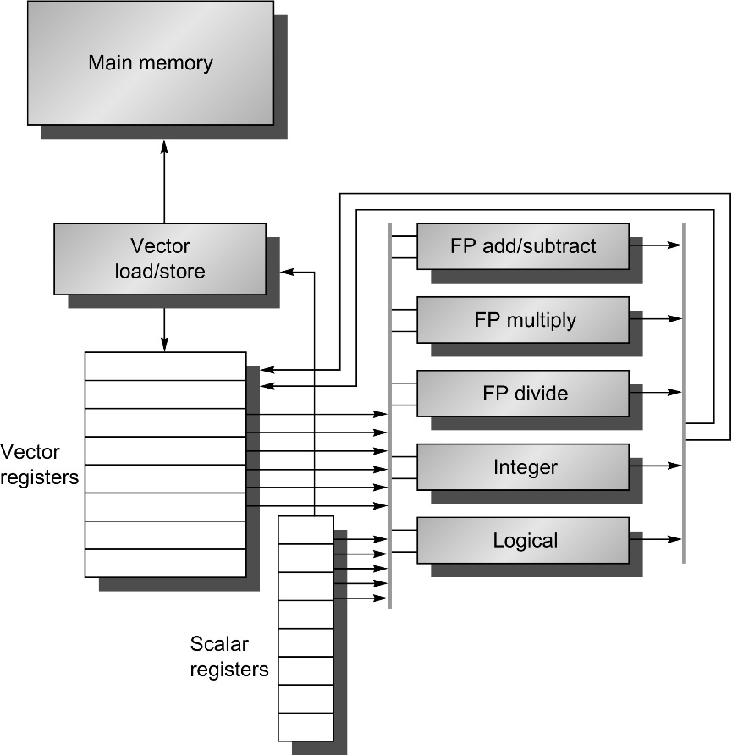
Basic structure of a Vector Architecture RV64V which includes a RISC-V scalar arch.

Slide 15
Why Multicore?
Moore’s law and architectural improvements
Parallelism in software and superscalability
More transistors converted to performance improvement by better architectural enhancements
Performance wall due to limited ILP in software
Clock frequency increase slowed down
Exploit parallelism among threads
More transistors converted to more processors (cores)
Both ILP and TLP are embedded in multicores
TLP for higher performance – programmer

Slide 16
Other High Performance Architectures
VLIW processors architecture
Warehouse scale computers
Large computing resources available to any one who can pay for its use
A supercomputer that is available not only for the scientific community, but for all
Goals and requirements
Cost-performance
Energy efficiency
Dependability via redundancy
Network I/O
Both interactive and batch processing workloads

Slide 17
Domain Specific Architecture – Ch 7
Moore’s Law cannot continue forever…we have another 10 to 20 years before we reach a fundamental limit
Gordon Moore
Intel Co-founder (2005)

Slide 18
Domain Specific Architectures
Features added in processor architectures due to Moore’s Law
1st, 2nd, 3rd and 4th level caches
512-bit SIMD Floating point units
15+ stage pipelines
Out-of-order Execution
Branch prediction units
Speculative prefetching
Multithreading
Multiprocessing
Achieve higher level of efficiency through Domain Specific Architecture (DSAs)
Heterogeneous multicores

Slide 19
Domain Specific Architectures
Standard processors would run conventional large programs – OS
Domain specific processors that perform only a narrow range of tasks efficiently
Examples:
Use of caches are good for general purpose architecture
May not work as well for DSAs
FPGAs or reconfigurable chips can be used to accommodate small volume applications
DSAs consist of architectures specifically designed to suit the applications
Do not have a conventional structure as a general purpose architecture

Slide 20
Domain Specific Architectures
Five guidelines for design of DSAs
Increased area and energy efficiency
Also provides a number of improvements
Use dedicated memories to minimize the distance over which data is moved
Invest the resources saved from dropping advanced micro-architectural optimizations into more arithmetic units or bigger memories
Use the easiest form of parallelism that matches the domain
Reduce the data type and size to the simplest needed for the domain
Use a domain specific programming language to port the code to the DSA

Slide 21
Domain Specific Architectures
Examples of domains that demand the design of architecture best suited for their needs
Deep Neural Networks (DNNs)
TPU – Tensor Processing Unit, an inference data center accelerator
Microsoft Catapult – A flexible data center accelerator
Intel Crest – a data center accelerator for training
Pixel Visual Core – A PMD image processing unit

