Slide 1

Week 9-10 Basics of Functional Dependencies & Normalization for Relational DB
Chapter: 14

Slide 2
Road Map
Informal Design Guidelines for Relation Schemas
Functional Dependencies
Normal Forms Based on Primary Keys
General Definitions of Second & Third Normal Forms

Slide 3
Road Map …
Boyce-Codd Normal Form
Multivalued Dependency & Fourth Normal Form
Join Dependencies & Fifth Normal Form

Slide 4
Informal Design Guidelines for Relation Schemas

Slide 5
Imparting Clear Semantics to Attributes in Relations
The semantics of a relation refers to its meaning resulting from the interpretation of attribute values in a tuple
In general, the easier it is to explain the semantics of the relation, the better the relation schema design will be

Slide 6
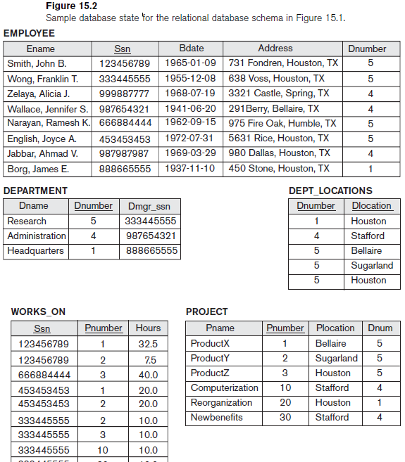
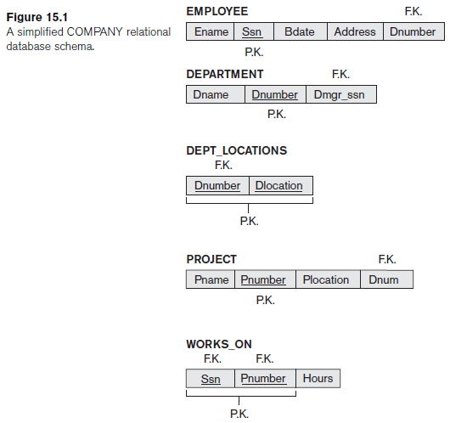
Imparting Clear Semantics to Attributes in Relations

Slide 7
Imparting Clear Semantics to Attributes in Relations
Guideline 1
Design a relation schema so that it is easy to explain its meaning
Do not combine attributes from multiple entity types and relationship types into a single relation
If a relation schema corresponds to one entity type or one relationship type, it is straightforward to interpret its meaning
if the relation corresponds to a mixture of multiple entities and relationships, semantic ambiguities will result and the relation cannot be easily explained.

Slide 8
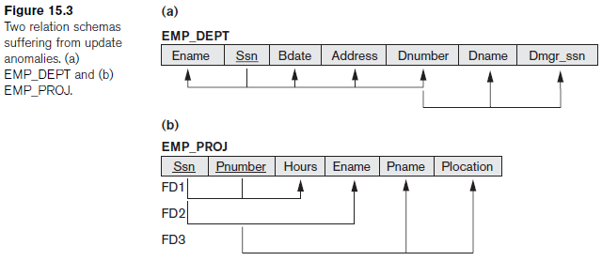
Imparting Clear Semantics to Attributes in Relations
Examples of Violating Guideline 1
Relation schemas in Figures 15.3(a) and 15.3(b) also have clear semantics
A tuple in EMP_DEPT relation schema in Figure 15.3(a) represents a single employee but includes additional information—namely, name (Dname) of the department for which the employee works and the Social Security number (Dmgr_ssn) of the department manager

Slide 9
Imparting Clear Semantics to Attributes in Relations
Examples of Violating Guideline 1
For EMP_PROJ relation in Figure 15.3(b), each tuple relates an employee to a project but also includes the employee name (Ename), project name (Pname), and project location (Plocation)
Although there is nothing wrong logically with these two relations, they violate Guideline 1 by mixing attributes from distinct real-world entities:
EMP_DEPT mixes attributes of employees and departments, and
EMP_PROJ mixes attributes of employees and projects and the WORKS_ON relationship
Hence, they fare poorly against the above measure of design quality
They may be used as views, but they cause problems when used as base relations

Slide 10
Redundant Information in Tuples & Update Anomalies
One goal of schema design is to minimize the storage space used by the base relations
Grouping attributes into relation schemas has a significant effect on storage space
For example, In EMP_DEPT, the attribute values pertaining to a particular department (Dnumber, Dname, Dmgr_ssn) are repeated for every employee who works for that department
In contrast, each department’s information appears only once in the DEPARTMENT relation. Only the department number (Dnumber) is repeated in the EMPLOYEE relation for each employee who works in that department

Slide 11
Redundant Information in Tuples & Update Anomalies
Storing natural joins of base relations leads to an additional problem referred to as Update Anomalies
These can be classified into:
insertion anomalies
deletion anomalies
modification anomalies

Slide 12

Redundant Information in Tuples & Update Anomalies
insertion anomalies
Insertion anomalies are of two types based on the EMP_DEPT relation:
To insert a new employee tuple into EMP_DEPT, we must include either the attribute values for the department that the employee works for, or NULLs (if the employee does not work for a department as yet
For example, to insert a new tuple for an employee who works in department number 5, we must enter all the attribute values of department 5 correctly so that they are consistent with the corresponding values for department 5 in other tuples in EMP_DEPT
If EMPLOYEE & DEPARTMENT tables are designed separately we do not have to worry about this consistency problem as we enter only the department number in the employee tuple while all other attribute values of department 5 are recorded only once in the database, as a single tuple in the DEPARTMENT relation

Slide 13
Redundant Information in Tuples & Update Anomalies
insertion anomalies
2nd Type of Insertion anomalies:
It is difficult to insert a new department that has no employees as yet in the EMP_DEPT relation. The only way to do this is to place NULL values in the attributes for employee. This violates the entity integrity for EMP_DEPT because Ssn is its primary key
Moreover, when the first employee is assigned to that department, we do not need this tuple with NULL values any more.
This problem does not occur in other case as a department is entered in the DEPARTMENT relation whether or not any employees work for it,
and whenever an employee is assigned to that department, a corresponding tuple is inserted in EMPLOYEE

Slide 14
Redundant Information in Tuples & Update Anomalies
Deletion Anomalies
The problem of deletion anomalies is related to the second insertion anomaly situation just discussed
If we delete from EMP_DEPT …
an employee tuple that happens to represent the last employee working for a particular department, the information concerning that department is lost from the database

Slide 15
Redundant Information in Tuples & Update Anomalies
Modification Anomalies
In EMP_DEPT, if we change the value of one of attributes of a particular department—say, the manager of department 5—we must update the tuples of all employees who work in that department; otherwise, the database will become inconsistent
If we fail to update some tuples, the same department will be shown to have two different values for manager in different employee tuples, which would be wrong

Slide 16
Redundant Information in Tuples & Update Anomalies
Guideline 2
Design the base relation schemas so that no insertion, deletion, or modification anomalies are present in the relations. If any anomalies are present, note them clearly and make sure that the programs that update the database will operate correctly
We can also see the need for a more formal approach to evaluating whether a design meets these guidelines
It is important to note that these guidelines may sometimes have to be violated in order to improve the performance of certain queries

Slide 17
NULL Values in Tuples
If many of the attributes do not apply to all tuples in the relation, we end up with many NULLs in those tuples
This can waste space at the storage level and may also lead to problems with understanding the meaning of the attributes and with specifying JOIN operations at the logical level
Another problem with NULLs is how to account for them when aggregate operations such as COUNT or SUM are applied
SELECT and JOIN operations involve comparisons; if NULL values are present, results may become unpredictable

Slide 18
NULL Values in Tuples
NULLs can have multiple interpretations, such as the following:
Attribute does not apply to this tuple. For example, Visa_status may not apply to U.S. students
The attribute value for this tuple is unknown. For example, the Date_of_birth may be unknown for an employee
The value is known but absent; that is, it has not been recorded yet. For example Home_Phone_Number for an employee may exist, but may not be available and recorded yet
Having the same representation for all NULLs compromises the different meanings they may have
Therefore, we may state another guideline

Slide 19
NULL Values in Tuples
Guideline 3
As far as possible, avoid placing attributes in a base relation whose values may frequently be NULL
If NULLs are unavoidable, make sure that they apply in exceptional cases only and do not apply to a majority of tuples in the relation

Slide 20
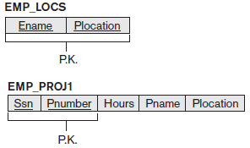
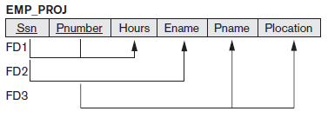
Generation of Spurious Tuples
Consider the two relation schemas EMP_LOCS and EMP_PROJ1 which can be used instead of the single EMP_PROJ relation in
A tuple in EMP_LOCS means that the employee whose name is Ename works on some project whose location is Plocation
A tuple in EMP_PROJ1 refers to the fact that the employee whose Social Security number is Ssn works Hours per week on the project whose name, number, and location are Pname, Pnumber, and Plocation

Slide 21
Generation of Spurious Tuples
Suppose that we used EMP_PROJ1 and EMP_LOCS as the base relations instead of EMP_PROJ
This produces a particularly bad schema design because:
we cannot recover the information that was originally in EMP_PROJ from EMP_PROJ1 and EMP_LOCS
If we attempt a NATURAL JOIN operation on EMP_PROJ1 and EMP_LOCS, the result produces many more tuples than the original set of tuples in EMP_PROJ

Slide 22
Generation of Spurious Tuples
Additional tuples that were not in EMP_PROJ are called spurious tuples because they represent spurious information that is not valid
Decomposing EMP_PROJ into EMP_LOCS and EMP_PROJ1 is undesirable because when we JOIN them back using NATURAL JOIN, we do not get the correct original information
This is because in this case Plocation is the attribute that relates EMP_LOCS and EMP_PROJ1, and Plocation is neither a primary key nor a foreign key in either EMP_LOCS or EMP_PROJ1

Slide 23
Generation of Spurious Tuples
Guideline 4
Design relation schemas so that they can be joined with equality conditions on attributes that are appropriately related (primary key, foreign key) pairs in a way that guarantees that no spurious tuples are generated
Avoid relations that contain matching attributes that are not (foreign key, primary key) combinations because joining on such attributes may produce spurious tuples

Slide 24
Summary and Discussion of Design Guidelines
The problems we pointed out are as follows:
Anomalies that cause redundant work to be done during insertion into and modification of a relation, and that may cause accidental loss of information during a deletion from a relation
Waste of storage space due to NULLs and the difficulty of performing selections, aggregation operations and joins due to NULL values
Generation of invalid and spurious data during joins on base relations with matched attributes that may not represent a proper (foreign key, primary key) relationship

Slide 25
Functional Dependencies

Slide 26
Definition of Functional Dependency
A functional dependency is a constraint between two sets of attributes from the database
Suppose that our relational database schema has n attributes A1, A2, ..., An; let us think of the whole database as being described by a single universal relation schema R = {A1, A2, ... , An}

Slide 27
Definition of Functional Dependency
Definition: A functional dependency, denoted by X → Y, between two sets of attributes X and Y that are subsets of R specifies a constraint on the possible tuples that can form a relation state r of R. The constraint is that, for any two tuples t1 and t2 in r that have t1[X] = t2[X], they must also have t1[Y] = t2[Y]
This means that the values of the Y component of a tuple in r depend on, or are determined by, the values of the X component; alternatively, the values of the X component of a tuple uniquely (or functionally) determine the values of the Y component
We also say that there is a functional dependency from X to Y, or that Y is functionally dependent on X. The abbreviation for functional dependency is FD or f.d
The set of attributes X is called the left-hand side of the FD, and Y is called the right-hand side
Thus, X functionally determines Y in a relation schema R if, and only if, whenever two tuples of r(R) agree on their X-value, they must necessarily agree on their Yvalue
Note the following:
If a constraint on R states that there cannot be more than one tuple with a given X-value in any relation instance r(R)—that is, X is a candidate key of R—this implies that X → Y for any subset of attributes Y of R (because the key constraint implies that no two tuples in any legal state r(R) will have the same value of X)
If X is a candidate key of R, then X→R
If X→Y in R, this does not say whether or not Y→X in R

Slide 28
Definition of Functional Dependency
A functional dependency is a property of the semantics or meaning of the attributes
The database designers will use their understanding of the semantics of the attributes of R—that is, how they relate to one another
Relation extensions r(R) that satisfy the functional dependency constraints are called legal relation states (or legal extensions) of R
Hence, the main use of functional dependencies is to describe further a relation schema R by specifying constraints on its attributes that must hold at all times
For example, {State, Driver_license_number} → Ssn should hold for all tuples

Slide 29
Definition of Functional Dependency
Consider the relation schema EMP_PROJ
from the semantics of the attributes and the relation, we know that the following functional dependencies should hold:
Ssn→Ename
Pnumber →{Pname, Plocation}
{Ssn, Pnumber}→Hours
These functional dependencies specify that
the value of an employee’s Social Security number (Ssn) uniquely determines the employee name (Ename)
The value of a project’s number (Pnumber) uniquely determines the project name (Pname) and location (Plocation), and
a combination of Ssn and Pnumber values uniquely determines the number of hours the employee currently works on the project per week (Hours)
Alternatively,we say that Ename is functionally determined by (or functionally dependent on) Ssn, or given a value of Ssn, we know the value of Ename, and so on.

Slide 30
Definition of Functional Dependency
A functional dependency is a property of the relation schema R, not of a particular legal relation state r of R
FD cannot be inferred automatically from a given relation extension r but must be defined explicitly by someone who knows the semantics of the attributes of R
For example, consider the TEACH relation schema
Although at first glance we may think that Teacher → Course,
But this does not hold true for all tuples as a teacher ma determine both ‘Data Structures’ and ‘Data Management,’
Hence, we can conclude that Teacher does not functionally determine Course

Slide 31
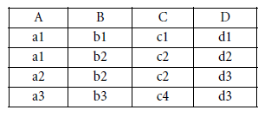
Definition of Functional Dependency
Given a populated relation, one cannot determine which FDs hold and which do not unless the meaning of and the relationships among the attributes are known
One can, however, emphatically state that a certain FD does not hold if there are tuples that show the violation of such an FD
Here, the following FDs may hold because the four tuples in the current extension have no violation of these constraints: B → C; C → B; {A, B} → C; {A, B} → D; and {C, D} → B
However, the following do not hold because we already have violations of them in the given extension: A → B (tuples 1 and 2 violate this constraint); B → A (tuples 2 and 3 violate this constraint); D→C (tuples 3 and 4 violate it)

Slide 32
Definition of Functional Dependency
Figure shows diagrammatic notation for displaying FDs as a horizontal line
The left-hand-side attributes of the FD are connected by vertical lines to the line representing the FD, while the right-hand-side attributes are connected by the lines with arrows pointing toward the attributes
We denote by F the set of functional dependencies that are specified on relation schema R
Typically, the schema designer specifies the functional dependencies that are semantically obvious; usually, however, numerous other functional dependencies hold in all legal relation instances among sets of attributes that can be derived from and satisfy the dependencies in F

Slide 33
Trivial and non-trivial FDs
Trivial − If a functional dependency (FD) X → Y holds, where Y is a subset of X, then it is called a trivial FD. Trivial FDs always hold.
Non-trivial − If an FD X → Y holds, where Y is not a subset of X, then it is called a non-trivial FD.
Consider this table with two columns Emp_id and Emp_name.
{Emp_id, Emp_name} -> Emp_id is a trivial functional dependency as Emp_id is a subset of {Emp_id,Emp_name}.

Slide 34
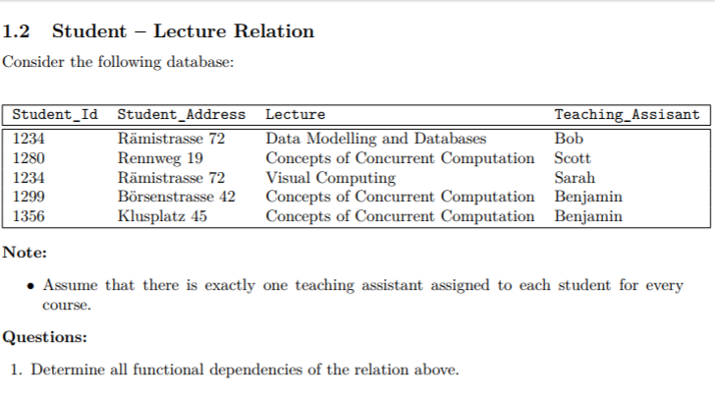

Slide 35
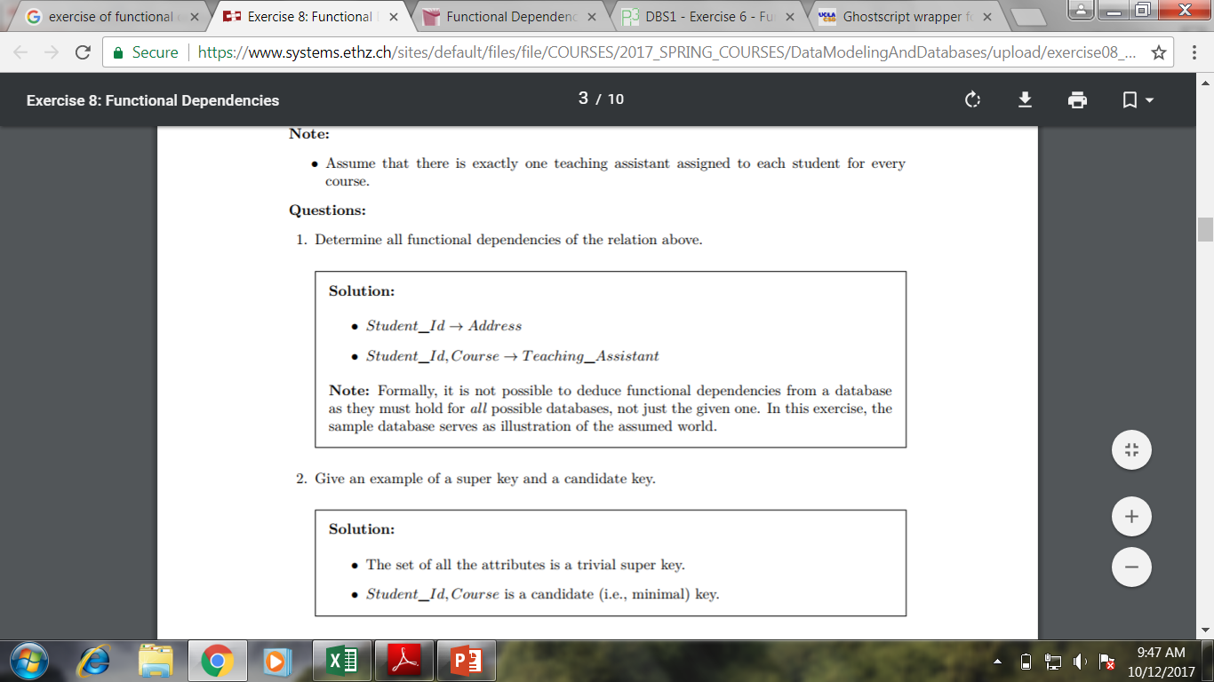

Slide 37
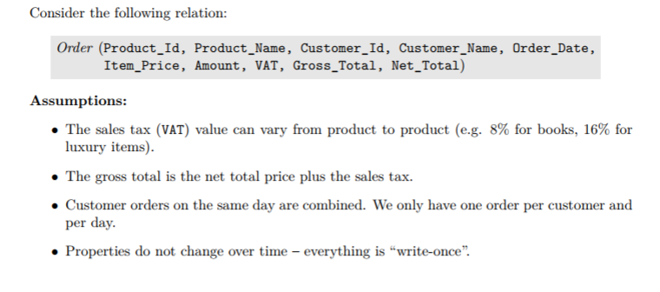
Exercise

Slide 38
Exercise : Determine All FDs

Slide 39
Normal Forms Based on Primary Keys

Slide 40
Normalization of Relations
The normalization process, as first proposed by Codd (1972a), takes a relation schema through a series of tests to certify whether it satisfies a certain normal form
The process, which proceeds in a top-down fashion by evaluating each relation against the criteria for normal forms and decomposing relations as necessary, can thus be considered as relational design by analysis
Initially, Codd proposed three normal forms, which he called first, second, and third normal form
A stronger definition of 3NF—called Boyce-Codd normal form (BCNF)—was proposed later by Boyce and Codd
All these normal forms are based on a single analytical tool: the functional dependencies among the attributes of a relation. Later, a fourth normal form (4NF) and a fifth normal form (5NF) were proposed, based on the concepts of multivalued dependencies and join dependencies, respectively

Slide 41
Normalization of Relations
Normalization of data can be considered a process of analyzing the given relation schemas based on their FDs and primary keys to achieve the desirable properties of
minimizing redundancy and
minimizing the insertion, deletion, and update anomalies
Thus, the normalization procedure provides database designers with the following:
Formal framework for analyzing relation schemas based on their keys and on functional dependencies among their attributes
A series of normal form tests that can be carried out on individual relation schemas so that the relational database can be normalized to any desired degree

Slide 42
Normalization of Relations
Definition: The normal form of a relation refers to the highest normal form condition that it meets, and hence indicates the degree to which it has been normalized.

Slide 43
Goals of Normalization
Lossless decomposition: The fragments should contain the same information as the original table. Otherwise decomposition results in information loss.
Dependency preservation: Dependencies should be
preserved within each Ri , i.e., otherwise, checking
updates for violation of functional dependencies may
require computing joins, which is expensive.
Good form: The fragments Ri should not involve
redundancy. Roughly speaking, a table has redundancy if there is a FD where the LHS is not a key

Slide 44
First Normal Form
First normal form (1NF) is defined to disallow multivalued attributes, composite attributes, and their combinations
It states that the domain of an attribute must include only atomic (simple, indivisible) values and that the value of any attribute in a tuple must be a single value from the domain of that attribute
Hence, 1NF disallows having a set of values, a tuple of values, or a combination of both as an attribute value for a single tuple
In other words, 1NF disallows relations within relations or relations as attribute values within tuples
The only attribute values permitted by 1NF are single atomic (or indivisible) values.

Slide 45
First Normal Form
Consider the DEPARTMENT relation schema with primary key Dnumber and suppose that we extend it by including the Dlocations attribute
We assume that each department can have a number of locations
As we can see, this is not in 1NF because Dlocations is not an atomic attribute

Slide 46
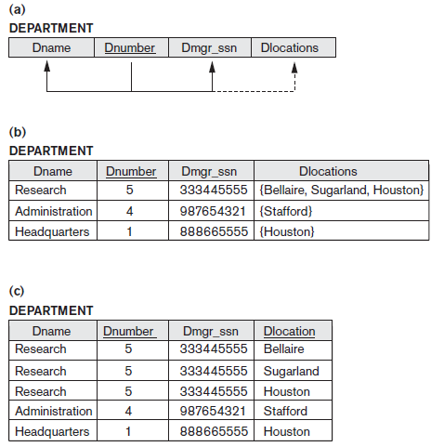
First Normal Form
There are two ways we can look at Dlocations attribute
The domain of Dlocations contains atomic values, but some tuples can have a set of these values. In this case, Dlocations is not functionally dependent on the primary key Dnumber.
The domain of Dlocations contains sets of values and hence is nonatomic. In this case, Dnumber→Dlocations because each set is considered a single member of the attribute domain

Slide 47
First Normal Form
the DEPARTMENT relation is not in 1NF; in fact, it does not even qualify as a relation
There are three main techniques to achieve first normal form for such a relation:
1. Remove the attribute Dlocations that violates 1NF and place it in a separate relation DEPT_LOCATIONS along with the primary key Dnumber of DEPARTMENT
The primary key of the new relation is the combination of {Dnumber, Dlocation}

Slide 48
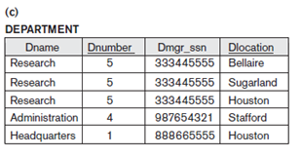
First Normal Form
2. Expand the key so that there will be a separate tuple in the original
DEPARTMENT relation for each location of a DEPARTMENT
In this case, the primary key becomes the combination {Dnumber, Dlocation}
This solution has the disadvantage of introducing redundancy in the relation

Slide 49
First Normal Form
3. If a maximum number of values is known for the attribute—
for example, if it is known that at most three locations can exist for a department—replace the Dlocations attribute by three atomic attributes: Dlocation1, Dlocation2, and Dlocation3
This solution has the disadvantage of introducing NULL values if most departments have fewer than three locations
It further introduces spurious semantics about the ordering among the location values that is not
originally intended
Querying on this attribute becomes more difficult
for example, consider how you would write the query: List the departments that have ‘Bellaire’ as one of their locations in this design

Slide 50
First Normal Form
Of the three solutions, first one is generally considered best because
it does not suffer from redundancy and
it is completely general having no limit placed on a maximum number of values
In fact, if we choose the second solution, it will be decomposed further during subsequent normalization steps into the first solution
First normal form also disallows multivalued attributes that are themselves composite. These are called nested relations
For Example, EMP_PROJ relation with nesting could represent an employee entity, and a relation PROJS(Pnumber, Hours) within each tuple represents the employee’s projects and the hours per week that employee works on each project
The schema of this EMP_PROJ relation can be represented as follows: EMP_PROJ(Ssn, Ename, {PROJS(Pnumber, Hours)})

Slide 51
Second Normal Form
It is based on the concept of full functional dependency
A functional dependency X → Y is a full functional dependency if removal of any attribute A from X means that the dependency does not hold any more; that is, for any attribute A ε X, (X – {A}) does not functionally determine Y
A functional dependency X→Y is a partial dependency if some attribute A ε X can be removed from X and the dependency still holds; that is, for some A ε X, (X – {A}) → Y
{Ssn, Pnumber} → Hours is a full dependency
However, the dependency {Ssn, Pnumber}→Ename is partial because Ssn→Ename holds

Slide 52
Second Normal Form
Definition: A relation schema R is in 2NF if every nonprime attribute A in R is fully functionally dependent on the primary key of R
The test for 2NF involves testing for functional dependencies
If the primary key contains a single attribute, the test need not be applied at all

Slide 53
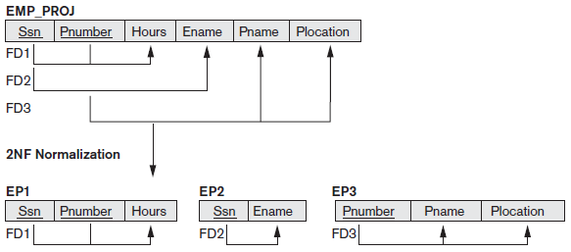
Second Normal Form
EMP_PROJ is in 1NF but is not in 2NF
The nonprime attribute Ename violates 2NF because of FD2,
the nonprime attributes Pname and Plocation because of FD3
The functional dependencies FD2 and FD3 make Ename, Pname, and Plocation partially dependent on the primary key {Ssn, Pnumber}
thus 2NF test is violated
If a relation schema is not in 2NF, it can be second normalized or 2NF normalized
the functional dependencies FD1, FD2, and FD3 will lead to decomposition of EMP_PROJ into the three relation schemas EP1, EP2, and EP3
each of these are in 2NF.

Slide 54
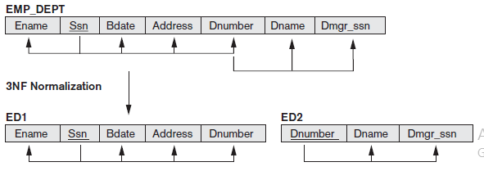
Third Normal Form
Third normal form (3NF) is based on the concept of transitive dependency
A functional dependency X→Y in a relation schema R is a transitive dependency if there exists a set of attributes Z in R that is neither a candidate key nor a subset of any key of R,and both X→Z and Z→Y hold
The dependency Ssn→Dmgr_ssn is transitive through Dnumber in EMP_DEPT, because both the dependencies Ssn → Dnumber and Dnumber → Dmgr_ssn hold and Dnumber is neither a key itself nor a subset of the key of EMP_DEPT
Intuitively, we can see that the dependency of Dmgr_ssn on Dnumber is undesirable in EMP_DEPT since Dnumber is not a key of EMP_DEPT

Slide 55
Third Normal Form
Definition: According to Codd’s original definition, a relation schema R is in 3NF if it satisfies 2NF and no nonprime attribute of R is transitively dependent on the primary key.
The relation schema EMP_DEPT is in 2NF, since no partial dependencies on a key exist
However, EMP_DEPT is not in 3NF because of the transitive dependency of Dmgr_ssn (and also Dname) on Ssn via Dnumber
We can normalize EMP_DEPT by decomposing it into the two 3NF relation schemas ED1 and ED2
Intuitively, we see that ED1 and ED2 represent independent entity facts about employees and departments
A NATURAL JOIN operation on ED1 and ED2 will recover the original relation EMP_DEPT without generating spurious tuples

Slide 56
General Definitions of Second & Third Normal Forms

Slide 57
Summary of Normal Forms
Normal Form | Test | Remedy (Normalization)
First (1NF) | Relation should have no multivalued attributes or nested relations. | Form new relations for each multivalued attribute or nested relation.
Second (2NF) | For relations where primary key contains multiple attributes, no non-key attribute should be functionally dependent on a part of the primary key. | Decompose and set up a new relation for each partial key with its dependent attribute( s).Make sure to keep a relation with original primary key and any attributes that are fully functionally dependent on it.
Third (3NF) | Relation should not have a non-key attribute functionally determined by another non-key attribute (or by a set of non-key attributes). That is, there should be no transitive dependency of a non-key attribute on the primary key. | Decompose and set up a relation that includes the nonkey attribute(s) that functionally determine(s) other nonkey attribute(s).

Slide 58
Boyce-Codd Normal Form

Slide 59
Boyce-Codd Normal Form
Boyce-Codd normal form (BCNF) was proposed as a simpler form of 3NF, but was found to be stricter than 3NF as
Every relation in BCNF is also in 3NF;
but, a relation in 3NF is not necessarily in BCNF
A relation R is in BCNF
If R is in 3NF
If any non-key attribute of R can only be determined by some key of R

Slide 60
Boyce-Codd Normal Form
For Example, consider attributes: A, B, C and D where key is: A and BC A→ BCD BC→ AD D → B
Now, D → B violates the condition as D is non-key
To resolve the situation, we split R as :
R1 (D, B)
R2 (A, C, D) where D is foreign key
Now, R1 and R2 are in BCNF

Slide 61
Boyce-Codd Normal Form
Boyce-Codd Normal Form (BCNF) is an extension of Third Normal Form on strict terms
BCNF states that − for any non-trivial functional dependency, X → A, X must be a super-key.
Stu_ID is the super-key in any relation Student_Detail
Zip is the super-key in any relation ZipCodes
So, Stu_ID → Stu_Name, Zip
Zip → City
Hence both relations are in BCNF as all non-keys can be determined by any Super Key

Slide 62
Multivalued Dependency & Fourth Normal Form

Slide 63
Fourth Normal Form
Multivalued dependencies are a consequence of first normal form (1NF which disallows an attribute in a tuple to have a set of values, and the accompanying process of converting an un-normalized relation into 1NF
If we have two or more multivalued independent attributes in the same relation schema, we get into a problem of having to repeat every value of one of the attributes with every value of the other attribute to keep relation state consistent and to maintain the independence among the attributes involved
This constraint is specified by a multivalued dependency.

Slide 64
Fourth Normal Form
Relation R, is in Four NF if
R is in BCNF
There is no multi-valued Dependency
If we have 3 attribues in R:
EmpName, ProjectName and DependentName
then we have muli-valued Dependency as :
EmpName: ProjectName = 1:N and
EmpName: DependentName = 1:N

Slide 65
Fourth Normal Form
To resolve his, we will divide R as:
R1 (EmpName: ProjectName) and
R2 (EmpName: DependentName)

Slide 66
Fifth Normal Form

Slide 67
Fifth Normal Form
5NF is also called project-join normal form (PJNF)
Relation R, is in Five NF if
R is in Four NF
only Trivial Join Dependency exists
If we have 3 attribues in R:
EmpName, ProjectName and DependentName
then we have muli-valued Dependency as :
EmpName: ProjectName = 1:N and
EmpName: ependentName = 1:N

Slide 69
Q & A
?

Slide 70
Thank You

