Slide 1
Articles of Faith
What do we need to believe in other than the five pillars of Islam

Slide 2
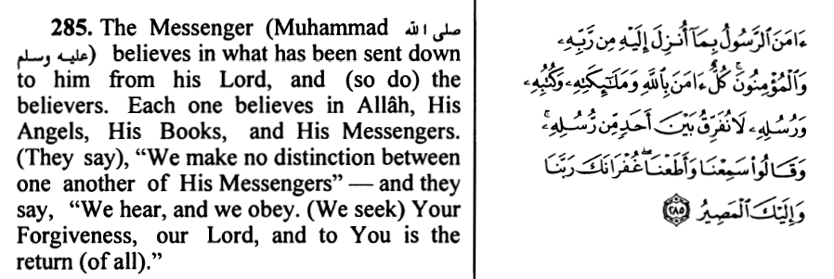
Allah Stated in Qur’an Kareem:

Slide 3
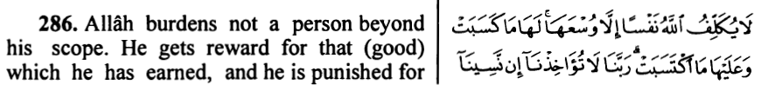
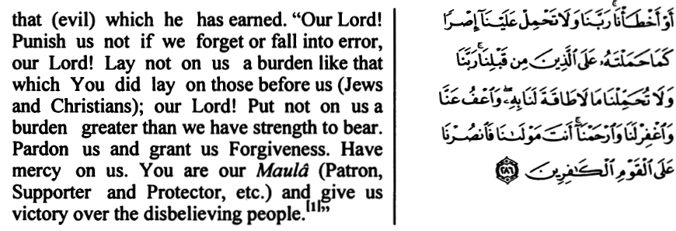

Slide 4
Articles of Faith
(ايمان مفصل)
آمنت بالله وملئكته وكتبه ورسله واليوم الآخر والقدر خيره وشره من الله تعالى والبعث بعد الموت
I believe in Allah, in His angels, in His books, in His messengers, in the last day, and in the fact that every thing good or bad, is decided by Allah, the Almighty, and in life after Death.
Oneness of Allah
Angles
Revealed Books
Prophets
Life after death

Slide 5
Oneness of Allah
The first principle of Islam is belief in the Oneness and Unity of Allah. This is known as Tawhid. This means that Allah is one, the Supreme being, the Creator, the Master of the entire universe, the Highest in authority and rank and therefore, exclusively worthy of worship.
All the prophets of Allah preached about the Unity of Allah and declared that all things and human beings are his creations and subordinate to Him. Therefore, He is alone worthy of worship. This is expressed in the declaration of 1st Kalimah
لاإله إلا الله محمد رسول الله

Slide 6
Quranic Verses regarding Tawhid
The main emphasis of Qur’an is upon the principle of Tawhid. Several verses in the Qur’an which highlight this concept.
وقل الحمد لله الذي لم يتخذ ولدا ولم يكن له شريك في الملك
( سوره بني إسرائيل:111)
Say praise be to Allah, Who begets no son and has no partner in (His) dominion.
الله لا إله إلا هو الحي القيوم
Allah there is no god but He, the Living, the self subsisting, Eternal.

Slide 7
Quranic Verses regarding Tauhid
ليس كمثله شيئ وهو السميع البصير
(سورة الشورى: 11)
There is nothing whatever like unto Him and He is the One that hears and sees (all things).
لو كان فيهما آلهة إلا الله لفسدتا
(سورة الأنبياء: 22)
If there were in the heaven and the earth other gods besides Allah, there would have been confusion in both.

Slide 8
Angels & Jinnnnn………….
Allah created certain creatures from light, and concealed them from our sight. These creatures are called angels. A lot of work has been entrusted to them. They never do any thing contrary to the orders of Allah. They do whatever work has been assigned to them.
Allah conveyed His message to prophets including Hazrat Muhammad (SAW) through an angel Jibrael. In the Holy Qur’an, angels are spoken of as messengers which denotes their spiritual function of divine messengers.
Allah created certain creatures from fire, we can’t see them too, they are called JINN….
They are good and bad, they also have children, the most notorious of them is the accursed Iblis i.e. Satan.

Slide 9
Some famous Angels
Hazrat Jibrael (A.S.)
Hazrat Mikael (A.S.)
Hazrat Izrael (A.S.)
Hazrat Israfeel (A.S.)
Kraman Katibeen (A.S.)
Munkar Nakeer (A.S.)
Mua’qibat (A.S.)
Malik (A.S.)
Rizwan (A.S.)

Slide 10
Revealed Books
A Muslim should have belief in all the books revealed to the prophets by Allah, but as the Qur’an is the last revelation of Allah its teaching alone should be followed now.
The well known books mentioned in the Holy Qur’an are:
Suhuf Ibrahim and Moosa. صحف إبراهيم وموسى (سورة الأعلى)
Taurat was revealed to Hazrat Moosa (A.S.), Allah Ta’la stated: ومن قبله كتاب موسى إماما ورحمة(سوره احقاف: 12) And before this was the book of Moosa as a guide and a mercy.

Slide 11
Revealed Books
Zabur was revealed to Hazrat Dawood (A.S.) Allah says: وآتينا داود زبورا (سورة النساء: 163) And We gave to Dawood the Zaboor.
Injil was revealed to Hazrat Isa (A.S.) وأرسلنا عيسى بن مريم وآتيناه الإنجيل (سورة الحديد:27) We sent the Isa the son of Maryam and gave him the Injil.
Qur’an Kareem was granted to Hazrat Muhammad صلى الله عليه وسلم Allah Stated: إنا أنزلناه قرآنا عربيا Indeed, We revealed the Arabic Qur’an.

Slide 12
Prophets
Allah has sent many prophets to guide mankind to the right path.
They have many chacteristics such as:
Free from Sins: All of them are free from sins. Their actual number is known to Allah alone.
Miracles: In order to establish their truthfulness, Allah enabled them to do certain things which other could not do, such acts are called Miracles.
There are two types of Messengers:
Rasool: One who brings new Shria.
Nabi: Those who are revealed by revelation.

Slide 13
Prophets
The First prophet is Adam عليه السلام and the last is Muhammad صلى الله عليه وسلم .
Khatm-e-Nubuat(the Seal of prophets): No prophet will come after Muhammad صلى الله عليه وسلم, He is the prophet of all mankind and JINN until the day of Judgement.
Mairaj: The journey from Makkah to Baitul Maqdis and from there to the seven heaven and from there to wherever Allah wanted, It is called Mairaj.

Slide 14
Life After Death
Belief in life after death, the day of judgment, bodily resurrection and heaven and hell is one of article of Faith in Islam.
Death is an absolute certainty.
According to the Holy Qur’an: كل نفس ذائقة الموت Every soul shall have a taste of death, and must pass away.
A man’s life on this earth is ends with his death, after which another life begins. The Qiyamat Sughra (lesser judgment takes place immediately after death.
Barzakh: ومن ورآئهم برزخ إلى يوم يبعثون Before them is a partition (Barzakh) till the day they are raise up. Barzakh is the place or state in which people will be after death and before Judgment.

