Slide 1
Lecturer-2
C Basics

Slide 2
We’ll Learn Today
printf() Function
Format Specifiers
Escape Sequences
scanf() Function
Constants
Operators

Slide 3
printf() Function
C uses formatted output. The printf function has a special formatting character (%) -- a character following this defines a certain format for a variable:
%c – characters
%d – integers
%f – floats
e.g.
printf(``%c %d %f'',ch,i,x);
NOTE: Format statement enclosed in ``...'', variables follow after. Make sure order of format and variable data types match up.

Slide 4
Format Specifiers
%c Single Character
%s String
%d Signed decimal integer
%f Floating point (decimal notation)
%e Floating point (exponential notation)
%u Unsigned decimal integer
%x Unsigned hexadecimal integer
%o Unsigned octal integer
l prefix used with %d, %u, %x, %o to specify long integer (e.g. %ld)
%Lf long double

Slide 5
Format Specifiers (con’t)
Example:
void main (void)
{
int event = 5;
char heat = ‘C’;
float time = 27.25;
printf(“ The winning time in heat %c”, heat);
printf(“ of event %d was %.2f”, event, time);
getch();
}

Slide 6
Escape Sequences
The following list shows the common escape sequences:
\n New line
\t Tab
\b Backspace
\r Carriage return
\f Form feed
\’ Single quote
\” Double quote
\\ Backslash

Slide 7
scanf() Funtion
Syntax:
scanf (“ format specifier ”, & var_name);
Obtains a value from the user
scanf() uses standard input (usually keyboard)
This scanf statement has two arguments
    Format specifier -indicates format of the data
    & var_name - location in memory to store variable
    & is confusing in beginning – for now, just remember to include it with the variable name in scanf statement
When executing the program the user responds to the scanf statement by typing in a number, then pressing the enter (return) key

Slide 8
scanf() Funtion (con’t)
Example:
#include<stdio.h>
main()
{
int num1,num2,res;
printf(“Enter First Number: “);
scanf(“%d”,&num1);
printf(“Enter Second Number: “);
scanf(“%d”,&num2);
res=num1+num2;
printf(“The sum of two numbers is: %d”, res);
}

Slide 9
constant
ANSI C allows you to declare constants. When you declare a constant it is a bit like a variable declaration except the value cannot be changed.
The const keyword is to declare a constant, as shown below:
int const a = 1;
const int a =2;
Note: You can declare the const before or after the type. Choose one an stick to it.
It is usual to initialise a const with a value as it cannot get a value any other way.

Slide 10
Operators
Definition:
“Operators are words or symbols that cause a program to do something to variables.”
There are may different kinds of operators, but most common of them are as follows:
  Arithmetic Operators
  Arithmetic Assignment Operators
  Increment/Decrement Operators
  Relational Operators

Slide 11
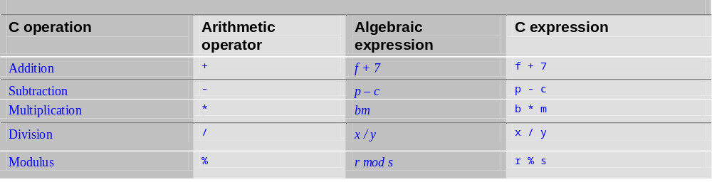
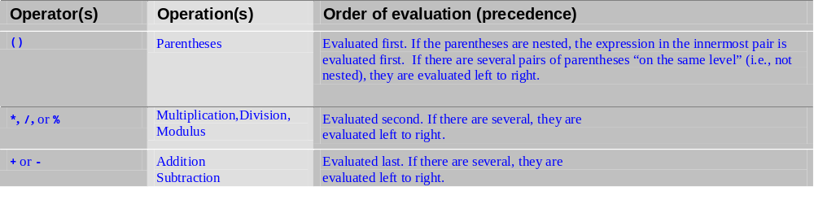
Operators (con’t)
Arithmetic:
Rules of Operator Precendence:

Slide 12
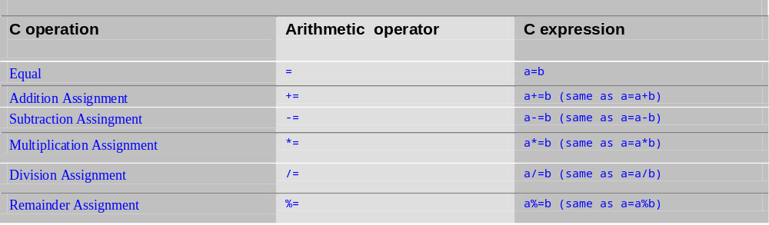
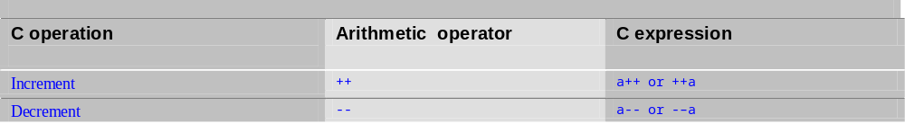
Operators (con’t)
Arithmetic Assignment:
Increment / Decrement:

Slide 13
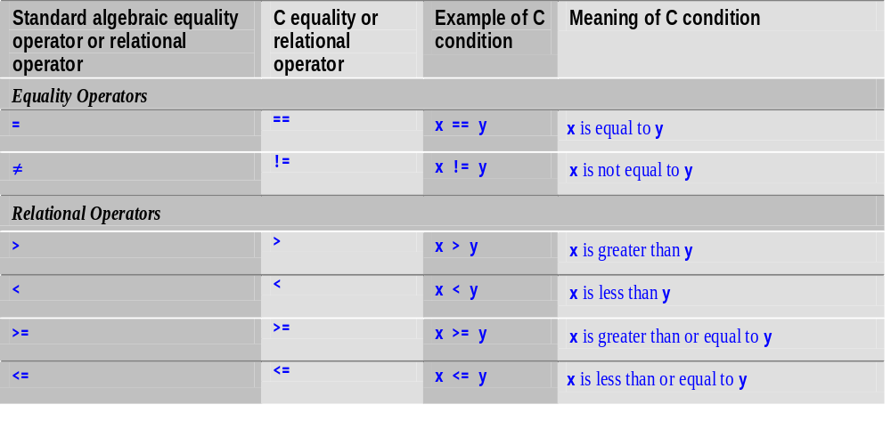
Operators (con’t)
Equality and Relational:

Slide 14
Assignments
Given as input an integer number of seconds, print as output the equivalent time in hours, minutes and seconds. Recommended output format is something like
7322 seconds is equivalent to 2 hours 2 minutes 2 seconds.
Write a program that asks the user to enter two numbers, obtains them from the user and prints their sum, product, difference, quotient and remainder.

Slide 15
Write a program that reads in the radius of a circle and prints the circle’s diameter, circumference and area. Use the constant value 3.14159 for π. Perform each of these calculations inside the printf statement(s) and use the conversion specifier %f.
Write a program that prints the numbers 1 to 4 on the same line. Write the program using the following methods.
a) Using one printf statement with no conversion specifiers.
b) Using one printf statement with four conversion specifiers.
c) Using four printf statements.

Slide 16
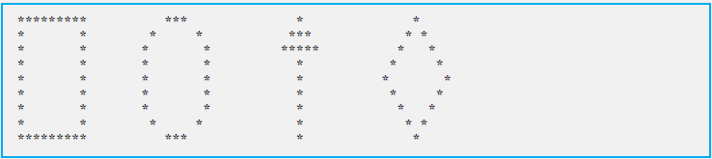

Write a program that prints the following shapes with asterisks.
Create a BMI calculator application that reads the user’s weight in pounds and height in inches, then calculates and displays the user’s body mass index.

Slide 17
End of Lecture
Any Questions?

