Slide 1
Control Structures II (REPETITION OR ITERATION OR LOOPING)

Slide 2
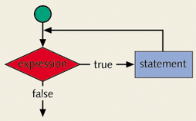
CONCEPT OF LOOPING (REPETITION) STRUCTURE
One of the basic structured programming concepts
The real power of computers is in their ability to repeat an operation or a series of operations many times
When action is repeated many times, the flow is called a loop

Slide 3
WHY IS REPETITION NEEDED?
Suppose we want to add five numbers (say to find their average).
From what you have learned so far, you could proceed as follows.
  scanf(%d %d %d %d %d, &num1,&num2,&num3,&num4,&num5);
  sum = num1+num2+num3+num4+num5;
  average = sum/5;
Suppose we wanted to add and average 100, or 1000, or more numbers.
We would have to declare that many variables, and list them again in scanf statement, and perhaps, again in the output statement.

Slide 4
SEQUENCE PROGRAM
Suppose the numbers we want to add are the following:
5 3 7 9 4
Consider the following statements
  (1) sum = 0;
  (2) scanf(%d,&num);
  (3) sum = sum + num;
Assume sum and num are variables of the type int.
The first statement initializes sum to 0.
Execute statements 2 and 3.
Statement 2 stores 5 in num and statement 3 updates the value of sum by adding num to it.
After statement 3 the value of sum is 5.

Slide 5
SEQUENCE PROGRAM
To add 10 numbers, you can repeat statements 2 and 3 10 times.
To add 100 numbers we can repeat statements 2 and 3 100 times.
You would not have to declare any addition variables as in the first code.
There are three repetition or looping structures in C that lets us repeat statements over and over until certain conditions are met.
  while Looping Structure
  for Looping Structure
  do…while Looping Structure

Slide 6
WHAT IS A LOOP
Loops repeat a statement, a block, a function or a set of any combination of these construct a number of times
The figure on the left demonstrates the repetition process of the statement printf and a=a+1.
The question about the figure is that when this loop will stop?
The loop will never stop and will infinitely repeat these statements until the program is forced to quit by the user
a=0
print a
a=a+1
0 1 2 3 4 5 6 7 ……..?

Slide 7
WHAT IS A LOOP
A loop must be controlled by a condition or an event in order to limit the number of iterations and prevent infinite loops from occurring
The figure to the left shows a loop controlled by a condition.
If the condition is true the loop will go on repeating the statements otherwise it breaks the cycle and continues with the rest of the program
The condition can be any logical or relational expression in C language
a=0
print a
a=a+1
Cond
True
false

Slide 8
THE WHILE LOOPING (REPETITION) STRUCTURE
The general form of the while statement is
The statement can be either a simple or compound statement.
The statement is called the body of the loop.
The expression provides an entry condition.
while(expression)
statement

Slide 9
WHILE LOOPS
while ( expression )
{
loop body
}
while ( a>b )
{
}
while ( a>b && c<=78 )
{
}
while ( 1 )
{
}
The “loop body” can be either a simple or compound statement.
The “expression” provides an entry condition.
A while loop checks the expression before entering the loop body
The expression is evaluated first (must produce true or false) then if the value is true (none zero) the loop will continue otherwise it exits the loop body proceeding with the rest of the program.
This is an infinite
loop if 1 is true

Slide 10
WHILE LOOPS: EXAMPLES (1)
start
int main()
{
int count = 0;
while(count <= 5)
{
count = count + 1;
printf(“%d ”,count);
}
}
count = 0
count <= 5?
False
True
count = count + 1
output count
1 2 3 4 5 6
end

Slide 11
WHILE LOOPS: EXAMPLES (2)
start
int main()
{
int count, A, B;
scanf(“%d”,&A);
scanf(“%d”,&B);
count = A;
while(count <= B)
{
count = count + 1;
printf(“%d ”,count);
}
}
input A
input B
count = A
count <= B?
False
True
count = count + 1
output count
3 8
4 5 6 7 8 9
end

Slide 12
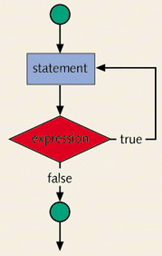
THE DO…WHILE LOOPING (REPETITION) STRUCTURE
The statement executes first, and then the expression is evaluated.
If the expression evaluates to true, the statement executes again.
As long as the expression in a do...while statement is true, the statement executes.
The general form of a do...while statement is:
do
statement
while(expression);

Slide 13
DO..WHILE LOOPS
do
{
loop body
} while ( expression );
do
{
} while ( a>b );
do
{
} while ( a>b && c<=7 );
do
{
} While ( 1 );
A do...while loop will allow the execution of the body once then checks the expression, if the expression is true then it will repeat again otherwise it exits the loop.
The expression is evaluated first (must produce true or false) then if the value is true (none zero) the loop will continue otherwise it exits the loop body proceeding with the rest of the program.
To avoid an infinite loop, make sure that the loop body contains a statement that ultimately makes the expression false and assures that it exits.
This is an infinite
loop if 1 is true

Slide 14
WHILE LOOP AND DO..WHILE LOOP
Loops in C language fall under two major categories, these are
  while , For loop
  The while loop, has the condition checked before entering the loop
  do while loop
  This type of loops will enter the loop body at least once then checks the condition
The two figures on the left show those two types
a=0
a=0
false
print a
Cond
True
a=a+1
print a
Cond
True
a=a+1
false
while
do while

Slide 15
DO…WHILE LOOPING STRUCTURE
Because the while and for loop has an entry condition, it may never activate, whereas, the do...while loop, which has an exit condition, always goes through at least once.
i = 11; while(i <= 10) { printf(“%d “,i); i++; } In the while loop, produces nothing. |  | i = 11; do { printf(“%d “,i); i++; } while(i <= 10); the do...while loop, outputs the number 11.

Slide 16
DO WHILE EXAMPLE(3)
start
int main()
{
int count = 0;
do
{
count = count + 1;
printf(“%d ”,count);
} while(count <= 5);
}
count = 0
count = count + 1
output count
count <= 5?
True
1 2 3 4 5 6
False
end

Slide 17
DO WHILE EXAMPLE(4)
start
int main()
{
int count, A, B;
scanf(“%d”,&A);
scanf(“%d”,&B);
count = A;
do
{
count = count + 1;
printf(“%d ”,count);
} while(count <= B)
}
input A
input B
count = A
output count
count = count + 1
count <= B?
True
3 8
4 5 6 7 8 9
False
end

Slide 18
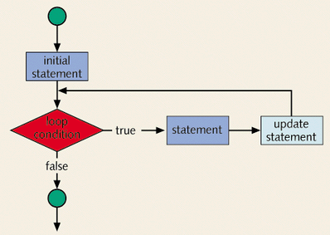
THE FOR LOOPING (REPETITION) STRUCTURE
The general form of the for statement is
for(initial statement; loop condition; update statement)
statement
The initial statement, loop condition and update statement (called for loop control statements) that are enclosed with in the parentheses controls the body (the statement) of the for statement.

Slide 19
FOR LOOPING STRUCTURE
The for loop executes as follows:
  The initial statement executes.
  The loop condition is evaluated. If the loop condition evaluates to true
    Execute the for loop statement.
    Execute the update statement.
  Repeat Step 2 until the loop condition evaluates to false.
The initial statement
  usually initializes a variable
  is the first statement to be executed and is executed only once.

Slide 20
THE FOR LOOPING (REPETITION) STRUCTURE
Problem: print numbers 1 through 10 on standard output
Solution using for statement
1 2 3 4 5 6 7 8 9 10
int counter;
for (counter = 1; counter <= 10; counter++)
printf(“%d ”,counter);
control
variable
limiting value of
control variable
for (counter = 1; counter <= 10; counter++)
for
keyword
initial value of
control variable
updating
control variable

Slide 21
FOR LOOPING STRUCTURE
The statement of a for loop may be a simple or a compound statement.
simple | compound
for(i = 1; i <= 5; i++) printf("Output of stars.\n“); printf("*“); | for(i = 1; i <= 5; i++) { printf("Output of stars.\n“); printf("*\n“); }
Output a line of stars.
Output a line of stars.
Output a line of stars.
Output a line of stars.
Output a line of stars.
*
Output a line of stars.
*
Output a line of stars.
*
Output a line of stars.
*
Output a line of stars.
*
Output a line of stars.
*
for(i = 1; i <= 5; i++);
printf("*“);
*

Slide 22
FOR LOOPING STRUCTURE
All three statements can be omit—initial statement, loop condition, and update statement.
for(;;)
printf("Hello\n“);
Count backward
for(i = 10; i >= 1; i--)
printf(“%d “,i);
Increment (or decrement) the loop control variable
for(i = 1; i <= 20; i = i + 2)
printf(“%d “,i);
Hello
Hello
.
.
Infinite output; press break to stop the program running
10 9 8 7 6 5 4 3 2 1
1 3 5 7 9 11 13 15 17 19

Slide 23
FOR LOOPING STRUCTURE
Example 5
// reads five numbers and find their sum and average
#include <stdio.h>
int main()
{
int i, newNum, sum, average;
sum = 0;
for(i = 1; i <= 5; i++)
{
scanf(“%d”,&newNum);
sum = sum + newNum;
}
average = sum / 5;
printf("The sum is %d\n”,sum);
printf(“The average is %d”,average);
return 0;
}
5 4 3 2 1
The sum is 15
The average is 3

Slide 24
BREAK STATEMENT
A break and continue statement alters the flow of control.
The break statement, when executed in a switch structure, provides an immediate exit from the switch structure.
You can use the break statement in while, for, and do...while loops.
When the break statement executes in a repetition structure, it immediately exits from these structures.
The break statement is typically used for two purposes:
  To exit early from a loop
  To skip the remainder of the switch structure
After the break statement executes, the program continues to execute with the first statement after the structure.

Slide 25
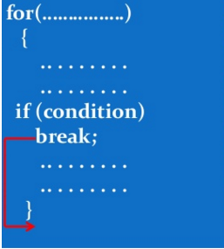
LOOPS AND BREAK KEYWORD
int i;
for(i=1;i<=10;i++)
{
if(i==3)
{
break;
}
printf(“%d\t”,i);
}

Slide 26
CONTINUE STATEMENT
The continue statement is used in while, for, and do-while structures.
When the continue statement is executed in a loop, it skips the remaining statements in the loop and proceeds with the next iteration of the loop.
In a while and do-while structure, the expression (that is, the loop-continue test) is evaluated immediately after the continue statement.
In a for structure, the update statement is executed after the continue statement, and then the loop condition (that is, the loop-continue test) executes.

Slide 27
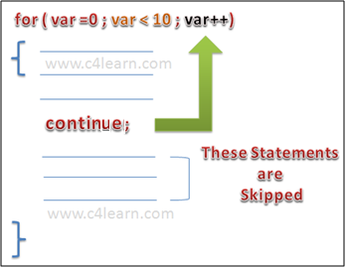
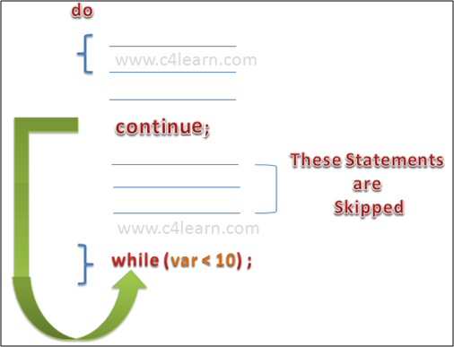
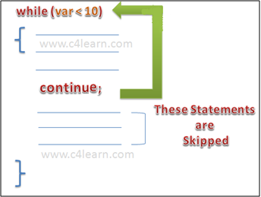
CONTINUE STATEMENT
int i;
for(i=1;i<=10;i++)
{
if((i==3)||(i==7))
{
continue;
}
printf(“%d\t”,i);
}

Slide 28
NESTED LOOPING
A loop (e.g., while, do-while, for) can be placed within the body of another loop.
When one loop is nested within another, several iterations of the inner loop are performed for every single iteration of the outer loop.
The inner and outer loops need not to be generated by the same type of control structures.

Slide 29

NESTED FOR LOOP (EXAMPLE 6)
for ( expr1a; expr2a; expr3a )
{
:
for ( expr1b; expr2b; expr3b )
{
:
}
:
}
#include<stdio.h>
int main()
{
int i,j;
for (i=1; i<=5;i++) //Line 1
{
for (j=1;j<=i;j++) //Line 2
{
printf("*"); //Line 3
}
printf("\n"); //Line 4
}
}

Slide 30
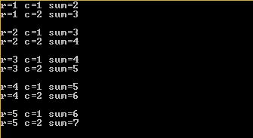
NESTED WHILE (EXAMPLE 7)
#include<stdio.h>
int main()
{
int r,c,s;
r=1;
while(r<=5) /*outer loop*/
{
c=1;
while(c<=2) /*inner loop*/
{
s=r+c;
printf("r=%d c=%d sum=%d\n",r,c,s);
c++;
}
printf("\n");
r++;
}
}
while (expr1)
{
:
while (expr2)
{
:
Update expr2;
}
:
update expr1;
}

Slide 31
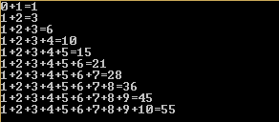
NESTED DO WHILE (EXAMPLE 8)
#include<stdio.h>
int main()
{
int i=1,j=0,sum;
do {
sum=0;
do{
sum=sum+j;
printf("%d",j);
j++;
if(j<=i)
{
printf("+");
}
}while(j<=i);
printf("=%d\n",sum);
j=1;
i++;
}while(i<=10);
}
do
{
:
do
{
:
Update expr;
}
while(expr);
:
update expr;
}
while(expr);

Slide 32
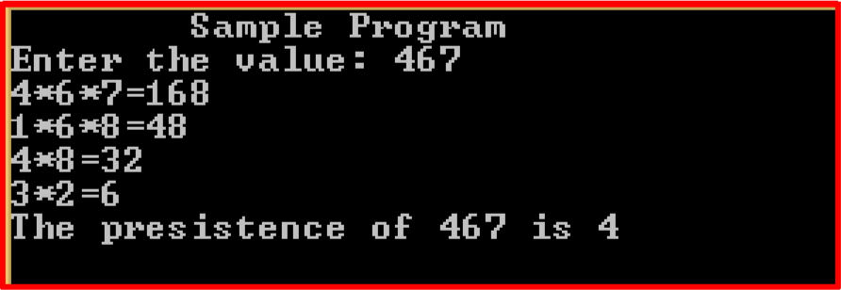
EXERCISES
Find the persistence of a number. It is the number, if times you can multiple the digits (iteratively) before you get a single digit number.

Slide 33
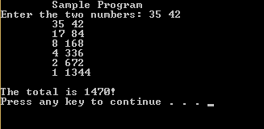
Given two numbers multiply them using the following method. Successively divide the smaller number by 2 (ignore any remainder) until the quotient is 1 and multiple the larger number by 2. Add to a total only those multiples of the larger which correspond to an odd quotient of the smaller.

Slide 34
Find the digital root of a number (repeatedly find the sum of the digits until you get a number 1 to 9.
285:
2+8+5=15
1+5=6
A ball is dropped from a height of x. It decreases 2/3 on height x at each bounce. How many bounces the ball will have until height is less than y? (Use while loop and if condition to break, when height x becomes less than y).

Slide 35
Write a C program that receives the total number of integers (N). Then, the program will ask for N real numbers. By applying for loop, your program should find and display the largest and the lowest of the numbers. Give a proper message for invalid user input (Don’t use arrays).

