Slide 1
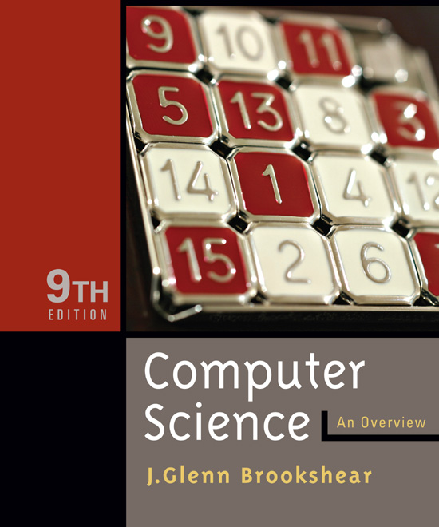

Chapter 2
Data Manipulation
<footer>© 2007 Pearson Addison-Wesley.
All rights reserved

Slide 2
Chapter 2: Data Manipulation
2.1 Computer Architecture
2.2 Machine Language
2.3 Program Execution
Notes:
Pictures on data Manipulation

Slide 3
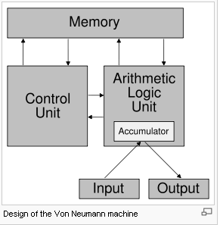
Computer Architecture - Von Neumann architecture
The von Neumann architecture is a computer design model specifying sequential architectures.
- Use a single storage structure to hold both instructions and data.
- Run any arbitrary (but well-formed) sequence of instructions;
- Have inputs and outputs;

Slide 4
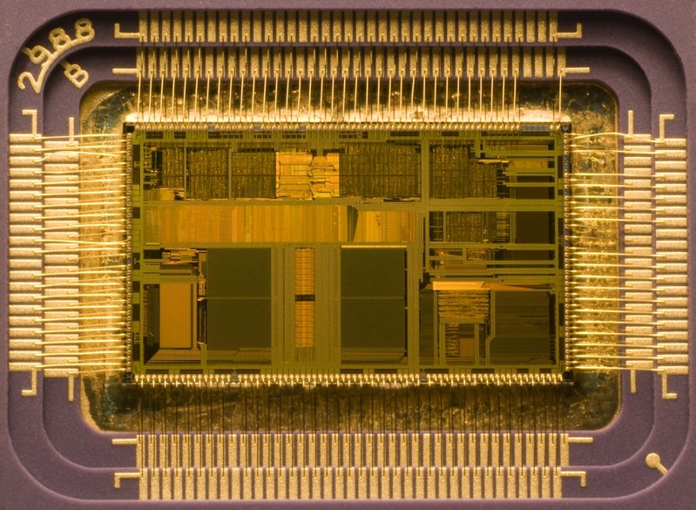
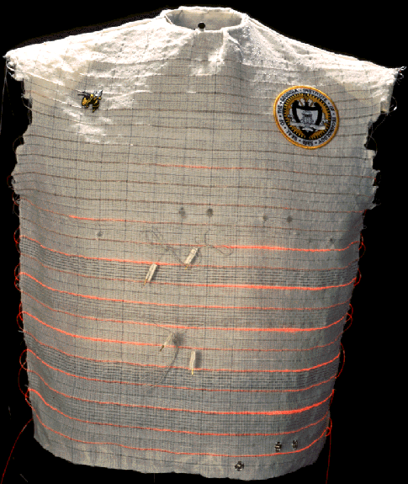
Computer Architecture
Central Processing Unit (CPU) or processor
  Arithmetic/Logic unit versus Control unit
  Registers
    General purpose (Data registers, address registers)
    Special purpose PC, IR

Slide 5
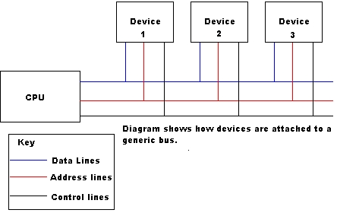
BUS
Control lines These allow the CPU to control which operations the devices attached should perform, I.E. read or write.
Address lines
Allows the CPU to reference certain (Memory) locations within the device.
Data lines
The meaningful data which is to be sent or retrieved from a device is placed on to these lines.

Slide 6
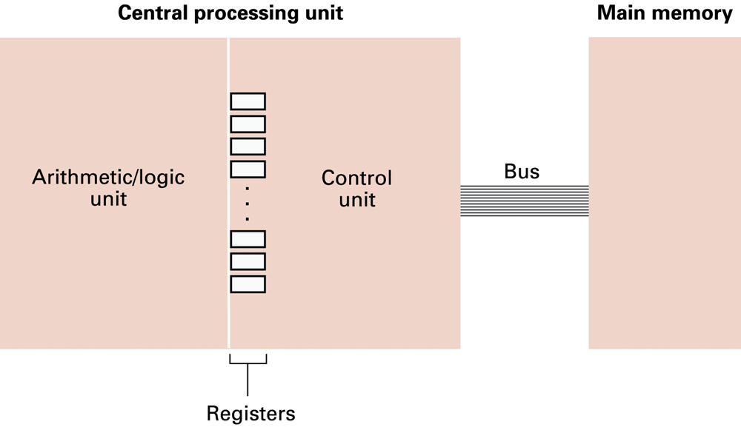
Figure 2.1 CPU and main memory connected via a bus

Slide 7
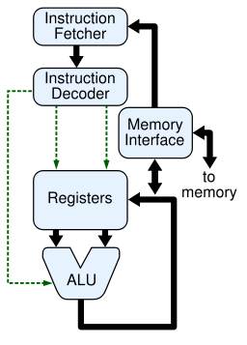
Stored Program Concept & CPU Operation
A program can be encoded as bit patterns and stored in main memory. From there, the CPU can then extract the instructions and execute them. In turn, the program to be executed can be altered easily.

Slide 8
Terminology
Machine instruction: An instruction (or command) encoded as a bit pattern recognizable by the CPU
Machine language: The set of all instructions recognized by a machine

Slide 9
Machine Language Philosophies
Reduced Instruction Set Computing (RISC)
  Few, simple, efficient, and fast instructions
  Example: PowerPC from Apple/IBM/Motorola
Complex Instruction Set Computing (CISC)
  Many, convenient, and powerful instructions
  Example: Pentium from Intel

Slide 10
Machine Instruction Types
Data Transfer: copy data from one location to another
Arithmetic/Logic: use existing bit patterns to compute a new bit patterns
Control: direct the execution of the program

Slide 11
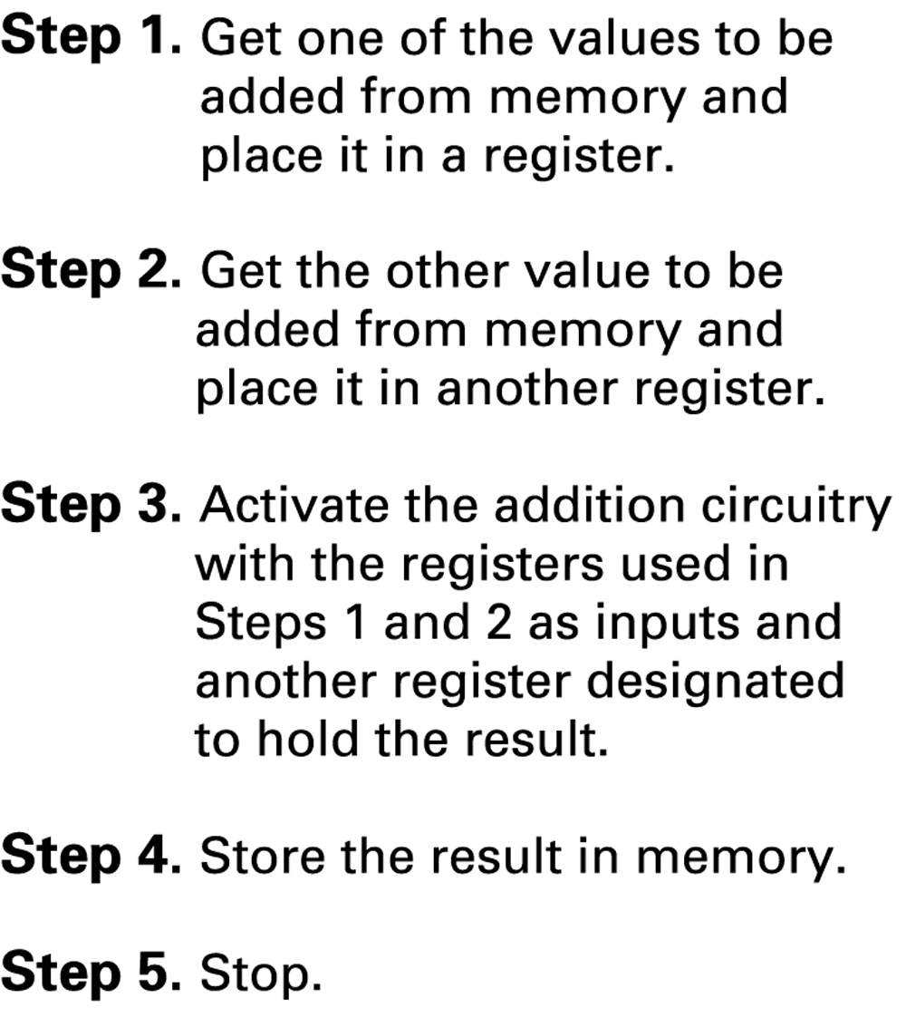
Figure 2.2 Adding values stored in memory

Slide 12
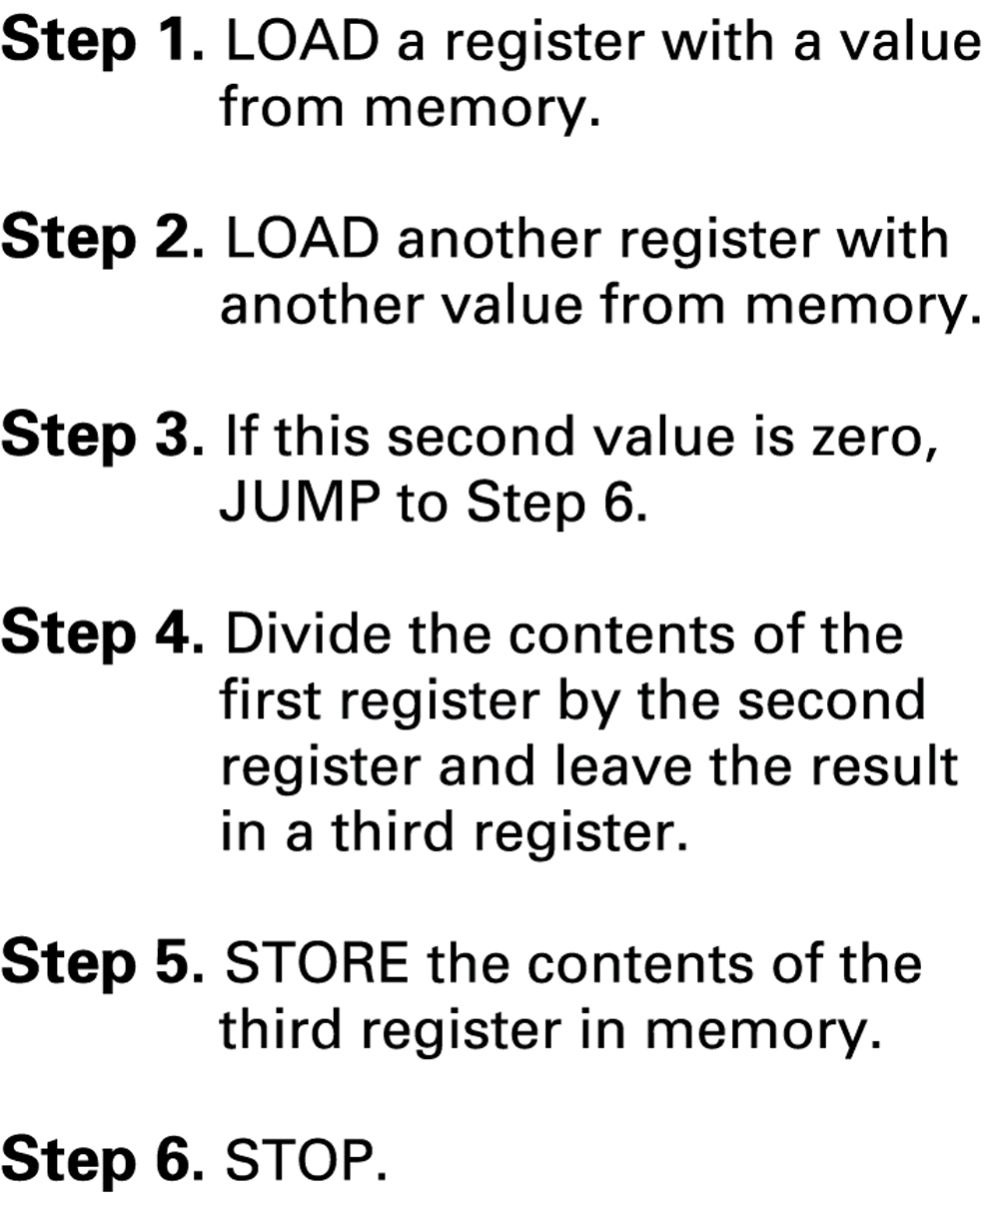
Figure 2.3 Dividing values stored in memory

Slide 13
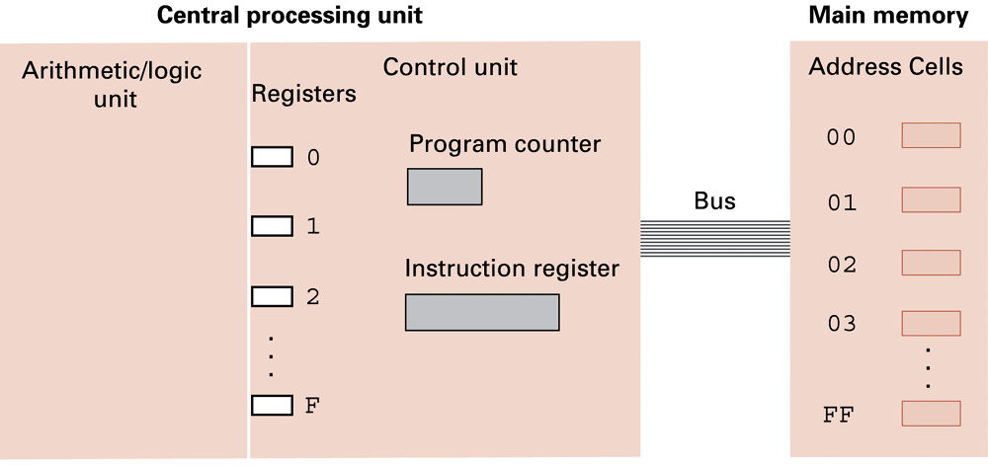
Figure 2.4 The architecture of the machine described in Appendix C

Slide 14
Parts of a Machine Instruction
Op-code: Specifies which operation to execute
Operand: Gives more detailed information about the operation
  Interpretation of operand varies depending on op-code

Slide 15
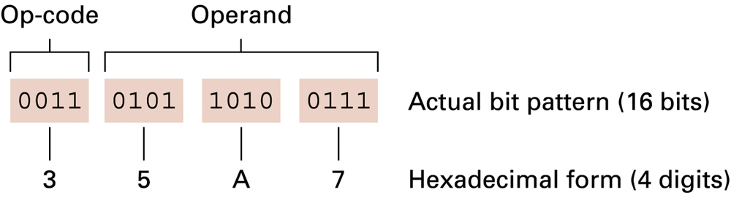
Figure 2.5 The composition of an instruction for the machine in Appendix C

Slide 16
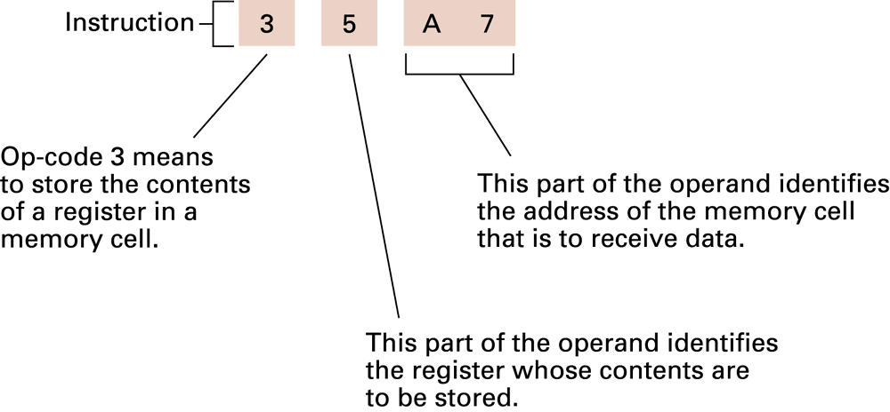
Figure 2.6 Decoding the instruction 35A7

Slide 17
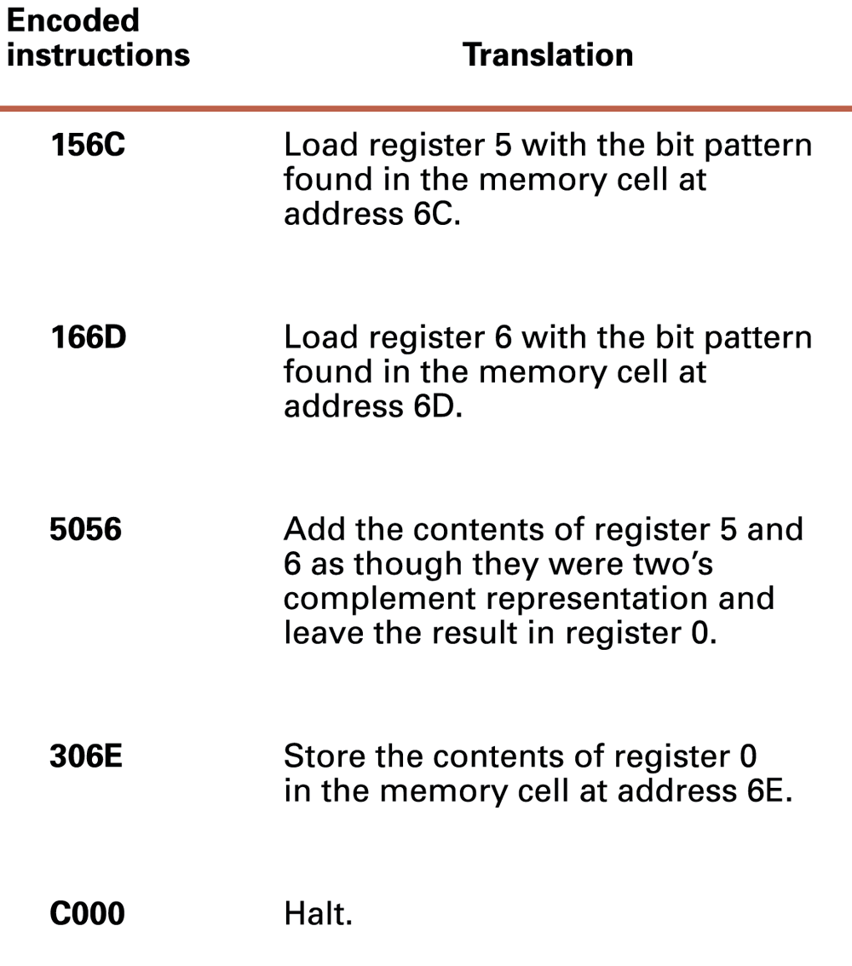
Figure 2.7 An encoded version of the instructions in Figure 2.2

Slide 18
Program Execution
Controlled by two special-purpose registers
  Program counter: address of next instruction
  Instruction register: current instruction
Machine Cycle
  Fetch
  Decode
  Execute

Slide 19
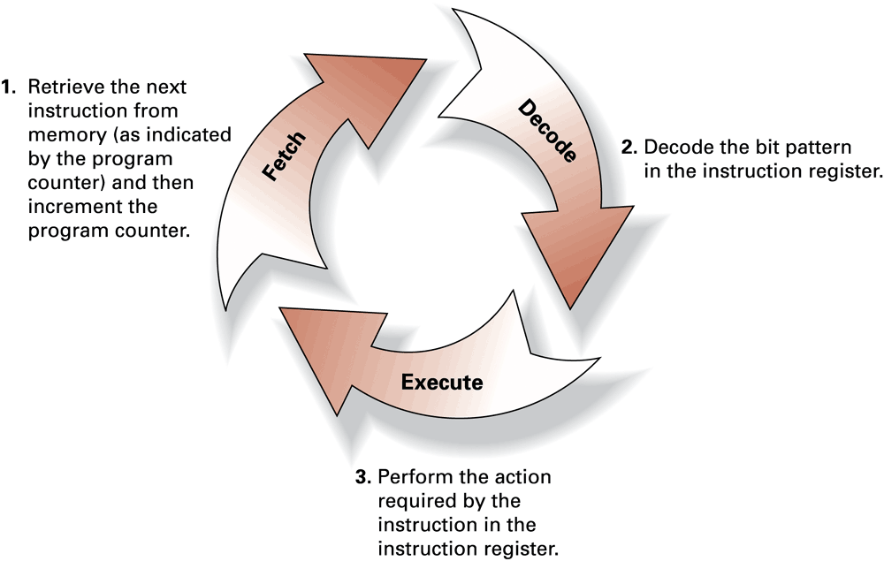
Figure 2.8 The machine cycle

Slide 20
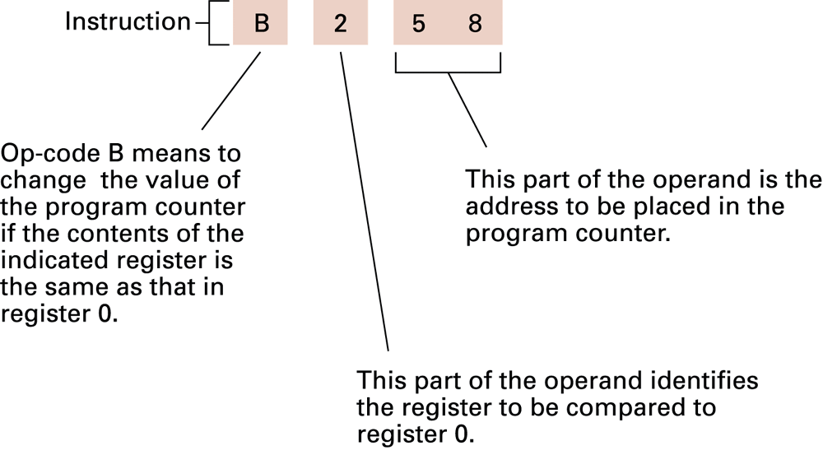
Figure 2.9 Decoding the instruction B258

Slide 21
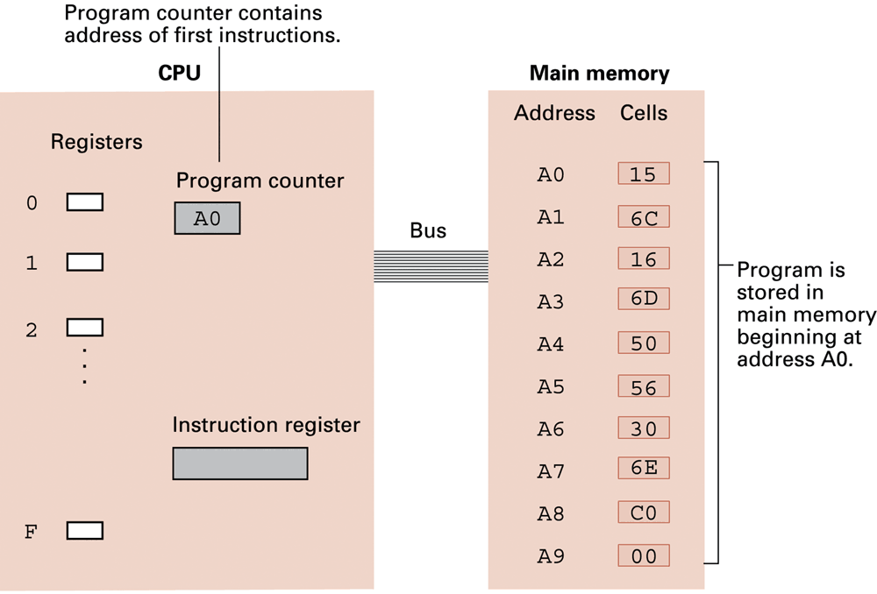
Figure 2.10 The program from Figure 2.7 stored in main memory ready for execution

Slide 22
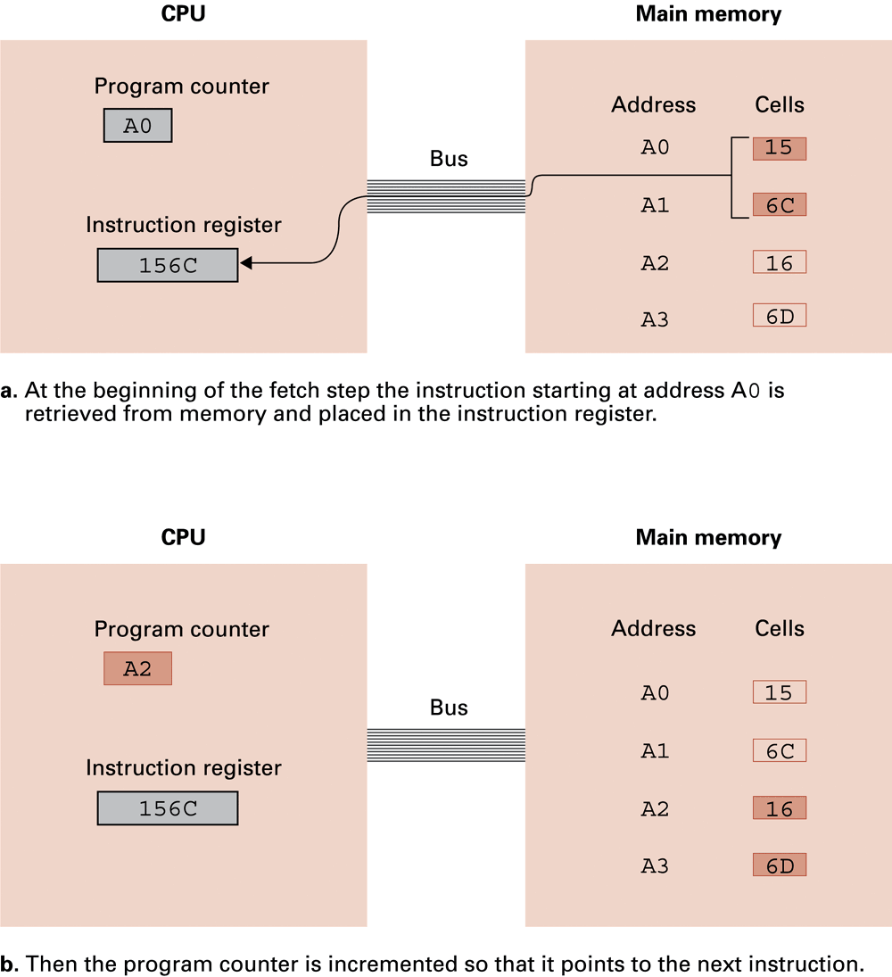
Figure 2.11 Performing the fetch step of the machine cycle

Slide 23
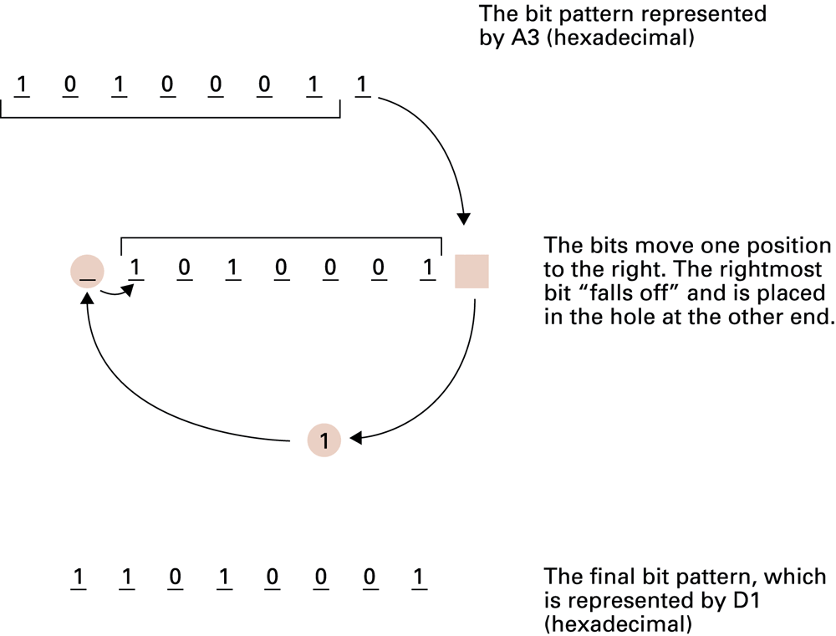
Figure 2.12 Rotating the bit pattern A3 one bit to the right
Notes:
Good

Slide 24
Figure 2.11 Performing the fetch step of the machine cycle (cont’d)

Slide 25
Review
Concept of instruction
Basics of computer architecture
- Von Newmann architecture model
- Roles of memory, CPU(control unit, ALU, Registers), Bus, I/O
- Decoding of instructions
- Machine cycle (Control unit performs its job)

Slide 26
Review : Von Neumann architecture model

