Slide 1
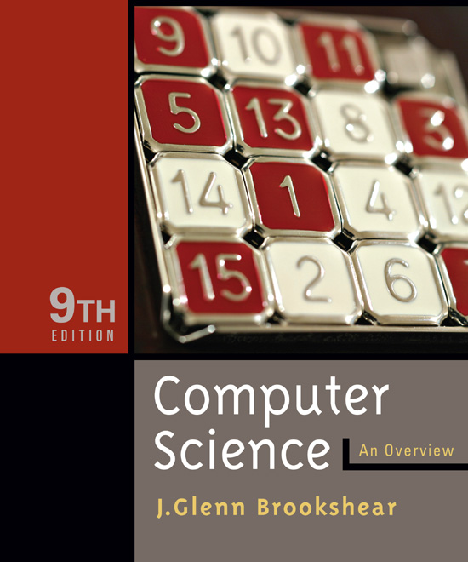

Chapter 3
Operating Systems
© 2007 Pearson Addison-Wesley.
All rights reserved

Slide 2
Chapter 3: Operating Systems
3.1 The History of Operating Systems
3.2 Operating System Architecture
3.3 Coordinating the Machine’s Activities
3.4 Security
© 2007 Pearson Addison-Wesley. All rights reserved
0-<number>

Slide 3
Functions of Operating Systems
Oversee operation of computer
Store and retrieve files
Schedule programs for execution
Coordinate the execution of programs
Monitor/ Printer (I/O)
Disk Management
(Files, Database)
Periphery Devices
Communications
Process Management
Memory Management
OS
© 2007 Pearson Addison-Wesley. All rights reserved
0-<number>

Slide 4
Evolution of Shared Computing
Batch processing
Interactive processing
  Requires real-time processing
Time-sharing/Multitasking
Multiprocessor machines
© 2007 Pearson Addison-Wesley. All rights reserved
0-<number>

Slide 5
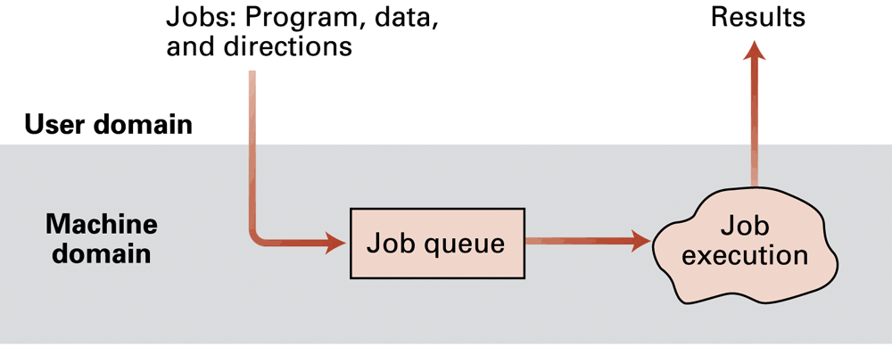
Figure 3.1 Batch processing
© 2007 Pearson Addison-Wesley. All rights reserved
0-<number>

Slide 6
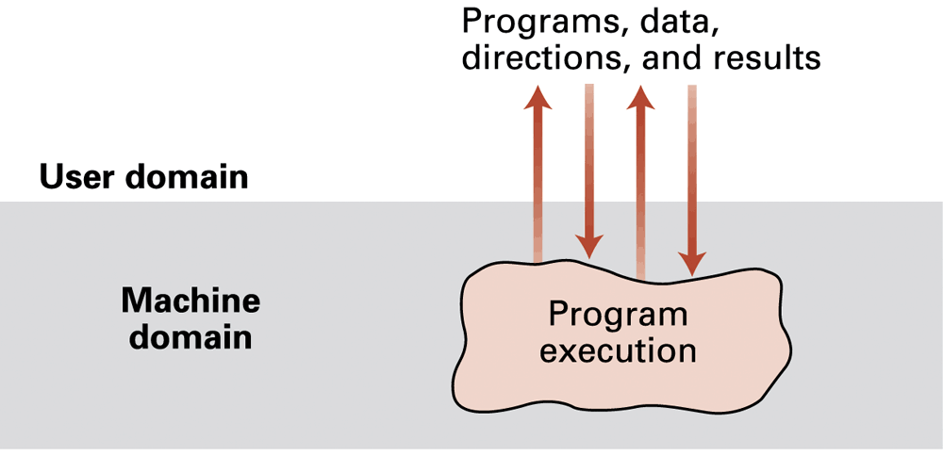
Figure 3.2 Interactive processing
© 2007 Pearson Addison-Wesley. All rights reserved
0-<number>

Slide 7
Types of Software
Application software
  Performs specific tasks for users
System software
  Provides infrastructure for application software
  Consists of operating system and utility software
© 2007 Pearson Addison-Wesley. All rights reserved
0-<number>

Slide 8
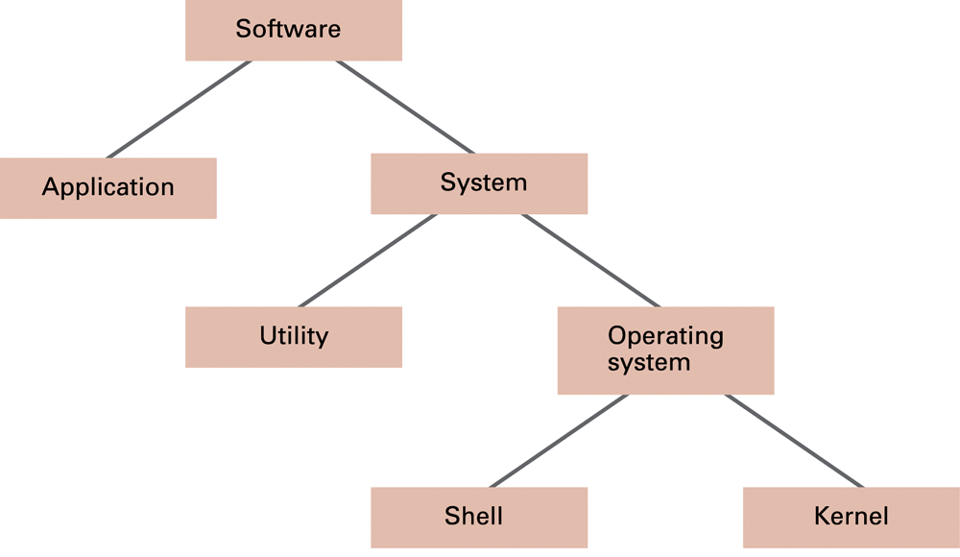
Figure 3.3 Software classification
© 2007 Pearson Addison-Wesley. All rights reserved
0-<number>

Slide 9
Operating System Components
Shell: Communicates with users
  Text based
  Graphical user interface (GUI)
    Window manager
Kernel: Performing basic required functions
  File manager
  Device drivers
  Memory manager
  Scheduler and dispatcher
© 2007 Pearson Addison-Wesley. All rights reserved
0-<number>

Slide 10
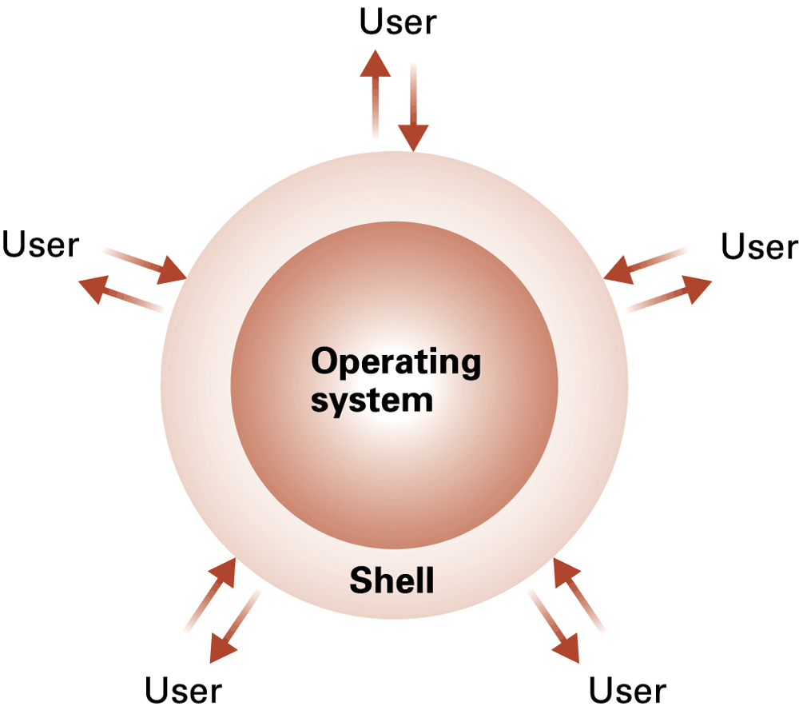
Figure 3.4 The shell as an interface between users and the operating system
© 2007 Pearson Addison-Wesley. All rights reserved
0-<number>

Slide 11
File Manager
Directory (or Folder): A user-created bundle of files and other directories (subdirectories)
Directory Path: A sequence of directories within directories
© 2007 Pearson Addison-Wesley. All rights reserved
0-<number>

Slide 12
Memory Manager
Allocates space in main memory
May create the illusion that the machine has more memory than it actually does (virtual memory) by playing a “shell game” in which blocks of data (pages) are shifted back and forth between main memory and mass storage
© 2007 Pearson Addison-Wesley. All rights reserved
0-<number>

Slide 13
Getting it Started (Bootstrapping)
Bootstrap: Program in ROM
  Run by the CPU when power is turned on
  Transfers operating system from mass storage to main memory
  Executes jump to operating system
© 2007 Pearson Addison-Wesley. All rights reserved
0-<number>

Slide 14
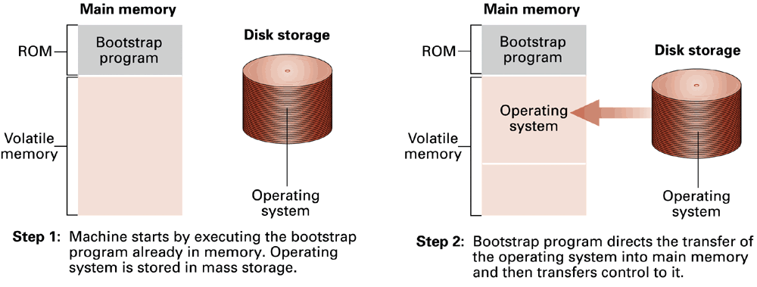
Figure 3.5 The booting process
© 2007 Pearson Addison-Wesley. All rights reserved
0-<number>

Slide 15
Processes
Process: The activity of executing a program
Process State: Current status of the activity
  Program counter
  General purpose registers
  Related portion of main memory
© 2007 Pearson Addison-Wesley. All rights reserved
0-<number>

Slide 16
Process Administration
Scheduler: Adds new processes to the process table and removes completed processes from the process table
Dispatcher: Controls the allocation of time slices to the processes in the process table
  The end of a time slice is signaled by an interrupt.
© 2007 Pearson Addison-Wesley. All rights reserved
0-<number>

Slide 17
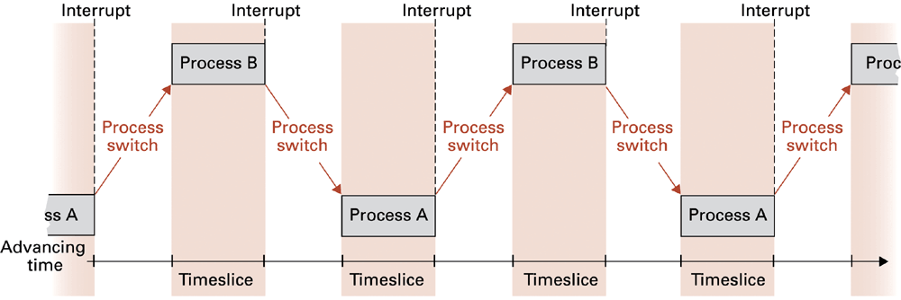
Figure 3.6 Time-sharing between process A and process B
© 2007 Pearson Addison-Wesley. All rights reserved
0-<number>

Slide 18
Handling Competition for Resources
Semaphore: A “control flag”
Critical Region: A group of instructions that should be executed by only one process at a time
Mutual exclusion: Requirement for proper implementation of a critical region
© 2007 Pearson Addison-Wesley. All rights reserved
0-<number>

Slide 19
Deadlock
Processes block each other from continuing
Conditions required for deadlock
  1. Competition for non-sharable resources
  2. Resources requested on a partial basis
  3. An allocated resource can not be forcibly retrieved
© 2007 Pearson Addison-Wesley. All rights reserved
0-<number>

Slide 20
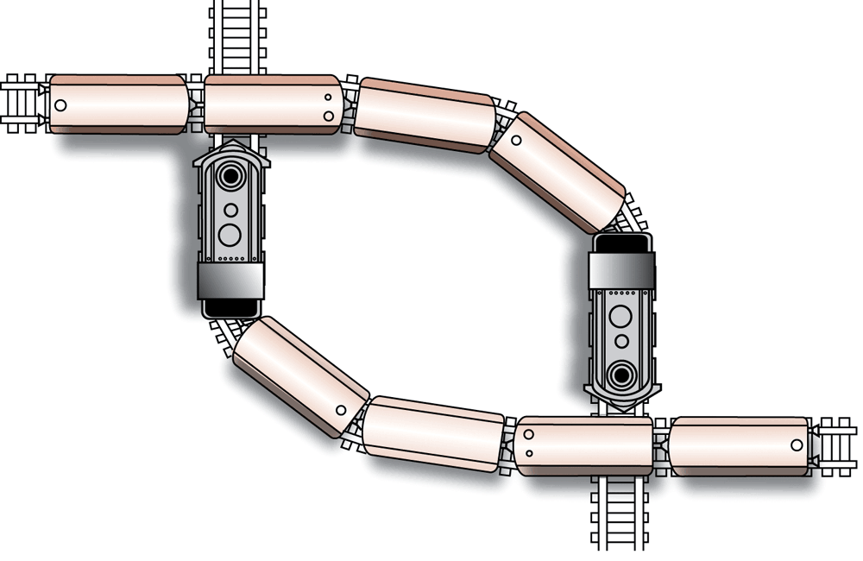
Figure 3.7 A deadlock resulting from competition for nonshareable railroad intersections
© 2007 Pearson Addison-Wesley. All rights reserved
0-<number>

Slide 21
Security
Attacks from outside
  Problems
    Insecure passwords
    Sniffing software
  Counter measures
    Auditing software
© 2007 Pearson Addison-Wesley. All rights reserved
0-<number>

Slide 22
Security (continued)
Attacks from within
  Problem: Unruly processes
  Counter measures: Control process activities via privileged modes and privileged instructions
© 2007 Pearson Addison-Wesley. All rights reserved
0-<number>

