Slide 1

WEEKLY PROGRESS REPORT
Arvind Limited
REPORT NO. 52
(23 July 2026 to 29 July 2026)
Construction of Worker Dormitory — Arvind Limited, Santej · Contractor Bhavana Infra · PMC Sharnam Project Development Consultants & Co.
Arvind Limited
1 / 58

Slide 2
Arvind Limited
INDEX
1
Project Brief
6
Weekly Safety Update
2
Project Stakeholders
7
Weekly Quality Update
3
Mobilisation Plan
8
Project Progress
4
Risk Register
9
Weekly Planned Vs. Actual
5
Procurement Tracker
10
Project Progress Pictures
Arvind Limited
2 / 58

Slide 3
03
Project Brief
Arvind Limited
Arvind Limited
3 / 58

Slide 4
Arvind Limited
Project Brief
Construction of Dormitory for Workers at Santej for Arvind Limited — 4,500 sqm, 8-month package. Week 23–29 July 2026 from the client WPR workbook.
Field | Value
Client | Arvind Limited
Project | Construction of Dormitory for Workers, Santej
Purpose | Dormitory Facility
Area | 4,500 sqm
Contract value (INR) | 10,46,48,777
Duration | 8 Months
Schedule | Delayed
PMC | Sharnam Project Development Consultants & Co.
Consultant | AK.Consultant
Contractor | Bhavana Infra
Week | 23 July 2026 to 29 July 2026
Arvind Limited
4 / 58

Slide 5
Arvind Limited
Site location / Google Earth view
Construction of Worker Dormitory — Arvind Limited, Santej
Santej
Placeholder — portal photos appear on Progress Pictures slides.
Arvind Limited
5 / 58

Slide 6
Arvind Limited
Project Stakeholders
Role | Organisation
Client | Arvind Limited
Consultant | AK.Consultant
PMC | Sharnam Project Development Consultants & Co.
Civil contractor | Bhavana Infra
Arvind Limited
6 / 58

Slide 7
Arvind Limited
Mobilization Plan
Item | Status
Site establishment / container office | In progress
Labour camp / dormitory | Ongoing
Temporary power / borewell | Client action pending
Machinery & shuttering | Partial — shortage flagged in risk register
Arvind Limited
7 / 58

Slide 8
Arvind Limited
Communication Matrix
Arvind dormitory — week 23–29 July 2026. Technical / commercial routing.
Type | From | To | Channel | SLA
Technical query | Contractor — Bhavana Infra | PMC — Sharnam | Email + site | 24 hrs
Drawing release | Consultant — AK.Consultant | PMC / Contractor | Email + DMS | 48 hrs
Site instruction | PMC — Sharnam | Contractor | Site + email | Same day
Commercial / PR | PMC — Sharnam | Client — Arvind Limited | Email | 5 days
Invoice / COP | Contractor / PMC | Client — Arvind Limited | Email + hard copy | 7 days
Hindrance / risk | PMC — Sharnam | Client + Consultant | WPR + email | Weekly
Arvind Limited
8 / 58

Slide 9
Arvind Limited
Project Dashboard · Part 1 of 2
KPI | Value
Project | Construction of Dormitory for Workers
Purpose | Dormitory Facility
Area (sqm) | 4500
Duration | 8 Months
Schedule | Delayed
Week ending | 29-07-2026
Budgeted project value (INR) | ₹ 10,46,48,777
Anticipated project value (INR) | ₹ 11,12,31,831
Achieved as on date (INR) | ₹ 10,96,50,960
Billed till date (INR) | ₹ 8,15,27,326
Cost completion % | 98.6%
Variance vs budget | 6.3%
Arvind Limited
9 / 58

Slide 10
Arvind Limited
Project Dashboard · Part 2 of 2
KPI | Value
Scheduled start | 2025-06-18
Actual start | 2025-07-23
Baseline end | 2026-04-30
Plan days (calendar) | 316
Actual days (calendar) | 384
Arvind Limited
10 / 58

Slide 11
Arvind Limited
Project dashboard · KPI summary
Reporting window: 2026-07-23 → 2026-07-29
Week
Project
Budgeted (INR)
23–29 Jul 2026
Worker Dormitory · Santej
₹ 10,46,48,777
Achieved (INR)
Cost completion
Schedule
₹ 10,96,50,960
98.6%
Delayed
Safe manhours (cum.)
Quality observations
Open NCRs
255848
182
0
Arvind Limited
11 / 58

Slide 12
Arvind Limited
Project S-curve · planned vs actual %
Rollup from published DPRs in the reporting window
Arvind Limited
12 / 58

Slide 13
Arvind Limited
Critical Areas
Area | Issue | Status
Non-availability of updated and approved drawings is causing delays in construction activities and may lead to execution errors due to outdated design references. Immediate action is required to provide the latest drawings. | Infra | Work in Progress
Non availability of permanent power connection for 3 phase power supply and borewell for construction purposes at site may affect overall activities at site. Immediate action reqquired for permanent power supply and borewell construction. | Infra | -
Container office at site for office and documentation works required at urgent basis. Immediate action requred to setup office at site. | site office | -
Ground beam and plinth beam drawings are required for making BBS and procuring steel. Drawings are demanded from last 15 days its required on urgent basis | Infra | -
In spite of repeated instructions and assurances, the manpower deployment for finishing work has not been augmented by M/s Bhavana Infra Projects Pvt. Ltd., leading to delays in planned activities and affecting the overall completion timeline | Infra | -
as instructed before the detailed delay mitigation plan shoud be developed and needs to submit by contractor. As it still yet receive from contractor | Infra | -
all drawings should be delivered on time as per schedule. Delay in drawings can lead to overall construction project delays. Remaining Drawings are Stair cabin slab with Over Head Water Tank | Infra | -
Due to heavy rains over the past three days, the approach road to the site has become muddy. To improve accessibility, debris will be laid along the road to stabilize the surface and facilitate movement. | Infra | -
Arvind Limited
13 / 58

Slide 14
Arvind Limited
Project CAPEX · Part 1 of 2
SPDC Budget WBS — Arvind dormitory pack (week 52).
Sr No | Description | Name of Stackholder | Amount | Actual WO Amount (Basic ) | Certified Amount ( Basic ) | Fore Casted ( Based on GFC ) | — | Non Tendered Items | Steel ( Till Date ) | — | Cement ( Till Date )
1 | Project Development Consultancy | SPDC | 2400000 | 1720000 | 2221707.94 | 501708 |  | 0
2 | Project Consultant | AK Consultant |  | 740000 | 250000 | 0 | 0 | 0
2.1 | Project Consultant | Vishwas Patel |  | 750000 | 750000 | 0 | 0 | 0
3 | Project Package
3.1 | Construction cost for Dormitory blocks | M/s Bhavna Infra | 64212977 | 67396394 | 48992314.580000006 | 5808266.608385501 | 11014505.009695001 | 4048503.5656 | 30538.629999999997 | 1662431.5727999997 | 0
3.1.2 | Road development |  |  |  | 0 | 2214305.134549993 | 499950.22969000007 | 0
3.1.3 | Compound wall (Precast) |  |  |  | 0 | 896162 | 1758380.3753097039 | 0
3.1.4 | Soil filling (within Plot area) |  |  |  | 0 | 0 | 0 | 0
3.1.5 | UG Tank/PVC Tank |  | 6000000 |  | 0 | 1540298.1395353 | 0 | 380000
3.1.6 | Anti-termite service | M/s Surti Pest-Control | 35532 | 35532 | 28424
3.2 | Borewell | Shree Shakti Pump | 1000000 | 1790460 | 1755864 | 0 | 0 | 0
3.3 | External Electrification ( power connection cost ) | Electech Engineering Pvt Ltd. | 5000000 | 4850000 | 3707500 | 0 | 239500 | 94350
Arvind Limited
14 / 58

Slide 15
Arvind Limited
Project CAPEX · Part 2 of 2
Sr No | Description | Name of Stackholder | Amount | Actual WO Amount (Basic ) | Certified Amount ( Basic ) | Fore Casted ( Based on GFC ) | — | Non Tendered Items | Steel ( Till Date ) | — | Cement ( Till Date )
3.3.1 | Temporary Power Connection | M/s. Indian Electricals |  | 350050 | 333900 | 0 | 0 | 0
3.3.2 | Electrical Package | Pearl Electricals | 5258950 | 7053515 | 6779312.3052058 | 1352729.2019670154 | 977194.7674700882 | 0
4 | Plumbing Package | Nayak Novel Engg & Const. | 5258950 | 6261956 | 6505414.66 | 1744301.4400000002 | 1074920.6 | 0
4.1 | External Drainage network & STP |  | 5000000 | 1317691 | 0 | 1201595 | 0 | 0
5 | Furniture Package | Vinayak Enterprise | 9146000 | 3039740 | 2710958 | 0 | 508800 | 783960
6 | Furniture Package | Pitrukrupa |  | 5088000 | 4452000 | 0 | 300144
7 | Aluminum Package | New SB Glass | 1143250 | 934315 | 0 | 331239.04999999993 | 129200 | 0
8 | Fire Package | PMS Projects | 228650 | 1961379.72 | 1217520.4 | 0 | 0 | 749450
9 | Gas Line | Jimit & Co. | 0 | 1050550 | 1050048.9300000002 | 0 | 18540 | 122400
10 | Misc. Electric Work | Indian Electric | 0 | 70825 | 70825
11 | WPC Door | Gajjar Furniture | 0 | 1014880 | 701535.8 | 0 | 101488
12 | Duct Louvers | Metalium | 0 | 348336
Arvind Limited
15 / 58

Slide 16
Arvind Limited
Project PR Tracker · Part 1 of 2
Sr No | PR Type | PR No | Discipline | Qty | Unit | Rate | Amount | Material Code | PO
1 | Service | 1300087731 | CIVIL WORK FOR WORKER DORMITORY PHASE-1 & EXTERNAL DEVELOPMENT WORKS | 1 | 1 | 67396394 | 67396394 | 3000717 | 3100007903
2 | Service | 1300087775 | CHARGES FOR BOREWELL AS PER DETAIL | 1 | 1 | 1790460 | 1790460 | 3000717 | 3100007908
3 | Service | 1300087776 | CHARGES FOR TEMPORARY POWER CONNECTION | 1 | 1 | 350050 | 350050 | 3001591 | 3100007990
4 | Service | 1300087778 | PMC CHARGES - DORMITORY SANTEJ | 1 | 1 | 1720000 | 1720000 | 3000417 | 3100007909
5 | Service | 1300087945 | DESIGN CONSULTANCY CHARGES | 1 | 1 | 750000 | 750000 | 3000791 | 3100008018
6 | Service | 1300088433 | DESIGN CONSULTANCY CHARGES | 1 | 1 | 740000 | 740000 | 3000791 | 3100008017
7 | Service | 1300088431 | ANTI-TERMITE FOR DORMITORY BUILDING | 1 | 1 | 35532 | 35532 | 3001591 | 3100008035
8 | Service | 1300088933 | ELECTRICAL WORK FOR WORKER DORMITORY PHASE-1 | 1 | 1 | 7053515 | 7053515 | 3001220 | 3100007964
9 | Service | 1300091487 | PLUMBING WORK FOR WORKER DORMITORY PHASE-1 | 1 | 1 | 7579647 | 7579647 | - | 3100008191
10 | Service | 1300094218 | DORMITORY WINDOW WORK | 1 | 1 | 934315 | 934315 | 3001076 | 3100008357
11 | Service | 1300094219 | MISC ELELECTRICAL WORK | 1 | 1 | 70825 | 70825 | 3000901 | 3100008418
12 | Service |  | FURNITURE WORK(Bed & Kitchen Platform) | 1 | 1 | 2742300 | 2742300 | - | 3100008445
Arvind Limited
16 / 58

Slide 17
Arvind Limited
Project PR Tracker · Part 2 of 2
Sr No | PR Type | PR No | Discipline | Qty | Unit | Rate | Amount | Material Code | PO
13 | Service | 1300096253 | WPC DOOR WORK | 1 | 1 | 1014880 | 1014880 | 3001066 | 3100008581
14 | Service | 1300095557 | GAS LINE WORK | 1 | 1 | 1050550 | 1050550 | 3000449 | 3100008498
13 | Service | 1300096252 | FIRE FIGHTING WORK | 1 | 1 | 2341330 | 2341330 | 3000939 | 3100008552
15 | Service | 1300096254 | METALIUM LOUVERS WORK | 1 | 1 | 258336 | 258336 | 3001066 | 3100008591
16 | Service |  | FURNITURE WORK(Wardrobe) | 1 | 1 | 5088000 | 5088000 | 3001066 | 3100008575
17 | Service |  | External Electric Work | 1 | 1 | 4850000 | 4850000 | 3000901 | 3100008668
19 | Service |  | Dining Tables Work | 1 | 1 | 707000 | 707000
Net Total |  |  |  |  |  |  | 106473134
Arvind Limited
17 / 58

Slide 18
Arvind Limited
Invoice Processing Tracker · Part 1 of 2
Sr No | Name of Work | Invoice No | PO | Vendor | Invoice Date | Invoice Rise (Excl. GST) | COP Status
1 | PMC Services for Worker Dormitory (July-25) | 32/25-26 | 3100007909 | Sharnam | 45974 | 37096.77
2 | PMC Services for Worker Dormitory (Aug-25) | 33/25-26 | 3100007909 | Sharnam | 45974 | 115000
3 | Borewell work for Worker Dormitory | 119 | 3100007908 | Shree Shakti Pump |  | 895230 | Done
5 | Civil work for Worker Dormitory | 27 | 3100007903 | Bhavana Infra | 45918 | 4758645.56 | Done
6 | PMC Services for Worker Dormitory (Sep-25) | 34/25-26 | 3100007909 | Sharnam | 45934 | 168333
7 | Design consultancy charges | VPA-03-25-26 | 3100008018 | VPA | 45934 | 750000
8 | Design consultancy charges | 44/25-26 | 3100008017 | Ashish K Bhavsar | 45939 | 250000
9 | Civil work for Worker Dormitory | 44 | 3100007903 | Bhavana Infra | 45972 | 2762022 | Done
10 | Civil work for Worker Dormitory | 43 | 3100007903 | Bhavana Infra | 45967 | 910033 | Done
11 | Civil work for Worker Dormitory | 46 | 3100007903 | Bhavana Infra | 45985 | 988771 | Done
12 | PMC Services for Worker Dormitory (Oct-25) | INV-000003 | 3100007909 | Sharnam | 45973 | 189032
13 | PMC Services for Worker Dormitory (Nov-25) | 38/25-26 | 3100007909 | Sharnam | 45991 | 213333.33
Arvind Limited
18 / 58

Slide 19
Arvind Limited
Invoice Processing Tracker · Part 2 of 2
Sr No | Name of Work | Invoice No | PO | Vendor | Invoice Date | Invoice Rise (Excl. GST) | COP Status
14 | Civil work for Worker Dormitory | 47 | 3100007903 | Bhavana Infra | 45996 | 5138504 | Done
15 | Temp Electric connection for Dormitory | IECI25-26/049 | 3100007990 | Indian Electric | 45982 | 333900 | Done
16 | Civil work for Worker Dormitory | 50 | 3100007903 | Bhavana Infra | 46006 | 2592839 | Done
17 | Civil work for Worker Dormitory | 51 | 3100007903 | Bhavana Infra | 46007 | 2639623 | Done
18 | Civil work for Worker Dormitory | 52 | 3100007903 | Bhavana Infra | 46006 | 693242 | Done
19 | Civil work for Worker Dormitory | 53 | 3100007903 | Bhavana Infra | 46021 | 771847 | Done
20 | ANTI-TERMITE FOR DORMITORY BUILDING | 1582 | 3100008035 | Surti Pest Control Service | 46017 | 28424 | Done
21 | Borewell work for Worker Dormitory | 200 | 3100007908 | Shree Shakti Pump | 46017 | 860634 | Done
22 | Civil work for Worker Dormitory | 54 | 3100007903 | Bhavana Infra | 46023 | 2694318.9 | Done
23 | PMC Services for Worker Dormitory (Dec-25) | PROFORMA-08 | 3100007909 | Sharnam | 46023 | 212484.84
24 | PMC Services for Worker Dormitory (Jan-26) | 57/25-26 | 3100007909 | Sharnam | 46053 | 215000
25 | Civil work for Worker Dormitory | 59 | 3100007903 | Bhavana Infra | 46055 | 613639 | Done
Arvind Limited
19 / 58

Slide 20
Arvind Limited
Hinderance Register · Part 1 of 2
Sr. No | Description of Hindrance | Location | Work affected | Correspondence | Type of Hindrance | Date of Occurrence | Date Resolved | No. of Days | Critical Activity affected
1 | Non-availability of updated and approved drawings is causing delays in construction activities and may lead to execution errors due to outdated design references. Immediate action is required to provide the latest drawings. | Infra | Site activity | On mail | Work in Progress | 45860 | 45861 | 1 | Constrcution Activity
2 | Non availability of permanent power connection for 3 phase power supply and borewell for construction purposes at site may affect overall activities at site. Immediate action reqquired for permanent power supply and borewell construction. | Infra | Site activity | on site | - | 45866 |  |  | Constrcution Activity
3 | Container office at site for office and documentation works required at urgent basis. Immediate action requred to setup office at site. | site office | documentation | on site | - | 45866 | 45873 |  | documentation
4 | Ground beam and plinth beam drawings are required for making BBS and procuring steel. Drawings are demanded from last 15 days its required on urgent basis | Infra | Steel Procurement & Site activity | Consultant | - | 45874 | 45877 |  | Constrcution Activity
1 | In spite of repeated instructions and assurances, the manpower deployment for finishing work has not been augmented by M/s Bhavana Infra Projects Pvt. Ltd., leading to delays in planned activities and affecting the overall completion timeline | Infra | Site activity | on site | - | 45887 |  |  | Constrcution Activity
6 | as instructed before the detailed delay mitigation plan shoud be developed and needs to submit by contractor. As it still yet receive from contractor | Infra | Site activity | on site | - | 45887 |  |  | Constrcution Activity
2 | all drawings should be delivered on time as per schedule. Delay in drawings can lead to overall construction project delays. Remaining Drawings are Stair cabin slab with Over Head Water Tank | Infra | Site activity | on site | - | 45888 |  |  | Constrcution Activity
8 | Due to heavy rains over the past three days, the approach road to the site has become muddy. To improve accessibility, debris will be laid along the road to stabilize the surface and facilitate movement. | Infra | Site activity | on site | - | 45894 |  |  | Constrcution Activity
2 | Firefighting work vendor is still not available at site, which may potentially delay the completion of dependent activities; therefore, timely mobilization of the vendor is essential. | Infra | Site activity | on site | Vendor Onboarding Delays | 45957 |  |  | Constrcution Activity
4 | Vendor POs are not alloted to all of the vendors. Which is causing delays in timely submission of bills and payment on time. | Infra | Site activity | on site |  | 45959 |  |  | Billing and Payments
4 | All material procurement approvals shall be shared with the vendor, ensuring that the PMC is kept informed. | Infra | Site activity | on site | - | 45959 |  |  | Site Execution / Construction Work
3 | The final drawings for external development works—including the septic tank with soak pit, road, and paver block layout and sections—are still pending submission from the design consultant, AK Bhavsar. | Infra | Site activity | on site | - | 45972 |  |  | Constrcution Activity
Arvind Limited
20 / 58

Slide 21
Arvind Limited
Hinderance Register · Part 2 of 2
Sr. No | Description of Hindrance | Location | Work affected | Correspondence | Type of Hindrance | Date of Occurrence | Date Resolved | No. of Days | Critical Activity affected
5 | The required changes for the electrical raising layout, Single Line Diagram (SLD) plan, and wire diagram are still pending submission, which is delaying the final approval and coordination of MEP works on site. | Infra | Site activity | on site | - | 45972 |  |  | Constrcution Activity
4 | The timely completion of all external development activities is being affected due to the delay in onboarding the required vendor. Vendor onboarding is essential to mobilize resources and commence the scheduled works. Any further delay in finalizing and engaging the vendor will directly impact the project timeline and may result in unavoidable delays in completing the external development works. | Infra | Site activity | - | Vendor Onboarding Delays | 45992 |  |  | Constrcution Activity
5 | Ground Floor Canteen Floor plan is yet to receive. Which is causing delays in completion of ground floor activities. | Infra | Site activity | - | - | 46015 |  |  | Constrcution Activity
 | If you want, I can also draft a concise version suitable for a site daily report or hindrance log.
4 | Delay in execution of compound wall work due to non-confirmation of compound wall marking by DILR survey. | Infra | Site activity | on site | - | 46050 |  |  | Constrcution Activity
1 | Delay in plumbing work due to non-mobilization of adequate manpower by the plumbing vendor, which is consequently affecting progress of dependent activities such as masonry, plastering, and flooring works. | Infra | Site activity | on site | - | 46063 |  |  | Constrcution Activity
4 | Delay in tiling work and dependent activities has been noted on site due to non availability of materials at site due to shortage in supply from manufacturar. Alternative arrangements should be made by Vendor. | Infra | Site activity | on site | Materials procurement delay | 46098 |  |  | Constrcution Activity
 |  |  |  |  |  |  |  | 0
Arvind Limited
21 / 58

Slide 22
Arvind Limited
Risk Register · Part 1 of 2
Risk ID | Risk Category | Dated Raised | Risk Name | Risk Description | — | Probability of Risk occuring | Consequence of Risk | Severity | Risk Owner
1 | General | 45867 | Contractor Mobilization Delay | The mobilization activities of the appointed civil contractor are progressing at a significantly slower pace than originally planned. Critical tasks such as site establishment, manpower deployment, material procurement, machinery mobilization, safety arrangements, and initial site clearance are either delayed or not being executed efficiently, potentially impacting the timely commencement of construction works. |  | High | High | High | Bhavna Infra
2 | General | 45867 | Testing Lab Setup Delay | To ensure adherence to project-specific technical specifications and quality standards, it is essential to establish a fully functional testing laboratory at the project site. The absence or delay in setting up this facility may hinder the timely sampling and testing of critical construction materials such as concrete, cement, aggregates, bricks, steel, and water. This can compromise the quality control (QC) process, delay approvals, and increase the risk of using substandard materials, ultimately affecting the structural integrity, safety, and overall progress of the project. |  | High | High | High | Bhavna Infra
3 | General | 45867 | Delay in Shuttering Material Supply and Site Organization | The shuttering materials required for upcoming PCC and RCC footing concreting works have not been fully supplied, nor are they properly stacked at the designated storage area on site. This delay and disorganization may hinder the concreting schedule and compromise shuttering alignment quality. |  | High | High | High | Bhavna Infra
1 | General | 45867 | The available site manpower is currently insufficient to meet scheduled activity demands, there is insufficiency of masons for masonry and plaster work on site. | It has been observed that the manpower currently available at the site is inadequate to meet the scheduled activity requirements of the project. The contractor has been instructed to mobilize the remaining workforce at the earliest. 8 masons are available on site for masonry and plaster work , which is targeted for 30 nos. |  | High | High | High | Bhavna Infra
5 | General | 45867 | Unauthorized Land Encroachment | Use of unauthorized land—whether for parking, material storage, machinery movement, or any other construction-related activity—is strictly prohibited and may result in serious legal and contractual consequences, including penalties, work stoppages, or disputes with landowners or authorities. To mitigate this risk, the approved site boundaries must be clearly demarcated using visible markers, barricades, or fencing. All workers, operators, and site personnel must be informed and routinely guided about the designated work area limits to prevent inadvertent encroachment. |  | High | High | High | Arvind Limited
2 | General | 45867 | Delay in Structural Drawing Release | Ground beam and plinth beam construction drawings are currently pending, which are essential for preparing the Bar Bending Schedule (BBS) and initiating steel procurement. The design consultant has committed to providing the required drawings within two days. Any delay beyond this timeline may lead to procurement hold-ups, reinforcement cutting/fabrication delays, and a potential impact on the construction schedule. |  | High | High | High | AK.Consultant
2 | General | 45876 | Delay in Footing Work Progress | As our footing work activity is already delayed contractor should makeup the lost time by increasing manpower and productivity. |  | High | High | High | Bhavna Infra
2 | General | 45881 | Delay In plinth level activity | The mitgation plan target date for completion of the Ground Floor slab RCC work is set for 18th October. Bhavana Infra has been instructed to increase night work hours work and aim for completion by 18th October. |  | High | High | High | Bhavna Infra
2 | General | 45876 | Wastage of raw materials and mixing with soil | Raw materials should be stacked at proper cleaned area to decrease wastage and maintain proper quality of materials |  | High | High | High | Bhavna Infra
3 | General | 45880 | Electrcal Safety | A distribution box shall be securely fixed and installed with all necessary accessories. All connections to equipment must be made using appropriate pin-top plugs to ensure safety, security, and compliance with electrical standards |  | High | High | High | Bhavna Infra
6 | General | 45877 | Hard Barricading for excavated area | As excavated area is deep as 3 meters proper hard barricading should be required for safety of all livelyhood |  | High | High | High | Bhavna Infra
7 | General | 45866 | Unavailability of permanent Power Supply And Borewell | The ongoing unavailability of a permanent 3-phase power connection and borewell at the construction site is significantly impacting overall site activities. The current temporary power supply is insufficient to support multiple operations, especially during night shifts, leading to delays and inefficiencies. |  | High | High | High | Arvind Limited
Arvind Limited
22 / 58

Slide 23
Arvind Limited
Risk Register · Part 2 of 2
Risk ID | Risk Category | Dated Raised | Risk Name | Risk Description | — | Probability of Risk occuring | Consequence of Risk | Severity | Risk Owner
7 | General | 45888 | Padestal Conctete Activity Delay | Concrete work for the pedestal must commence at the earliest to mitigate delays in the overall project schedule. |  | High | High | High | Arvind Limited
5 | General | 45888 | Drawings shoudld be made available on time. | The design deliverables schedule should be signed off by the consultant, and all design submissions must be delivered on time as per the agreed schedule |  | High | High | High | Arvind Limited
9 | General | 45895 | Delay in steel procurement | The steel delivery has been delayed due to a production issue at the supplier’s end. |  | High | High | High | Bhavna Infra
10 | General | 45893 | Waterlogging in excavated area | Due to heavy rains flood water is looged in excavated area. Dewatering should be carried out at earliest |  | High | High | High | Bhavna Infra
5 | General | 45895 | Bricks Procurement Pending | Bhavana Infra should procure bricks that approximate the specified make and standards outlined in the BOQ. This will help ensure timely material availability on site and facilitate the completion of testing as scheduled |  | High | High | High | Bhavna Infra
5 | General | 45901 | Shuttering and steel to be stacked at desired place. | Materials Should not be dumped directly on soil surface. Steel and shuttering materials found layed in mud and soil. |  | High | High | High | Bhavna Infra
5 | General | 45902 | PPE Issuance and workerd ID list | Workers safety and ID list with PPE issuance is required for safety and security purposes. |  | High | High | High | Bhavna Infra
4 | General | 45905 | Sieve test set not available at site. | Site testing materials(sieve test set) for gradation test not available on site. |  | High | High | High | Bhavna Infra
6 | General | 45917 | Volume box not available at site | Volume box for preparing mortar for masonry is not available on site. |  | High | High | High | Bhavna Infra
2 | General | 45965 | Honey Combing in columns and damages to the egdes | During the site visit, it was observed that the quality of the concrete was unsatisfactory, with honeycombing noted on the cast columns |  | High | High | High | Open
2 | General | 45971 | NDT test Confirmation pending by Design Consultant | The 7-day concrete cube test results failed to meet the required strength parameters. Following this, Non-Destructive Testing (NDT) was conducted and all relevant reports and supporting documents were submitted to the design consultant (AK Consultant). However, no comments, approval, or technical confirmation have been received from the consultant. This lack of timely feedback poses a risk to construction progress, quality assurance, and structural safety decision-making. |  | High | High | High | Bhavna Infra
3 | General | 45971 | The erection, provision of proper structural supports, and installation of stair access for the watch tower are still pending. | Since the watch tower is proposed primarily for observation and work tracking purposes, the delay may affect site monitoring efficiency and hinder effective supervision of ongoing construction activities. Limited visibility from ground level could result in reduced oversight of manpower deployment, equipment utilization, and progress tracking. This may lead to coordination challenges, delays in identifying on-site issues, and reduced accuracy in reporting daily work progress. Although the pending erection does not pose a direct structural or safety risk to ongoing works, it impacts project management effectiveness and may indirectly influence overall productivity and schedule adherence. |  | High | High | High | Bhavna Infra
Arvind Limited
23 / 58

Slide 24
Arvind Limited
Legal Approval Tracker
Sr. No. | Approvals | Authority for Approval | Action Taken | Action Required | Due date | Approval Date | Risk Associated | Status
1 | 3-Phase Electrical Power Supply at Site | Arvind limited | Construction electric power has to provided by client at site |  | 45874 |  | Construction activity | Done
2 | Labour License (Form V) | Arvind limited | Required if more than 20 workers are engaged at the site. | Form 5 must be issued by client | 45874 |  | Legal penalty,project stoppage. | Not done
3 | Form V – Principal Employer Certificate | Arvind limited | Must be signed and stamped by the client (principal employer). | Form 5 must be issued by client | 45874 |  | Delay in license; unclear liability. | Not done
4 | Contractor’s All Risk (CAR) Insurance Policy | Bhavna Infra | Must cover civil works, machinery, equipment, and third-party liabilities. |  | 45874 |  | Financial loss from damages; contract issues. | Not done
5 | Workmen Compensation Insurance Policy | Bhavna Infra | Mandatory to safeguard against workplace accidents and injuries. |  | 45874 |  | Heavy liability in case of injury; legal action. | Done
6 | PPE Issuance Proof | Bhavna Infra | Record of issued helmets, shoes, jackets, gloves, etc., with signature. |  | 45874 |  | Injury risk; safety non-compliance. | Done
7 | Labour Law Compliance Undertaking | Arvind limited | Signed declaration by contractor to comply with labour laws and safety standards. | Form 5 must be issued by client | 45874 |  | Legal gaps; accountability issues. | Not done
8 | ESIC Registration | Bhavna Infra | Declaration submitted. Not applicable if <10 workers. |  | 45874 |  | Penalty for non-compliance; worker dissatisfaction. | Done
9 | EPF Registration & Challan Copy | Bhavna Infra | Registration completed. Latest challan submitted. |  | 45874 |  | Audit issues; client may withhold payment. | Done
10 | First Aid Facility Details | Bhavna Infra | First aid kit arranged and available on site. |  | 45874 |  | Poor emergency response; safety violation. | Done
11 | Worker List with ID Proof | Bhavna Infra | Updated list with ID proofs submitted weekly. |  | 45874 |  | Security risk; claims complications. | Done
Arvind Limited
24 / 58

Slide 25
Arvind Limited
Drawing Register _ DCI · Part 1 of 2
DCI — Arvind Limited drawing register (17 Jun 2026 cut).
DISCIPLINE | BUILDING/AREA | DWG. NO. | CONSULTANT DRW. NO. | TITLE | DATES RECEIVED BY THE CONSULTANT | R0 | R1 | R2 | R3 | R4 | R5
A-01 | GENERAL | A-01 |  | Area diagram | 45856 | 45856 | 45871
A-02 | GENERAL | A-02 |  | Site Layout Option-04 | 45856 | 45929 | 45967
A-03 | GENERAL | A-03 |  | Revised plan for dormitory | 45856 | 45856 | 45905
A-04 | Master Layout Plan | A-04 |  | Site boundaries, access, services |  |  | 45905
A-05 | Area Statement | A-05 |  | Floor-Wise BUA/FAR/FSI
A6–A11 | Floor Plans (GF to 4F + Terrace) | A6–A11 |  | Room layout, shafts, corridor widths | 45910 | 45905 | 45967 | 45979 | 45994 | 46029
A12–A15 | Elevations (North, East, South, West) | A12–A15 |  | Façade, window alignment, height | 45925 | 45905 | 45979
A-15.1 | Elevations | A-15.1 | G.A.~ 04 | ELEVATION.~ A for DORMITORY BUILDING. |  | 45909 | 45979
A16–A17 | Sections (AA, BB) | A16–A17 |  | Vertical height, structural cut | 45925 | 45905 | 45979
A18 | Door/Window Schedule | A18 |  | Type, sizes, opening direction | 45925 | 45905 | 45967 | 45979 | 45994
A19 | Staircase Plan & Details | A19 |  | Riser, tread, railing detail | 45925
A20 | Typical Toilet Layout | A20 |  | Plumbing point, tile zone, partition | 45925
Arvind Limited
25 / 58

Slide 26
Arvind Limited
Drawing Register _ DCI · Part 2 of 2
DISCIPLINE | BUILDING/AREA | DWG. NO. | CONSULTANT DRW. NO. | TITLE | DATES RECEIVED BY THE CONSULTANT | R0 | R1 | R2 | R3 | R4 | R5
A21–A24 | Toilet Elevations (4 Sides) | A21–A24 |  | Tile layout, mirror, tap fittings | 45925
A25–A31 | Finishing Layouts (GF–4F) | A25–A31 |  | Floor finish types, borders, skirting | 45925 | 45979
A32 | Finishing Schedule – Room-wise | A32 |  | Wall/ceiling/floor finish, paint codes | 45925 | 45990
A33 | Fire Evacuation Plan | A33 |  | Fire exits, signage, assembly point
A34 | Floor Build-up Section (typical) | A34 |  | Slab + screed + tile + skirting buildup | 45925 | 45877 | 45889
ST-01 | Dormitory | ST-01 |  | Column Location | 45856 | 45856 | 45860 | 45861
ST-01 | Dormitory | ST-01 |  | Column Location | 45856 | 45856 | 45860 | 45861
ST-02 | Dormitory | ST-02 |  | Schedule of column | 45856 | 45856 | 45860 | 45861
ST-03 | Dormitory | ST-03 |  | Typical footing section | 45856 | 45856 | 45860 | 45861
ST-04-12 | Dormitory | ST-04-12 |  | Combined foundation detail for C1,C2,C3 | 45856 | 45856 | 45860 | 45861
S-05 | Design Basis Report | S-05 |  | Load assumptions, codes, seismic zone
S-06 | Wall Foundation detail | ST-04 |  | Bar spacing, lap, type | 45877 | 45877
Arvind Limited
26 / 58

Slide 27
Arvind Limited
Drawing register · DCI by discipline
Share of registered drawings per discipline
Arvind Limited
27 / 58

Slide 28
Arvind Limited
Design Status
Sr. No. | Status | Status (In Percentage) | Planned End Date | Remark | — | — | —
1 | Architectural | 1 | - | As Per Approved MockUp sample Further Drawings were not required
2 | Structural | 1 | - | As Per Approved MockUp sample Further Drawings were not required
3 | Electrical | 1
4 | Plumbing | 1
5 | Fire Protection | 1
Arvind Limited
28 / 58

Slide 29
Arvind Limited
Procurement Status
Sr.No. | Workpackage | Items descriptions | Responsible stakeholder | Contractor Name | Target date of inquiry float | Date of Vendor appointment | Lead time | Priority Level | Vendor Appointed | Remark
1 | Weight Bridge | Weight bridge | Client | Eagle Scale Manufacturing Works | 45677 | 45699 | 22 days | 1 | Yes
2 | Dock Leveller | Dock Leveller | Client |  | 45677 |  |  | 1 | No
3 | Mechanical Packages | HVAC (Heating, Ventilation & Air Conditioning), Fire Fighting & Suppression System, Plumbing & Drainage and Compressed Air System | Client |  | 45787 |  |  | 1 | No
4 | Electrical Packages | Power Distribution System, Lighting & Small Power, Low Current Systems (CCTV, Access Control) & Earthing & Lightning Protection | Client |  | 45818 |  |  | 1 | No
5 | Process Equipment & Utilities | Heavy Machinery & Equipment | Client |  | 45789 |  |  | 2 | No
Arvind Limited
29 / 58

Slide 30
21
Project Progress
Arvind Limited
Arvind Limited
30 / 58

Slide 31
Arvind Limited
Project Milestone Schedule
Arvind dormitory dates from Dash Bord For Budget 52 (Anup-II) — not the generic Progress Overview sample.
ID | Phase | Milestone | Planned start | Planned end | Planned days | Actual start | Actual end | Actual days | Weight %
M01 | Start | Construction start vs calendar | 2025-06-18 | 2026-04-30 | 316 | 2025-07-23 |  | 384
M02 | Civil | Building civil work anticipated end | 2026-04-30 | 2026-07-20
M03 | External | External civil anticipated end |  | 2026-08-02
M04 | MEP | Plumbing anticipated end |  | 2026-08-11
Arvind Limited
31 / 58

Slide 32
Arvind Limited
Project milestone schedule
Plan vs actual days — edit data labels in PowerPoint
Arvind Limited
32 / 58

Slide 33
Arvind Limited
Weekly Manpower Histogram · Part 1 of 2
Type of Manpower | Required Manpower for week | Available | Shortage
Reinforcement work | 0 | 0 | 0
Carpenter | 7 | 7 | 0
Mason | 28 | 28 | 0
Helper | 7 | 7 | 0
Unskilled Worker | 105 | 105 | 0
Drivers | 7 | 7 | 0
Staff | 26 | 26 | 0
Plumbing | 49 | 28 | 21
Tiles Work | 14 | 14 | 0
Painter | 14 | 14 | 0
Electric Work | 14 | 14 | 0
Fabricator | 0 | 0 | 0
Flush Door - Carpenter | 0 | 0 | 0
PreCast | 25 | 25 | 0
Arvind Limited
33 / 58

Slide 34
Arvind Limited
Weekly Manpower Histogram · Part 2 of 2
Type of Manpower | Required Manpower for week | Available | Shortage
WPC | 0 | 0 | 0
Fire Fighting | 0 | 0 | 0
Gas Line | 0 | 0 | 0
Wardrobe | 0 | 0 | 0
Bed and Platform | 0 | 0 | 0
Windows | 0 | 0 | 0
Total of Above | 296 | 275 | 21
Available
Date | Rein. work | Carpenter | Mason
46184 | 0 | 1 | 4
46185 | 0 | 1 | 4
46186 | 0 | 1 | 4
46187 | 0 | 1 | 4
46188 | 0 | 1 | 4
Arvind Limited
34 / 58

Slide 35
Arvind Limited
Weekly manpower histogram
Required vs available / daily headcount
Arvind Limited
35 / 58

Slide 36
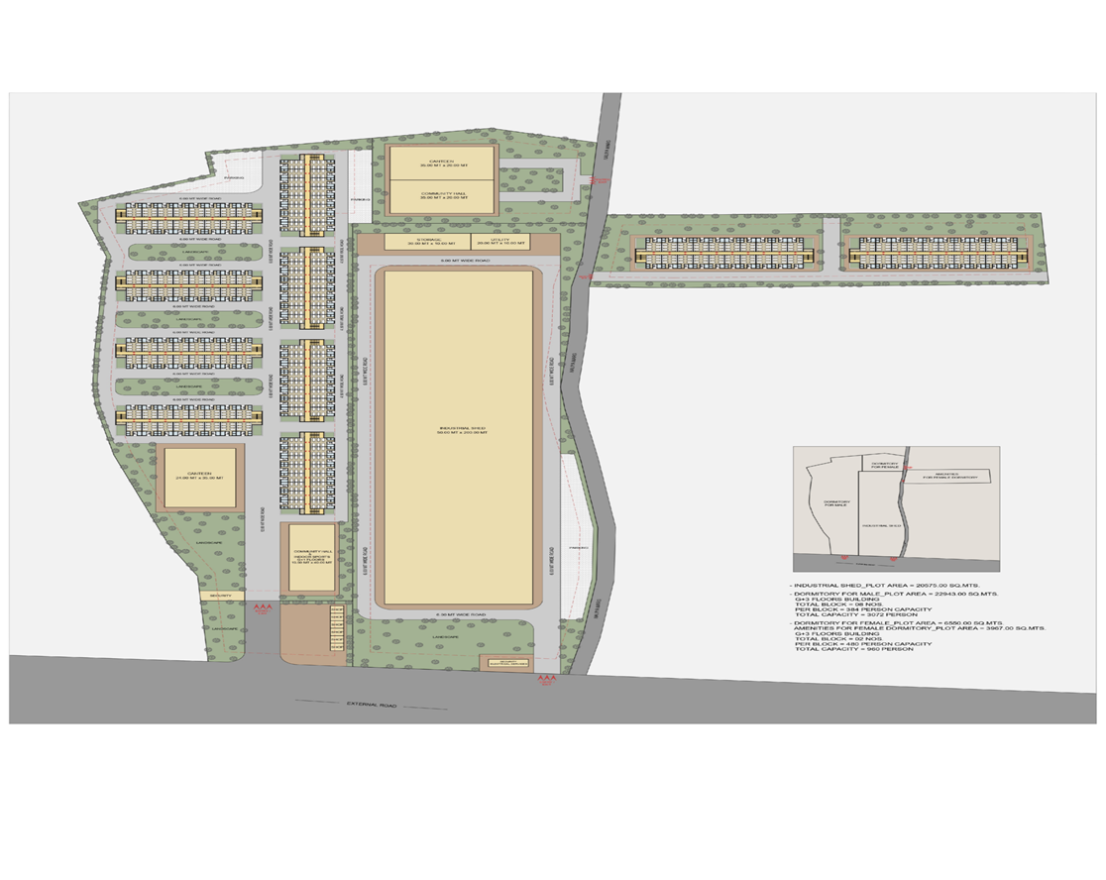
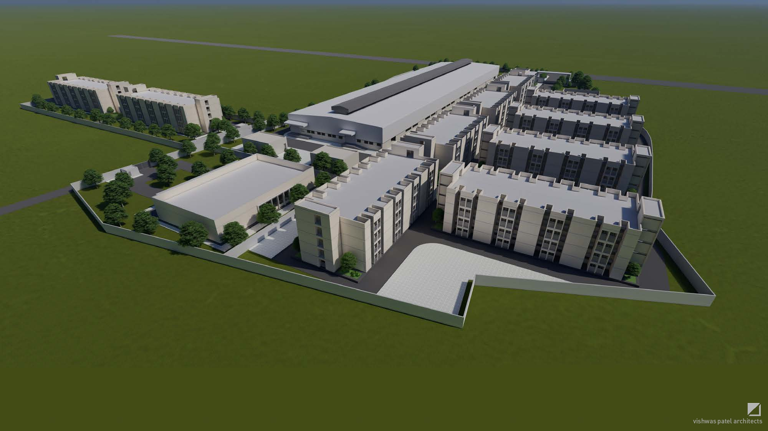
Arvind Limited
Weekly Executed Plan · Part 1 of 3
1
2
(No photo)
(No photo)
Photo 3
Photo 4
Arvind Limited
36 / 58

Slide 37
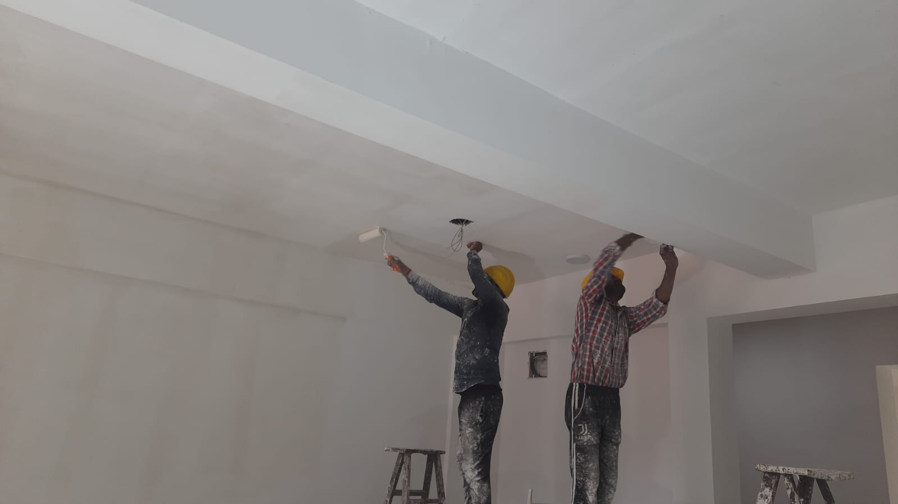
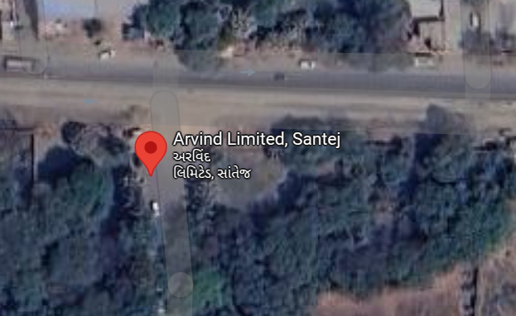
Arvind Limited
Weekly Executed Plan · Part 2 of 3
3
4
(No photo)
(No photo)
Photo 3
Photo 4
Arvind Limited
37 / 58

Slide 38
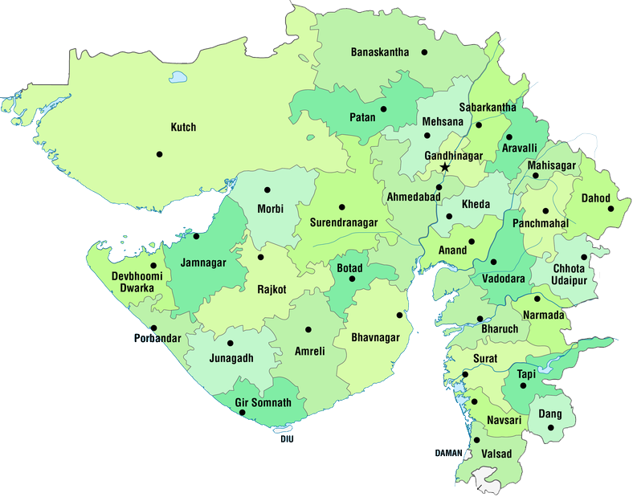
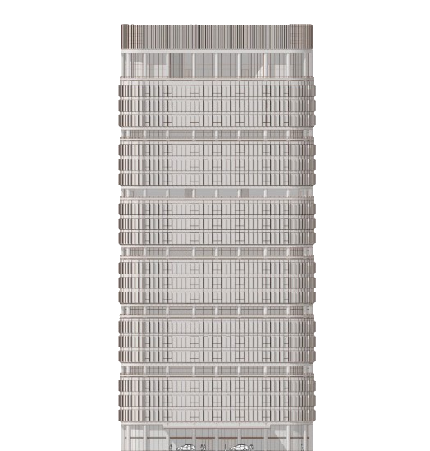
Arvind Limited
Weekly Executed Plan · Part 3 of 3
5
6
(No photo)
(No photo)
Photo 3
Photo 4
Arvind Limited
38 / 58

Slide 39
Arvind Limited
Project Cashflow Overview · Part 1 of 2
Month | — | Budgeted work | Planned Work | Actual Work
August | RA 01 |  | 5000000 | 1063955
September | RA 02 |  | 7200000 | 7797193
October | RA 03 |  | 5000000 | 168333
November | RA 04 |  | 7500000 | 2376171
December | RA 05 |  | 8000000 | 12765763
January | RA 06 |  | 9000000 | 2906803.7399999998
February | RA 07 |  | 12596861.8 | 9418848.1
March | RA 08 |  | 12596861.8 | 2123756.45
April | RA 09 |  | 12596861.8 | 8730949.04
May | RA 10 |  | 12596861.8 | 19313808.5
June | RA 11 |  | 12596861.8 | 8306604.76
July | RA 12 |  | 12596861.8 | 5227082.93
Month |  |  | January
Planned
Arvind Limited
39 / 58

Slide 40
Arvind Limited
Project Cashflow Overview · Part 2 of 2
Month | — | Budgeted work | Planned Work | Actual Work
Actual
Arvind Limited
40 / 58

Slide 41
Arvind Limited
Project cashflow overview
Planned vs actual (₹ lakh) by period
Arvind Limited
41 / 58

Slide 42
40
Weekly Quality Update
Arvind Limited
Arvind Limited
42 / 58

Slide 43
Arvind Limited
Weekly Quality Updates
Sr.no. | Observation | Total | Open | Close
1 | Site Observation | 89 | 0 | 89
2 | Site Instruction | 89 | 0 | 89
3 | NCR | 4 | 0 | 4
Arvind Limited
43 / 58

Slide 44
Arvind Limited
Quality Statistic
Site Observation / Instruction / NCR — totals from the week sheet
Arvind Limited
44 / 58

Slide 45
Arvind Limited
Cube Test
No of sample | Compressive strength at 7 days | IS code lower limit
1 | 17.97 | 17
2 | 20.23 | 17
3 | 19.5 | 17
4 | 21.32 | 17
5 | 19.85 | 17
6 | 18.45 | 17
Arvind Limited
45 / 58

Slide 46
51
Weekly Safety Update
Arvind Limited
Arvind Limited
46 / 58

Slide 47
Arvind Limited
Weekly Safety Updates
Sr.No | HSE indicators | Up to Previous Week (PW) | Current Week (CW) | Cumulative
1 | Safe-manhours | 253648 | 2200 | 255848
2 | Safe-man-days | 364 | 7 | 371
3 | Toolbox Talk | 64 | 0 | 64
4 | HSE induction | 17 | 0 | 17
5 | HSE trainings | 4 | 0 | 4
6 | Reported Incident/Accident | 0 | 0 | 0
7 | Site safety Instructions | 241 | 0 | 241
8 | NCN Raised | 4 | 0 | 4
9 | SOR Raised | 0 | 0 | 0
10 | FAC | 0 | 0 | 0
Arvind Limited
47 / 58

Slide 48
Arvind Limited
HSE Statistic · previous vs current week
Safe manhours, TBT, induction, trainings — PW vs CW from the week sheet
Arvind Limited
48 / 58

Slide 49
54
Weekly Planned Vs. Actual
Arvind Limited
Arvind Limited
49 / 58

Slide 50
Arvind Limited
Planned Vs. Actual · Part 1 of 3
Sr.No. | Tower | Activity | Planned Start Date by Contractor | Planned End Date by Contractor | Unit | As per BOQ total Quantity | Total GFC Qty | Executed qty till 22-07-2026 | Balance Qty. | Weekly planned Qty. | Weekly actual Qty.
1 | Upto Plinth | Excavation | 46009 | 46015 | CUM | 3925 | 1826 | 1826.1999999999998 | -0.1999999999998181 | 0 | 0
2 |  | Footing PCC | 46009 | 46015 | CUM | 265 | 91.31 | 91.31 | 0 | 0 | 0
3 |  | Yellow Soil Filling | 46009 | 46015 | CUM | 10000 | 1123.22 | 1123.22 | 0 | 0 | 0
4 |  | Rubble Soling | 46009 | 46015 | CUM | 195.5 | 173.81 | 173.81 | 0 | 0 | 0
5 |  | Footing Shuttering | 46009 | 46015 | SMT | 1075 | 441.908 | 441.91 | -0.0020000000000095497 | 0 | 0
6 |  | Footing RCC | 46009 | 46015 | CUM | 380 | 292.764 | 292.76 | 0.004000000000019099 | 0 | 0
7 |  | Padestal Upto Plinth Top Shuttering | 46009 | 46015 | SMT | 1075 | 664 | 663.9999999999999 | 0 | 0 | 0
8 |  | Padestal Upto Plinth Top RCC | 46009 | 46015 | CUM | 380 | 62.65 | 62.65 | 0 | 0 | 0
9 |  | GB Excavation | 46009 | 46015 | CUM | 3925 | 11.795 | 11.795 | 0 | 0 | 0
10 |  | GB PCC | 46009 | 46015 | CUM | 265 | 7.944 | 7.944 | 0 | 0 | 0
11 |  | GB Shuttering | 46009 | 46015 | SMT | 1075 | 142.938 | 142.85 | 0.08799999999999386 | 0 | 0
12 |  | GB RCC | 46009 | 46015 | CUM | 380 | 23.994 | 23.979999999999997 | 0.014000000000002899 | 0 | 0
Arvind Limited
50 / 58

Slide 51
Arvind Limited
Planned Vs. Actual · Part 2 of 3
Sr.No. | Tower | Activity | Planned Start Date by Contractor | Planned End Date by Contractor | Unit | As per BOQ total Quantity | Total GFC Qty | Executed qty till 22-07-2026 | Balance Qty. | Weekly planned Qty. | Weekly actual Qty.
13 |  | Masonry Above GB | 46009 | 46015 | CUM | 130 | 86.294 | 86.294 | 0 | 0 | 0
14 |  | Plinth Beam PCC | 46009 | 46015 | CUM | 265 | 18.07 | 18.07 | 0 | 0 | 0
15 |  | Plinth Beam Shuttering | 46009 | 46015 | SMT | 1075 | 387.1 | 387.1 | 0 | 0 | 0
16 |  | Plinth Beam RCC | 46009 | 46015 | CUM | 380 | 45.72 | 45.72 | 0 | 0 | 0
17 |  | Plinth Plaster | 46009 | 46015 | SMT | 5235 | 92.29 | 92.29 | 0 | 0 | 0
18 |  | Masonry above PB | 46009 | 46015 | CUM | 130 | 16.168 | 16.17 | -0.0020000000000024443 | 0 | 0
19 |  | Floor PCC | 46009 | 46015 | CUM | 265 | 86.9 | 86.9 | 0 | 0 | 0
20 |  | Floor RCC Shuttering | 46009 | 46015 | SMT | 1075 | 15.3 | 15.3 | 0 | 0 | 0
21 |  | Floor RCC | 46009 | 46015 | CUM | 380 | 88.03 | 88.03 | 0 | 0 | 0
Avreage Achivement : -
22 | Ground Floor | Plinth to GF slab column shuttering | 46170 | 46176 | SQM | 1680 | 427.554 | 427.554 | 0 | 0 | 0
23 |  | GF beam shuttering | 46170 | 46176 | SQM |  | 700.59 | 700.59 | 0 | 0 | 0
Arvind Limited
51 / 58

Slide 52
Arvind Limited
Planned Vs. Actual · Part 3 of 3
Sr.No. | Tower | Activity | Planned Start Date by Contractor | Planned End Date by Contractor | Unit | As per BOQ total Quantity | Total GFC Qty | Executed qty till 22-07-2026 | Balance Qty. | Weekly planned Qty. | Weekly actual Qty.
24 |  | GF Slab shuttering | 46170 | 46176 | SQM |  | 664.23 | 664.23 | 0 | 0 | 0
25 |  | GF staircase shuttering | 46170 | 46176 | SQM |  | 57.39 | 57.39 | 0 | 0 | 0
26 |  | GF lintel shuttering | 46170 | 46176 | SQM |  | 70.36 | 70.36 | 0 | 0 | 0
27 |  | Plinth to GF slab column concrete | 46170 | 46176 | CUM | 210 | 32.82 | 32.82 | 0 | 0 | 0
28 |  | GF beam Concrete | 46170 | 46176 | CUM |  | 61.75 | 61.75 | 0 | 0 | 0
29 |  | GF Slab Concrete | 46170 | 46176 | CUM |  | 101.98 | 101.98 | 0 | 0 | 0
30 |  | GF staircase concrete | 46170 | 46176 | CUM |  | 8.52 | 8.52 | 0 | 0 | 0
31 |  | GF lintel Concrete | 46170 | 46176 | CUM |  | 6.92 | 6.92 | 0 | 0 | 0
32 |  | Brick masonary GF (230 mm) | 46170 | 46176 | CUM | 80 | 75.25 | 75.25000000000001 | 0 | 0 | 0
33 |  | Brick masonary GF (115 mm) | 46170 | 46176 | SMT | 1170 | 404.61 | 404.61 | 0 | 0 | 0
34 |  | Internal Plaster | 46170 | 46176 | SMT | 1591.21 | 1812.85 | 1812.85 | 0 | 0 | 0
35 |  | Flooring | 46170 | 46176 | SMT | 830 | 895.5 | 895.5 | 0 | 0 | 0
Arvind Limited
52 / 58

Slide 53
Arvind Limited
Weekly planned vs actual quantities
Activity-level progress for the reporting week
Arvind Limited
53 / 58

Slide 54
Arvind Limited
Value Addition
Sr.No. | Block | Package | Planning | Suggestions | Value Engineering Points | Cost | Time | Quality | Approval | — | —
1 | Infra | Utility |  | Vendor Name | Provide vendor details for Hume pipe procurement and negotiate total cost hjkhf | 33600 |  |  | Client
2 | Infra | Vastu Compound Wall |  | Rate Assesment | Provide well-defined rate analysis for rate as per VMS vol 1 & 2 | 587500 |  |  | Client
3 | MFB | RMC Mix Design |  | Observation on Quality Standards | The cement content has to meet the standard specifications & also consider only 20% of fly ash in their mix design | 819600 |  |  | PMC
Arvind Limited
54 / 58

Slide 55
Arvind Limited
Material Stock
Sr.No | Date | Material Name | Total Purchase | Balance Quantity | Unit | Location/Storage | Remarks
1 | 46232 | Cement (OPC 53 Grade) | 14380 | 110 | Bags | On Site | -
2 | 46232 | TMT(For Building) | 196.25 | 9 | MT | On Site | -
3 | 46232 | TMT(For External Dev) | 17.86 | 4 | MT | On Site | -
 |  |  |  |  |  | ro | 1550
Arvind Limited
55 / 58

Slide 56
59
Project Progress Pictures
Arvind Limited
Arvind Limited
56 / 58

Slide 57
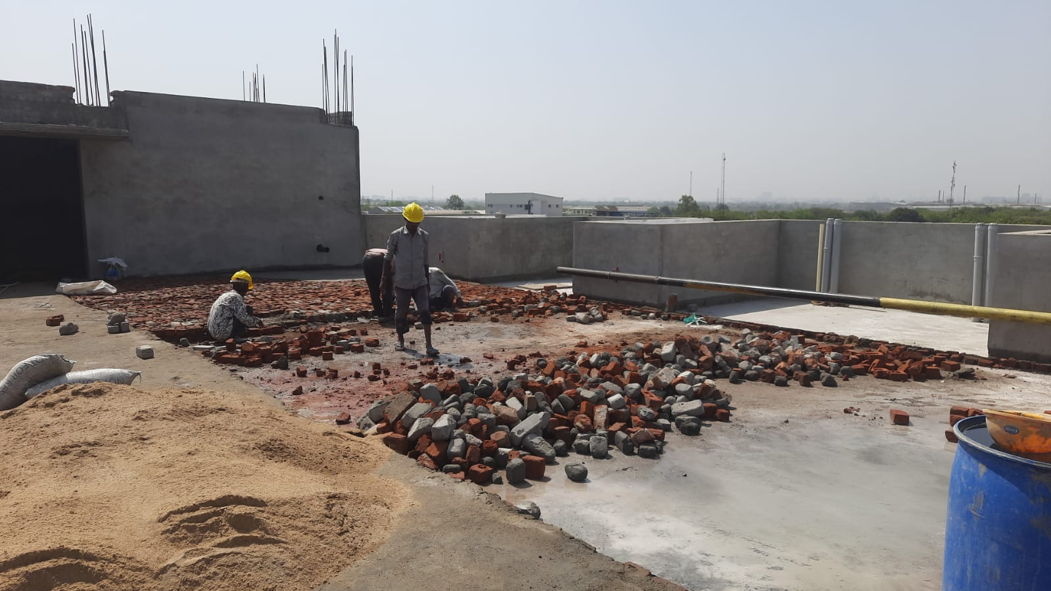
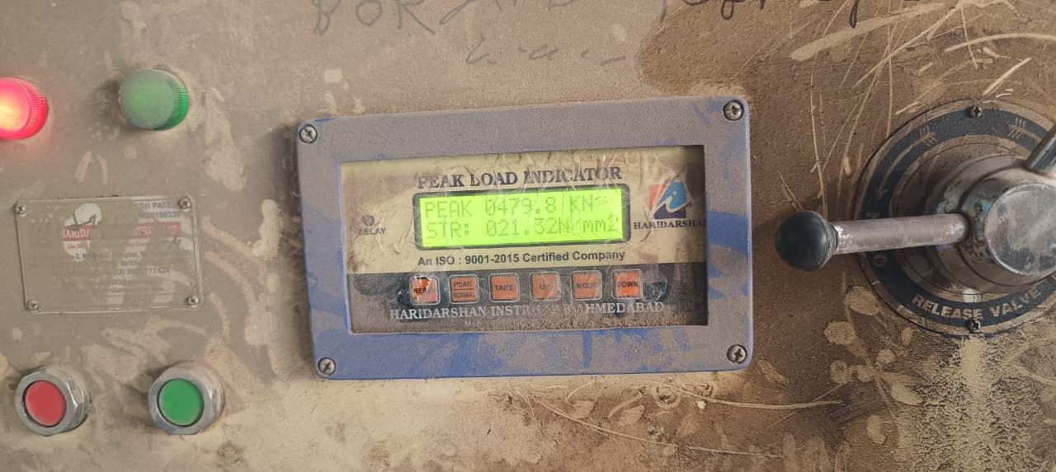
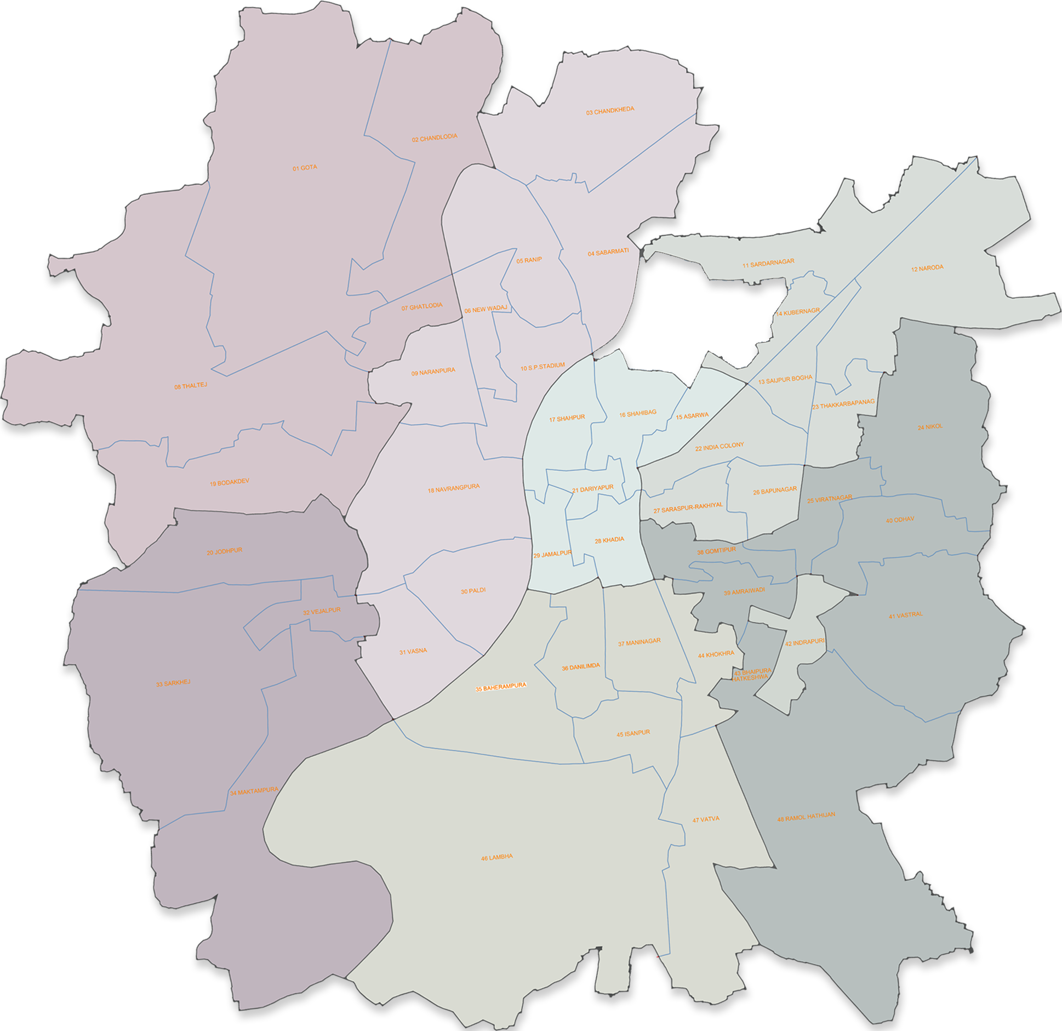
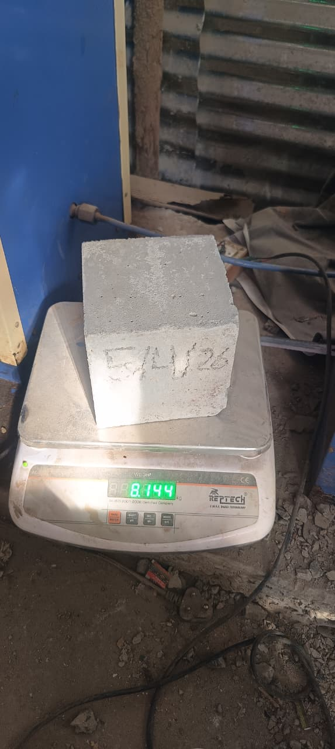
Arvind Limited
Project Progress · Part 1 of 2
Progress photo 1
Progress photo 2
Progress photo 3
Progress photo 4
Arvind Limited
57 / 58

Slide 58
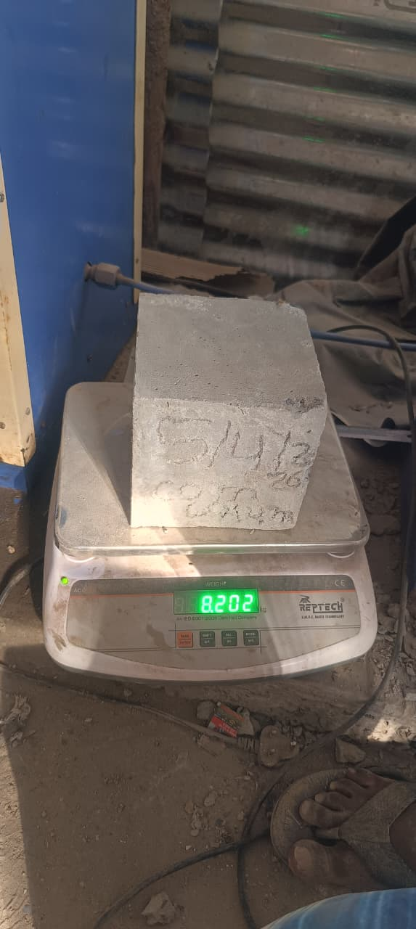
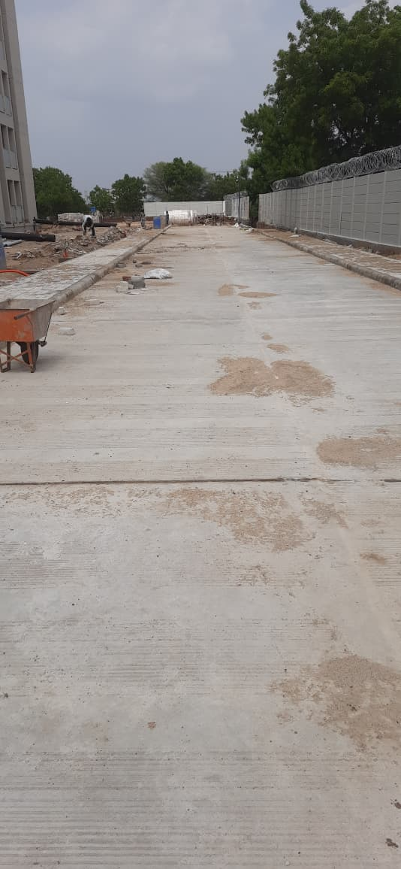
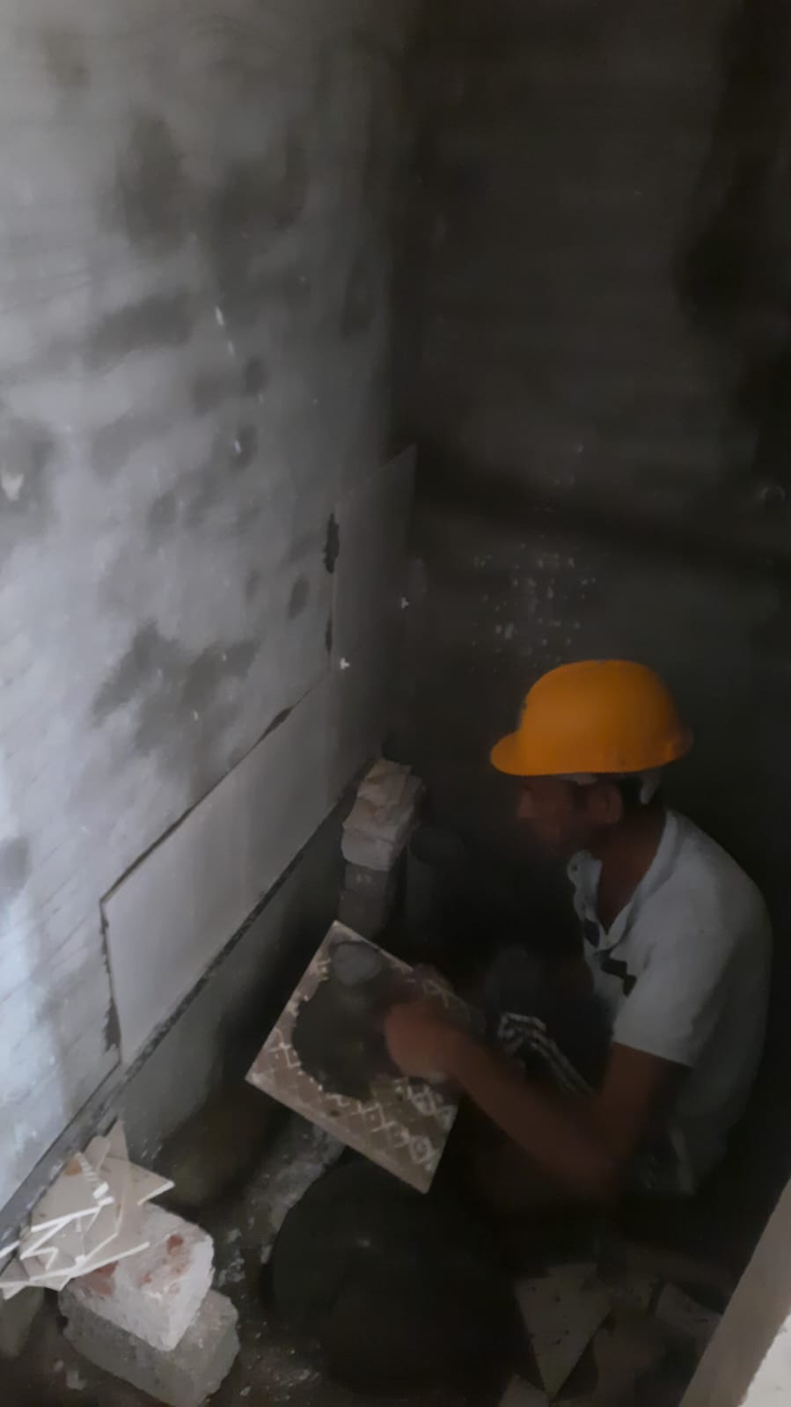
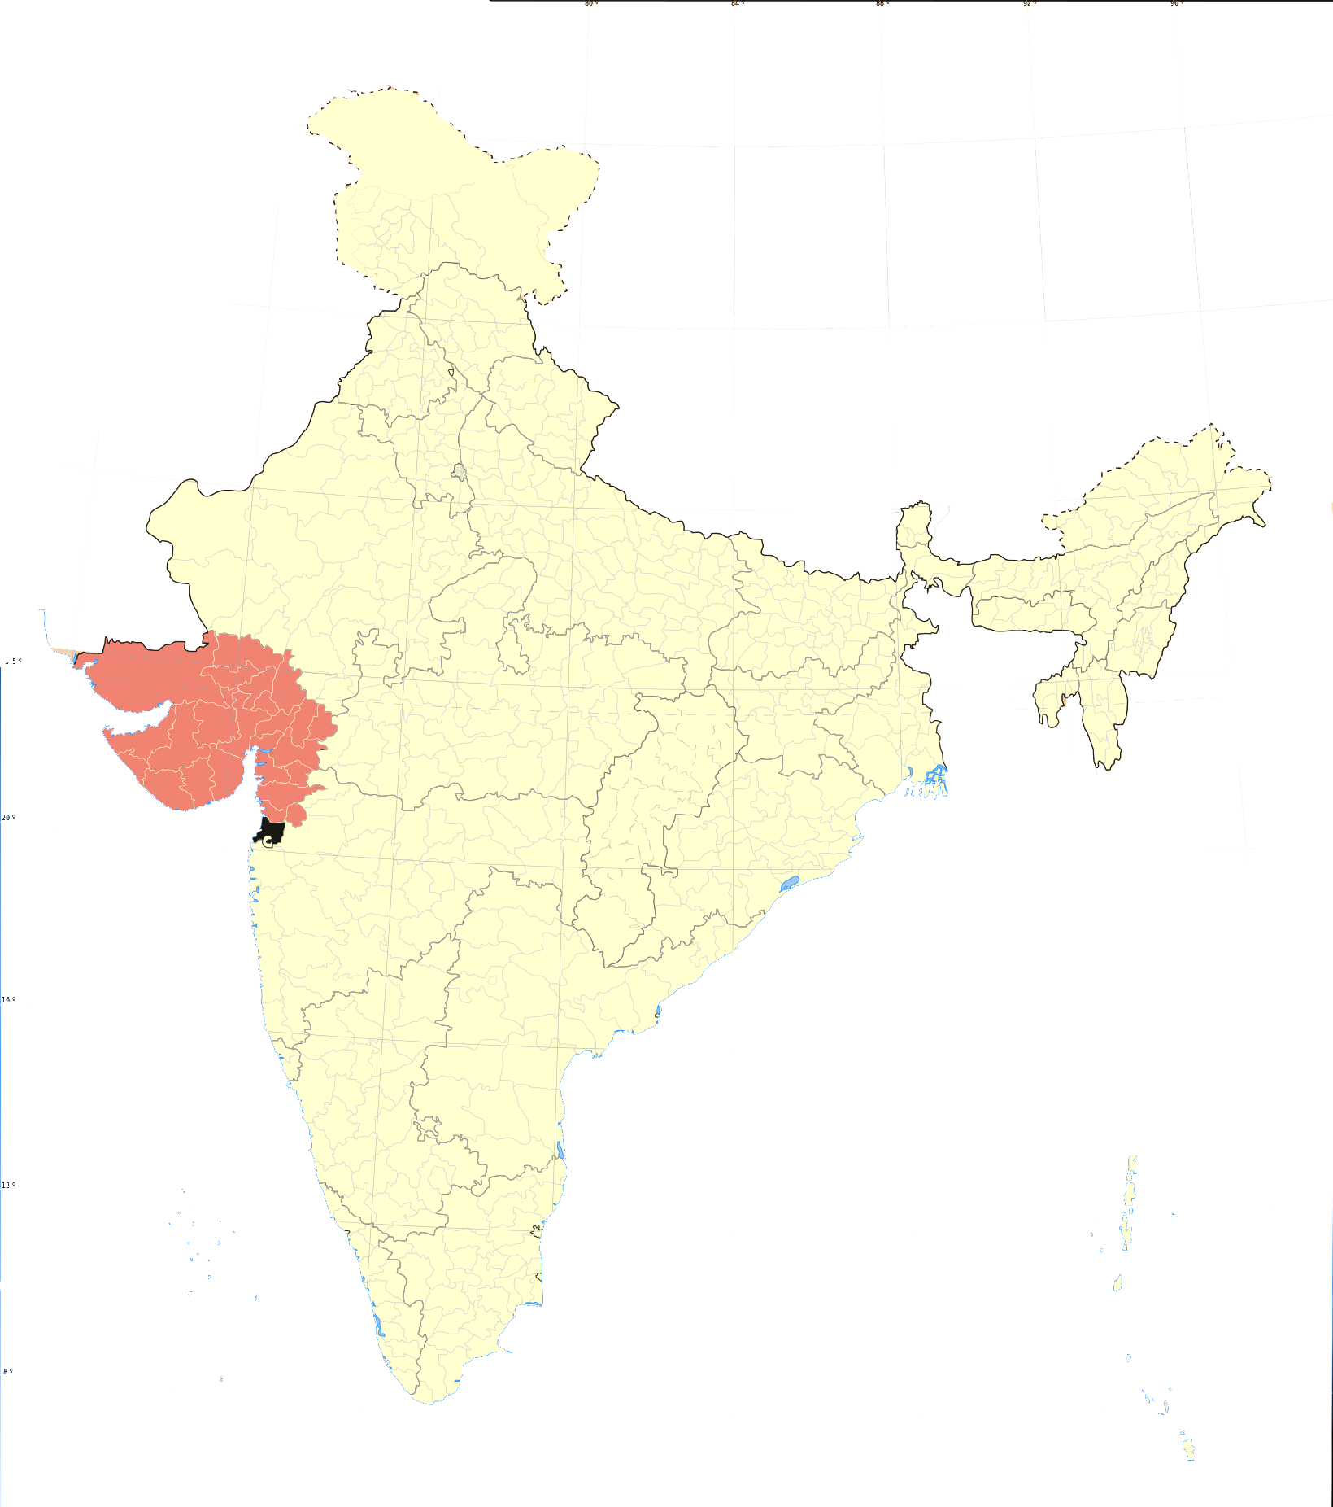
Arvind Limited
Project Progress · Part 2 of 2
Progress photo 5
Progress photo 6
Progress photo 7
Progress photo 8
Arvind Limited
58 / 58

