Slide 1
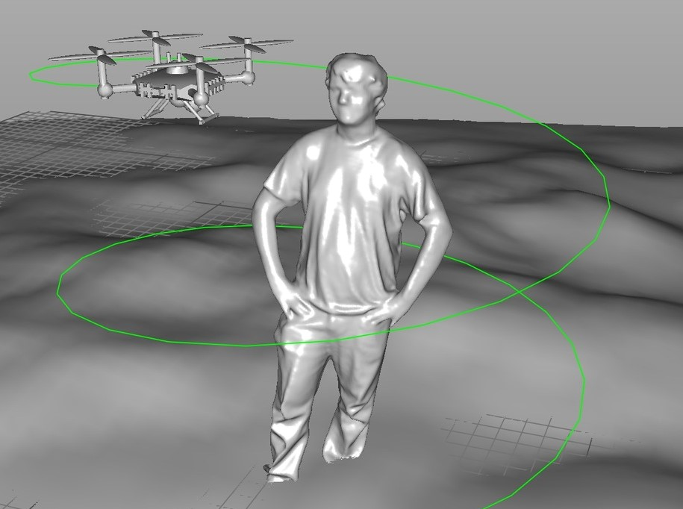
Obhijaatric
Drone based flooded area mapping
Team Members: Hossain Md. Sabir,
(Email: hossainsabir123@gmail.com
Md. Fatin Ishmam,
(Email: fatinishmam@gmail.com)
Md. Mustafizur Rahman
(Email: mustafizur.cd@gmail.com

Slide 2
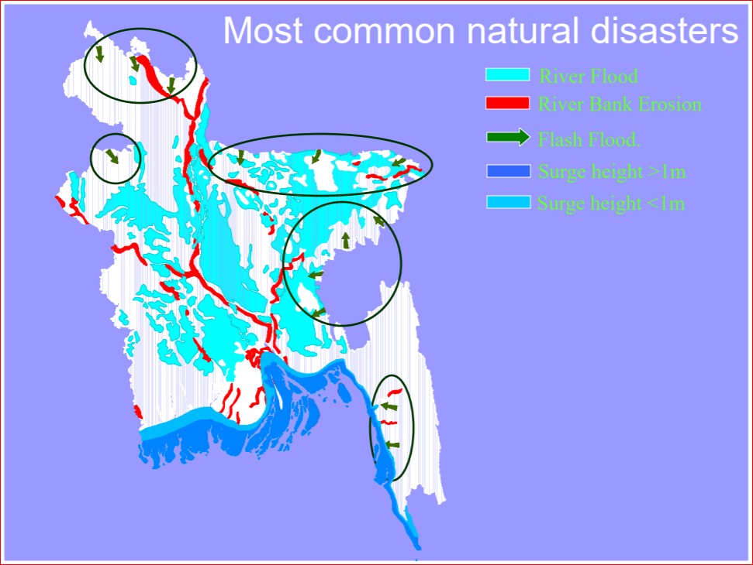
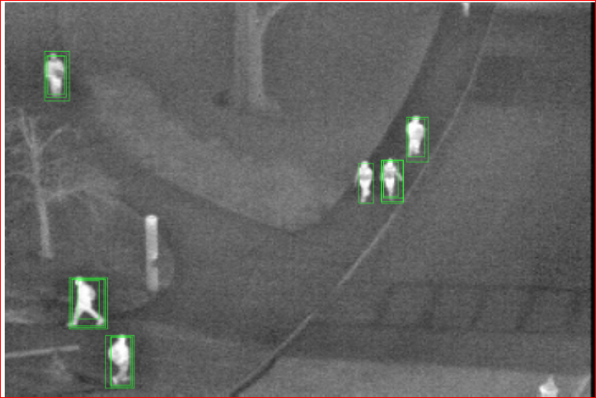
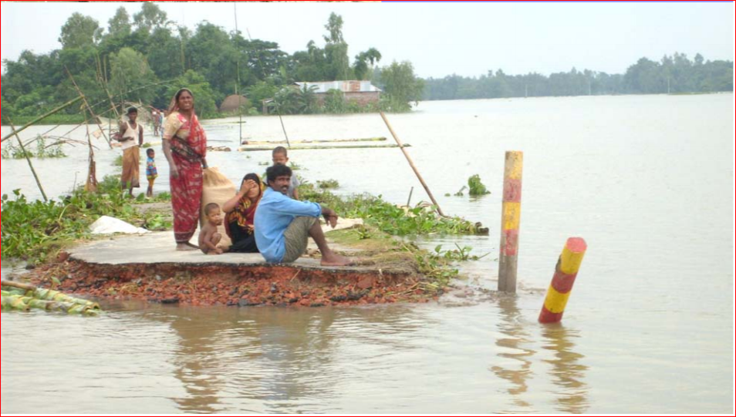
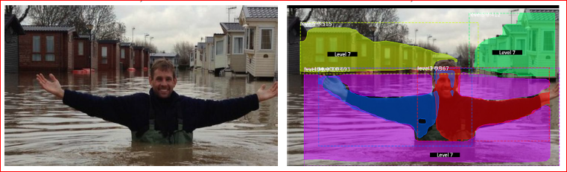
Outline
Based on Image processing using machine learning
Detection of
Human and living objects (IR Camera)
Water Level
Highland
Flow of water
Significant Objects
Loss of Infrastructure
Make Decision
Stuck people
Probability of spreading disease
Food availability
Pure water availability
Path for rescue and relief operation
Suggest safer place in affected area

Slide 3
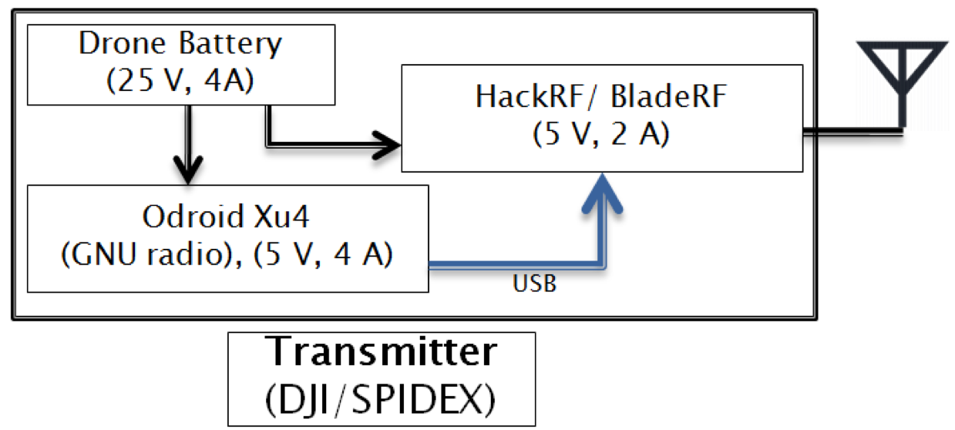
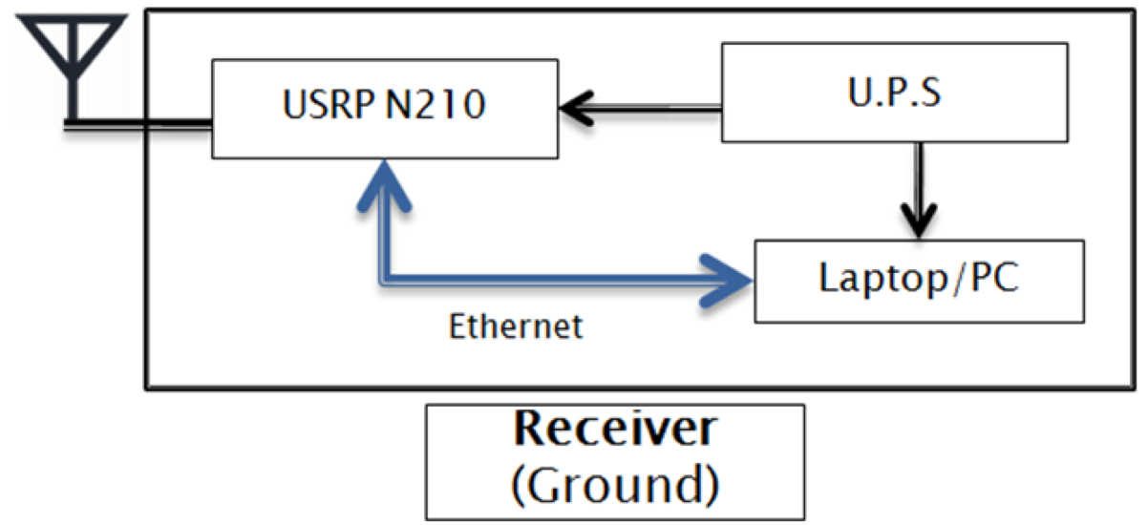
System Block Diagram
HackRF/ BladeRF
(5V, 2A)
Drone Battery
(25 v, 4 A)
Raspberry Pi 4
(5V, 2.5A)
Cameras
Transmitter
(Drone)

Slide 4
Novelty
These technologies are basically being used in different developed countries. But in Bangladesh these have not been implemented yet. We have some local challenges also like water-borne diseases spread out a lot in flood time. We have an intention to detect the probability and already spreaded diseases using different factors.

Slide 5
Concepts taken from the forum,
The communication link between drone to ground has been taken from the session - Modelling of Drone- Ground Links using RF Measurements, taken by Professor K V S HARI
Ideas of object detection from images was partially came from the session- Machine Learning for Disease Classification by Norliza Mohd. Noor

Slide 6
Relevancy with 4th Industrial Revolution
4th Industrial revolution is fusion of advances in AI, robotics, IoT, and other technologies. Our project is based on drone which includes ML, which is obviously relevant with 4th industrial revolution.

