Slide 1
NFT Marketplace Development
Using Hardhat, Solidity, Nodejs And React

Slide 2
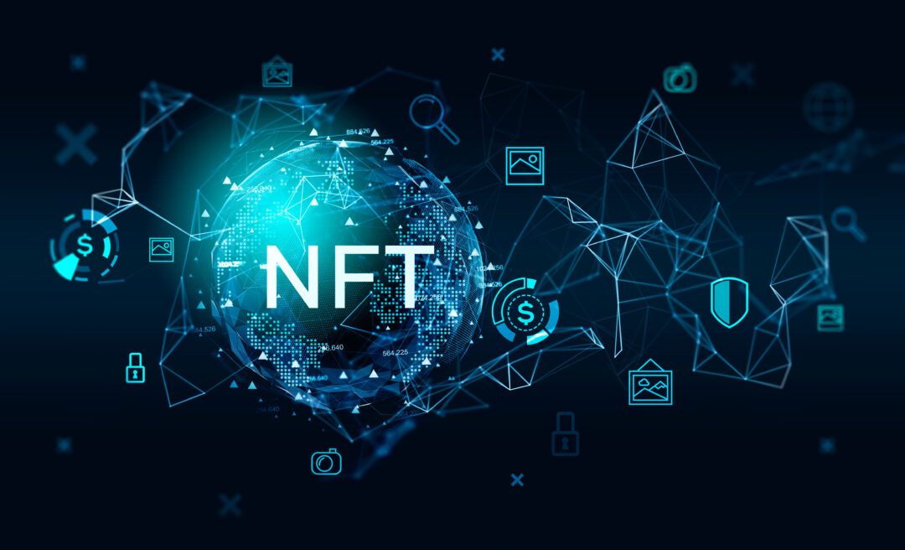
What IS NFT?
NFT or Non-Fungible Tokens are record on the blockchain that stores the information about the digital file who created it, who linked it to the blockchain,and who bought it and who has owned it through its history.

Slide 3
What IS The NFT Marketplace?
An NFT marketplace is a digital platform for buying and selling NFTs. These platforms allow people to store and display their NFTs plus sell them to others for cryptocurrency or money.

Slide 4
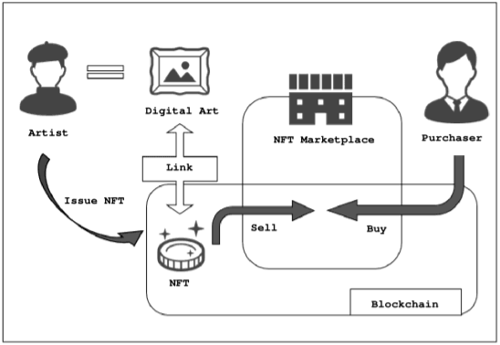
What’s The Mechanism Of NFT And Its Marketplace?
The creator of an NFT needs to create a unique digital asset and upload it to the marketplace. The NFT is stored on a blockchain. Interested buyers can browse the marketplace for NFTs they want to purchase. When a buyer decides to purchase an NFT, they send a cryptocurrency payment to the seller's wallet address. Once the payment is confirmed, the ownership of the NFT is transferred to the buyer's wallet address.The buyer can then hold onto the NFT as a digital asset, or they can sell it on the marketplace to another interested buyer.

Slide 5
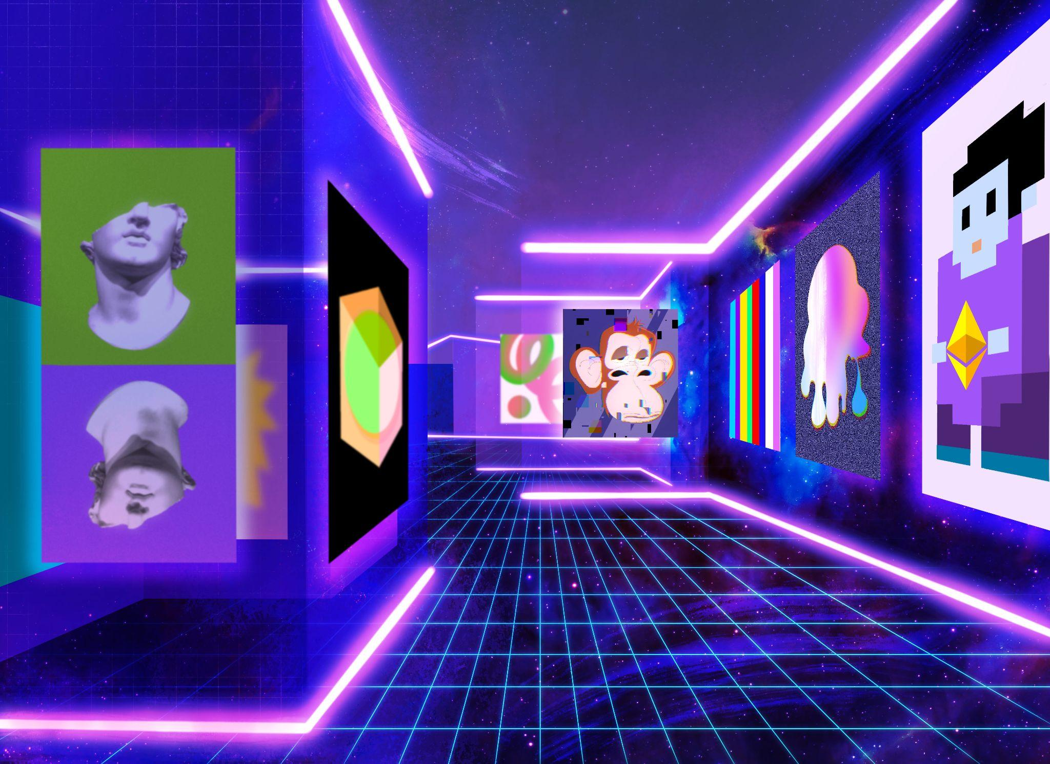
How We Built An NFT Marketplace?
Set up the development environment
write the smart contract
Deploy the smart contract
Setting up the backend
Build the frontend
Test and deploy

Slide 6
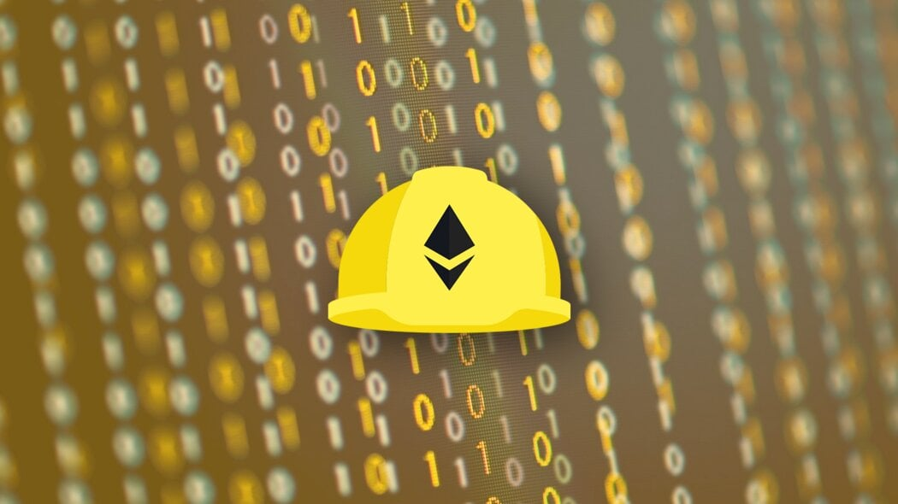
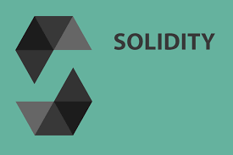
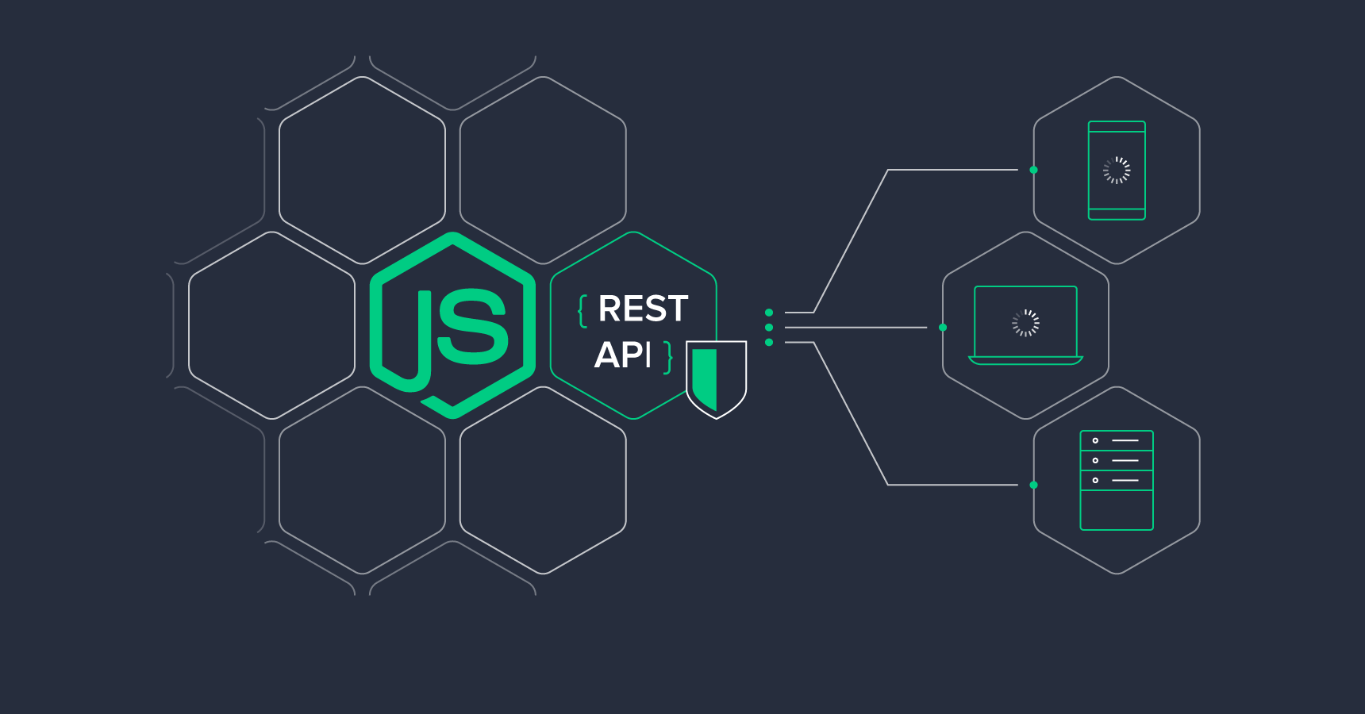
Important Tools We Used For Building NFT Marketplace
Hardhat: It is a popular development environment for Ethereum, designed to streamline the development process by providing a range of tools and services
Solidity: It is the programming language used to write smart contracts
Nodejs: It is a popular server-side platform that can be used to develop the backend of your marketplace
React is a widely-used front-end library for building user interfaces.

Slide 7
Why NFT (Non-Fungibe Tokens)?
NFTs (non-fungible tokens) are unique cryptographic tokens that exist on a blockchain and cannot be replicated.
NFTs can represent digital or real-world items like artwork and real estate.
"Tokenizing" these real-world tangible assets makes buying, selling, and trading them more efficient while reducing the probability of fraud.
NFTs can represent individuals' identities, property rights, and more.
Collectors and investors initially sought NFTs after the public became more aware of them, but their popularity has since waned.

Slide 8
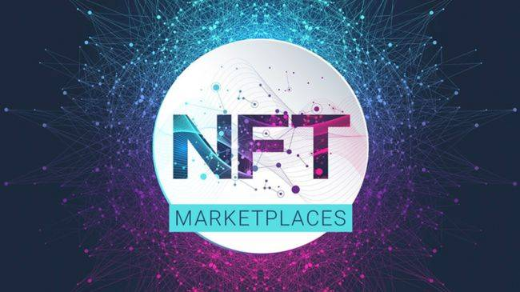
Conclusion
NFTs address the issue of digital ownership and provenance by enabling creators to assert ownership and control over their digital goods.
By enabling authors to commercialize their digital creations and forge connections with their fans and collectors, NFTs give authors a new source of income.
For collectors looking to buy rare digital assets and ready to pay a premium for them, NFT exchanges have created a new market.
Increased security and transparency for digital transactions are provided by NFT marketplaces.
NFTs have the ability to drastically alter how we think about digital asset ownership and value.

