Slide 1
Angular 2.4.0 pt2 Lot4 Team
Mustaq Hussain
8th March 2017

Slide 2
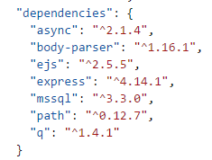
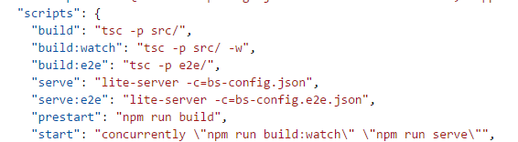
package.json
Command: node
“main” default file
Command: node app
Will run app.js rather than “main”
Command: npm install
“dependencies” modules installed into node_module
(npm install <mod> --save adds <mod> to dependencies)
Command: npm <script>
“scripts” runnable scripts

Slide 3
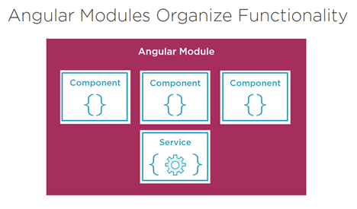
Module
An application is an assemble of modules (default AppModule)
A module exports an asset e.g. Service, Component or shared values/constants

Slide 4
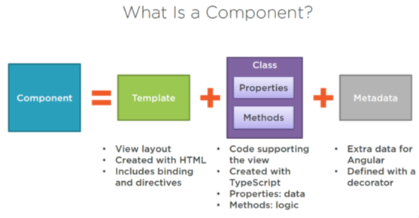
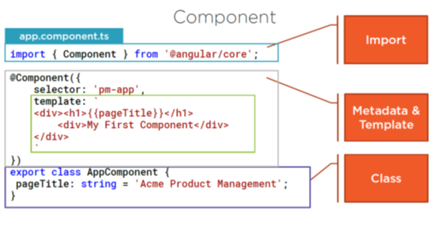
Component (default AppComponent)
A component contains application
Logic that controls a region of the
View (user interface)

Slide 5
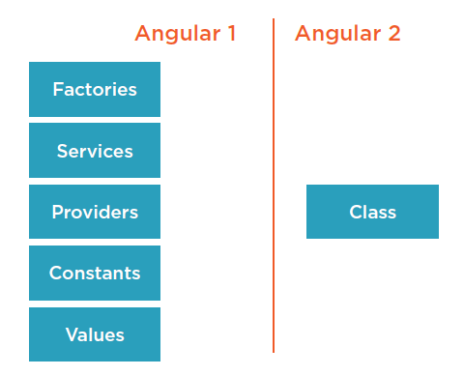
Services
A Service is a class that has a focused purpose
Shares functions or data
Eg Data layer, Logger, Message Service, Library Service
Angular 2 simplified services
compared to Angular 1

Slide 6
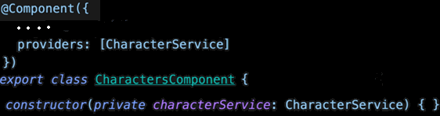
Dependency Injection
Dependency Injection coding pattern in which a class receives (eg Component) an instance of an object (eg Service) from an external source rather than creating it themself:
Register with a provider
Inject into constructor
Provider: register
Constructor: Inject service

Slide 7

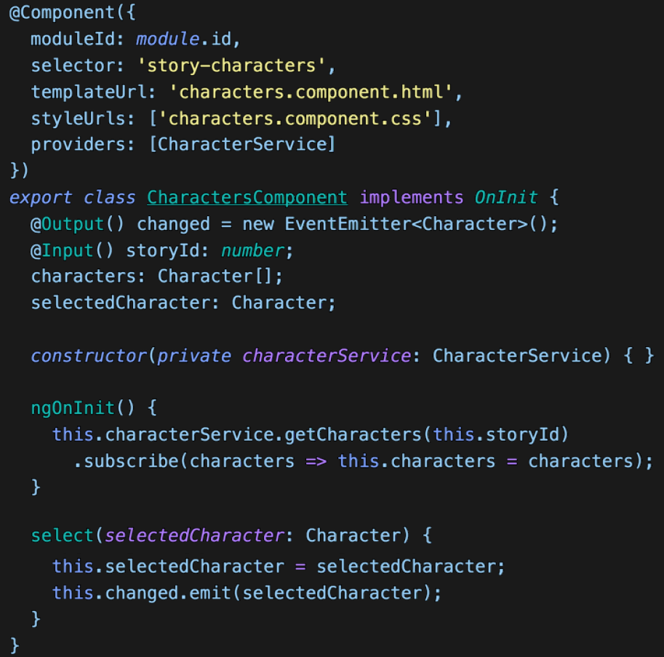

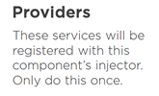







Typical Component Parts

Slide 8
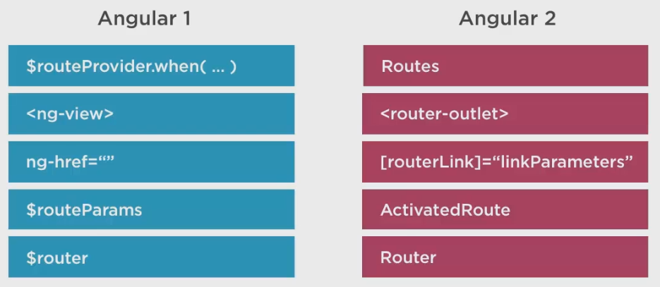
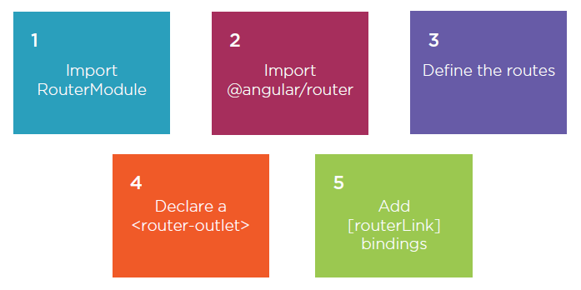
Routing

Slide 9
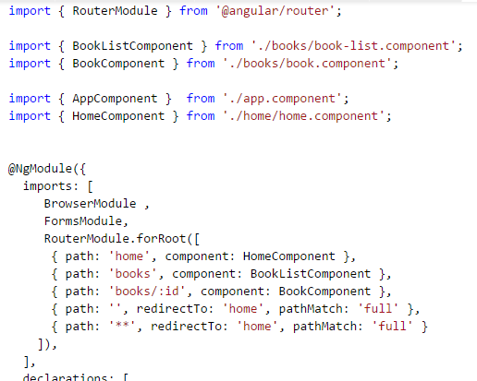
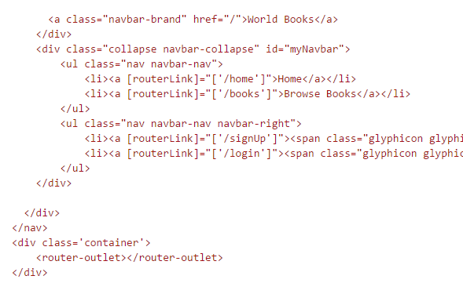
Routing Example

