Slide 1
Session 26 MNIST part 2 App Service, API, ML
Mustaq Hussain
22nd November 2017

Slide 2
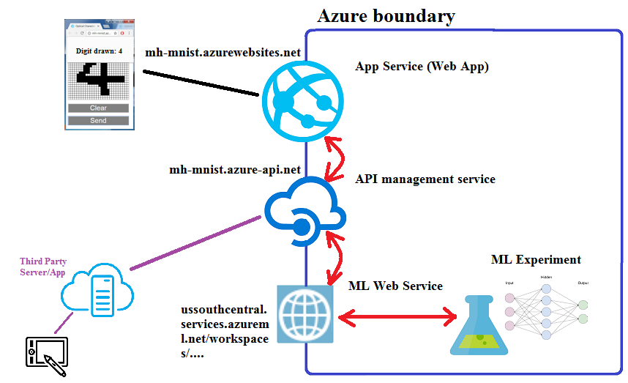
MNIST Azure Machine Learning: 2nd week

Slide 3
Azure Services
ML Web Service
MNIST predictive experiment
API management service
API can call ML Web Service
Can control Cross-Origin Resource Sharing (CORS)
Permits none Azure apps/domains call this API
Hides Web Service config
ML Web Service API keys
Complex ML Web Service URI
Simpler API URL than ML Web Service URL
App Service
Deployed Web App
Call API endpoint/URI

