Slide 1
SQL Injection & XSS Threats Lot4 Team
Mustaq Hussain
9th August 2017

Slide 2
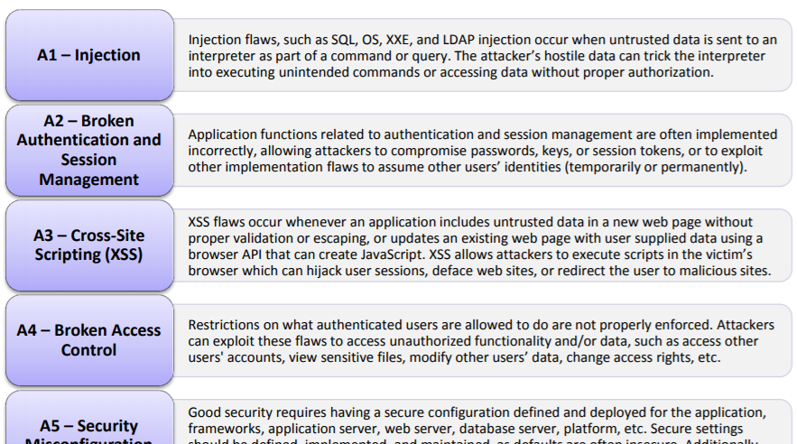
OWASP Top 10 Application Security Risk 2017
Open Web Application Security project (OWAP)

Slide 3
SQL Injection – What is it?
Still #1 attack – since 2010
Commands inserted into SQL where only data expected
Query is ‘hijacked’ to form new unexpected query
SELECT * FROM Products WHERE Name LIKE ‘%{input}%’ ORDER BY Name
{input} = hat’; DELETE FROM Name --
SELECT * FROM Products WHERE Name LIKE ‘%hat’;
DELETE FROM Name -- %’ ORDER BY NAME
Notes: hat’; ← Semi-colon ends of one query
Notes: -- ← Double dash ignore everything else (ie ORDER BY Name)

Slide 4
SQL Server Useful Injection Commands
UNION of two queries
SELECT Name, Desc, Cost FROM Products
WHERE Name like ‘%hat%’ UNION
SELECT ‘1’, ‘1’, ‘1’ -- number of columns must match SELECT
On SQL Server use sysobjects to get list of tables
SELECT * FROM sysobjects ORDER By type = ‘u’
Use syscolumns joined with sysobjects to get list of columns in tables
SELECT so.name,sc.name FROM syscolumns AS sc
INNER JOIN sysobjects AS so ON sc.id=so.id
WHERE so.type='u' ORDER BY 1

Slide 5
How is it exploited and prevented?
Attacker injects code to be executed
Injection can be result of string functions
Can do virtually anything system permissions allow
Install backdoors
Copy/Delete database
…
Ensure all calls are parameterized
No concatenated strings
Use Regex (a-z, 0-9 only)
Use ORM like Entity framework

Slide 6
XSS (Cross Site Scripting)
Script (Javascript) injected into page
Scripts injected from
Form itself
From Database
Prevention
Regex (a-z, 0-9 only)

