Slide 1
Azure Introduction
Mustaq Hussain
24th August 2017

Slide 2
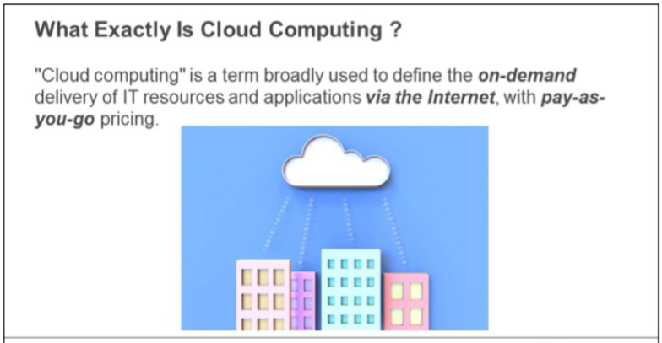
What is Cloud Computing?

Slide 3
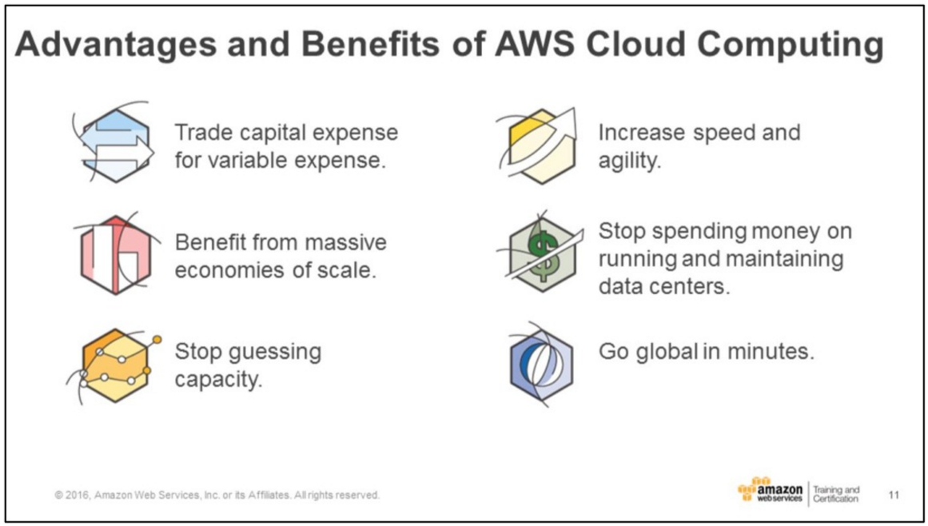
Advantages and Benefits

Slide 4
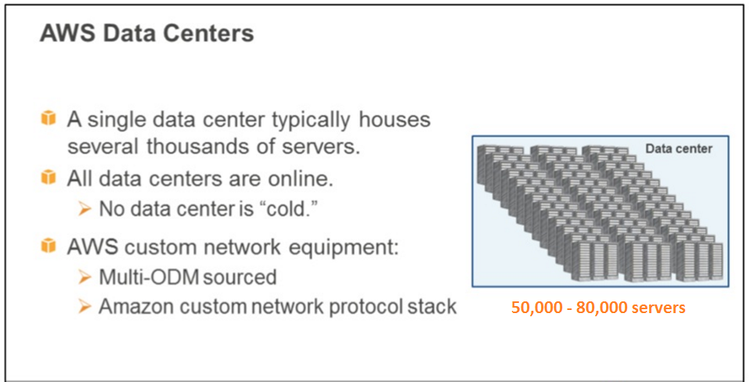
AWS/Azure Data Centres

Slide 5
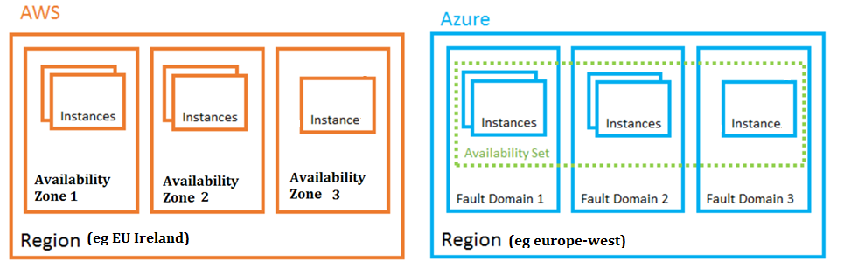
AWS/Azure Data Centres
AWS: Xen Azure: Hyper -V

Slide 6
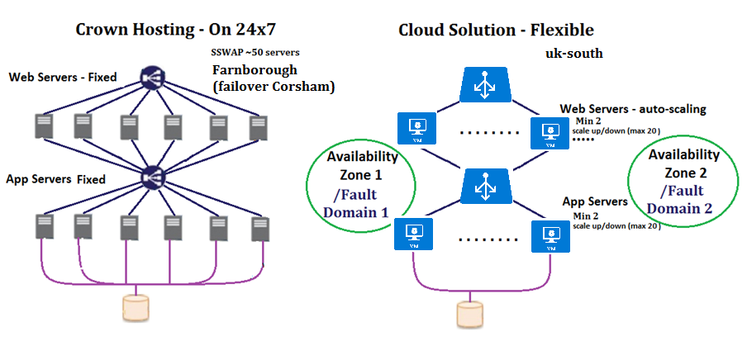
Data Centres vs Cloud Hosting

Slide 7
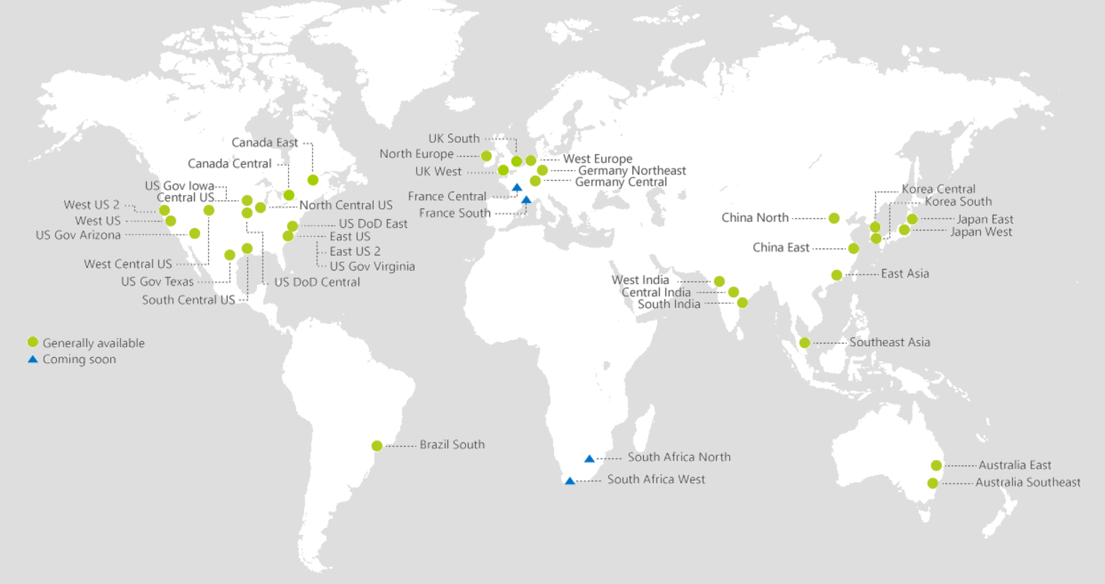
Azure Regions – as of August 2017

Slide 8
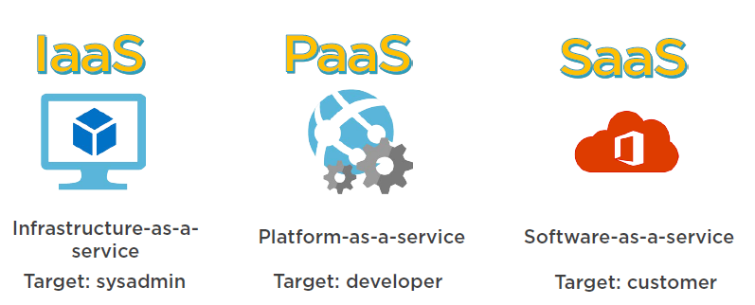
Infrastructure, Platform & Software as a Service
Virtual Machines Pay for hardware as needed You manage VM | Manage only your code VMs managed for you | Pre-built application Pay by user

Slide 9
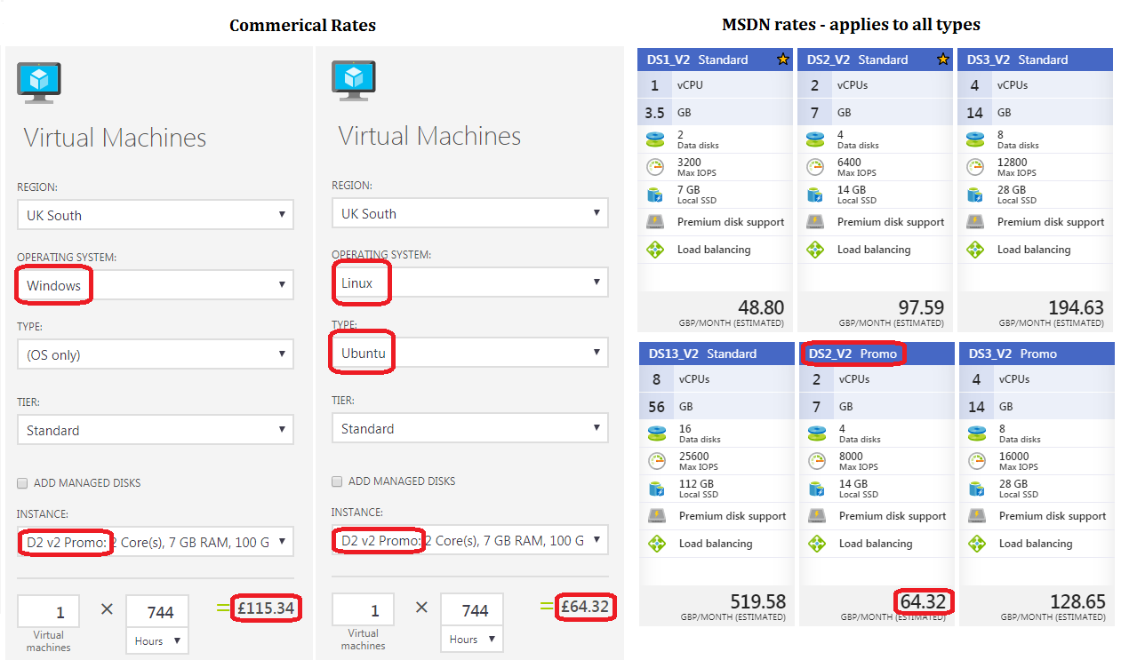
Azure Cost of Virtual machines (Windows/Linux)

Slide 10
Our 1st Azure Deployment (IaaS)
Resource Group
Container
Subnet – tiers
Web, App, DB
Network Security Group
Allowed protocols
VM
Win Server 2016
IIS

