Slide 1
Angular 1.6.1 pt2 Lot4 Team
Mustaq Hussain
31st January 2017

Slide 2
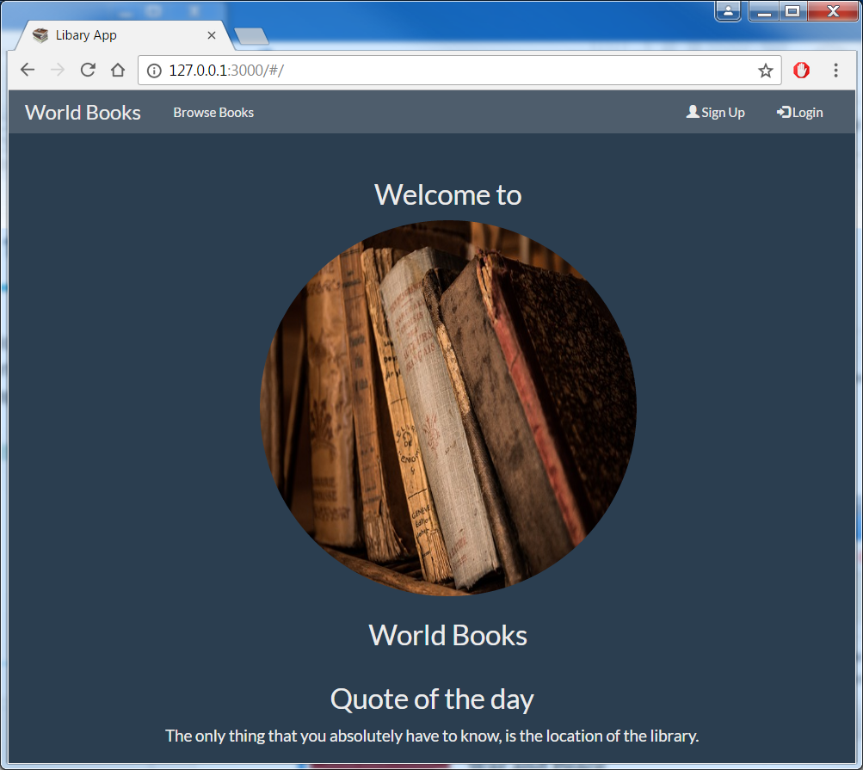
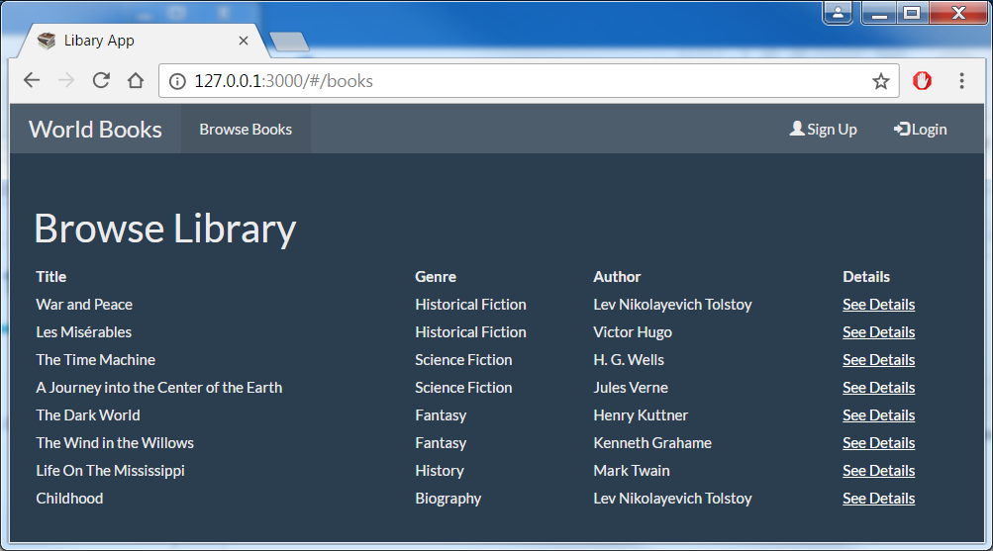
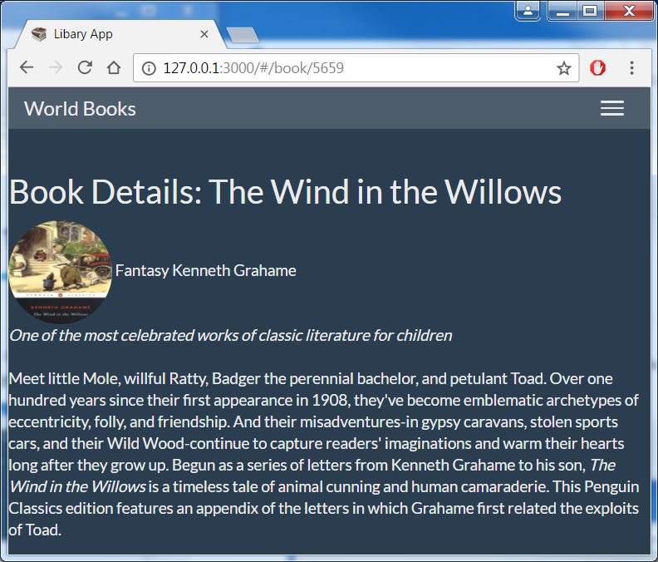
World Books Demo App in Angular 1.6.1
Responsive app World Books
Single Page Application
Login encrypted
Angular 1.6.1 + Bootstrap
MongoDB LibraryApp DB, books collection
Third party API call to Goodreads to get book images & further details

Slide 3
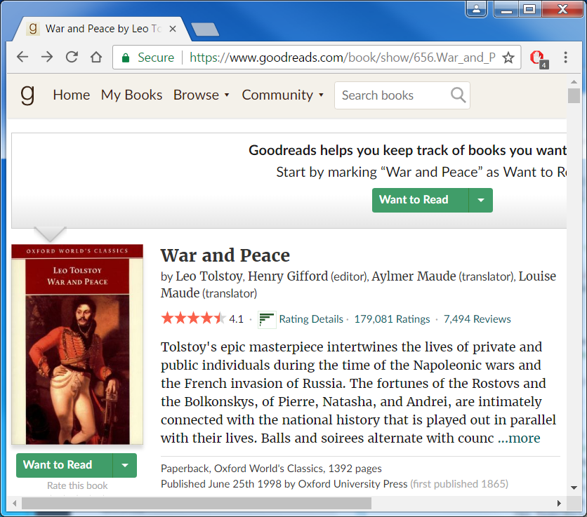
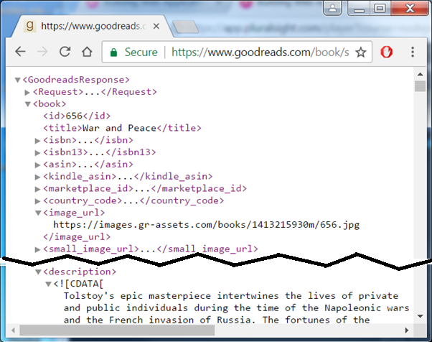
Goodreads https://www.goodreads.com/
Goodreads: ‘world’s largest site for readers and book recommendations’
Has a public HTTP API to get inform about books e.g. author, isbn, descr..
https://www.goodreads.com/api sign up for a free developer key
Use Goodreads API book.show & Goodreads’ book ID eg 656 for War and Peace (Oxford World’s Classics) & format (xml) & developer key
https://www.goodreads.com/book/show/656?format=xml&key=mN1DyVoFS4cfbCMh5HmnpA

Slide 4


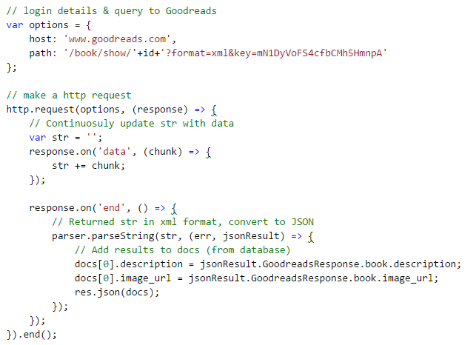
Express: Route to get book id
Goodreads HTTP API
with id & dev key
Book details docs[0]
from mongodb
Append Goodreads
details to docs[0]

Slide 5
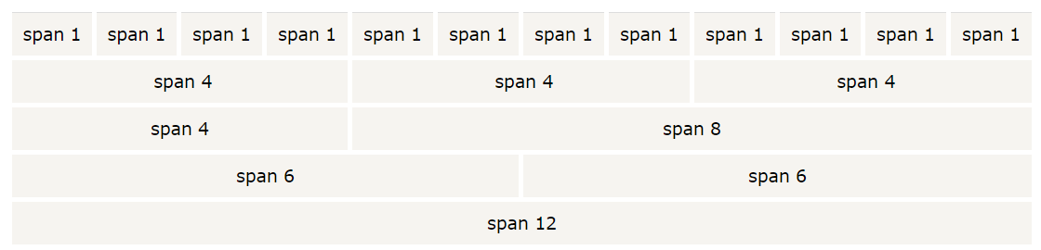
Bootstrap http://www.w3schools.com/bootstrap/
Bootstrap (originally from titter) is a popular free HTML, CSS and JavaScript framework for developing responsive, mobile-first web sites.
Responsive Web Design:
Web sites which automatically adjust themselves to different devices - from small phones to large desktops
E.g. Bootstrap's grid system allows up to 12 columns across the page
To use include Bootstrap css js & jquery (before js) too:
<link rel="stylesheet" href="https://maxcdn.bootstrapcdn.com/bootstrap/3.3.7/css/bootstrap.min.css">
<script src="https://ajax.googleapis.com/ajax/libs/jquery/3.1.1/jquery.min.js"></script>
<script src="https://maxcdn.bootstrapcdn.com/bootstrap/3.3.7/js/bootstrap.min.js"></script>

Slide 6
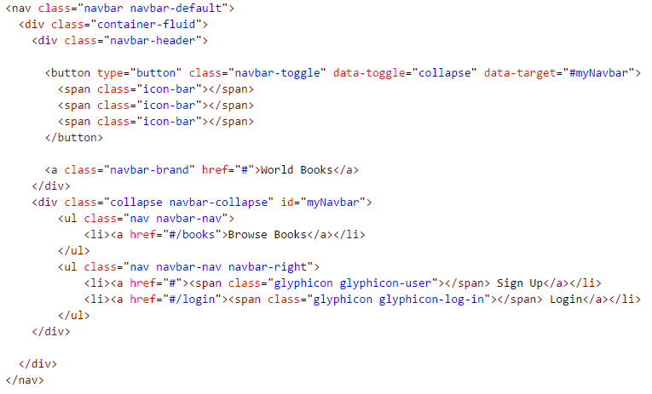

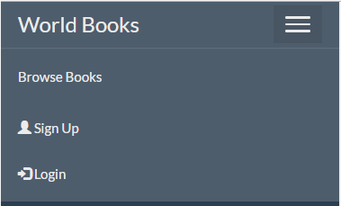
Header.html of app
Bootstrap’s: http://www.w3schools.com/bootstrap/bootstrap_navbar.asp
Class: describes behaviour of navbar, glyphicons (Sign up/Login)
On smaller screen/device
Click on ‘hamburger’

