Slide 1
Node Introduction Part1 Lot4 Team
Mustaq Hussain
6th December 2016

Slide 2
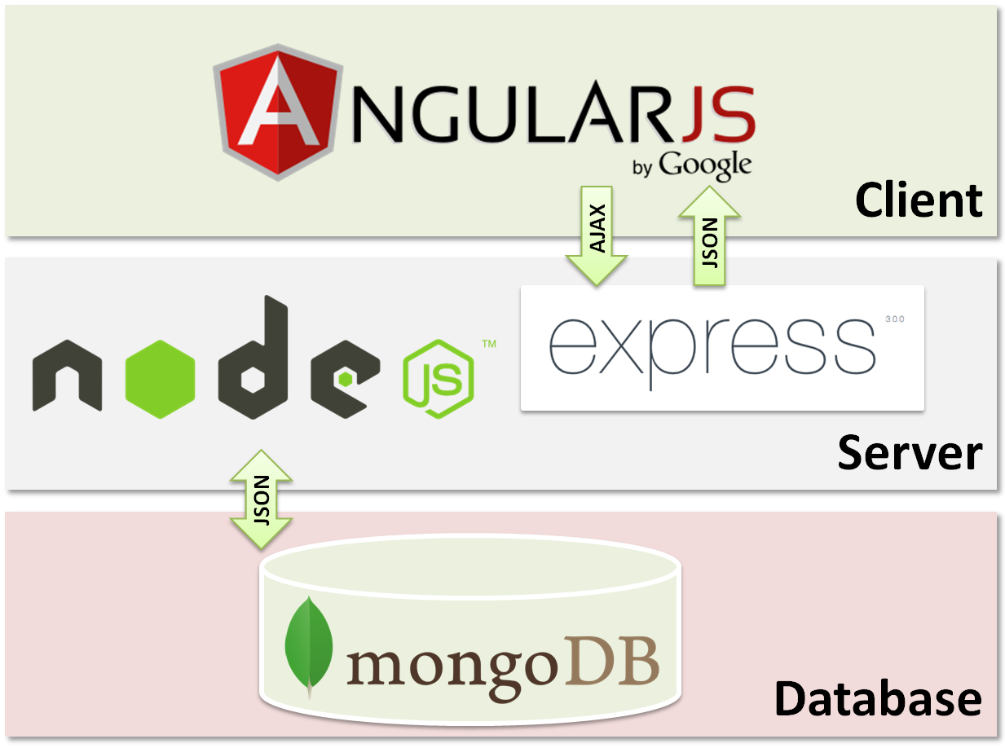
MongoDB Express Angular Node (MEAN)

Slide 3
Background
Web programming can take years to master
Complexity comes about from the number of moving parts including:
networking, protocols, security,
databases,
server-side development,
client-side development,
a medley of programming languages
Notes:
TCP, HTTP, HTTPS, SSL, Sessions, Certificates
SQL Server, Oracle, Ingress
JEE, Spring, .Net, MVC
Javascript, PHP, ASP,
C#, Java

Slide 4
Example technologies in .Net
For example in .Net you should know about
IIS
Machine.config
Web.config
Process Model
Global.asax
ASP.NET MVC or WebForms (huge paradigms in themselves)
HTML, CSS, and JavaScript
MS Visual Studio
How to create a solution
How to deploy the application to IIS
C# ……

Slide 5
Node.js
(In comparison, Node.js is simple compared to .Net, its base technology is JavaScript)
1995 JavaScript Netscape Browser
2009 Ryan Dahl (JSConf) created Node.js
a framework used primarily to create scalable network applications.
built on top of Google’s V8 JavaScript engine (used in Chrome)
libuv an asynchronous I/O library
Notes:
.

Slide 6
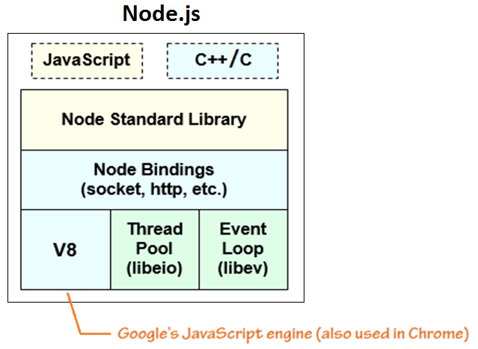
Node.js build blocks:

Slide 7
Node.js notes…
Node is simply a JavaScript runtime engine
It is just another way to execute code on your compute
It runs on the server/local machine (not browser)
Node by default is not a webserver (like IIS or Apache)
To create a http webserver, you can use built-in libraries/modules
It packs a lot of functionality into a small amount of code

Slide 8
Node http web app – only 6 lines
// Load the http module to create an http server
// C# Import -> Node require()
var http = require('http');
// Create and configure server to respond with Hello World to all requests.
http.createServer(function (request, response) {
response.writeHead(200, {'Content-Type': 'text/plain'});
response.end('Hello World\n');
// Listen at location 127.0.0.1, port 1337
}).listen(1337, '127.0.0.1');
console.log('Server running at http://127.0.0.1:1337/');
Notes:
5 lines if you ignore comment
Try doing that in .NET
All of that’s pretty much just as easy and intuitive as Node.js

Slide 9
Exercise
Exercise summary (from ‘NodeIntroPart1.docx’, see below)
1 Download and install Node.js
2 Download and install IDE
3 Write helloWorld.js file
4 Run helloWorld as a Node app/server
5 See results in browser
Download Instructions ‘NodeIntroPart1.docx’ from Github:
1 In a browser enter https://github.com/MustaqHussain
2 Select repository Node-Introduction
3 Select ‘NodeIntroPart1.docx’
4 Select ‘Download’

