Slide 1
Session 23 Machine Learning Introduction
Mustaq Hussain
18th October 2017

Slide 2
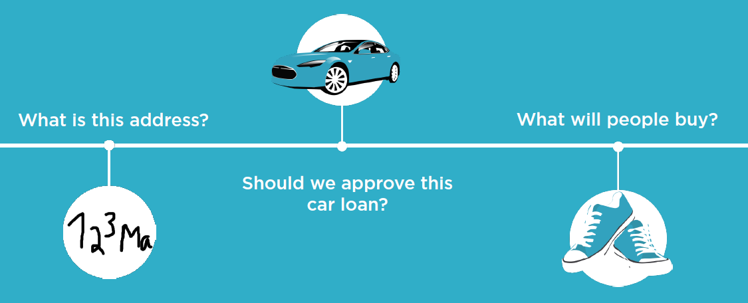
Machine Learning in Action
US Post Office Banks Google & Amazon using
98% recognition search history
https://www.youtube.com/watch?v=O1pDOkzsFOU

Slide 3


Slide 4
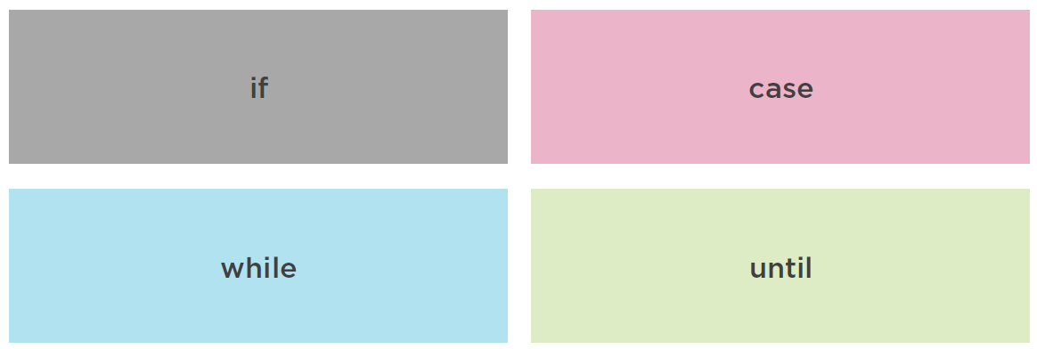
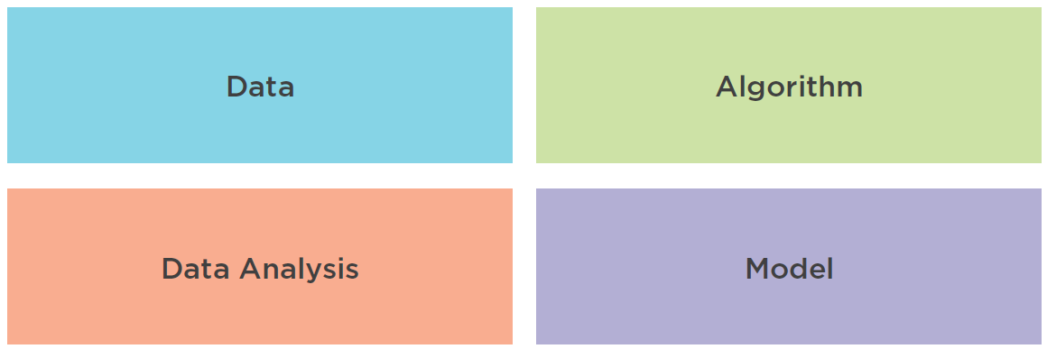
ML vs Traditional Logic
Traditional
Control Logic
ML Logic

Slide 5
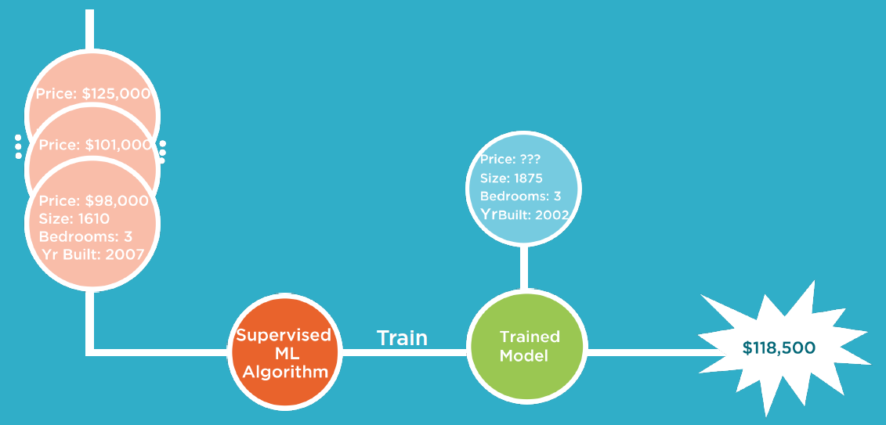
Categories of ML
Supervised – requires labels
This is good loan risk
This traffic indicates DOS
This house is worth
Unsupervised – less common
These customers similar

Slide 6
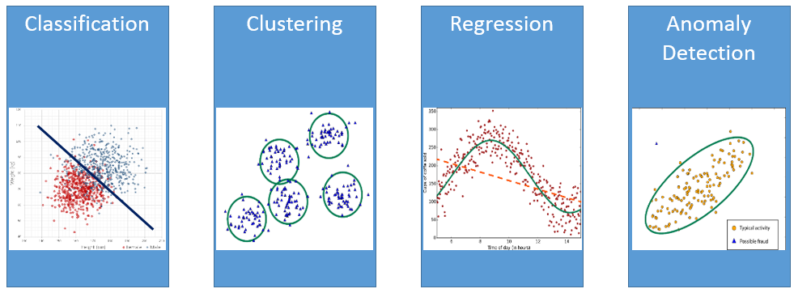
Common Classes of Algorithms
Yes/No Group Data Predict Values Anomaly
Is this fraudulent? Similar customer Sales forecasts
Type of disease
Decision Tree, NN K-Means, SOM Linear Regression, NN NN

Slide 7
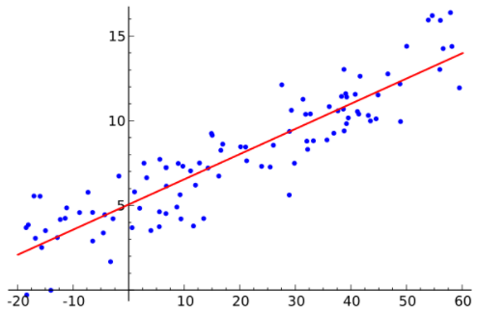

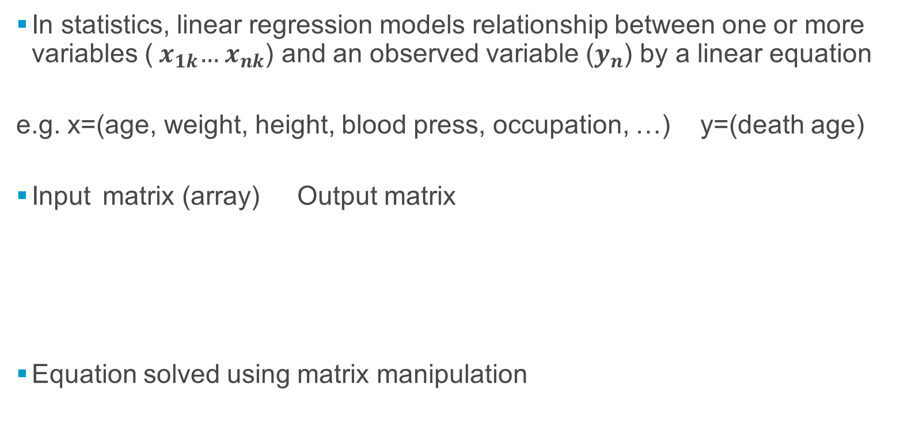


Linear Regression
In statistics, linear regression models relationship between one or more variables (${ x}_{1k}…{ x}_{nk}$) and an observed variable ($y_{n}$) by a linear equation
e.g. x=(age, weight, height, blood press, occupation, …) y=(death age)
Input matrix (array) Output matrix
Equation solved using matrix manipulation
$$X=\left[\begin{matrix}1_{ } \\ \begin{matrix}{1 }_{ } \\ ⋮\end{matrix} \\ {1 }_{ }\end{matrix}\begin{matrix}x_{11} \\ \begin{matrix}x_{21} \\ ⋮\end{matrix} \\ x_{n1}\end{matrix}\begin{matrix}… \\ … \\ \begin{matrix}… \\ …\end{matrix}\end{matrix}\begin{matrix}{ x}_{1k} \\ \begin{matrix}x_{21} \\ ⋮\end{matrix} \\ { x}_{nk}\end{matrix}\right]$$
$$Y=\left[\begin{matrix}y_{1} \\ \begin{matrix}y_{2} \\ \begin{matrix}⋮ \\ y_{n}\end{matrix}\end{matrix}\end{matrix}\right]$$
$$Y=mX+c$$

Slide 8
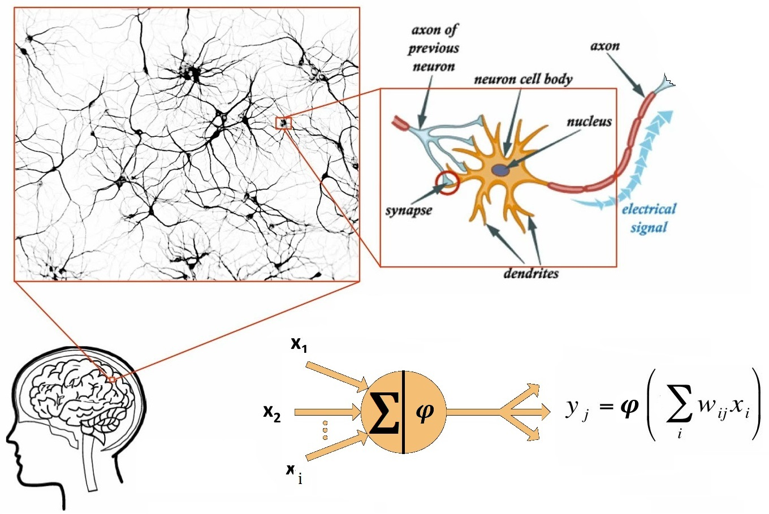
Neural Networks: Inspiration Biological Neuron
100,000,000,000 (100 billion) Neurons, each connected to ~1,000Neurons
100,000,000,000,000 (100 trillion) connections
(Dolphins/Whales have more neurons!)

Slide 9
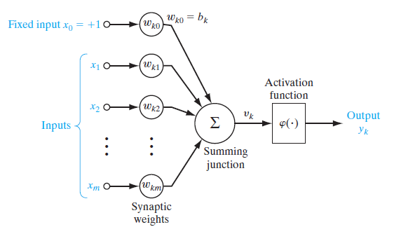
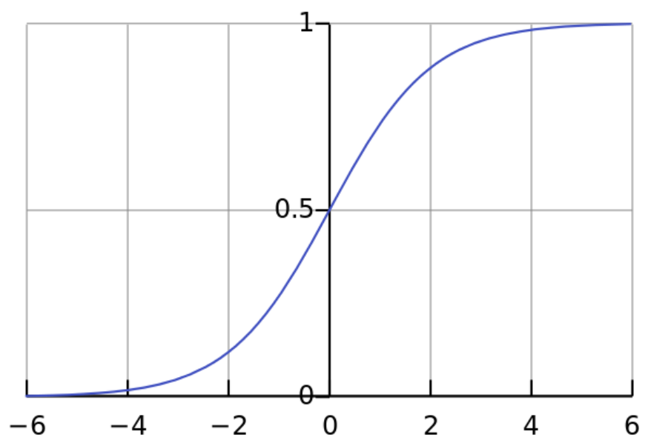
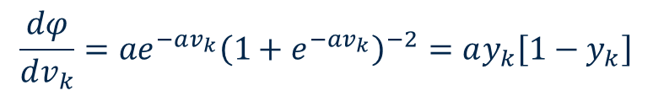

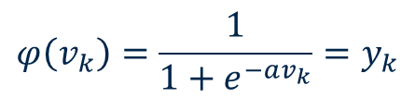
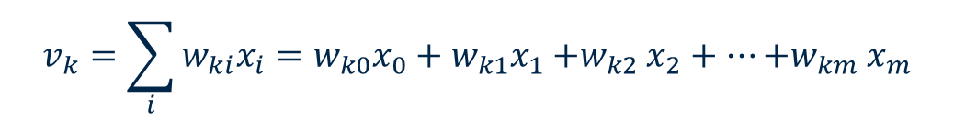
Neuron Model
$x_{i}$ input
$w_{ki}$: synaptic weight of kth neuron
$y_{k}$: output from kth neuron
$$φ\left(v_{k}\right)=\frac{1}{1+e^{−av_{k}}}=y_{k}$$
$$v_{k}=\sum_{i}{{w_{ki}x}_{i}}=w_{k0}x_{0}+w_{k1}x_{1}{+w}_{k2}x_{2}+…{+w}_{km}x_{m}$$
$$\frac{dφ}{dv_{k}}={ae}^{−av_{k}}{\left(1+e^{−av_{k}}\right)}^{−2}=ay_{k}\left[1−y_{k}\right]$$

Slide 10
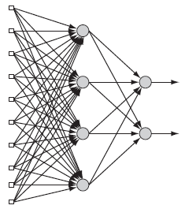
Multilayered Perceptron (MLP) - Supervised NN - & Backpropogation Algorithm
Hebbian learning (1949) – biological
Perceptron (1958) - single layer NN
Backpropogation(1975/1985) – hidden layer
Multilayered Perceptron network
One input layer
One or more hidden layer (feature detectors)
One output layer
(two or more neuron layers)
Hidden layer – feature detectors
Not seen directly from Input or Output layers
Deep Learning : Multiple Hidden layers

Slide 11
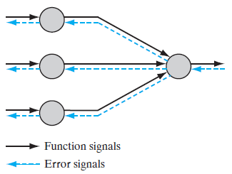
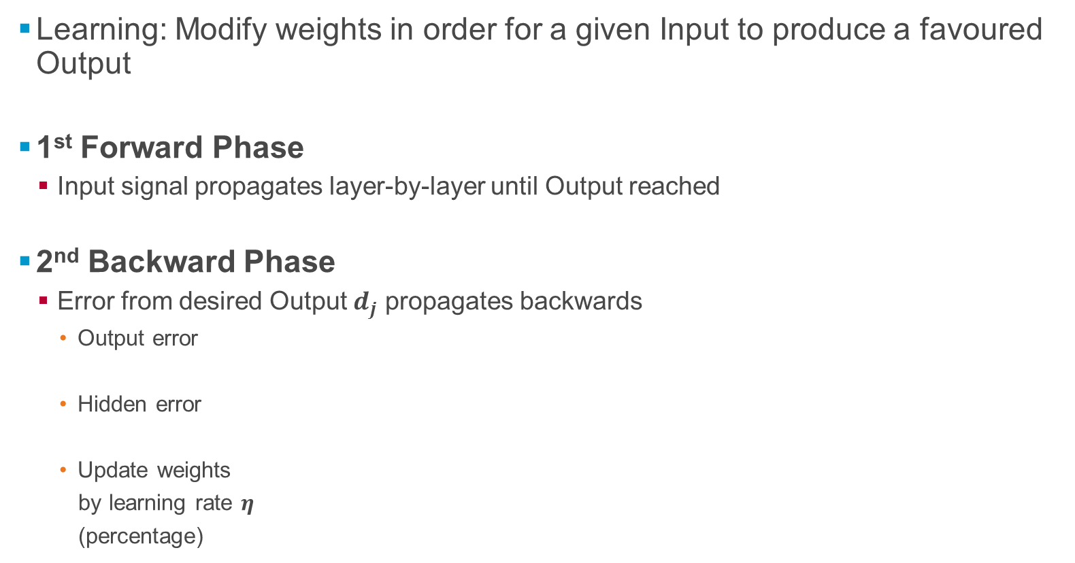
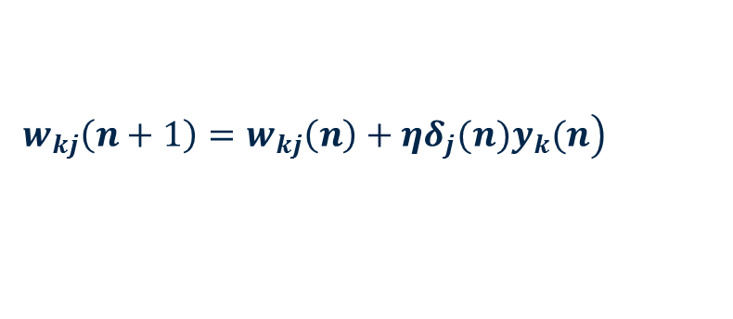
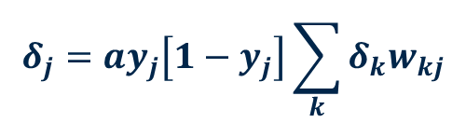

Backpropogation Algorithm
Learning: Modify weights in order for a given Input to produce a favoured Output
1st Forward Phase
Input signal propagates layer-by-layer until Output reached
2nd Backward Phase
Error from desired Output $d_{j}$ propagates backwards
Output error
Hidden error
Update weights
by learning rate $η$
(percentage)
$$δ_{j}=a\left[d_{j}−o_{j}\right]o_{j}\left[1−o_{j}\right]$$
$$δ_{j}=ay_{j}\left[1−y_{j}\right]\sum_{k}{δ_{k}w_{kj}}$$
$$\left.w_{kj}\left(n+1\right)={w_{kj}\left(n\right)+ηδ}_{j}(n)y_{k}(n\right)$$

Slide 12
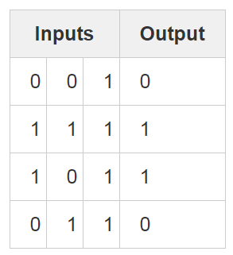
Workshop – Work out trained weights
Create a MLP of following truth table (training data):
3 Inputs
4 Hidden neurons : 3x4=12 hidden weights
1 output neurons : 4X1=4 output weights

Slide 13
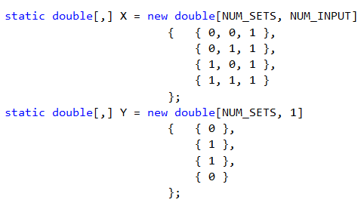
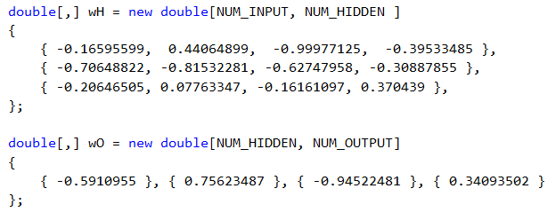
Setup
Initial weights:
randomly set (-1 to +1) but
for this exercise pre-set

Slide 14
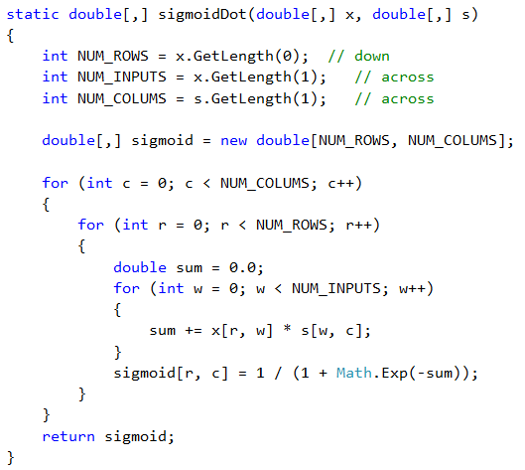

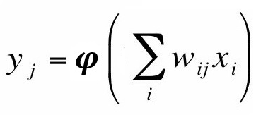
Forward Phase
Output from neuron

Slide 15
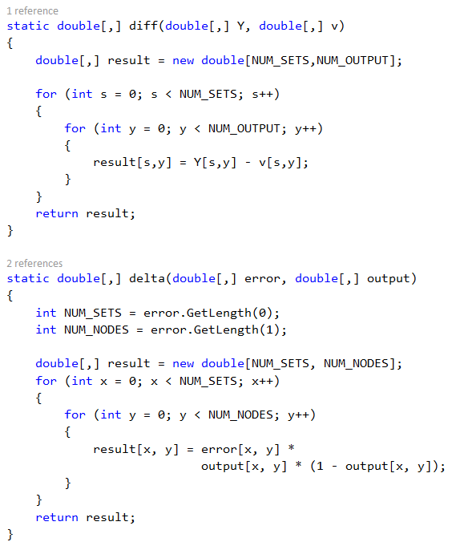
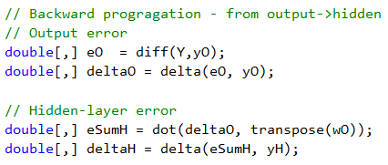
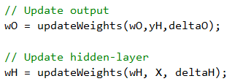

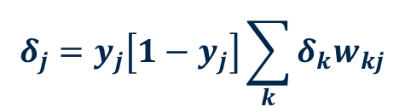

Backward Phase
Work out deltas (Set a=1)
Update weights:
$$δ_{j}=\left[d_{j}−o_{j}\right]o_{j}\left[1−o_{j}\right]$$
$$δ_{j}=y_{j}\left[1−y_{j}\right]\sum_{k}{δ_{k}w_{kj}}$$
$$\left.w_{kj}\left(n+1\right)={w_{kj}\left(n\right)+ηδ}_{j}(n)y_{k}(n\right)$$

