Slide 1
Node Introduction Part2 Lot4 Team
Mustaq Hussain
13th December 2016

Slide 2
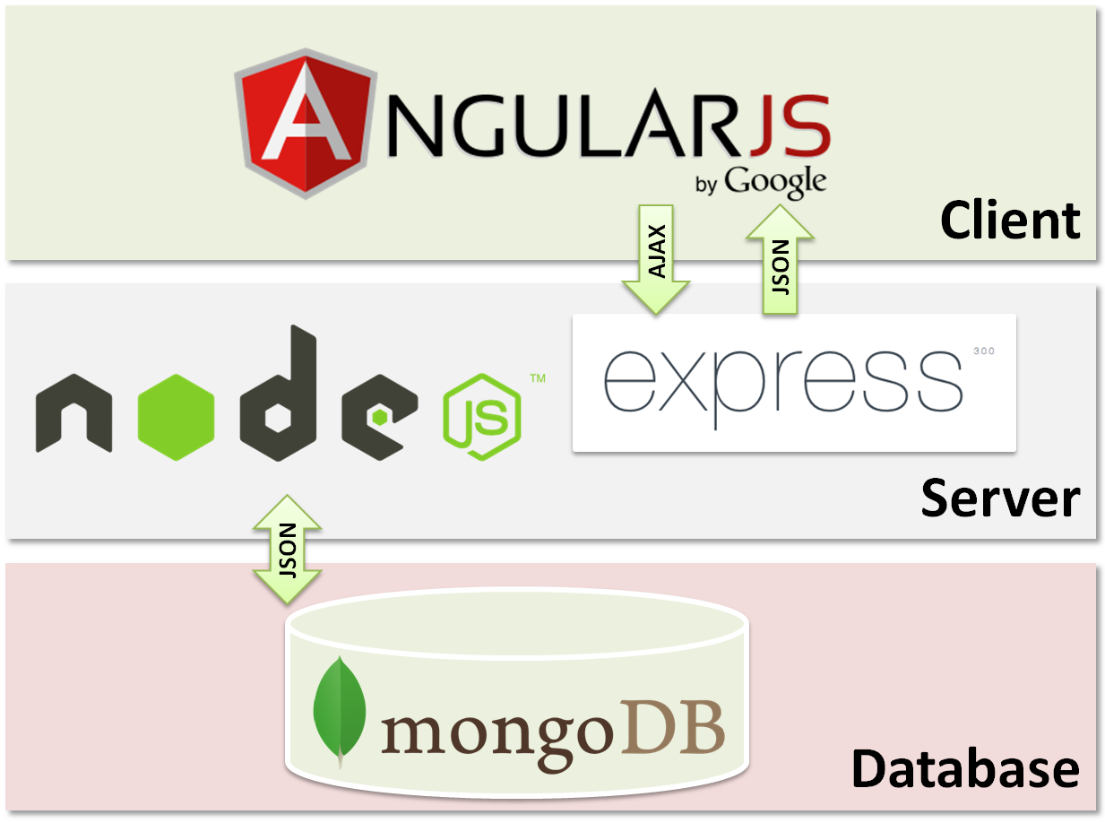
MongoDB Express Angular Node (MEAN)

Slide 3
JavaScript functions – first-class objects
// 1. function definition - has keyword 'function'
function add(a, b) {
return a + b;
}
// 2. function expression - variable assigned the function named ‘sub’
var s = function sub(a, b) {
return a - b;
};
// 3. function expression
// anonymous function - no name after 'function'
var m = function (a, b) {
return a * b;
};
// 4. New syntax ES6 for anonymous functions, arrow syntax
var d = (a, b) => {
return a / b;
};
Notes:
If you see 'function' it is a definition
Internally all functions & variables 'hoisted'/moved to top of current scope/file
Variables are undefined

Slide 4
JavaScript function execution
// Arithmetic functions
var x = 5;
var y = 3;
console.log('x=' + x);
console.log('y=' + y);
console.log('add = ' + add(x, y));
console.log('subtract = ' + s(x, y));
console.log('multiply = ' + m(x, y));
console.log('divide = ' + d(x, y));
Notes:
a(..) function expression

Slide 5
Functions - first-class objects
You can pass int/strings../objects to other functions
add(2,4);
add(x,y);
Functions are objects too:
var someFunc = function( a1, a2 ) {...};
Therefore you can pass functions to other functions (both the same):
doSomething( someFunc, 2, 4, x, y);
doSomething( function( a1, a2 ) {...}, 2, 4, x, y);

Slide 6
Callbacks
Callback are ubiquitous in JavaScript.
A callback is a:
Function that is passed as an argument to another function &
Latter executed - after an event has completed/returned
setTimer( function() {
console.log(‘After minimum 2.5s print this message’);
}, 2500)
$.ajax('www.xyz.com/test.html', {
success: function(data) {
$('#main').data;
}
});
Notes:
You can use anon callbacks as in this example, or named callbacks
SHOW functions.js

Slide 7



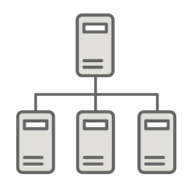
Cost Of I/O
L1-cache | 3 cycles
L2-cache | 14 cycles
RAM | 250 cycles
Disk | 41,000,000 cycles
Network | 240,000,000 cycles
Disk I/O 1000s of orders of magnitude slower compared to RAM
Network I/O 10s of orders of magnitude slower compared to Disk

Slide 8
Traditional approach to system call
In most software systems such as .NET every system call like:
Reading/writing a file
Querying a database
Network call
is blocking. i.e., program execution waits for call to return its result
then program execution resumes
This is blocking I/O and synchronous programming.
The more program waits for the result, the more costly it is - this is cost of I/O.
One of the core points of Node.js is to reduce this cost (the cost of waiting for I/O) – this what makes Node.js (JavaScript) so popular.

Slide 9
Traditional example – Web Server .NET
Client is blocked waiting for
results majority of time
Client has requested every car in DB that is “red.”
1 Web Server creates a DB query and sends it to the remote server housing DB | I/O latency Network 240,000,000 cycles
2 The DB engine runs the query and assembles results | I/O latency Disk 41,000,000 cycles
3 The DB server responds with the results | I/O latency Disk 41,000,000 cycles
4 The Web Server reads from the local file system to find an appropriate HTML doc to display the results | I/O latency Disk 41,000,000 cycles
Notes:
Most of the time spend doing Network I/O – if db query non-quick
I/O activity that blocks other processing from happen in a running program is known as blocking I/O.

Slide 10
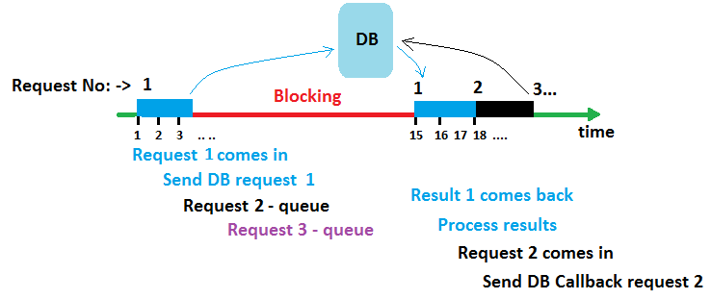
Blocking timeline
Assume 4 Request are coming into server, 1 CPU (as ITSST) single thread
Blocking (.Net – wait for db results)
After 18s only Request 1 completed, others queued
Notes:
Assume 1 thread – thread switching is expensive (saving/retrieving its state)
1 Request 1 comes in
3 Request 1 does a a DB call – which now blocks that thread
3..4 Request 2, 3 come in but have to wait because blocked
15. Eventually Request 1 DB results come back
17 Request 1 completes
18 Request 2 processed (after waiting 15s)
So 12 s thread doing nothing - blocked

Slide 11
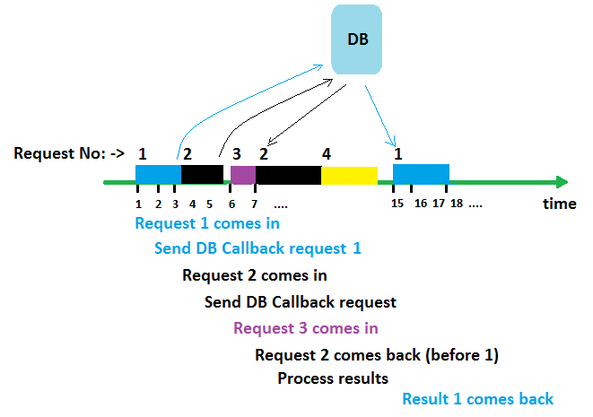
Non-Blocking timeline – using callbacks
Non-blocking (Node.js/JavaScript – using callbacks)
After 18s Request 1,2,3 & 4 (say from different users) completed
Notes:
1 Request 1 comes in
3 Request 1 does a DB call and registers a return Callback
Request 1 complete
4 Request 2 comes in – not blocked
5 Request 2 does a DB call and registers a return Callback
Request 2 complete
5.5 Idle
4 Request 3 comes in and completes
7. Request 2 DB result comes back (before Request 1)
Request 2 DB callback complete
So non-blocking means more Request processed using Callbacks

Slide 12
Programmatic Approachs
Traditional synchronous approach:
var conn = getDBConnection( ConectionString ); -- 2.0s
var results = conn.dbGetLoginedInUser(); -- 4.0s
print('<H1>Hello ' + results.user.firstName() + '</H1>'); -- 0.01
Asynchronous 'non-blocking‘ approach, using two callbacks:
getDBConnection( ConectionString, function( error, conn ) {
conn.dbGetLoginedInUser( function( error, results ) {
print('<H1>Hello ' + results.user.firstName() + '</H1>');
})
});
Notes:
Still takes 6.01s but can continue to process other request.
DEMO blocking.js & nonBlocking.js

Slide 13
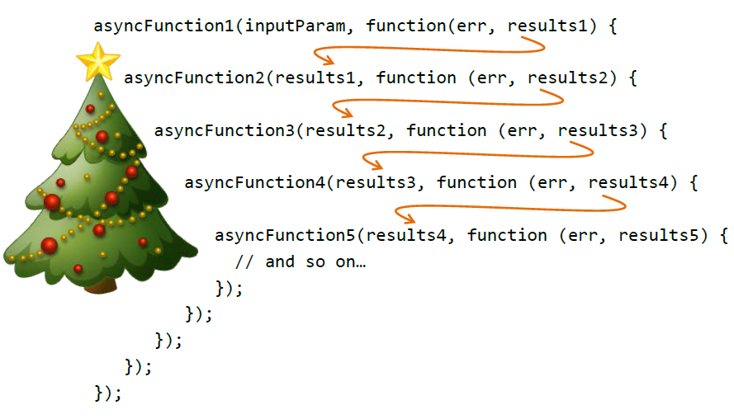
Christmas tree effect
Beware of nesting too deeply

Slide 14
Exercise
To find sample files, go to https://github.com/MustaqHussain
Select repository Node-Introduction
Pull down functions.js
Run the app and make sure you understand what it is doing.
What happens when setTimeout is set to 0?
Can you explain why?
Pull down blocking.js
Run the app via browser
Make repeated calls to server (press F5 5 times say)
What is happening?
Repeat same file nonBlocking.js, what is the difference?

Slide 15
Videos
Callback ordering (~12.00) – and the event loop 2014
https://www.youtube.com/watch?v=8aGhZQkoFbQ
Original Node.js presentation by Ryan Dahl in 2009
https://www.youtube.com/watch?v=ztspvPYybIY

