Slide 1
NoSQL Introduction Lot4 Team
Mustaq Hussain
21st December 2016

Slide 2
What is NoSQL?
Not Only SQL
Does not use SQL as querying language
Distributed, large databases, fault-tolerant architecture
No fixed schema
No joins (typical in databases operated with SQL)
Expensive operation for combining records from two or more tables into one set
Joins require strong consistency and fixed schemas
Lack of these makes NoSQL databases more flexible
It's not a replacement for a RDBMS but compliments it

Slide 3
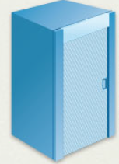
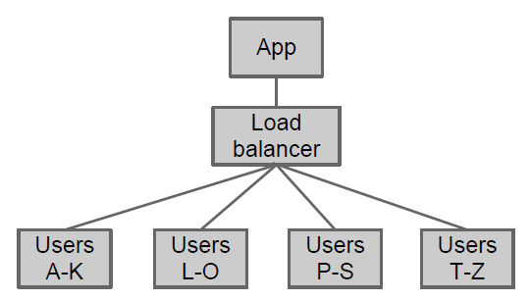
Database Scaling
RDBMS are scaled up/vertically by adding
hardware, processing power
NoSQL is scaled out/horizontally by spreading the load
○ Partitioning (sharding) / replication

Slide 4
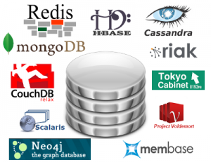
NoSQL categories
1. Key-value
DynamoDB, Voldermort, Scalaris
2. Document-based
MongoDB, CouchDB
3. Column-based
BigTable, Cassandra, Hbased
4. Graph-based
Neo4J, InfoGrid

Slide 5
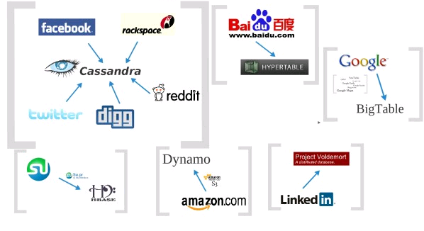
Who is using them?
● Google (BigTable, LevelDB)
● LinkedIn (Voldemort)
● Facebook (Cassandra)
● Twitter (Hadoop/Hbase, FlockDB, Cassandra)
● Netflix (SimpleDB, Hadoop/HBase, Cassandra)
● CERN (CouchDB)

Slide 6
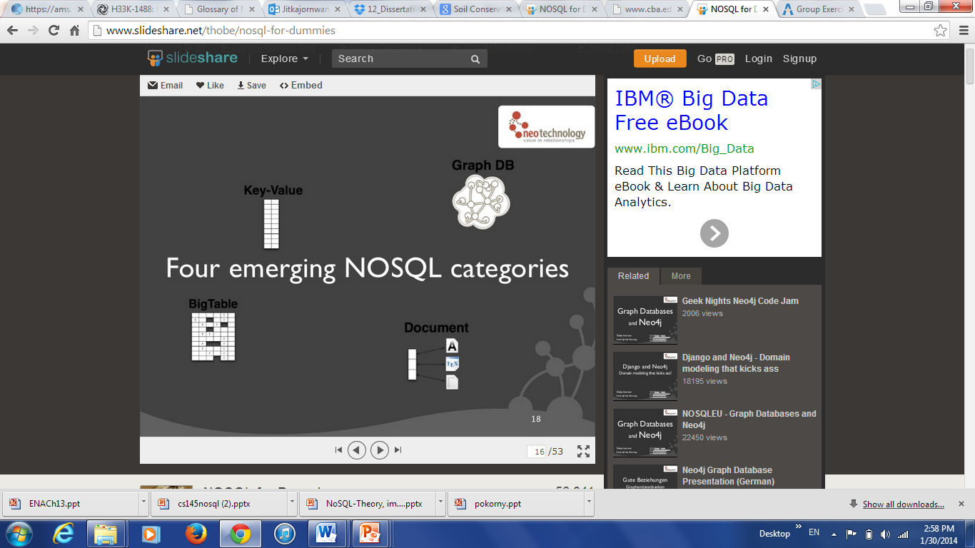
Document-based (mongoDB)
Can model more complex objects than other types
Inspired by Lotus Notes
Data model: collection of documents
Document: JSON (JavaScript Object Notation)
Key-value pairs, which supports objects,
records, structs, lists, array, maps,
dates, Boolean with nesting).

Slide 7
Benefits of NoSQL
Elastic Scaling
•RDBMS scale up – bigger load , bigger server
•NO SQL scale out – distribute data across multiple hosts seamlessly
DBA Specialists
•RDMS require highly trained expert to monitor DB
•NoSQL require less management, auto repair and simpler data models
Big Data
•Huge increase in data RDMS: but capacity and constraints of data volumes at its limits
•NoSQL designed for big data

Slide 8
Benefits of NoSQL conti.
Flexible data models
Change to schema for RDMS have to be carefully managed
NoSQL databases more relaxed in structure of data
Database schema changes do not have to be managed as one complicated change unit
Economics
RDMS expensive proprietary servers
No SQL: clusters of cheap commodity servers
Cost per gigabyte or transaction/second for NoSQL can be lower than the cost for a RDBMS

Slide 9
Drawbacks of NoSQL
Support
Are open source projects with startups supporting them
•Reputation not yet established
Maturity
NoSQL are still implementing their basic feature set
Administration
Lack of Expertise
Analytics and Business Intelligence
Not designed for ad hoc query of the data (yet)

Slide 10
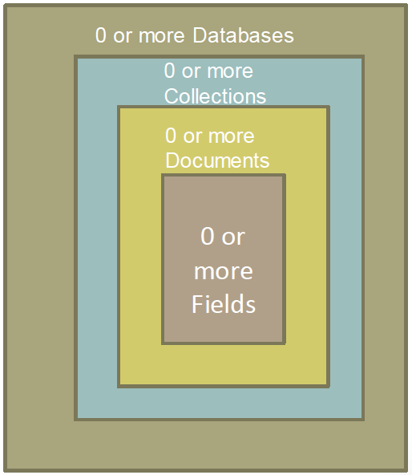
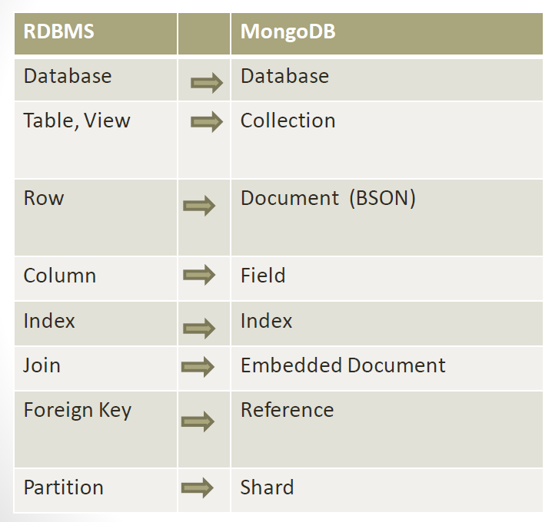
MongoDB to RDBMS mapping

Slide 11
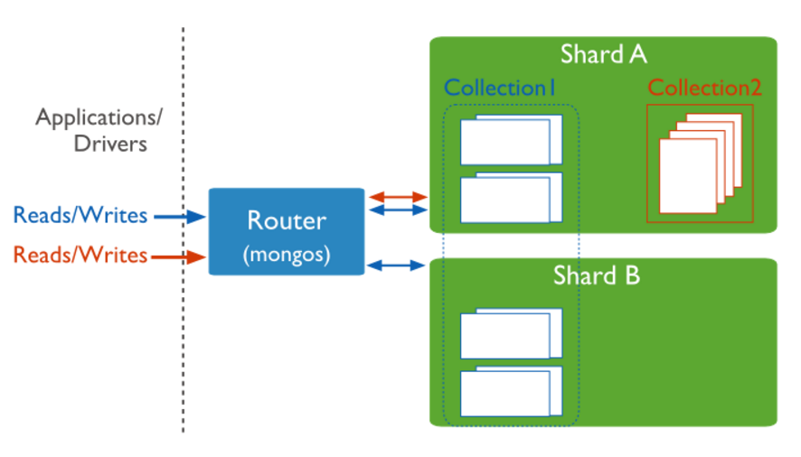
mongoDB sharding
Distributes a single logical database system across a cluster of machines
Uses range-based partitioning to distribute documents based on a specific shard key
Automatically balances the data associated with each shard
Can be turned on and off per collection (table)

Slide 12
mongoDB simple query
SQL Statement | MongoDB commands
SELECT * FROM table | db.collection.find()
SELECT * FROM table WHERE artist = ‘Nirvana’ | db.collection.find({Artist:’Nirvana’})
SELECT* FROM table ORDER BY Title | db.collection.find().sort(Title:1)
DISTINCT | .distinct()
GROUP BY | .group()
>=, < | $gte, $lt

Slide 13
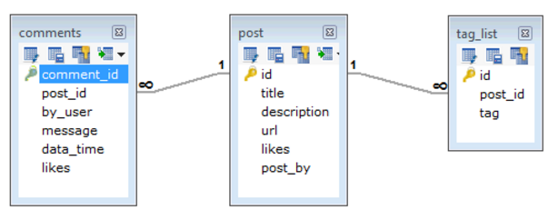
Example - between RDBMS and MongoDB
Typical design for a blog website:
In RDBMS schema design will be have three tables : post, comments, tag_list.

Slide 14
Example - between RDBMS and MongoDB
In mongoDB schema design could have one collection ‘post’ with all data:
{
_id: POST_ID
title: TITLE_OF_POST,
description: POST_DESCRIPTION,
by: POST_BY,
url: URL_OF_POST,
tags: [TAG1, TAG2, TAG3],
likes: TOTAL_LIKES,
comments: [
{
user:'COMMENT_BY',
message: TEXT,
dateCreated: DATE_TIME,
like: LIKES
},
{
user:'COMMENT_BY',
message: TEXT,
dateCreated: DATE_TIME,
like: LIKES
}
]
}
So to extract/display data: RDBMS: need to search and join three tables mongoDB: data will be all in one collection.

