Slide 1
Session 25 MNIST Azure Machine Learning Studio
Mustaq Hussain
1st November 2017

Slide 2
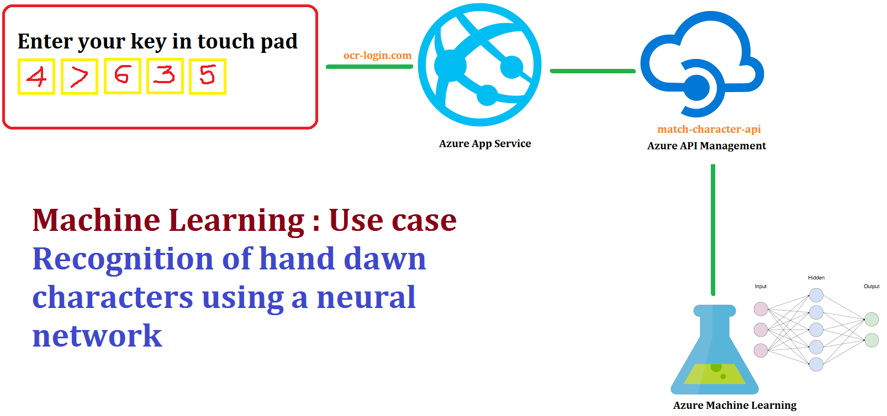
MNIST Azure Machine Learning: over 2 weeks

Slide 3
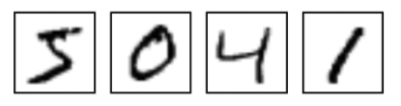
MNIST (Modified National Institute of Standards and Technologies)
MNIST dataset of handwritten digit (0,1,..8,9) images
Standard data collection to train and test out image processing systems and ML algorithms
There are two sets (therefore no need to split dataset) of digits:
60k for training
10k for testing
Each digit represented by
A label (what number it represents 0-9)
784=28*28 grey scale features (values 0->255)

Slide 4
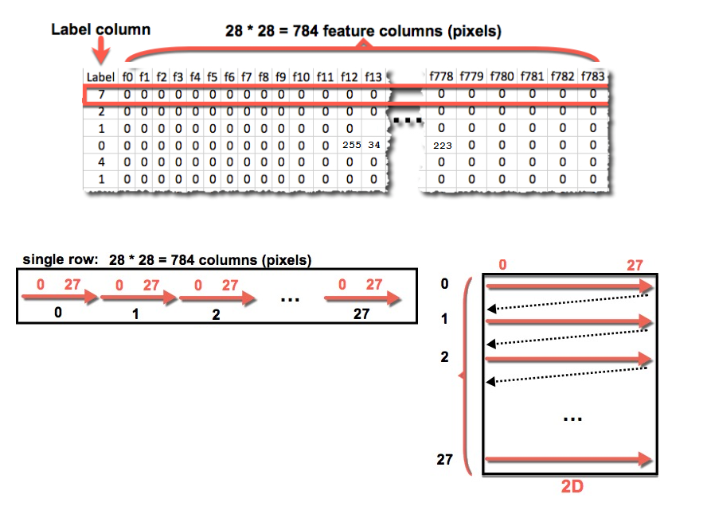
MNIST Data Structure
Each digit (represented as a row):
One Label (0-9)
28*28 features/pixels
(grey scale 0->255
where 0 is white
255 is black
and rest shades of grey)
How to represent 1D as 28*28 2D picture - reshape:
Each 28 features is 1 row
28 rows

Slide 5
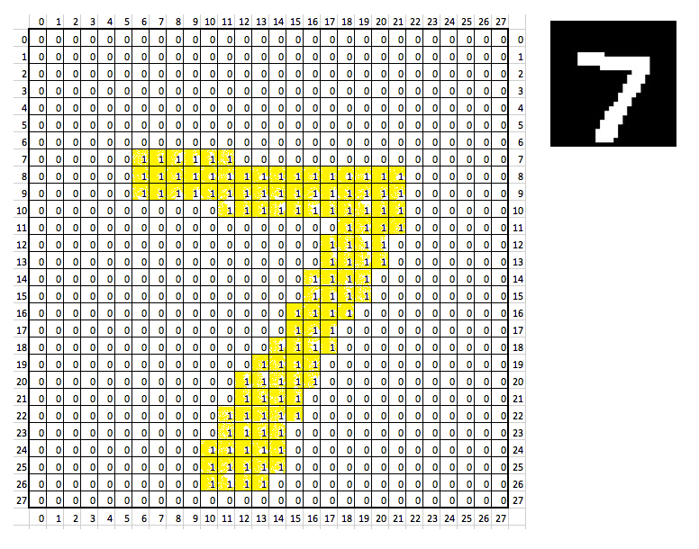
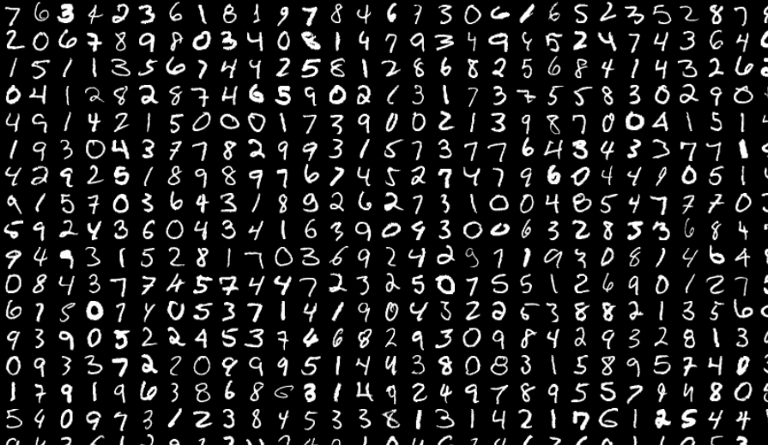
Example: Re-shape & Convert grey scale to binary {0:Black, 1:White – Note flipped black-white }
1st test digit: Convert pixel value >0 set to 1, so converted to 0/1
First few hundred (grey scale) or so digits in test set

Slide 6
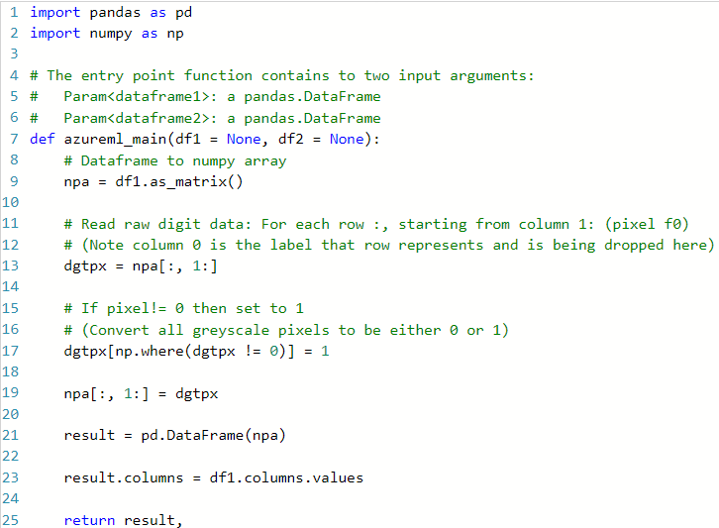
Python Script: convert grey scale to binary pixel
Python popular scientific and ML
language because of its extensive
libraries
Python’s libraries include:
numpy (array processing, linear algebra)
pandas (data manipulation)
scikit (ML)

Slide 7
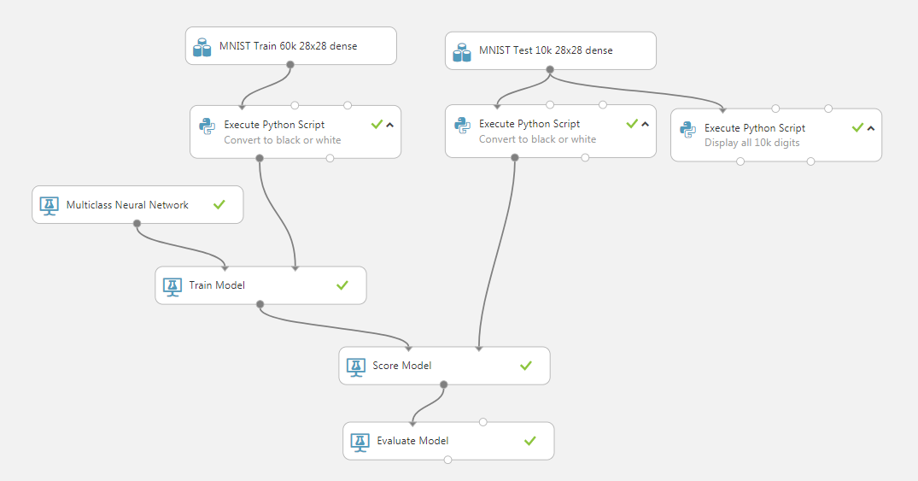
Session 25: MNIST dataset used to train NN to recognise handwritten digit
Outline

Slide 8
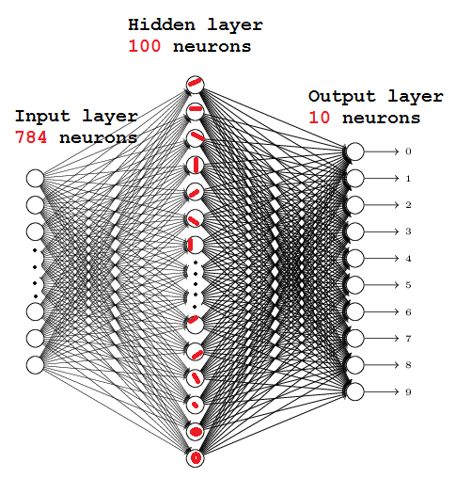
Azure ML MNIST NN Structure
784*100 = 78,400 input weights
10*100 = 1,000 output weights
79,400 weights
Train – just one pass
50k*79,000 = 3.97 billon multiplies
Train – Azure default 100 iteration
39.7 billon multiplies
After training (highly simplified)
Hidden layer nodes learnt to
specialise

Slide 9
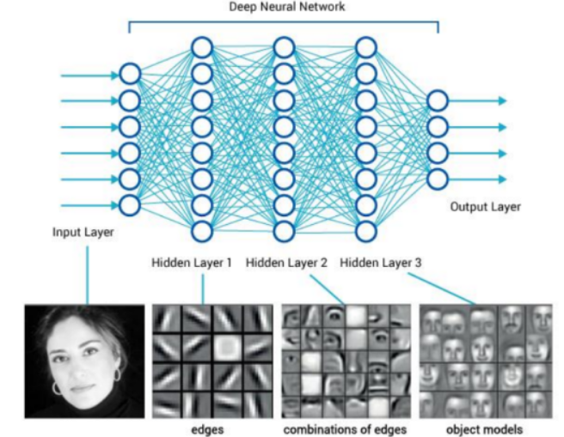
Deep Neural Network – face/people recognition

